Slide 1
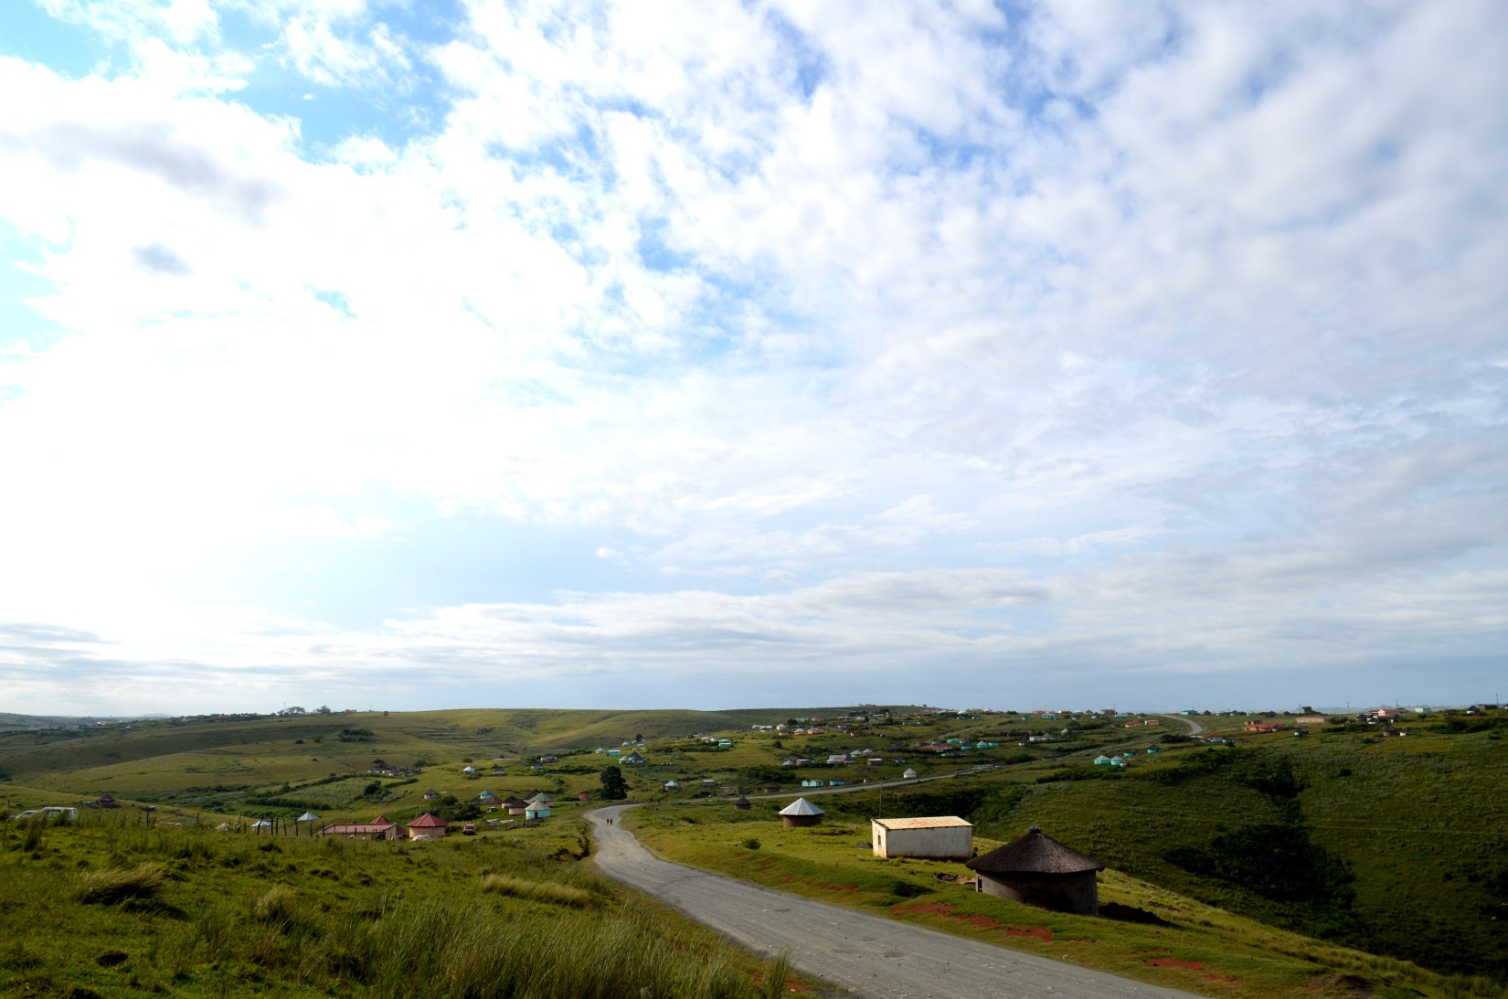
Winter School
Using climate information for adaptation and policy development
An annual one week short course.
Cape Town, South Africa

Slide 2
Using climate information for adaptation and policy development
Dates | Held annually during June – July Dates for 2017 are 24-28 July
Places | ±23
Fees (2016) | For International Participants Full course fee = US$1,050 (increase due to Exchange Rate Fluctuation) | For South African Participants Full course fee = R 13750 (the same as 2016)
 | The course fee includes all materials necessary for the course, and catering of lunches and teas during the course. Please note the fee does not include: Airport transfers, other transportation needs or transport to and from the Winter School venue Visas Medical or travel insurance costs Participants are encouraged to make sure they are fully covered for these before traveling to South Africa.
Funding | The CSAG Winter School is not currently financially supported through any funded project. It therefore has a course fee attached which is used to support it as well as raise funds for participants who are struggling to secure finance. Each year we offer a limited amount of scholarships for this purpose. These are primarily for candidates from less developed countries, especially those from Africa. Please note that the sponsorships will only cover tuition fees and all candidates are strongly advised to attempt to source their own funding. Decisions on who will receive sponsorship is decided upon by the Winter School Committee.
Language | The course is conducted in English. Full competence in English, written and spoken is an essential requirement
Target Audience | Winter school is a one week intensive course aimed for mid-career professionals engaged in decision and policy development which may involve issues related to climate change and adaptation.
Location | University of Cape Town, Cape Town, South Africa

Slide 3
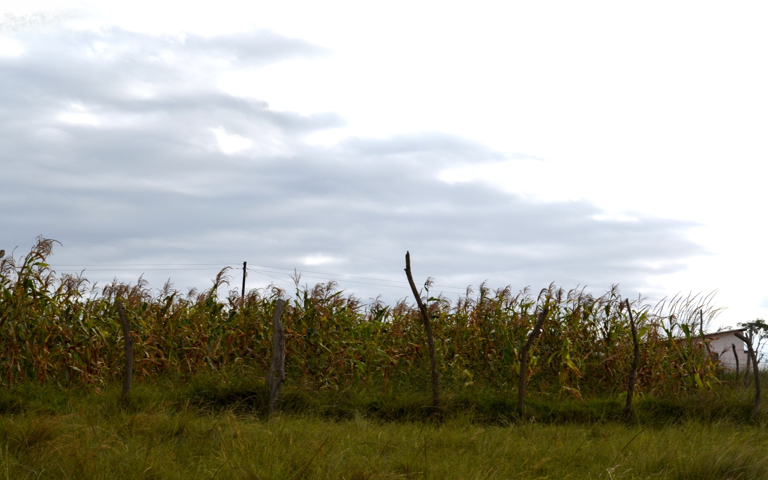
Course Background
The CSAG Winter School started in 2009 through a UNITAR funded initiative. As part of a larger C3D+ project, this capacity building training course was undertaken with financial support for three years. The initial phase of the project involved a large part in developing all the course curriculum and teaching materials. There needed to be a balance between the basic theory, data analysis and practical case studies. The course is very focused on the needs of developing countries especially in Africa, and case studies are based around these. The course aims to address the needs of participants from these countries and understand some of their constraints.

Slide 4
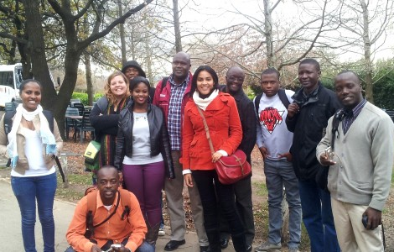
Trainers and Facilitators
The course facilitators are a mix of CSAG staff and researchers and specialist from other institutions including the Stockholm Environmental Institute (SEI), South African National Botanical Institution (SANBI), Council for Scientific and Industrial Research (CSIR) and the City of Cape Town. A large portion of the course is presented through a mixture of formal presentations and direct interaction with the participants. In this way the course is moulded to the needs of the participants rather than being strictly scripted.
Recent Contributors Include:
Professor Bruce Hewitson, Dr Chris Lennard, Kate Kloppers, Anna Steynor, Katinka Waagsaether, Dr Olivier Crespo, Dr Jane Battersby-Lennard, Dr Mark Tadross, Professor Mark New, Leonie Joubert, Bettina Koelle, Dr Chris Jack, Dr Peter Johnston and Michael Boulle.
''The trainers and facilitators at Winter School were a great mix! Academics and practitioners bringing on board diverse perspectives in the climate change field.''
-Winter School 2013 participant

Slide 5
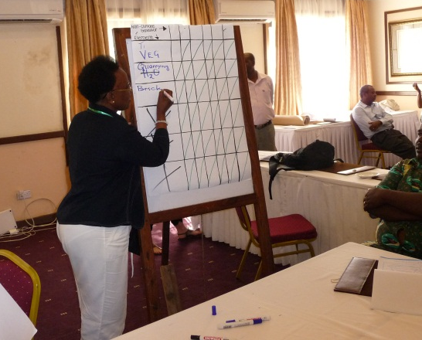
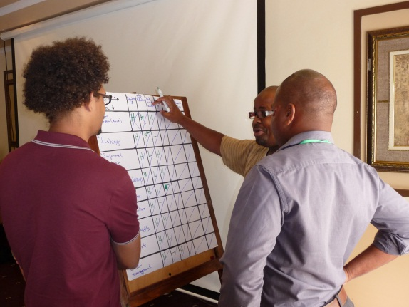
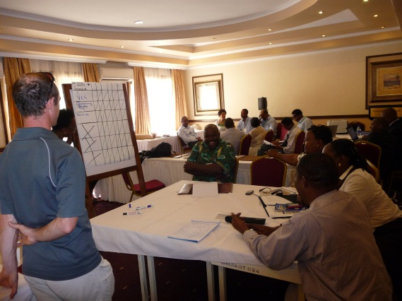
Course content and Structure
The Winter School course aims to take participants through the full spectrum of climate and climate change related topics. These include:
Climate dynamics
Risk and vulnerability framing
An introduction to climate modeling
Climate change scenarios
Climate adaptation frameworks
Downscaling methods
Adaptation planning, policy and decision making
The course is structured around an equal mix of interactive lecture input and case study based group work. This structure has proven to be a dynamic, effective and fun one week.

Slide 6
How to apply
To apply, please visit our website, http://www.csag.uct.ac.za/climate-services/winter-school-2017/ and complete our Winter School online application form which will be available from mid April.
For more information or assistance, please email Kate Kloppers at winterschool@csag.uct.ac.za.
Postal Address: CSAG, Environmental and Geographical Science dept., University of Cape Town, Private Bag X3, Rondebosch 7701, South Africa
Phone: +27 21 650 2784
Fax: +27 21 650 5773
Email: winterschool@csag.uct.ac.za

