Slide 1
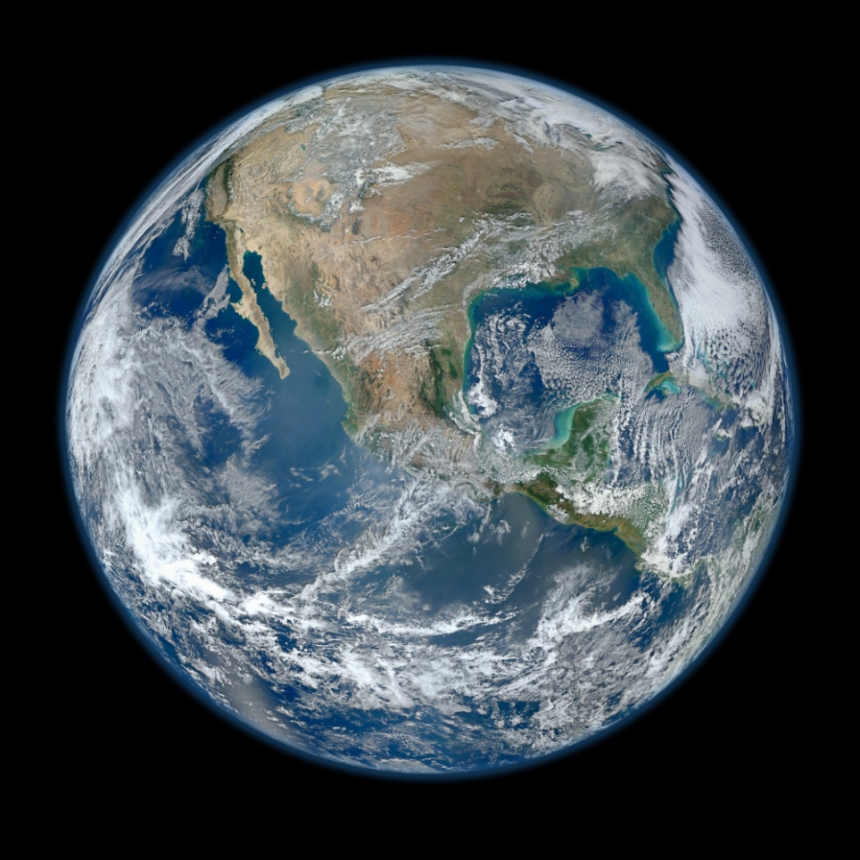
GEOGM1405
Climate Change: Science and Impacts
Dr Joseph Daron – jdaron@csag.uct.ac.za
Climate System Analysis Group, University of Cape Town
Joint module for MSc in Climate Change Science and Policy
and MSc in Environmental Policy and Management
September to December 2014

Slide 2
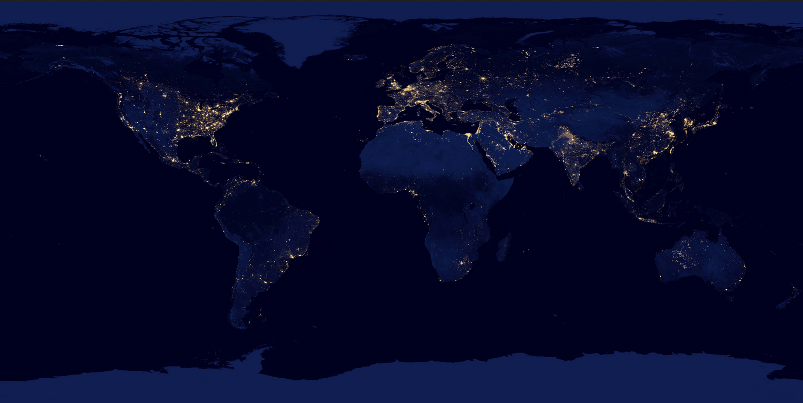
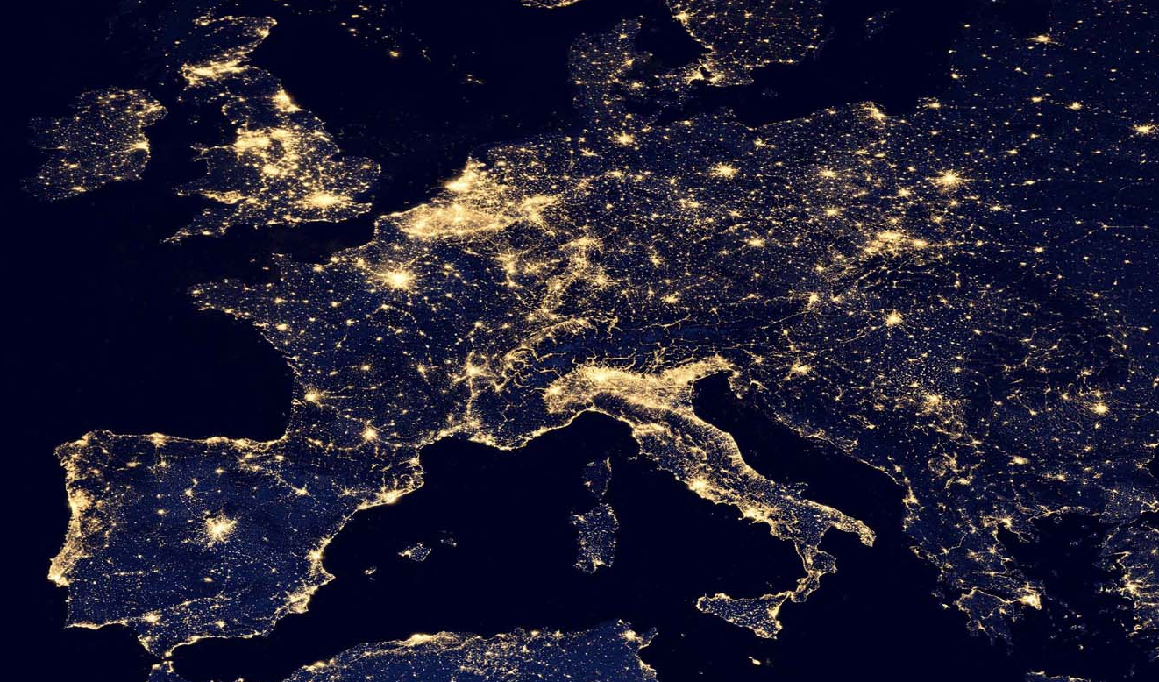
The Anthropocene

Slide 3
Global Change: The Grand Challenge
Human activities are causing unprecedented global scale changes
Anthropogenic climate change is part of a much broader change in the Earth system
To understand and respond to these changes we require “whole” (holistic) systems analysis
Policy makers and the public broadly agree with the need to move towards a sustainable future
Our challenge is to bridge the divide among natural sciences, engineering, social sciences, economics and politics to provide the knowledge required to support the transformation to sustainability

Slide 4

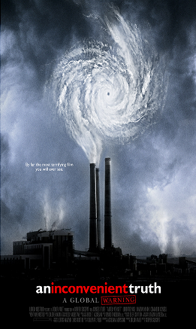
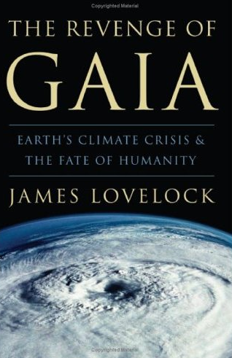


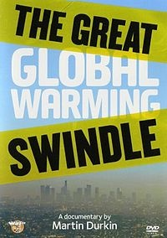
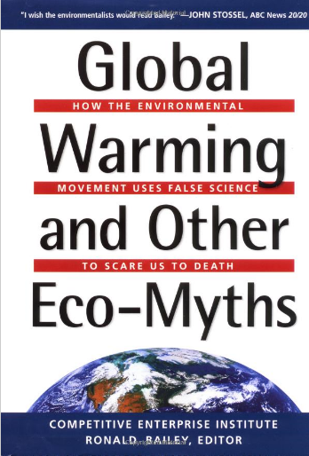

Slide 5
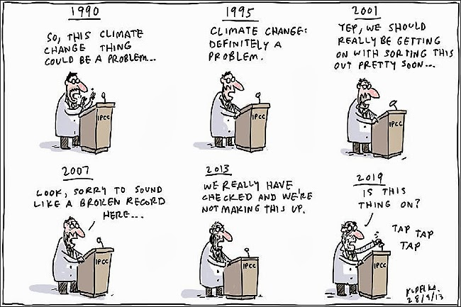
stochastictrend.blogspot.com

Slide 6
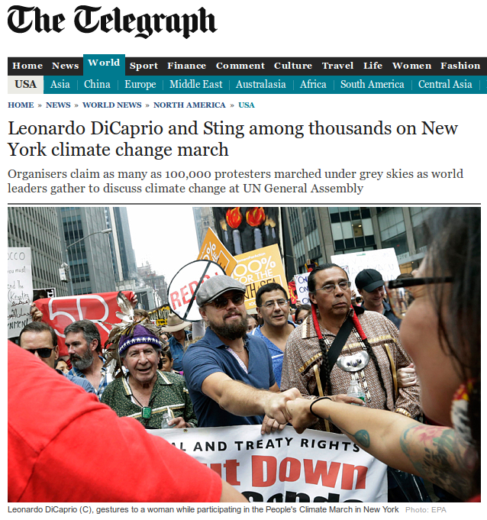
Leonardo DiCaprio's 2014 UN Climate Summit Speech

Slide 7
Who’s in the room?

Slide 8
Course Aims
To become familiar with the fundamental principles of climate science
  What is the evidence for climate change?
  How do we predict the future climate and what are the projections for the 21st century?
  What processes in the climate system lead to uncertainty in future projections?
Develop knowledge of the impacts, adaptation and mitigation strategies for climate change
  What are the impacts of climate change for natural and human systems?
  How can we generate and use climate information to guide societal decision making?

Slide 9
Course Outline
Week Topic Date
1 Introduction and key concepts September 30th
2 Drivers of climate change October 14th
3 Past climate change October 21st
4 Future climate: part 1* November 4th
5 Future climate: part 2 November 11th
6 Mitigation November 18th
7 Impacts on natural systems* November 25th
8 Impacts on human systems December 2nd
9 Adaptation and Risk December 9th
10 Ethics and Decision Making December 16th

Slide 10
Assignments
There will be two assessed assignments:
Analysis of climate model output and 1,000 word report
An essay (max 2,000 words) on a key impact of climate change
Both assignments are due at midday on Friday 19th December, to be submitted on Blackboard.

Slide 11
Structure of sessions
The first 10 minutes at the beginning: group report back on what is making the news.
Approx 60 minutes of lecture material
In the last 20 to 30 minutes, something different.

Slide 12
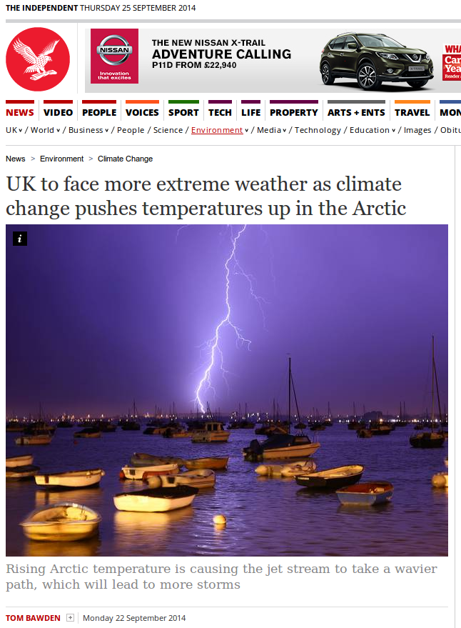
Climate Science in the news

Slide 13

Climate Science in the news
Excerpts
“The rising Arctic temperature is causing the jet stream – a key determinant of the weather – to take a more amplified and wavier path, which will lead to more storms, says Professor Jennifer Francis, of Rutgers University in the US”
“The disproportionate warming of the Arctic has reduced the temperature difference between the region and the “mid-latitudes”. As the temperature difference declines, the jet stream slows and weakens, making it follow a wavier route.”
“When the jet stream swings north, it sweeps warm air from the tropics over Europe, Russia or North America. When it swings south, it sucks in cold air from the Arctic. Each weather pattern causes extreme heat, cold, floods or droughts.”

Slide 14
Climate Science in the news
The study / studies
Francis and Vavrus (2012) Evidence linking Arctic amplification to extreme weather in mid-latitudes. Geophys Res Lett 9, L06801
Based on observations from the NCEP (National Centre for Environmental Prediction) Reanalysis
“One effect is a reduced poleward gradient in 1000-500 hPa thicknesses, which weakens the zonal upper-level flow. According to Rossby wave theory, a weaker flow slows the eastward wave progression and tends to follow a higher amplitude trajectory, resulting in slower moving circulation systems. More prolonged weather conditions enhance the probability for extreme weather due to drought, flooding, cold spells, and heat waves.
“The second effect is a northward elongation of ridge peaks in 500 hPa waves, which amplifies the flow trajectory and further exacerbates the increased probability of slow moving weather patterns. Enhanced 500-hPa ridging observed over the eastern N. Atlantic is consistent with more persistent high surface pressure over western Europe. This effect has been implicated as contributing to record heatwaves in Europe during recent summers.”

Slide 15
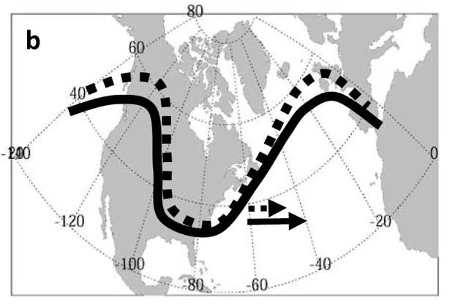
Climate Science in the news
The study / studies
Francis and Vavrus (2012) Evidence linking Arctic amplification to extreme weather in mid-latitudes. Geophys Res Lett 9, L06801
Figure 2b Schematic of ridge elongation (dashed vs. solid) in upper-level heights caused by enhanced warming in Arctic relative to mid-latitudes. Higher amplitude waves progress eastward more slowly, as indicated by arrows.

Slide 16
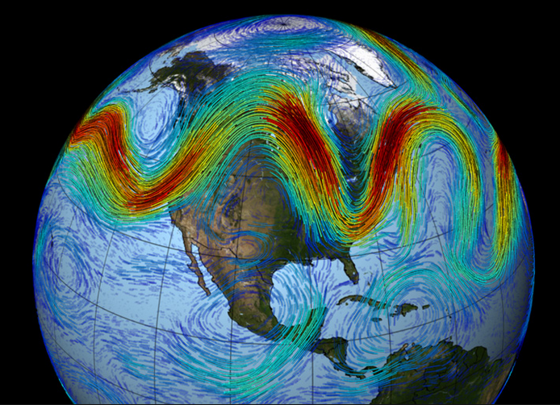
Climate Science in the news
Underlying science
Rossby Waves and the Jet Stream
Where two air masses of different temperatures or densities meet, the resulting pressure difference causes high winds within the transition zone
The polar jet occurs at a height of approximately 7 to 12km in the atmosphere. There is also a subtropical jet at a height of 10 to 16km.
A wave on the jet stream is known as an atmospheric Rossby wave.

Slide 17
Climate Science in the news
Underlying science
The Arctic Amplification
As the climate warms, the summer melt season lengthens and intensifies, leading to less sea ice at summer’s end. Summertime absorption of solar energy in open water areas increases the sensible heat content of the ocean. Ice formation in autumn and winter is delayed. This promotes enhanced upward heat fluxes, seen as strong warming at the surface and in the lower troposphere.
Serreze et al (2009) The emergence of surface-based Arctic amplification. Cryosphere 3, 11–19

Slide 18
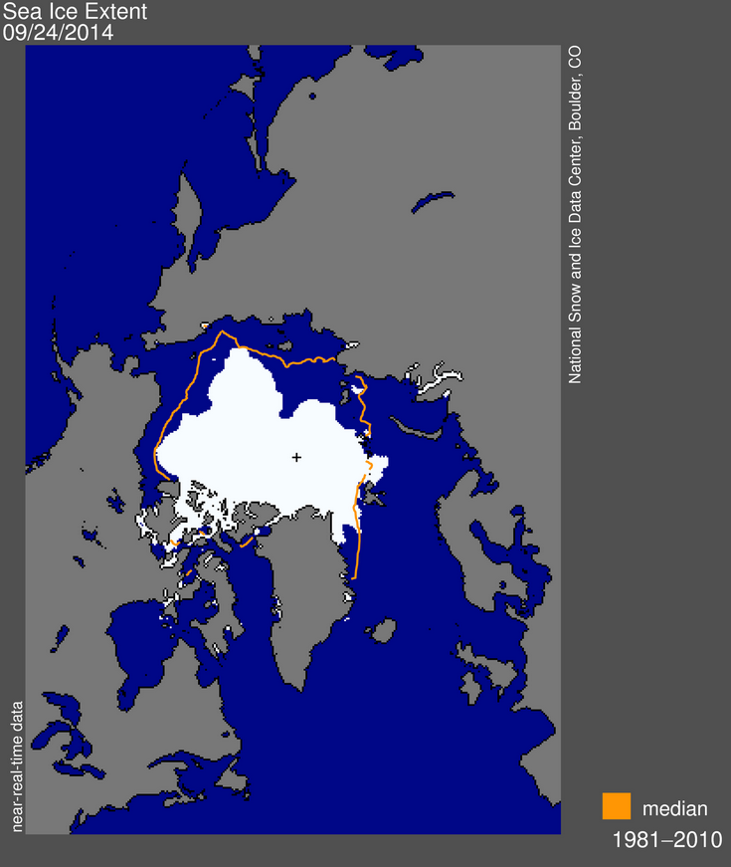
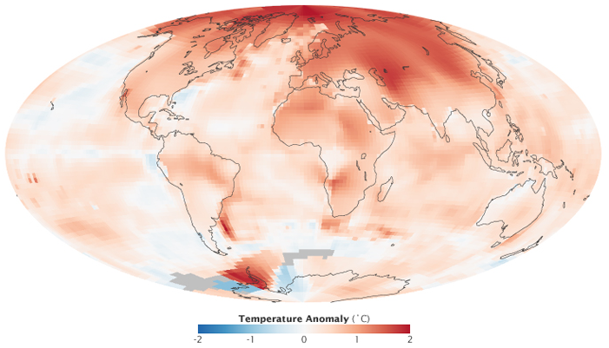
Climate Science in the news
Underlying science
The Arctic Amplification
NASA GISS; temp anomaly 2000-2009, compared to 1951-1980

Slide 19
Aim of Todays Lecture
Introduce the concepts of climate and climate change
Detail the key driving processes that influence the climate system
Provide background on climate prediction
Introduce the Intergovernmental Panel on Climate Change (IPCC)

Slide 20
What is Climate?
Miller and Armstrong

Slide 21
What is Climate?
Climate in a narrow sense is usually defined as the ‘average weather’.
...or more rigorously, as the statistical description in terms of the mean and variability of relevant quantities over a period of time ranging from months to thousands or millions of years. The classical period is 30 years, as defined by the World Meteorological Organization (WMO). These quantities are most often surface variables such as temperature, precipitation, and wind.
...Climate in a wider sense is the state, including a statistical description, of the climate system.
(IPCC TAR and AR4)
“Climate is what you expect, weather is what you get”
Robert A. Heinlein

Slide 22
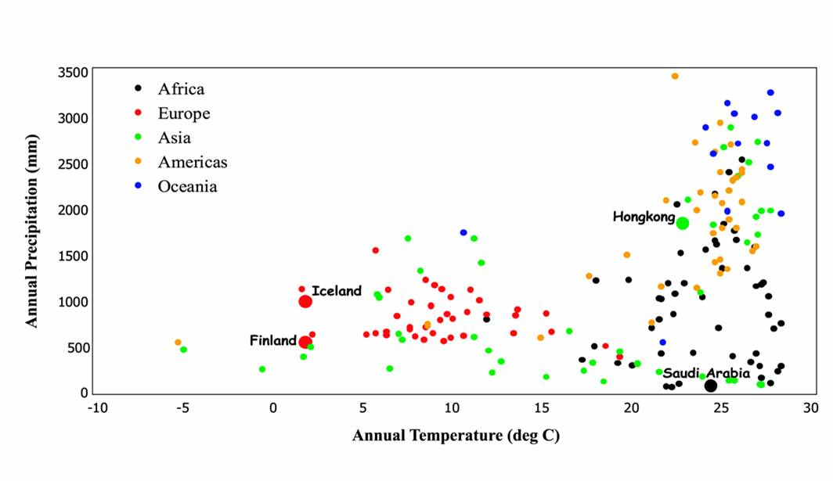
What is Climate?
Mitchell, T.D., Hulme, M. and New, M., 2002: Climate data for political areas. Area 34, 109-112. http://www.cru.uea.ac.uk/~timm/grid/papers/mitchell2002a.pdf

Slide 23
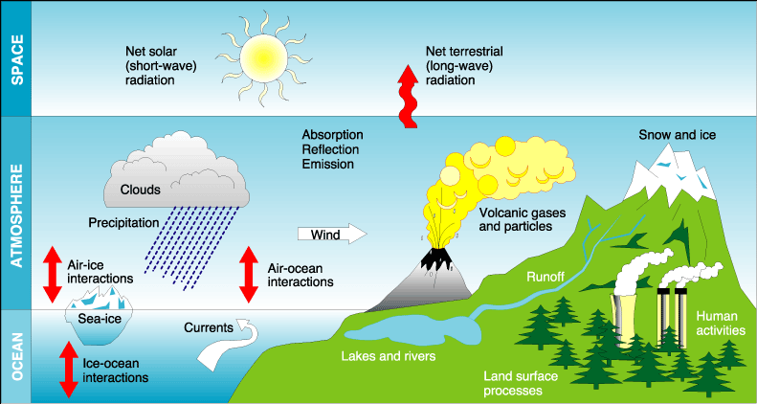
What influences our climate?

Slide 24
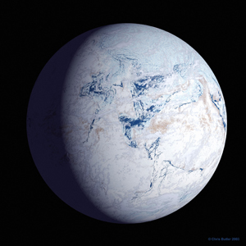
The Temperature of the Earth
The Stefan Boltzmann Law

Slide 25
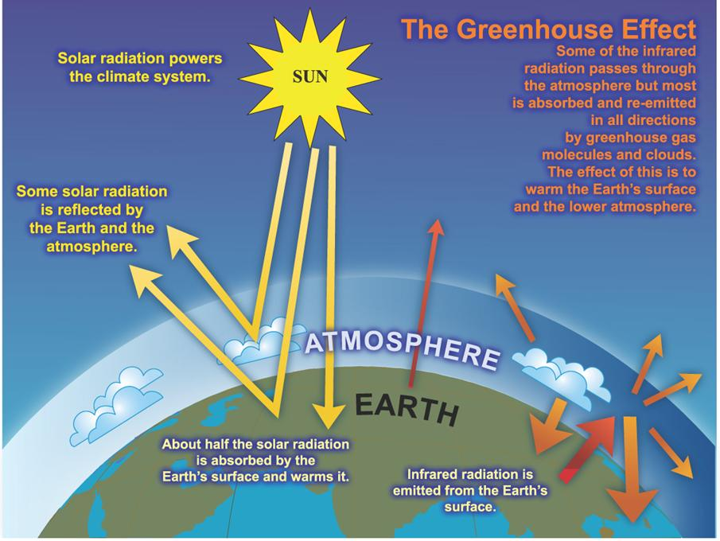
The Greenhouse Effect

Slide 26
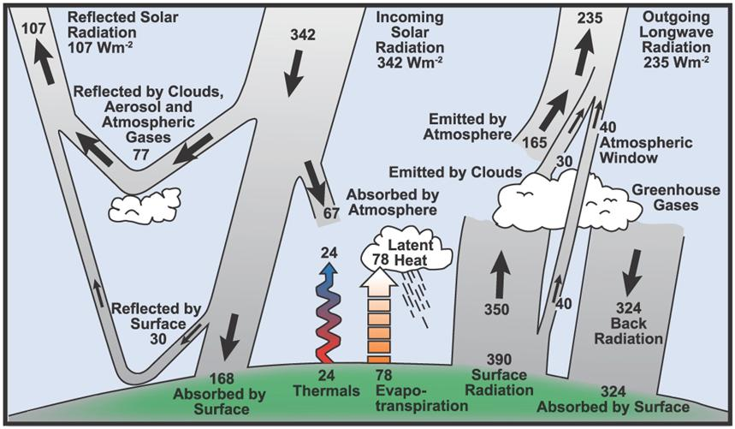
Energy balance of the Earth

Slide 27
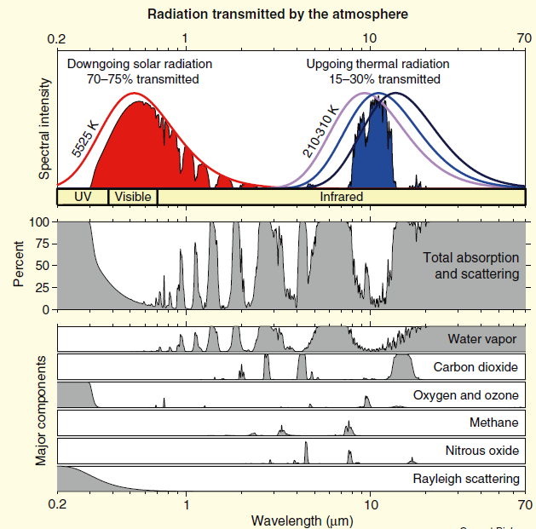
Why are greenhouse gases important?
Composition of the atmosphere
Main Constituents:
Nitrogen, N₂ = 78%;
Oxygen, O₂ = 21%;
Argon, Ar = 0.93%
GHGs:
H₂O (0.40%; 1%-4% at surface)
CO₂ = 0.04%; CH₄ = 0.000179%.
Notes:
Nitrogen and Argon are not reactive, whereas Oxygen is (e.g., rusting of iron)

Slide 28
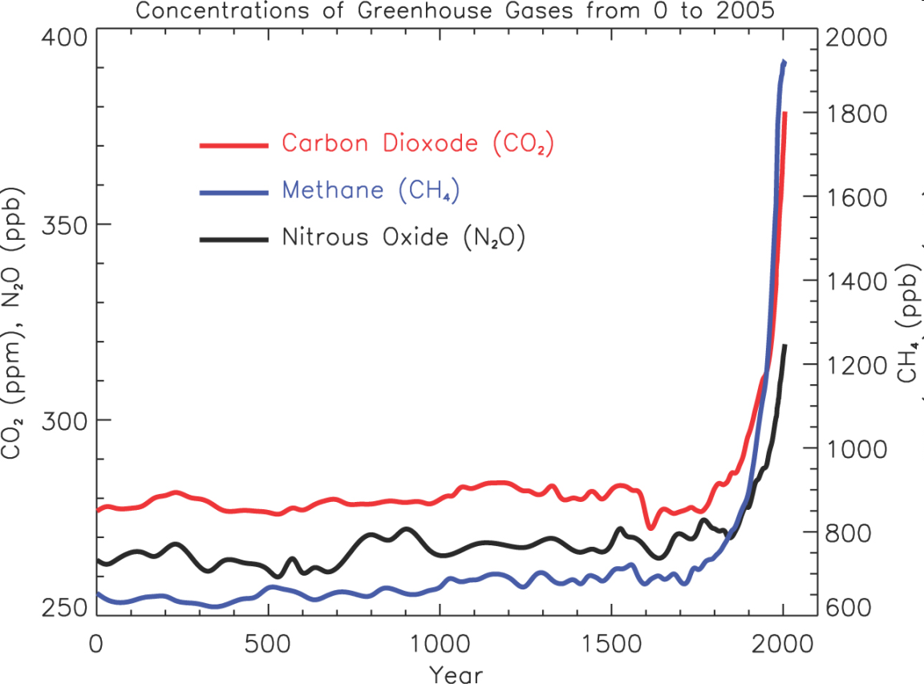
Greenhouse gas concentrations
IPCC AR4

Slide 29
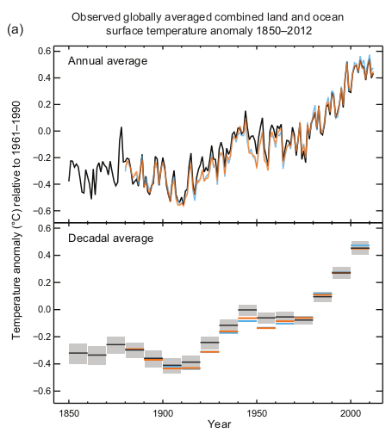
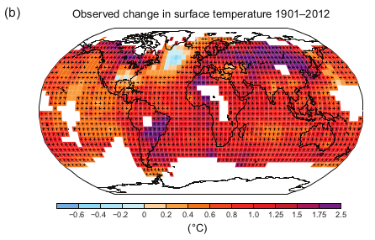
The consequence…

Slide 30
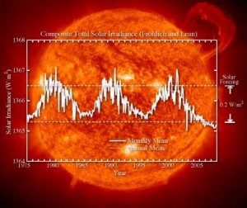
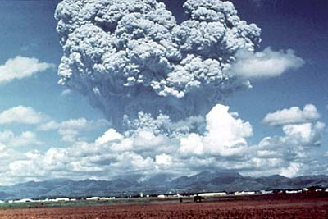
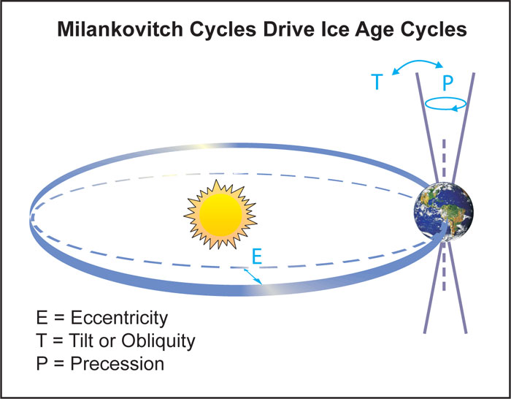
Natural Processes Influencing climate
Volcanic eruptions emit dust, sulphates and CO₂
The energy output from the Sun varies on many different time scales
On longer time scales the orbit around the Sun changes

Slide 31
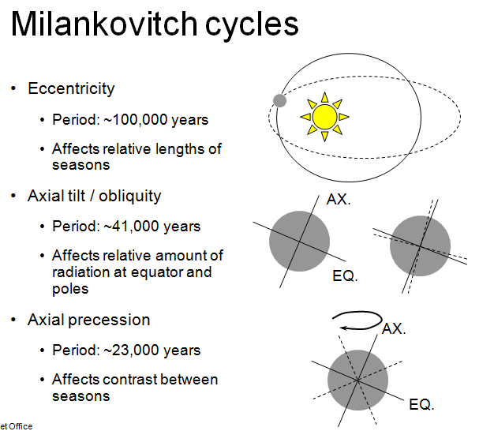

Slide 32
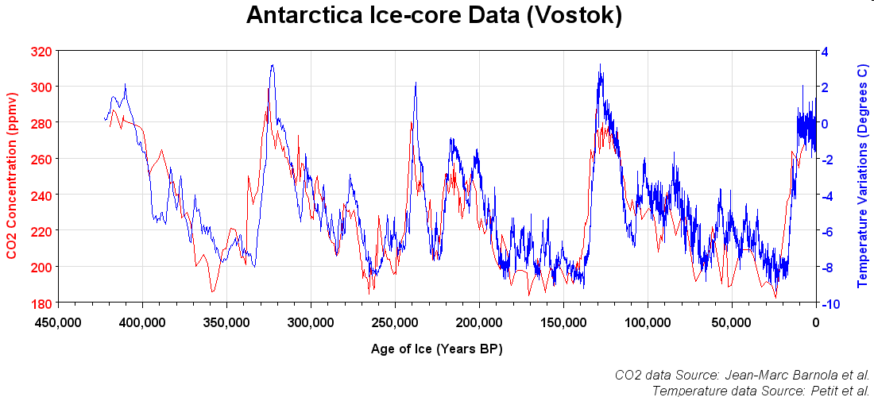
How does warming cause a rise in atmospheric CO2? As the oceans warm, the solubility of CO2 in water falls (Martin 2005). This causes the oceans to give up more CO2, emitting it into the atmosphere. However, this does not deny the causative effect of increased carbon dioxide concentrations leading to higher global temperatures.

Slide 33
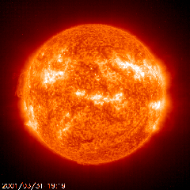
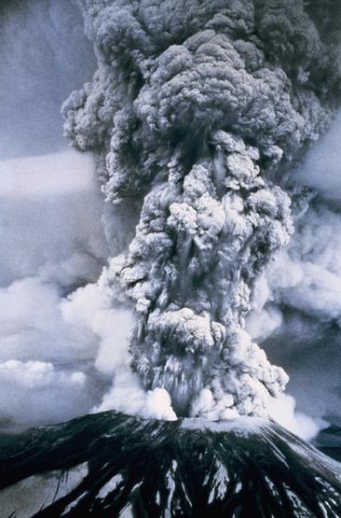
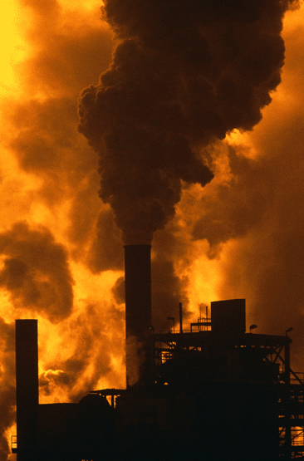
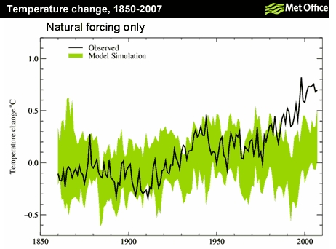
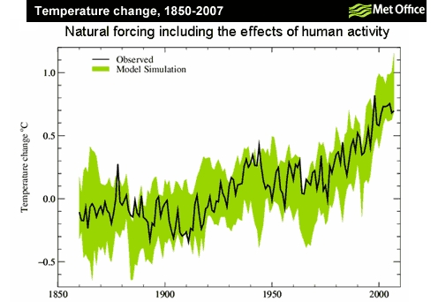
Anthropogenic or Natural?
+
+
+
Notes:
How do we know that humans are contributing to climate change?
We know that the climate is affected naturally by variations in the sun’s output and also by the eruption of volcanoes. This graph compares observed global mean temperature changes since 1860 with the results of climate model simulations of past climate. In these simulations, only natural factors are included. We can see that the agreement isn’t very good.
This graph shows what happens to the agreement when we include natural and man-made effects. The agreement is much better, this is compelling evidence for the fact that humans are contributing to climate change.

Slide 34
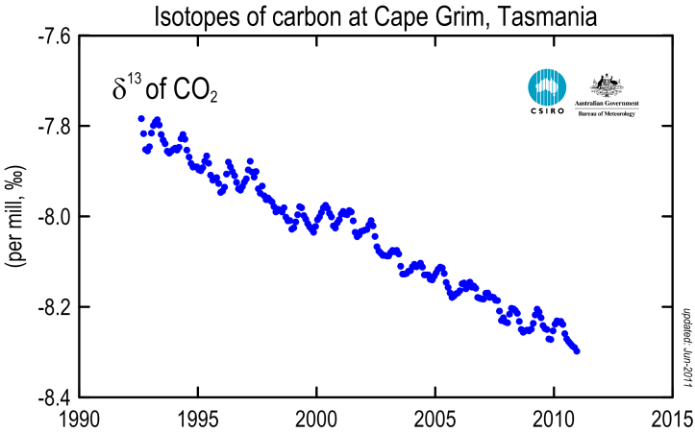

Anthropogenic or Natural?
Isotope analysis of carbon atoms explores the ratio of heavy to light carbon occurring in the atmosphere. The ratio has changed in such a way that the increase of carbon dioxide in the atmosphere can be attributed to human emissions.
There are three naturally occurring isotopes of carbon on Earth: 99% of the carbon is carbon-12, 1% is carbon-13, and radioactive carbon-14 occurs in trace amounts.
The C-12 isotope is lighter than the C-13 isotope and it is more abundant in vegetation and fossil fuels (formed from past vegetation) and less abundant in the oceans and volcanic emissions.
C-14 is present in atmospheric CO₂ but absent in
fossil fuels and decreasing C-14 concentrations
support the evidence that current CO₂ levels are
a result of burning fossil fuels.

Slide 35
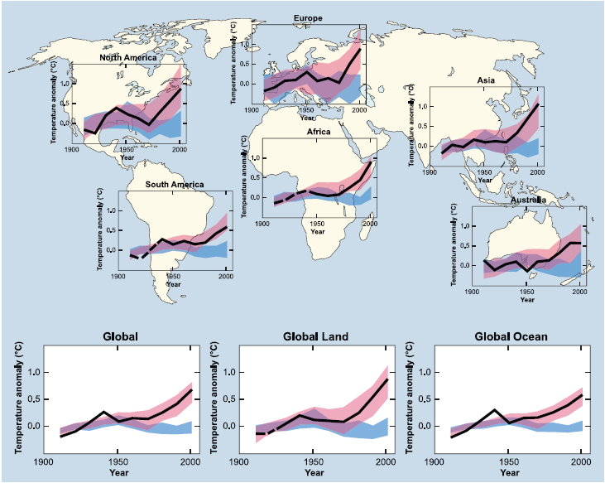
Anthropogenic or Natural?
IPCC AR4

Slide 36
…and pause

Slide 37
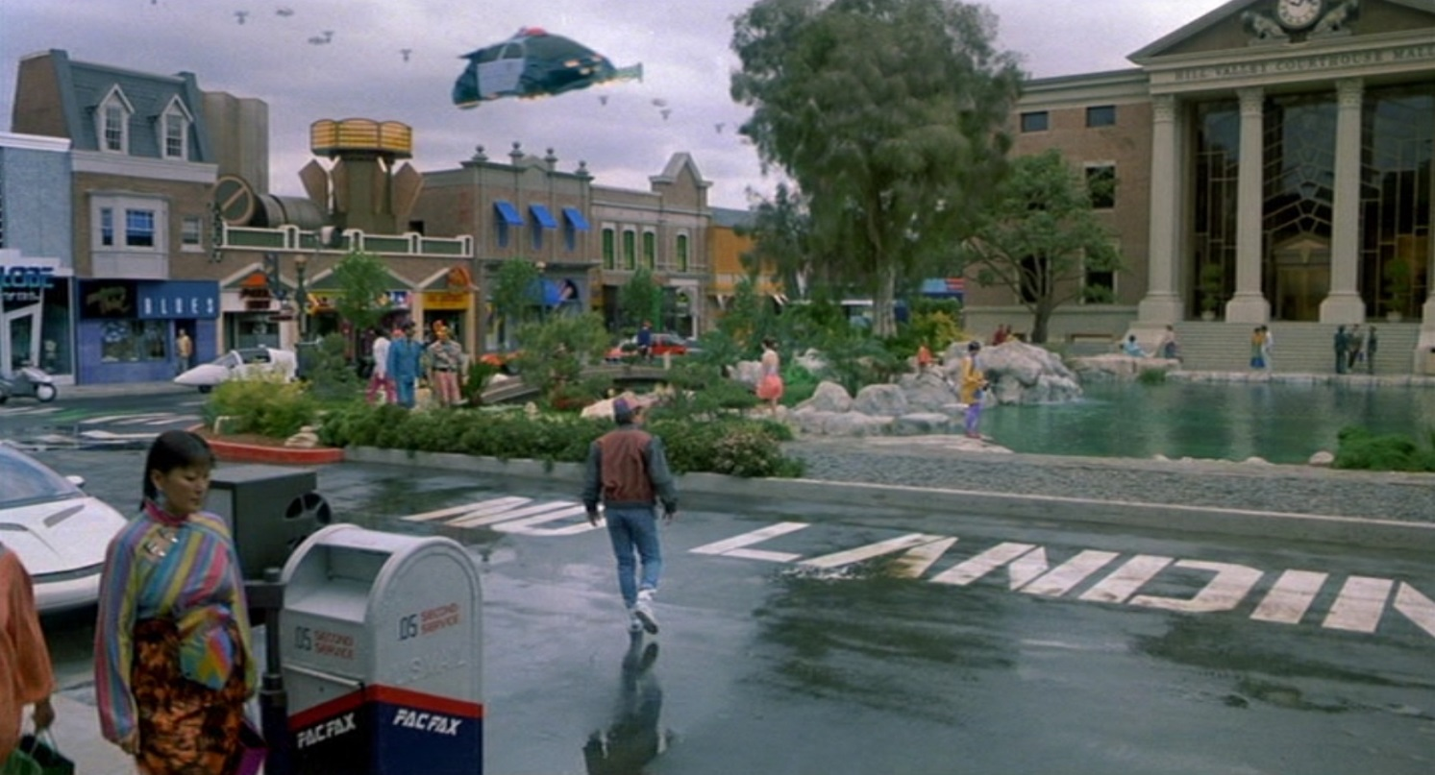
The future…

Slide 38
Prediction
"Prediction is very difficult, especially if it's about the future."
--Niels Bohr, Nobel laureate in Physics
"Those who have knowledge, don't predict. Those who predict, don't have knowledge. "
--Lao Tzu, 6th Century BC Chinese Poet
"This is the first age that's ever paid much attention to the future, which is a little ironic since we may not have one. "
--Arthur C. Clarke
Notes:
38

Slide 39
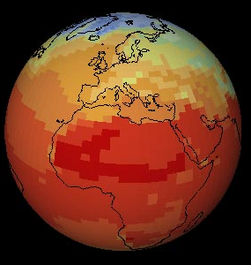
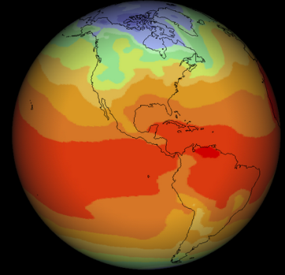
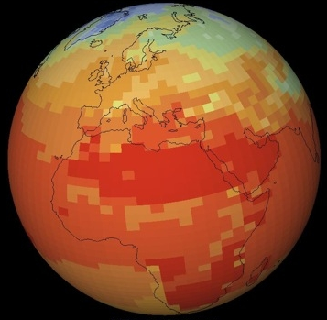
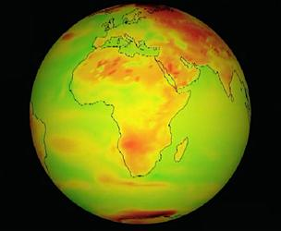
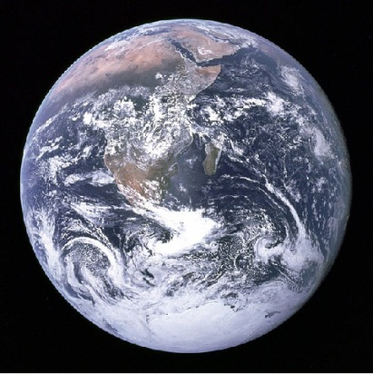
Climate Prediction
HadCM3, UK
ECHAM-5, Germany
GFDL-CM2, USA
CSIRO-Mk3, Australia
Planet Earth

Slide 40
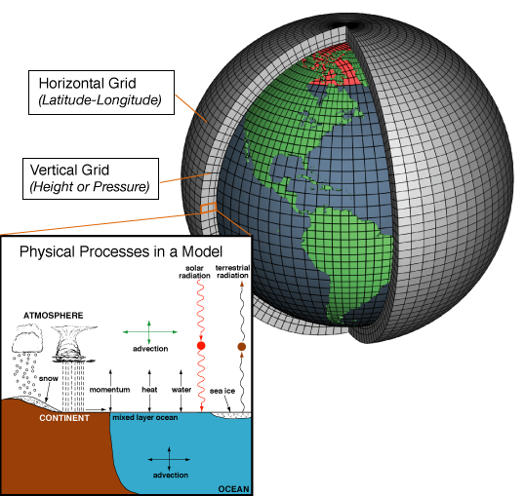

Climate modeling
Climate models are mathematical representations of the climate system based on fundamental physics
General Circulation Models or Global Climate Models (GCMs) mathematically solve the equations that govern atmosphere and ocean dynamics: the Navier-Stokes equations (equations of fluid motion)
It has not yet been proven that in three dimensions solutions always exist.
Millennium Prize Problems: $1 Million up for grabs!

Slide 41

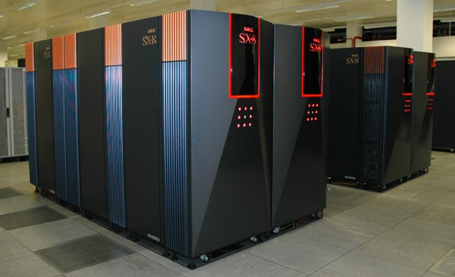
Why do we need computers?
Climate prediction is essentially an integration problem
Much faster at making calculations than the human brain
We cannot ‘experiment’ with the Earth’s climate

Slide 42
The IPCC
The Intergovernmental Panel on Climate Change (IPCC) is the leading international body for the assessment of climate change.
It was established by the United Nations Environment Programme (UNEP) and the World Meteorological Organization (WMO) in 1988 to provide the world with a clear scientific view on the current state of knowledge in climate change and its potential environmental and socio-economic impacts.
It reviews and assesses the most recent scientific, technical and socio-economic information produced worldwide relevant to the understanding of climate change. It does not conduct any research nor does it monitor climate related data or parameters.
Governments participate in the review process and the plenary Sessions, where main decisions about the IPCC work programme are taken and reports are accepted, adopted and approved.

Slide 43
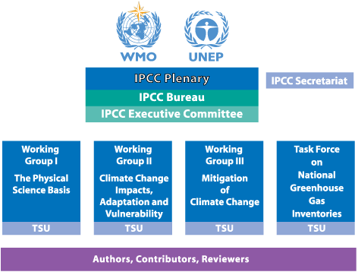
The IPCC

Slide 44
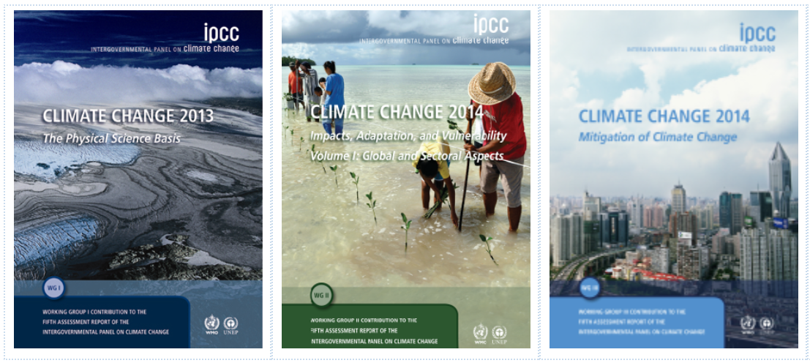
The IPCC
The IPCC produces reports five to six years. The latest full report is due this year and there are three volumes: http://www.ipcc.ch/report/ar5

Slide 45

IPCC AR5 SPM headline messages
“Warming of the climate system is unequivocal…”
Definition of unequivocal:
Adjective - leaving no doubt; unambiguous.
http://www.oxforddictionaries.com/definition/english/unequivocal

Slide 46
IPCC AR5 SPM headline messages
“In the Northern Hemisphere, 1983–2012 was likely the warmest 30-year period of the last 1400 years (medium confidence).”
“Average Northern Hemisphere temperatures during the second half of the 20th century were very likely higher than during any other 50-year period in the last 500 years and likely the highest in at least the past 1,300 years.” (IPCC AR4)

Slide 47
IPCC AR5 SPM headline messages
“It is extremely likely that human influence has been the dominant cause of the observed warming since the mid-20th century.”
“Continued emissions of greenhouse gases will cause further warming and changes in all c­omponents of the climate system. Limiting climate change will require substantial and sustained reductions of greenhouse gas emissions.”

Slide 48
Summary
“Climate is what you expect, weather is what you get”
The Earth System is highly complex and influenced by many different processes.
  It is difficult to perform “scientific experiments” on the system
  Hence we use climate models to understand and predict different aspects of the system
  Complex models (GCM’s) include detailed representation of the physics of climate
The IPCC reviews and assesses the body of climate science literature to inform policy makers. The latest assessment report from the IPCC provides stronger evidence of anthropogenic global warming.

Slide 49
The IPCC AR5 WG1 SPM challenge!
Split into groups of three
Each group will take on the role of an organisation or country
  (e.g. USA, China, UK, Vanuatu, Greenpeace, Exxon-Mobil, The Heartland Institute)
Extract at least three statements in the SPM that best support your position/agenda. Be mindful of the following questions:
  What are your primary motivations for selecting specific statements?
  What criteria do you use when selecting statements?
  Which of the statements is your headline message?

Slide 50
Course material available at:
email: jdaron@csag.uct.ac.za
See you on 14th October!
csag.uct.ac.za/~jdaron/GEOGM1405.html

