Slide 1
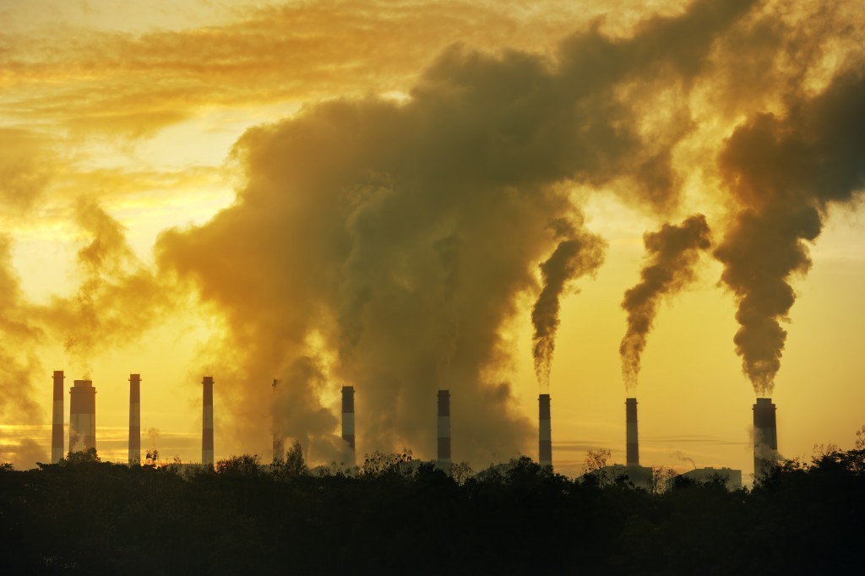
GEOGM1405
Climate Change: Science and Impacts
WEEK 2
Drivers and feedbacks in the
climate system

Slide 2
Course material, including reading list, available at:
www.csag.uct.ac.za/~jdaron/GEOGM1405.html
email: jdaron@csag.uct.ac.za

Slide 3
Course Outline
Week Topic Date
1 Introduction and key concepts September 30th
2 Drivers of climate change October 14th
3 Past climate change October 21st
4 Future climate: part 1 November 4th
5 Future climate: part 2* November 11th
6 Mitigation November 18th
7 Impacts on natural systems* November 25th
8 Impacts on human systems December 2nd
9 Adaptation and Risk December 9th
10 Ethics and Decision Making December 16th

Slide 4
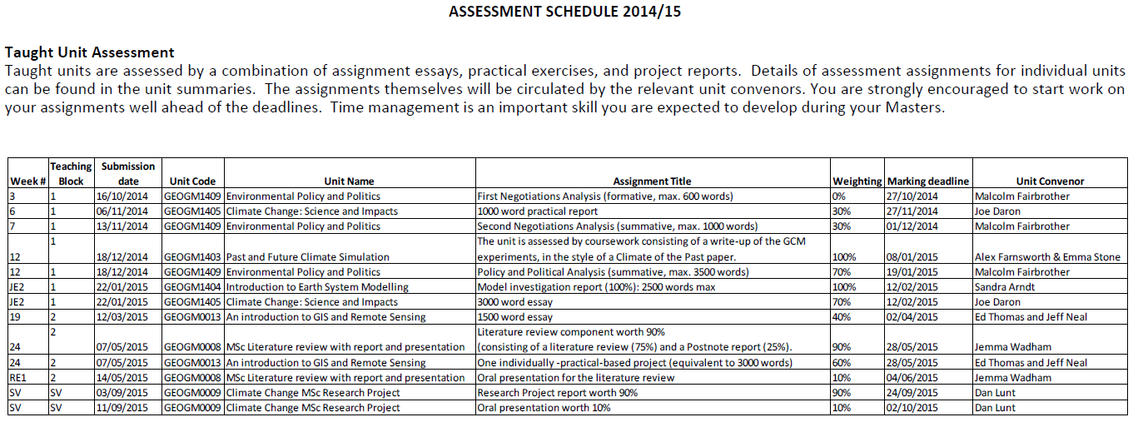
Assignment Deadlines

Slide 5
Revised Assignment Deadlines
Assignment 1: practical write-up
Date issued Tuesday, November 11th 2014
Submission date Friday, November 28th 2014 (5pm)
Marking deadline Friday, December 19th 2014
Assignment 2: impacts essay (as in handbook)
Date issued Tuesday, November 25th 2014
Submission date Thursday, January 22nd 2015 (5pm)
Marking deadline Thursday, February 12th 2015

Slide 6
Aims of Today’s Lecture
Examine the changes to key forcings (drivers) on the climate system
Discuss the generation of emissions scenarios used to drive climate model projections
Understand key feedbacks in the climate system

Slide 7
FAQs

Slide 8
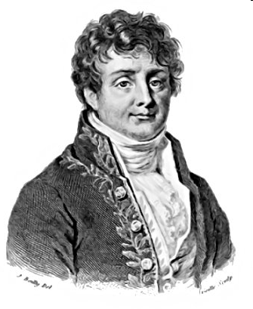
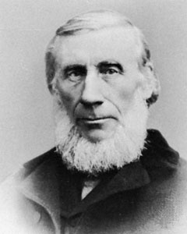
A very brief Greenhouse Gas (GHG) history
1824: Joseph Fourier recognises the importance of the atmosphere in trapping heat and influencing the temperature of the Earth
1859: John Tyndall undertakes laboratory experiments, identifying water vapour and carbon dioxide as heat-trapping gases.

Slide 9
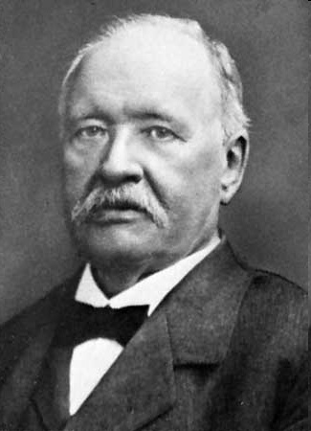
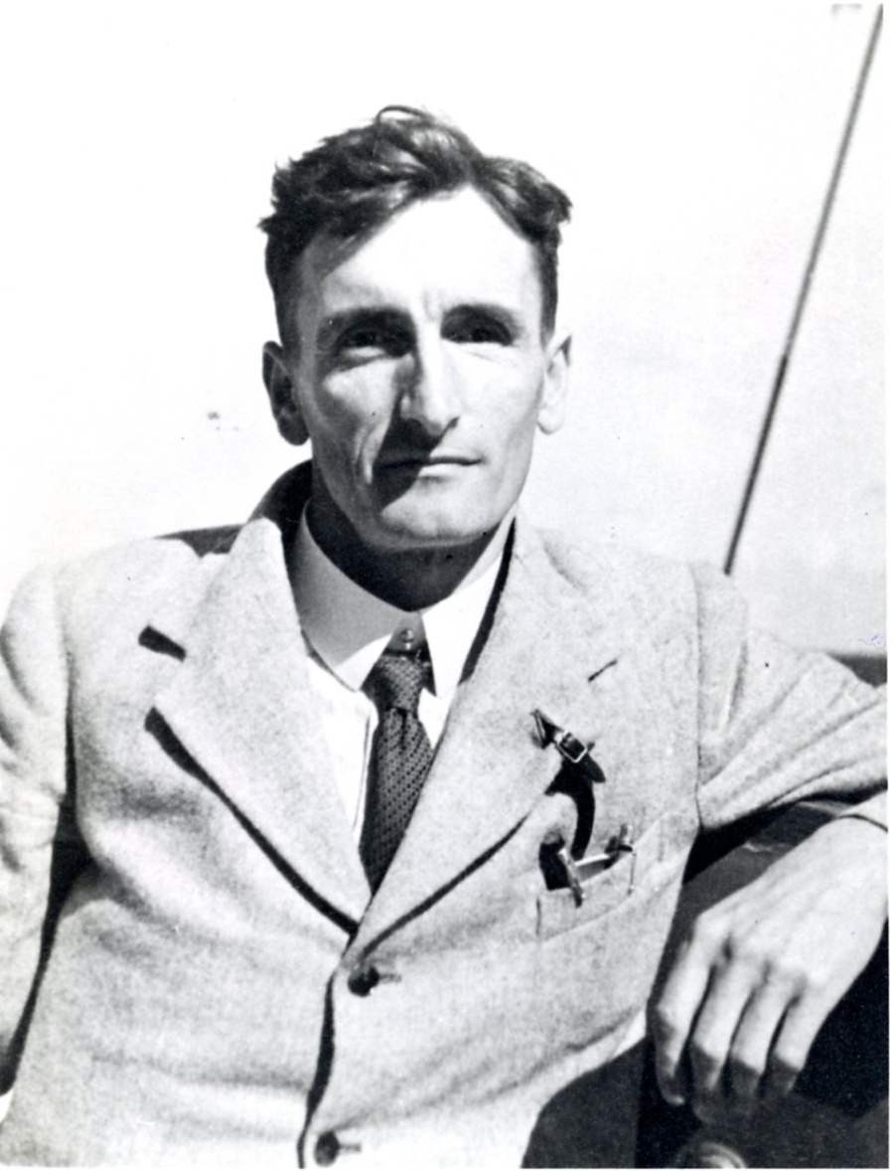
1896: Svante Arrhenius makes the first quantitative climate prediction: doubling of CO2 will increase temperature by around 5 to 6°C. He later revised this to 3.7°C with the water vapour feedback accounting for 2.1°C of the change.
1938: Guy Callendar predicts that doubling atmospheric CO2 concentrations would increase the mean global temperature by 2°C with considerably more warming at the poles. He also linked increasing fossil fuel combustion with a rise in CO2.

Slide 10
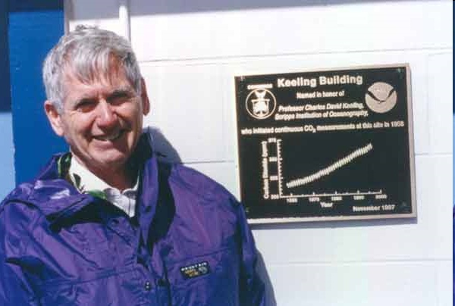
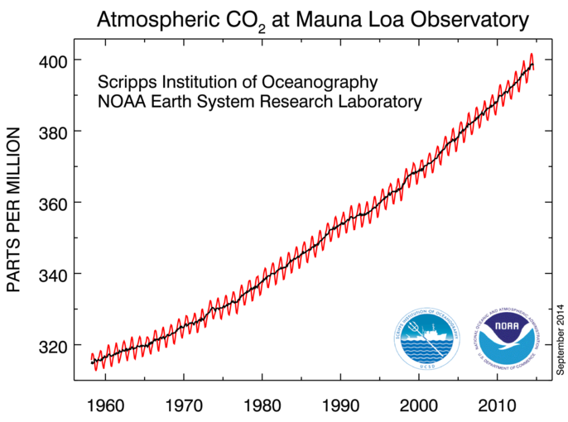
1958: Charles Keeling makes the first direct measurement of atmospheric CO2, on Mauna Loa, Hawaii (316 parts per million).

Slide 11
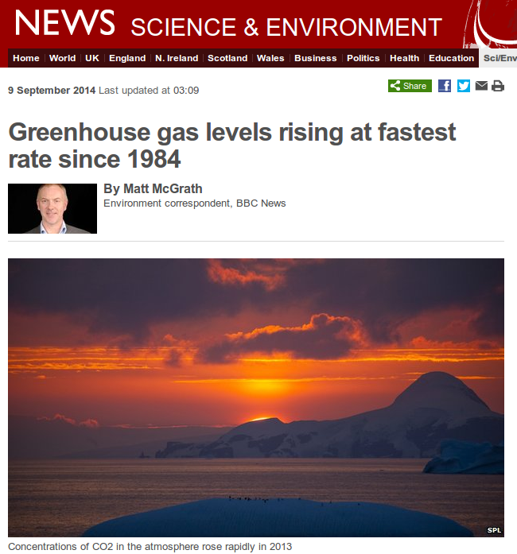
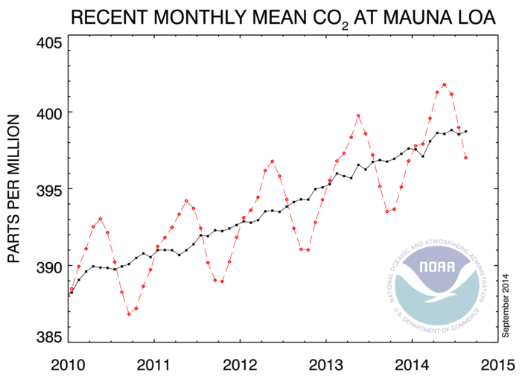

Slide 12
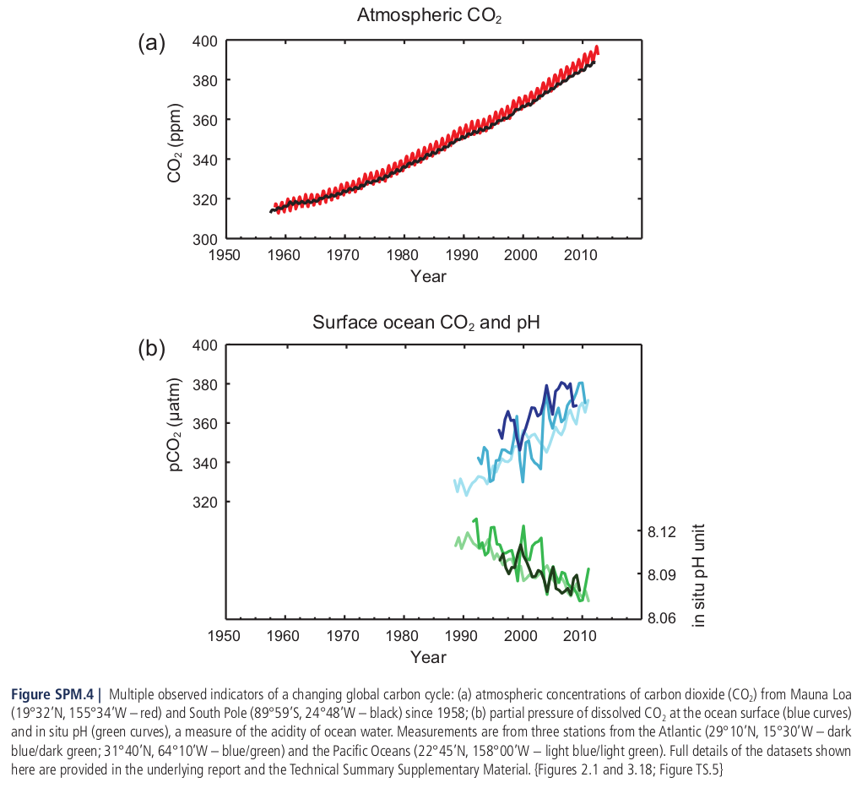

Slide 13
How is our atmosphere changing?
Video clip

Slide 14
The atmospheric concentrations of carbon dioxide, methane, and nitrous oxide have increased to levels unprecedented in at least the last 800,000 years.
Carbon dioxide concentrations have increased by 40% since pre-industrial times, primarily from fossil fuel emissions and secondarily from net land use change emissions.
The ocean has absorbed about 30% of the emitted anthropogenic carbon dioxide, causing ocean acidification.

Slide 15
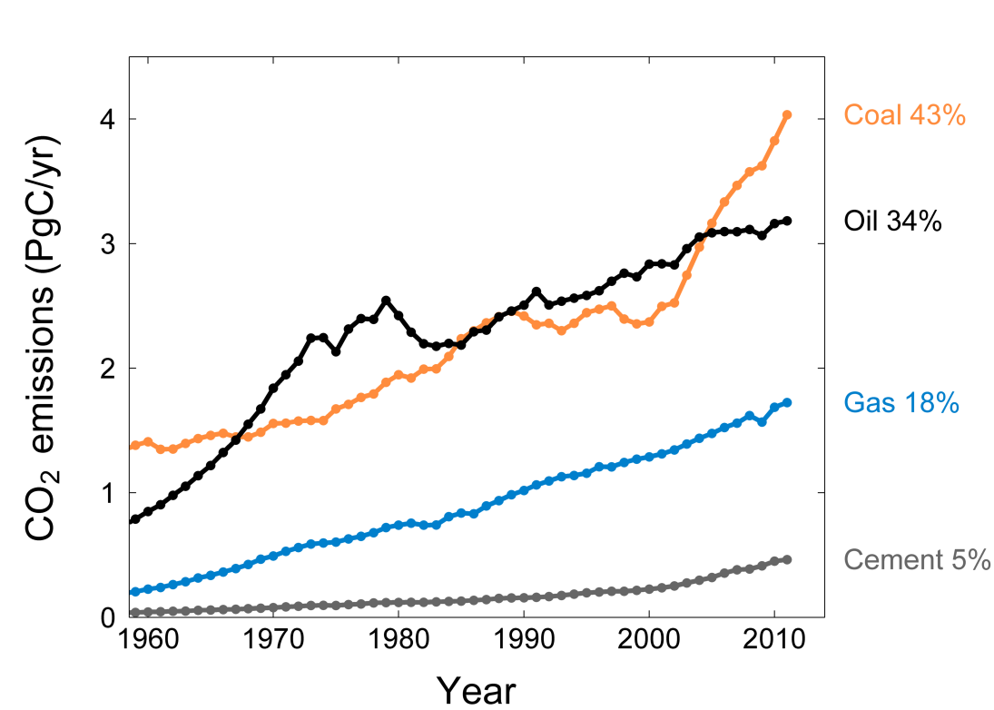
Contributions to rising GHG concentrations
Emissions growth 2000-2011: coal (4.9%/yr), oil (1.1%/yr), gas (2.7%/yr), cement (6.9%/yr), flaring (4.3%/yr, not shown)
Source: Global Carbon Project

Slide 16
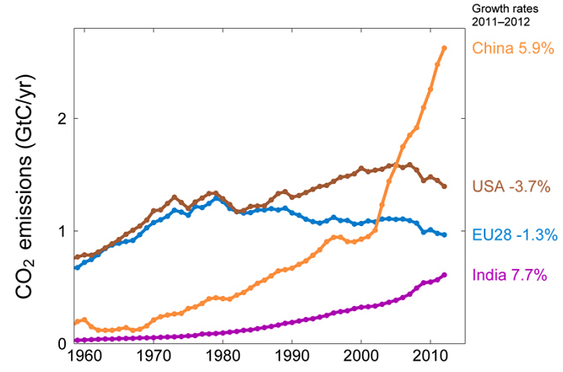
Contributions to rising GHG concentrations
The top four emitters in 2012 covered 58% of global emissions: China (27%), United States (14%), EU27 (10%), India (6%)
Source: Global Carbon Project

Slide 17
Where is the carbon going?
2000-2010
(PgC y⁻¹)
7.9±0.5
1.0±0.7
2.5±1.0
4.1±0.2
2.3±0.5
Global Carbon Project 2011
Updated from Le Quéré et al. 2009, Nature Geoscience; Canadell et al. 2007, PNAS
Notes:
How the global carbon budget is put together:
Atmospheric CO2. The data is provided by the US National Oceanic and Atmospheric Administration Earth System Research Laboratory. Accumulation of atmospheric CO2 is the most accurately measured quantity in the global carbon budget with an uncertainty of about 4%.
Emissions from CO2 fossil fuel. CO2 emissions from fossil fuel and other industrial processes are calculated by the Carbon Dioxide Information Analysis Center of the US Oak Ridge National Laboratory. For the period 1958 to 2007 the calculations were based on United Nations Energy Statistics and cement data from the US Geological Survey, and for the years 2008 and 2009 the calculations were based on BP energy data. Uncertainty of the global fossil fuel CO2 emissions estimate is about ±6% (currently ±0.5 PgC). Uncertainty of emissions from individual countries can be several-fold bigger.
Emissions from land use change. CO2 emissions from land use change are calculated by using a book-keeping method with the revised data on land use change from the Food and agriculture Organization of the United Nationals Global Forest Resource Assessment 2010. Uncertainty on this flux is the highest of all budget components.
Ocean CO2 sink. The global ocean sink is estimated using an ensemble of five process ocean models. Models are forced with meteorological data from the US national Centers for Environmental Prediction and atmospheric CO2 concentration. Current uncertainty is around 0.4 PgC y-1.
Land CO2 sink. The terrestrial sink is estimated as the residual from the sum of all sources minus ocean+atmosphere sink. The sink can also be estimated using terrestrial biogeochemical models as in previous carbon budget updates.
More information on data sources, uncertainty, and methods are available at:
http://lgmacweb.env.uea.ac.uk/lequere/co2/carbon_budget.htm

Slide 18
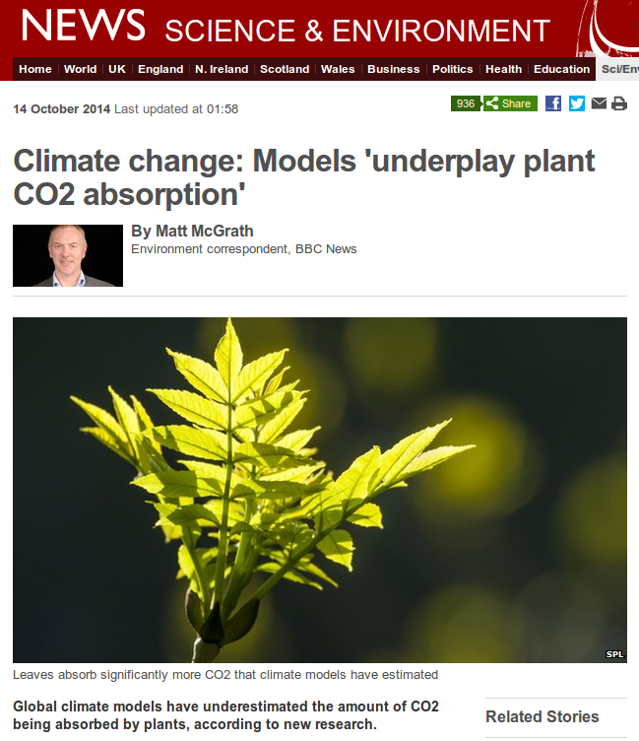

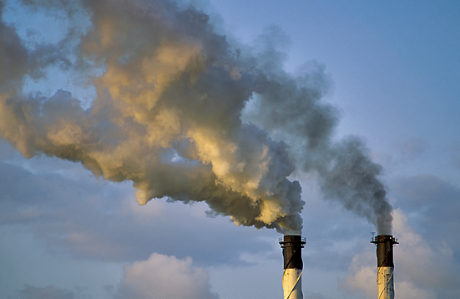
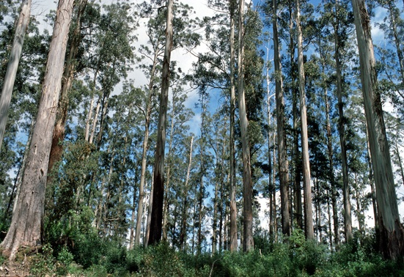
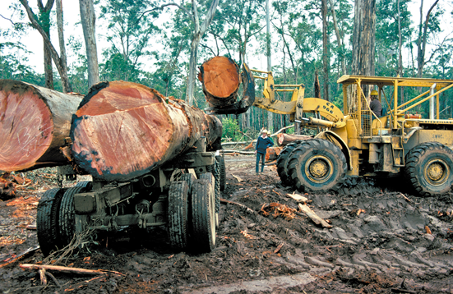
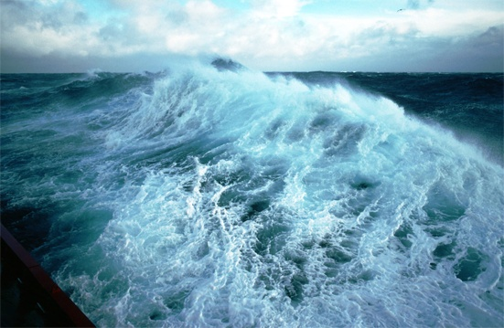
Where is the carbon going?
46%
+
28%
26%
The sinks have continued to grow with increasing emissions but it is uncertain how efficient the sinks will be in the future.

Slide 19
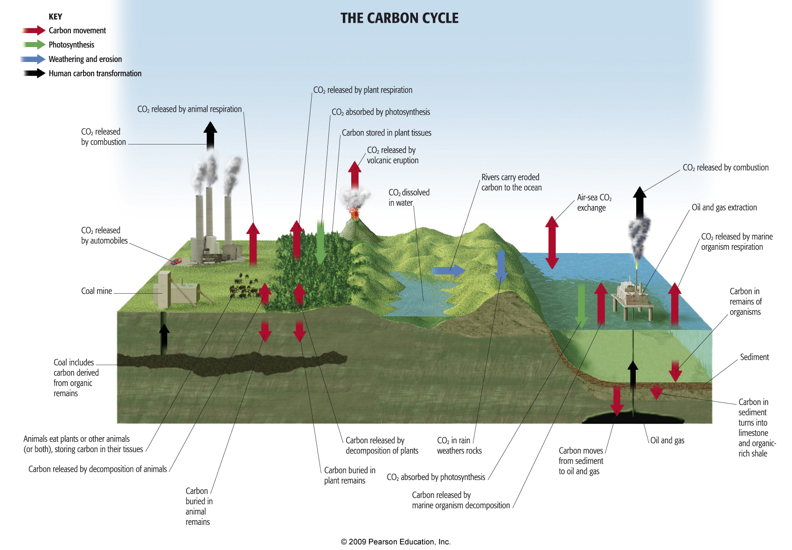
The Carbon Cycle
The Carbon Cycle

Slide 20
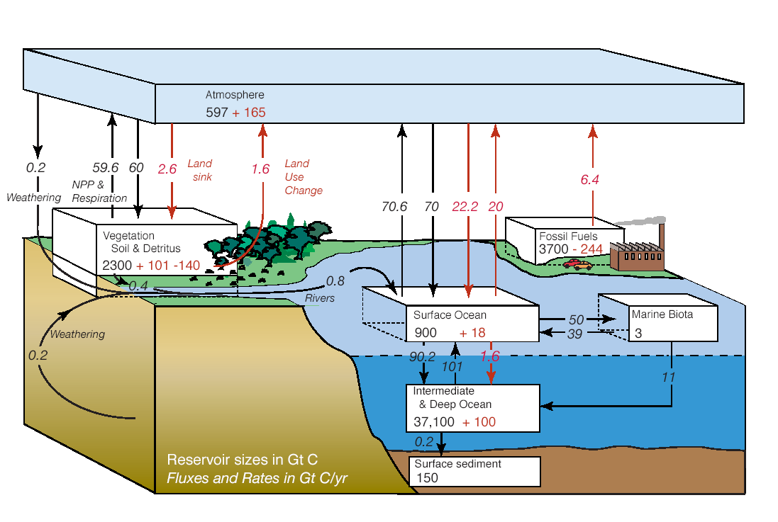
The Carbon Cycle
Black line = natural contributions
Red line = human contributions
Source: NOAA
Storage reservoirs are in PgC ( = GtonC =10¹⁵g C) and fluxes are in PgC/year
1 PgC is equivalent to 3.67 Pg CO₂ or 0.47 ppm CO₂

Slide 21
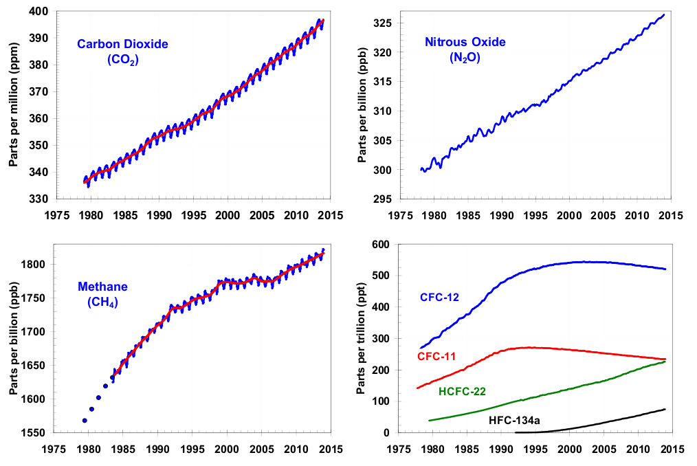
Other important drivers:
Methane (CH₄), Nitrous Oxide (N₂0) and HFCs
US Govt - NOAA (http://www.esrl.noaa.gov/gmd/aggi/)

Slide 22
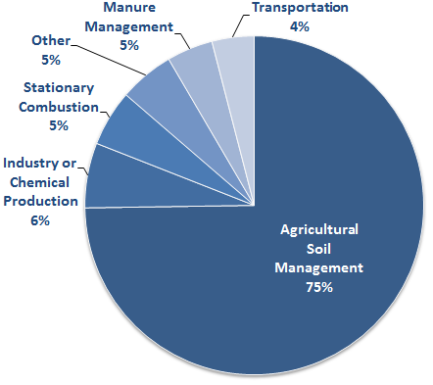
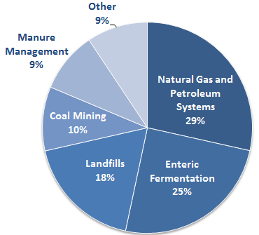
Other important drivers:
Methane (CH₄), Nitrous Oxide (N₂0) and HFCs
US Nitrous Oxide Emissions, 2012: US EPA
US Methane Emissions, 2012: US EPA

Slide 23
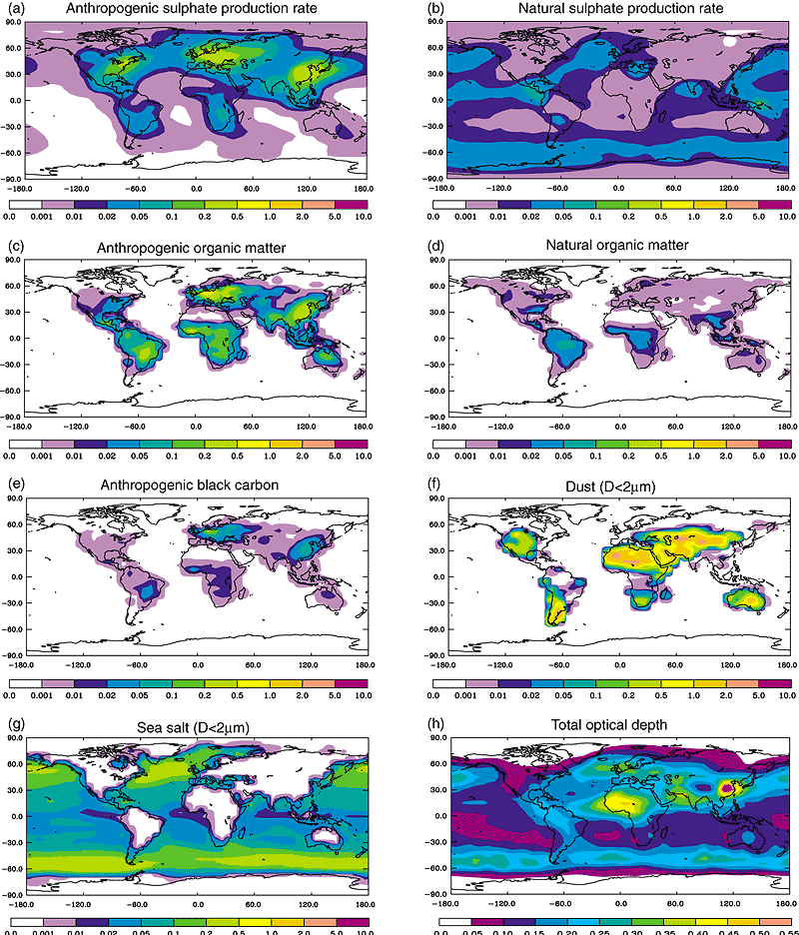
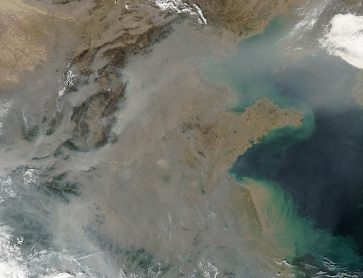
Other important drivers:
Aerosols (e.g. dust, particulate air pollutants and smoke)
Global dimming is caused by an increase in aerosols such as sulfate aerosols in the atmosphere due to human activity. It led to a gradual reduction in the amount of global direct irradiance at the Earth's surface. The effect varies by region but it has been estimated to be of the order of a 4% reduction over the three decades from 1960–1990.

Slide 24
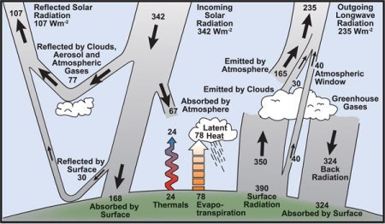
Radiative forcing
IPCC Glossary
Radiative forcing is the change in the net, downward minus upward, radiative flux (expressed in W m–2) at the tropopause, or top of atmosphere, due to a change in an external driver of climate change, such as, for example, a change in the concentration of carbon dioxide or the output of the Sun.
For the purposes of the IPCC report, radiative forcing is further defined as the change relative to the year 1750 and, unless otherwise noted, refers to a global annual average value.

Slide 25
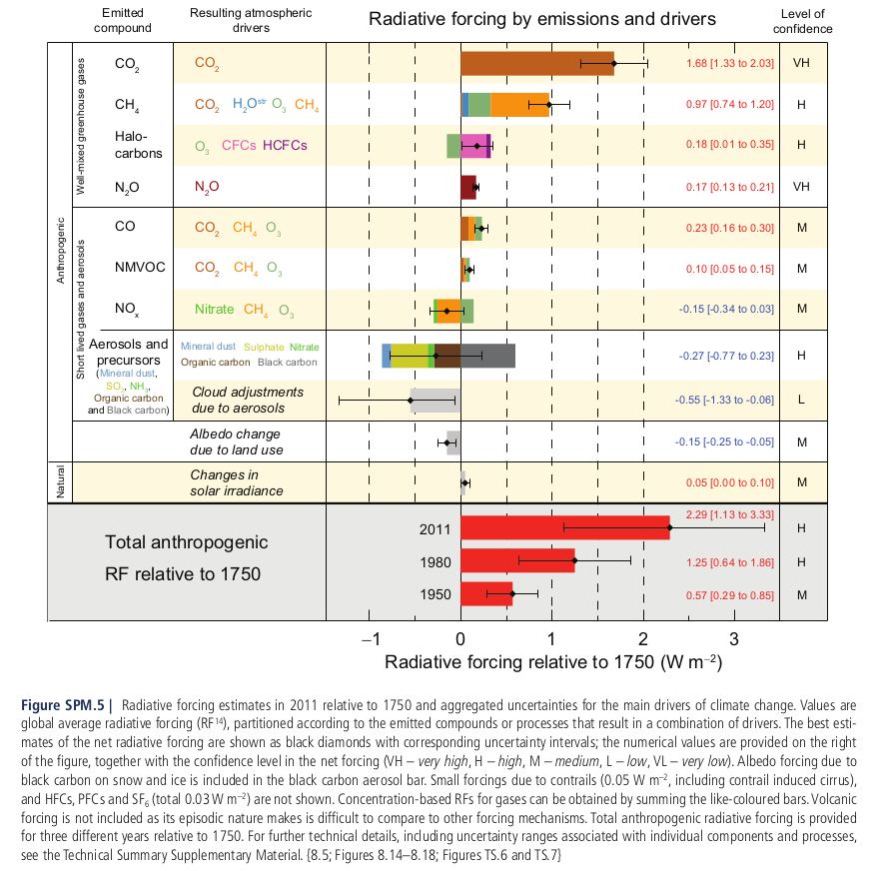

Slide 26
Global Warming Potential (GWP)
Time integrated radiative forcing from an instantaneous release of 1 kg of a gas, relative to that of a 1kg of a reference gas (normally CO₂).
The GWP represents the combined effect of the differing times these gases remain in the atmosphere and their relative effectiveness in absorbing outgoing thermal infrared radiation. The Kyoto Protocol is based on GWPs from pulse emissions over a 100-year time frame.

Slide 27
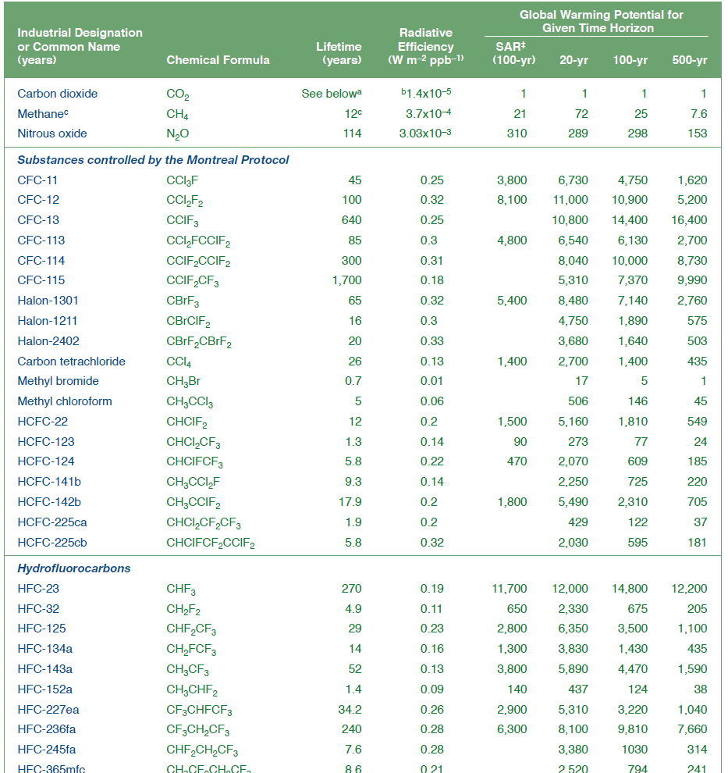
Global Warming Potentials (GWP)

Slide 28
Emissions Scenarios

Slide 29
What are scenarios and what are their purpose?
Scenarios are storylines. In the context of climate change, they represent alternative plausible visions of how the future might evolve. They can be considered as:
tools to understand how different combinations of driving forces may influence the future climate system
tools to assess the effectiveness of different policy options e.g. adaptation, mitigation
Notes:
Emissions scenarios
if we end up doing this to the world ..... then.....
Management tools
if we try this.......then........
Stabilisation scenarios
if we want to avoid this.....then......
So first lets take emissions scenarios, how are these implemented

Slide 30
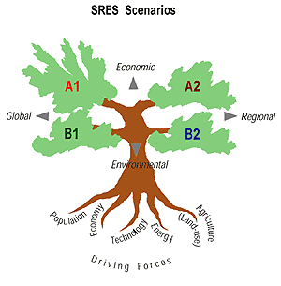
SRES storylines
Special Report on Emissions Scenarios – IPCC, 2000
A1
Economic growth rapid
Population peak 2050
Technological growth rapid
Capacity building
A1F1: fossil intensive
A1T: non-fossil energy
A1B: Balance
A2
Economic development regional - disparity
Population continues rising
Technological growth - slow, fragmented
Self reliance, heterogeneity
B1
Economic shift - services/information
Population peak 2050
Technology -clean/efficient
Global solutions to sustainability/equity
B2
Economic development intermediate
Population continues rising slowly
Technological growth - diverse
Local and regional solutions to environment/equity
Notes:
SRES scenarios do not include additional cliamte incentives which means they include no explicit actions to implement the UNFCCC of the Kyoto emissions targets
However, GHG emissions are affected by other policies such as energy efficiency, population and resource control, and pollution control

Slide 31
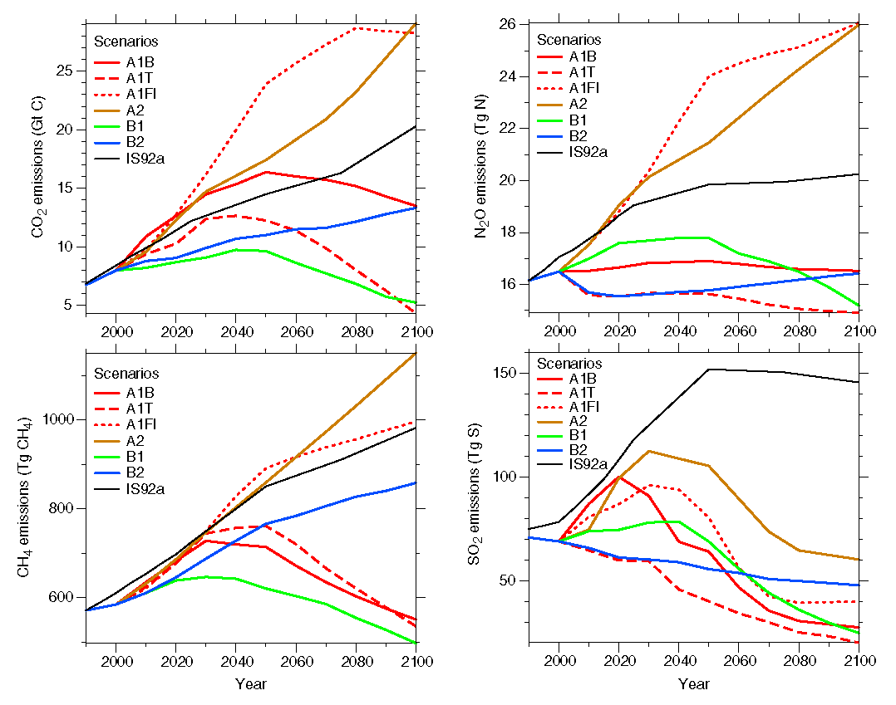
SRES - Emissions Scenarios
IPCC TAR synthesis report 2001

Slide 32
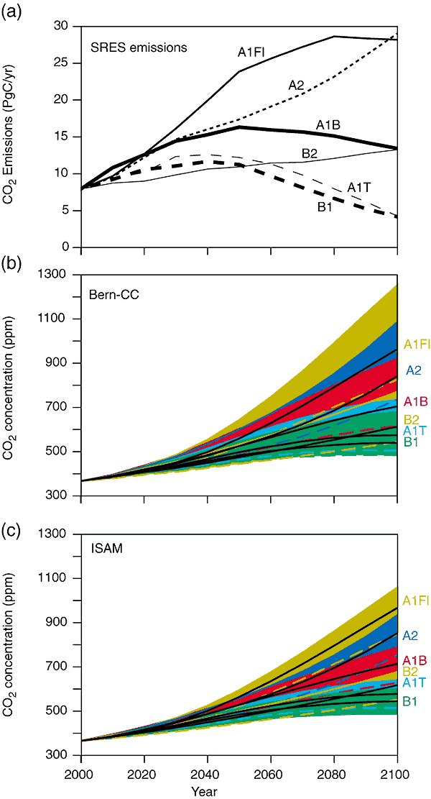
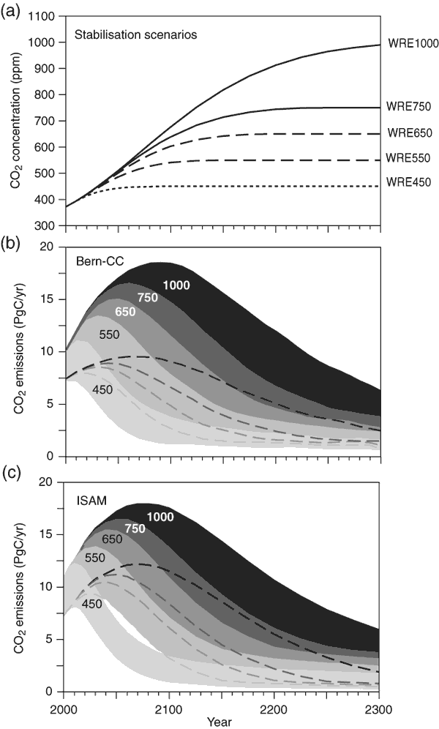
From emissions to concentrations

Slide 33
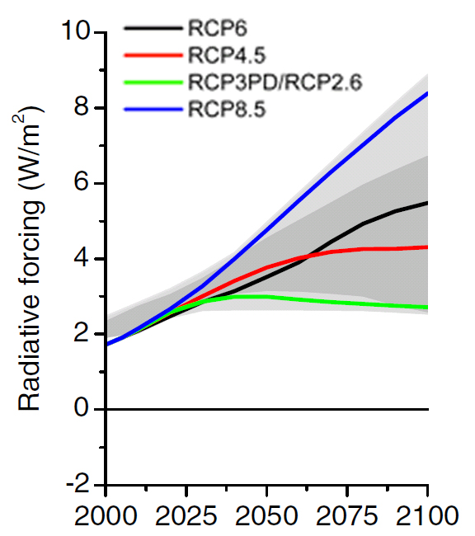
Representative Concentration Pathways (RCPs)
Scenarios that include time series of emissions and concentrations of the full suite of greenhouse gases and aerosols and chemically active gases, as well as land use/land cover. The word representative signifies that each RCP provides only one of many possible scenarios that would lead to the specific radiative forcing characteristics. The term pathway emphasizes that not only the long-term concentration levels are of interest, but also the trajectory taken over time to reach that outcome.
Four RCPs produced from Integrated Assessment Models were selected from the published literature and are used in the AR5 as a basis for the climate predictions and projections.
RCP2.6 One pathway where radiative forcing peaks at approximately 3 W m–2 before 2100 and then declines.
RCP4.5 and RCP6.0 Two intermediate stabilization pathways in which radiative forcing is stabilized at approximately 4.5 W m–2 and 6.0 W m–2 after 2100.
RCP8.5 One high pathway for which radiative forcing reaches greater than 8.5 W m–2 by 2100 and continues to rise for some amount of time.

Slide 34
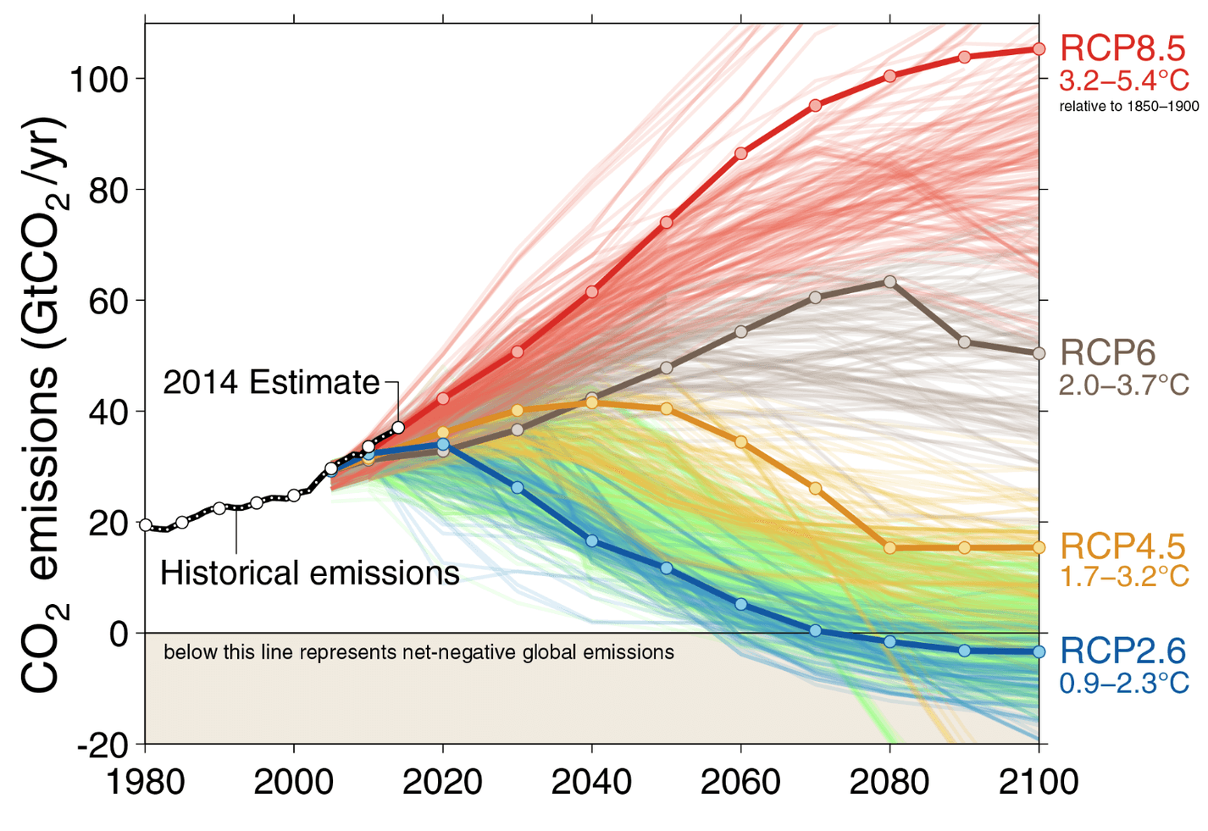
Carbon Intensity
Fuss et al. 2014

Slide 35
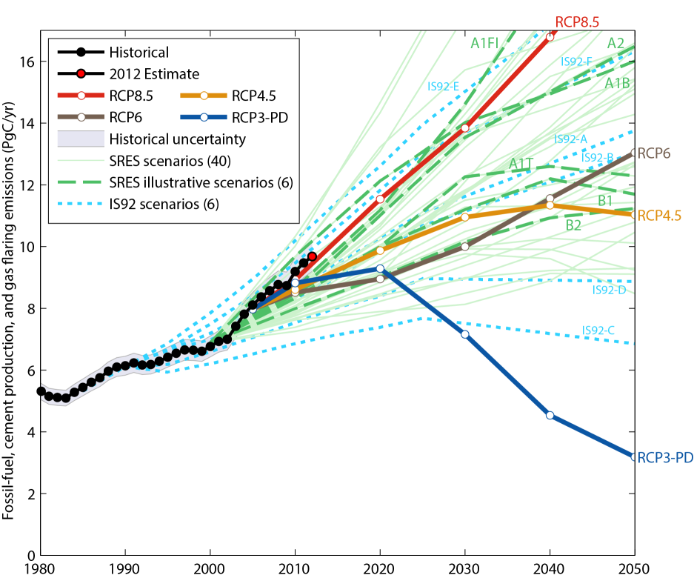
Scenarios compared to observed emissions
Source: Peters et al. 2012a; Global Carbon Project 2012

Slide 36
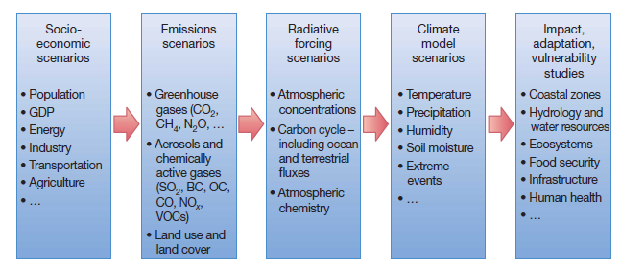
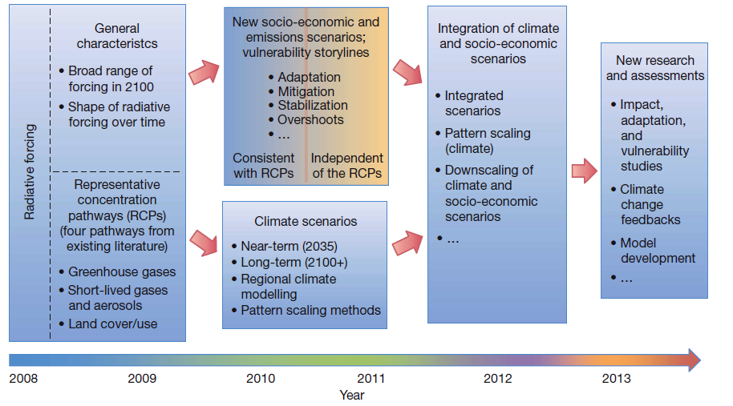
Developing Scenarios for the IPCC
Sequential
(SRES)
Parallel
(RCPs)

Slide 37
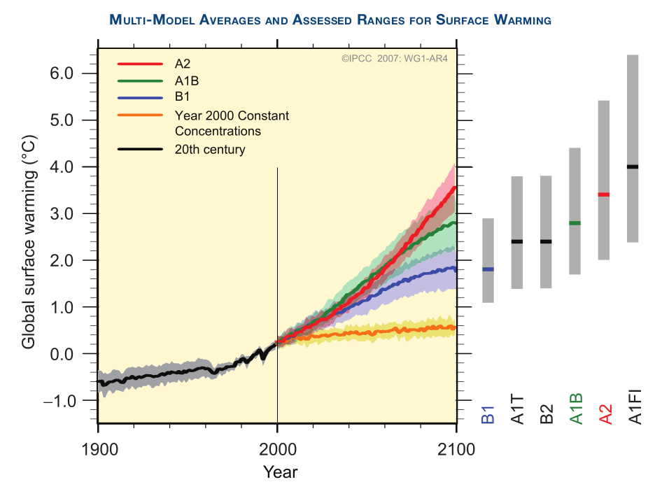
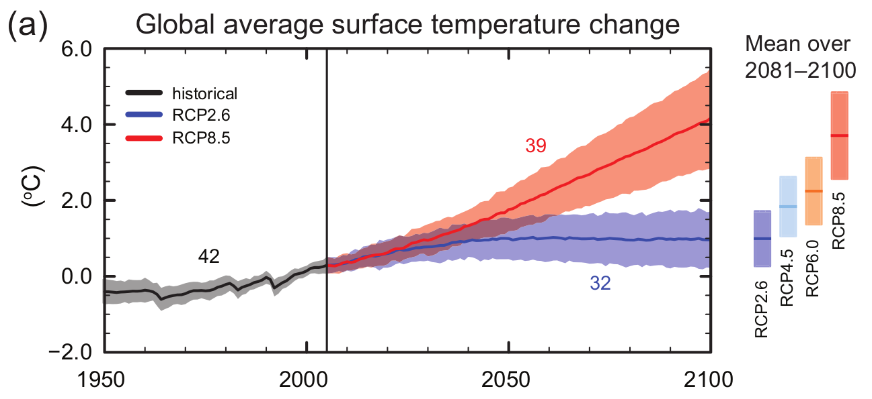
AR4
AR5

Slide 38
The IPCC AR5 WG1 SPM challenge!
Split into groups of three
Each group will take on the role of an organisation or country
  (e.g. USA, China, UK, Vanuatu, Greenpeace, Exxon-Mobil, The Heartland Institute)
Extract at least three statements in the SPM that best support your position/agenda. Be mindful of the following questions:
  What are your primary motivations for selecting specific statements?
  What criteria do you use when selecting statements?
  Which of the statements is your headline message?

Slide 39
Feedbacks

Slide 40
What is a climate feedback?
“An interaction mechanism between processes in the climate system is called a climate feedback when the result of an initial process triggers changes in a second process that in turn influences the initial one.
A positive feedback intensifies the original process, and a negative feedback reduces it.”
(IPCC, AR4)

Slide 41
Positive feedback
Account balance grows
More interest earned
Negative feedback
Body temperature rises
Body temperature drops
Body sweats more

Slide 42
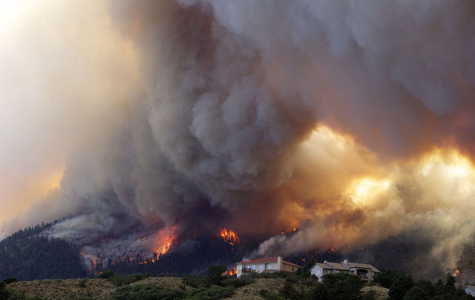
Why are feedbacks important?
“Forest fires represent ‘positive feedback loops’ in climate trends. Fires emit vast quantities of carbon dioxide into the atmosphere, which warms the planet, and sets up favourable conditions for more fires, more carbon dioxide, and more warming.”
(policymic.com,
1 July 2012)
Mitra et al. “while the increased incidence of wildfires that may occur with climate change could release additional CO₂ to the atmosphere, this could be countered over the long term by increased soil or sediment sequestration of black carbon” ... “this sink for atmospheric CO₂ into an estuarine environment would represent a negative climate feedback”. (www.co2science.org)
So who is right?

Slide 43
Why are feedbacks important?
Climate Sensitivity
“The equilibrium change in near-surface air-temperature that would result from a sustained doubling of the atmospheric (equivalent) CO₂ concentration.” (IPCC)
where ΔT_{s} is the change in near-surface temperature (deg C), λ is the climate sensitivity parameter and RF is the Radiative Forcing (W/m²). RF = 3.7 W/m² (IPCC, 2001).
Uncertainty derives from the sum of the individual temperature feedbacks, (λ₁ + λ₂+... λ_{n}).
If λ _{f} > 1, the feedback is positive and increases the rate of warming.
If λ _{f} < 1, the feedback is negative and decreases the rate of warming.

Slide 44
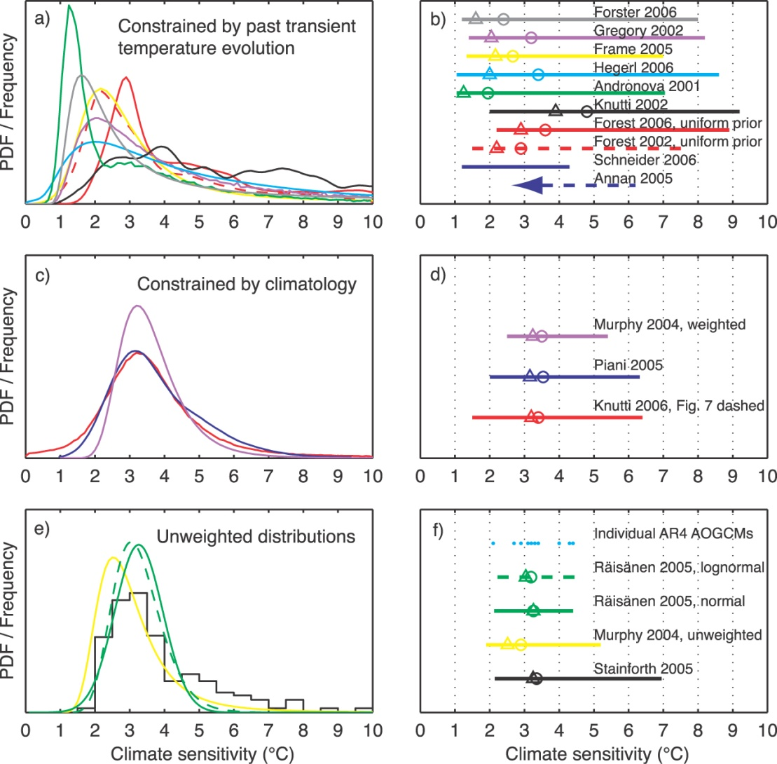
Why are feedbacks important?
“This range in climate sensitivity is attributable to differences in the strength of ‘radiative feedbacks’ between models and is one of the reasons why projections of future climate change are less certain than policy makers would like.”
realclimate.org (2006)

Slide 45
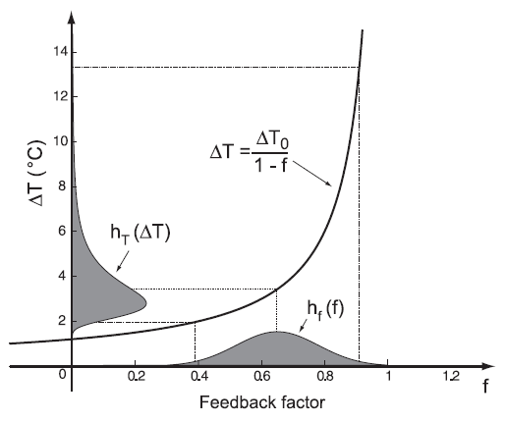
Why are feedbacks important?
“In the absence of feedback processes, climate models show λ= 0.30 to 0.31 [K/(W/m2)], giving an equilibrium increase ΔT = 1.2°C in response to sustained 2 × CO₂.”
Roe et al. (2007) - Why is climate sensitivity so unpredictable?

Slide 46
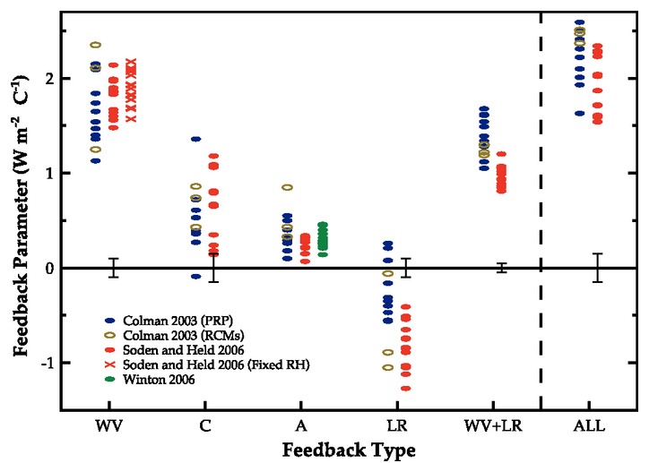
Soden and Held (2006); IPCC AR4, fig 8.14

Slide 47
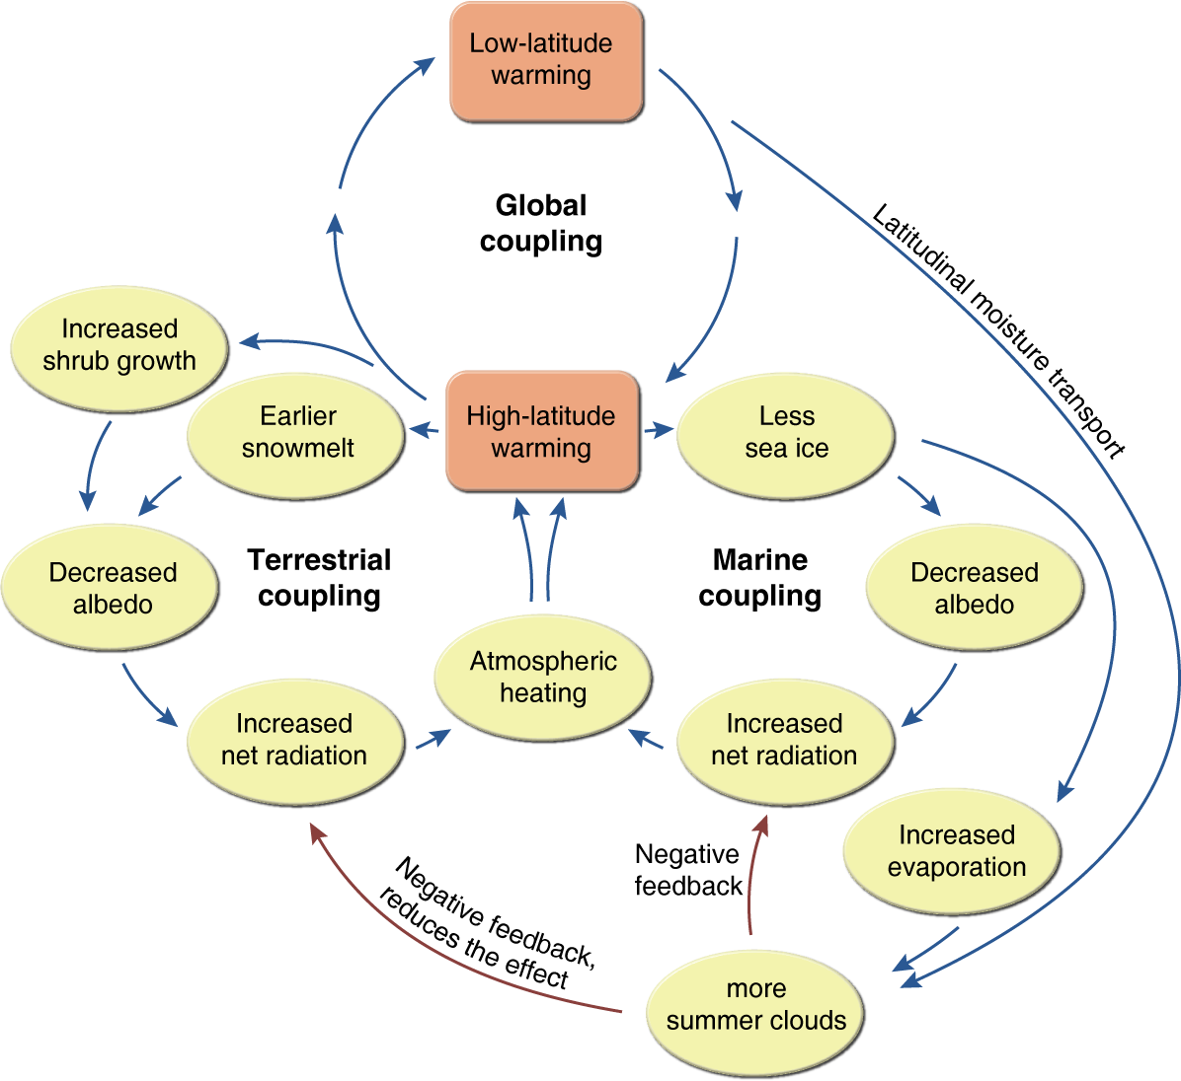
Understanding feedbacks
Feedbacks are rarely isolated

Slide 48

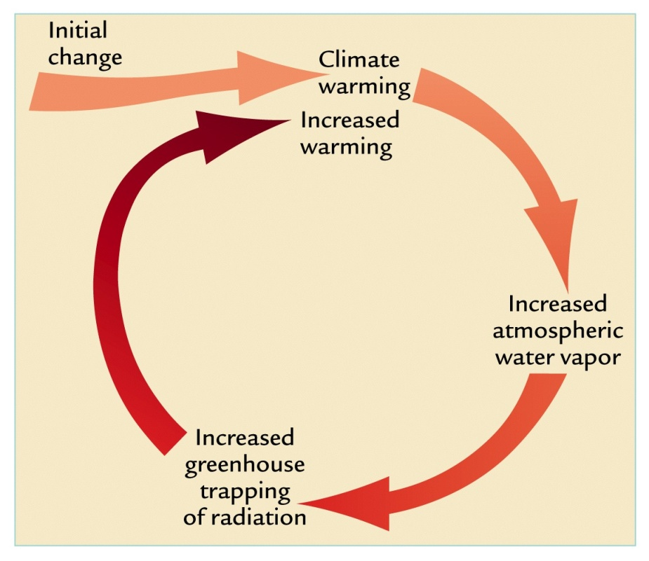
Water vapour feedback
Water vapour is the dominant greenhouse gas.
The ability to hold moisture in the atmosphere increases with higher atmospheric temperatures.
All models predict that concentrations of water vapour will increase as the climate warms.
The water vapour feedback acting alone would double the warming beyond that resulting in the absence of feedbacks.
It also interacts with other feedbacks.

Slide 49
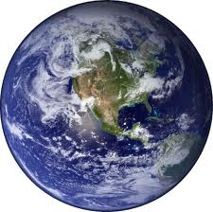
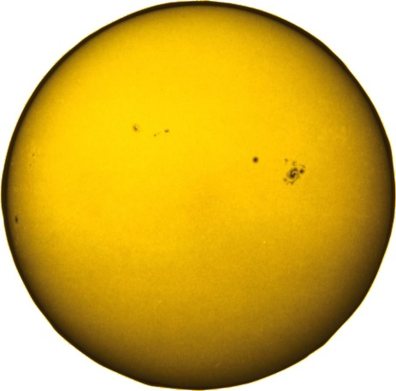
Lapse rate feedback
Earth absorbs 70% of the incoming solar radiation. To balance this incoming radiation, a black body would have to radiate at a temperature of 255 K. But the actual mean surface temperature of the Earth is close to 288 K.
The atmosphere's temperature decreases with height. Therefore, the Earth’s effective temperature (Te) occurs in the mid-troposphere, about 5 km above the surface on average.
255 K
288 K
256 K
254 K
Outgoing = Incoming

Slide 50
Lapse rate feedback
As GHG concentrations increase, less infrared radiation is being lost to space. But the incoming solar radiation is not changing. The effective temperature of the Earth (255K) therefore doesn’t need to change.
Earth must maintain radiative balance; outgoing = incoming. Radiation is a function of temperature. To re-establish radiative balance, Earth’s average temperature must increase. However, the increase does have to be the same everywhere.
255 K
288 + ?
288 K
256 K
254 K
Outgoing = Incoming

Slide 51
Lapse rate feedback
No change in Lapse rate:
Lapse rate = - 6.5 K/km
Z(new)
Increase warming in mid-high
Troposphere:
Lapse rate = - 6 K/km
Height above surface
Z(new)
Z(e)
Surface
T(e)
Temperature

Slide 52
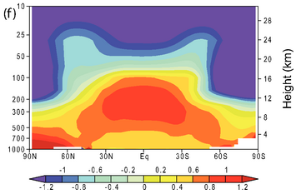
Lapse rate feedback
As the surface warms, there is an increase in evaporation and more moisture in the air. This decreases the atmospheric lapse rate.
Fig 9.1: IPCC AR4
Zonal mean atmospheric temperature change from 1890 to 1999 (deg C per century) as simulated by the PCM model.

Slide 53
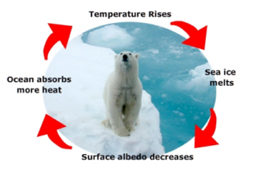
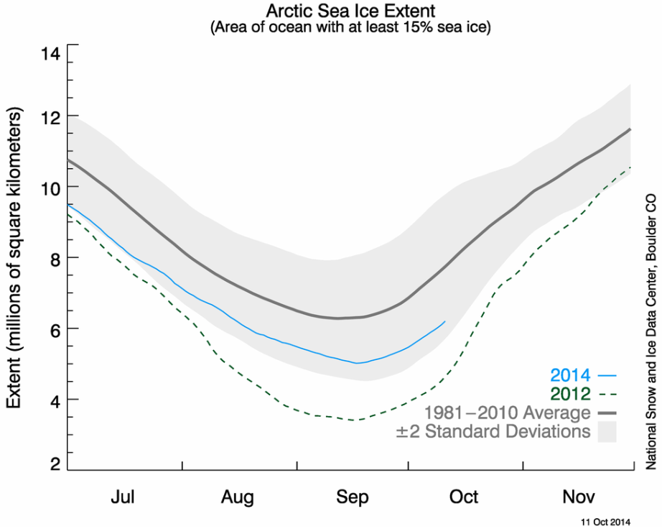


Sea-ice ‘albedo’ feedback
Sea ice and snow has a high albedo, reflecting the majority of incoming solar radiation. With increasing temperatures, the spatial area of sea ice and snow cover decreases, exposing new expanses of ocean and land that absorbs solar radiation. This increase of total absorbed solar radiation contributes to continued and accelerated warming.

Slide 54

Cloud feedbacks
Clouds double the Earth’s albedo.
Increased evaporation is expected to increase cloud cover on average.
Under global warming, models predict changing cloud distributions.
Increased cloud cover increases the reflection of solar radiation from the Earth’s surface but it can also increase the net long-wave radiation emitted downward from the same clouds back to the surface.
The net effect of decreased incoming solar radiation combined with a potential increase in the amount of reflected outgoing longwave radiation is very uncertain and a primary uncertainty in climate change science.

Slide 55

Cloud feedbacks
T low
T high

Slide 56

Cloud feedbacks
Hugo and Slingo (2009)

Slide 57



Direct effect of aerosols
Aerosols are tiny solid and liquid airborne particles. Sizes range 0.01 μm to 10 μm.
  Natural Volcanoes; sea salt; desert dust; plant emitted Volatile Organic Compunds (VOC's)
Anthropogenic Biomass burning for agricultural purposes or hunting; food preparation; industry; transport
Notes:
11-07-15
57

Slide 58


Indirect effect of aerosols
Normal
Small number of cloud condensation nuclei
Small number of large cloud droplets
Relatively low reflectivity
With Anthropogenic Emissions
High number of cloud condensation nuclei
High number of small cloud droplets
Relatively high reflectivity

Slide 59

Carbon cycle feedbacks
Plant life on land and in the ocean plays a crucial role in the global carbon cycle. Changes in the physical climate can have a profound effect on the carbon budget, which can in turn alter the amount of atmospheric CO₂ and hence further change the climate.
Notes:
11-07-15
59

Slide 60

Terrestrial carbon feedbacks
Carbon cycle feedbacks
“Over the last 30 years, the net result of all these processes has been the uptake of atmospheric CO₂ by terrestrial ecosystems. Will uptake by the terrestrial biosphere grow or diminish with time, or even reverse so that the terrestrial biosphere becomes a net source of CO₂ to the atmosphere? “
(IPCC, AR4)
UNEP, 2011

Slide 61


Tipping points/elements
Other feedbacks could lead to major disruptions of the Earth’s climate
  e.g. THC collapse e.g. Tundra methane release

Slide 62

What are the implications of feedbacks for climate prediction and how we approach societal responses to climate change?
Provides a source of large uncertainty
Implies that coupled models are required which include different interacting components of the Earth system
Feeds the discourse on climate change scepticism
Has consequences for adaptation and mitigation policy choices

Slide 63
Summary
  Carbon dioxide has increased to levels not seen during at least the past 800,000 years.
  Human emissions of greenhouse gases are increasing but there are large differences in the historical contributions of each country,
  Future climate projections use emissions scenarios of imagined futures that depend on societal choices,
  The response of the climate system to increased greenhouse gases is made complicated because the system is complex and nonlinear, and consists of many interacting positive and negative feedbacks.

Slide 64
Before you leave…
FAQs
jdaron@csag.uct.ac.za

Slide 65
Course material available at:
See you next week - 21st October
www.csag.uct.ac.za/~jdaron/GEOGM1405.html
jdaron@csag.uct.ac.za

