Slide 1
GEOGM1405
Climate Change: Science and Impacts
WEEK 3
Historical climate change
and climate change skepticism

Slide 2
Course Material
https://www.ole.bris.ac.uk/bbcswebdav/courses/GEOGM1405_2014
FAQs
http://www.csag.uct.ac.za/~jdaron/GEOGM1405_FAQ.html
email: jdaron@csag.uct.ac.za

Slide 3
…leftovers from week 2

Slide 4
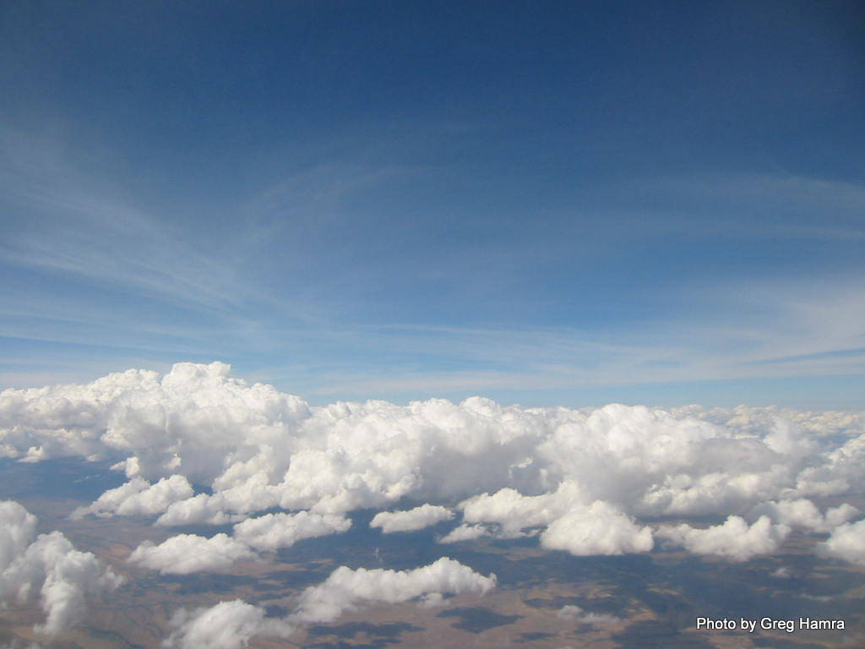
Cloud feedbacks
Clouds double the Earth’s albedo.
Increased evaporation is expected to increase cloud cover on average.
Under global warming, models predict changing cloud distributions.
Increased cloud cover increases the reflection of solar radiation from the Earth’s surface but it can also increase the net long-wave radiation emitted downward from the same clouds back to the surface.
The net effect of decreased incoming solar radiation combined with a potential increase in the amount of reflected outgoing longwave radiation is very uncertain and a primary uncertainty in predicting future climate change.

Slide 5
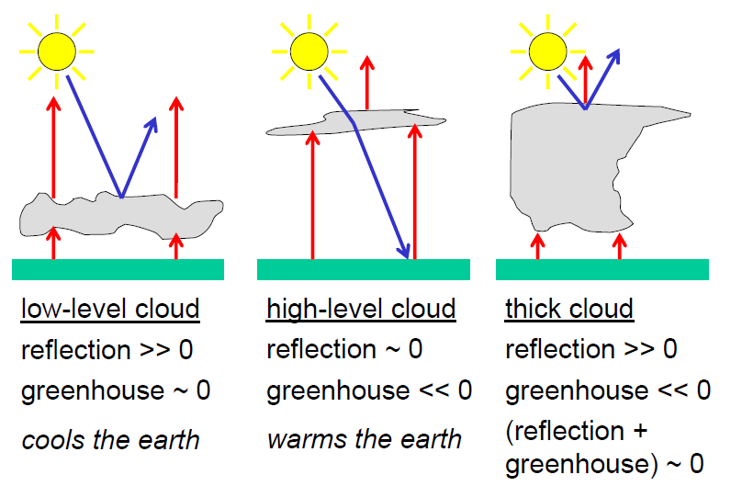
Cloud feedbacks
T low
T high

Slide 6
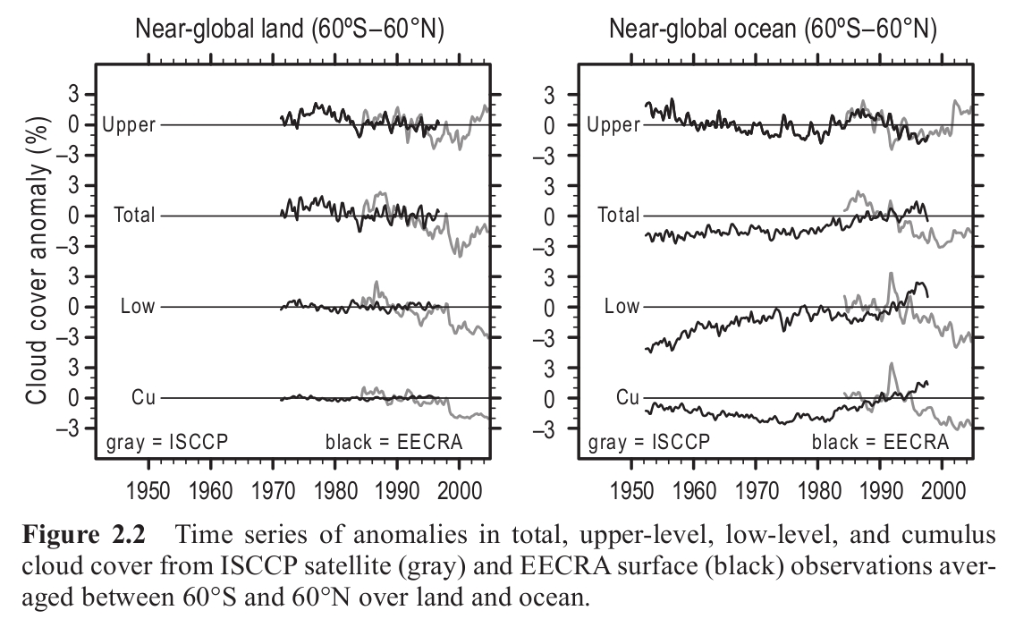
Cloud feedbacks
Hugo and Slingo (2009)

Slide 7
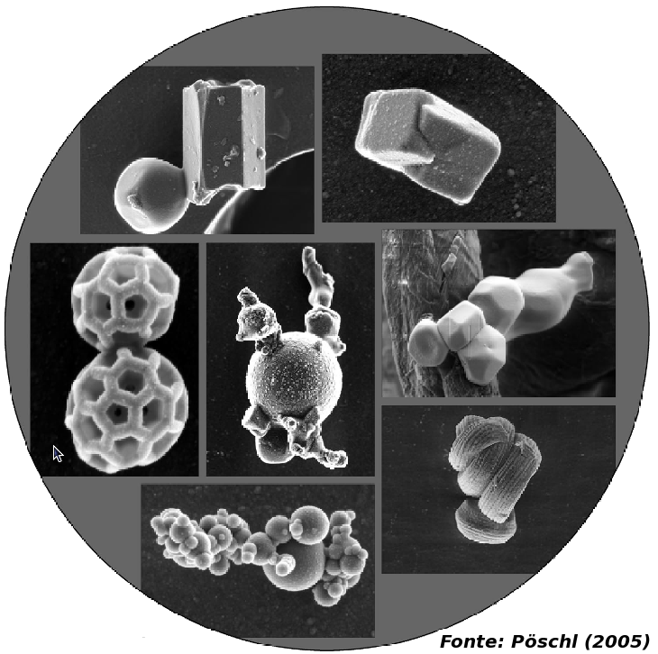
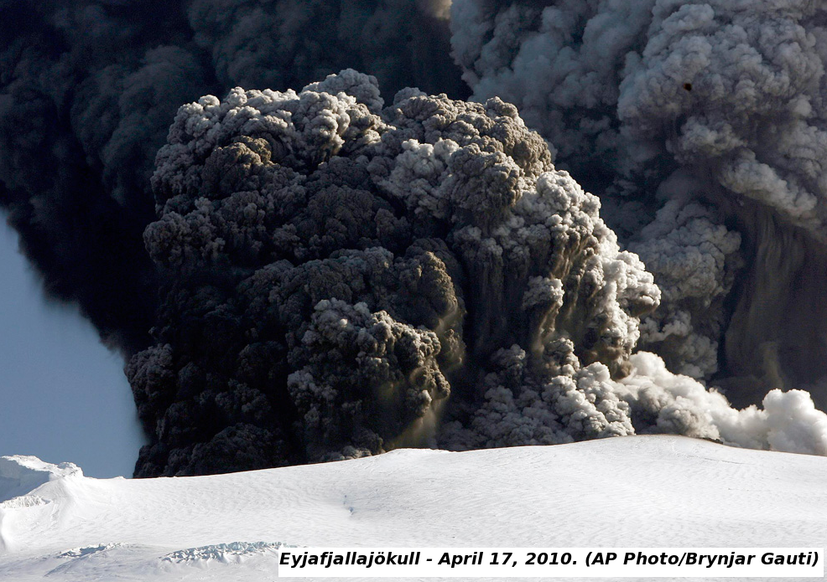
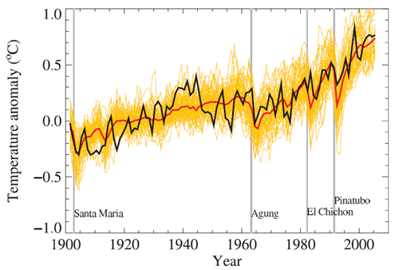
Direct effect of aerosols
Aerosols are tiny solid and liquid airborne particles. Sizes range 0.01 μm to 10 μm.
  Natural Volcanoes; sea salt; desert dust; plant emitted Volatile Organic Compunds (VOC's)
Anthropogenic Biomass burning for agricultural purposes or hunting; food preparation; industry; transport
Notes:
11-07-15
7

Slide 8

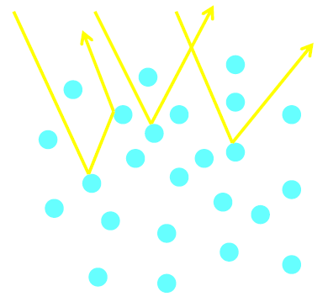
Indirect effect of aerosols
Normal
Small number of cloud condensation nuclei
Small number of large cloud droplets
Relatively low reflectivity
With Anthropogenic Emissions
Higher number of cloud condensation nuclei
Higher number of small cloud droplets
Relatively high reflectivity

Slide 9
Aims of Today’s Lecture
Examine historical climate records to understand recent changes in the climate system
Discuss climate change skepticism
Introduce the concepts of detection and attribution

Slide 10
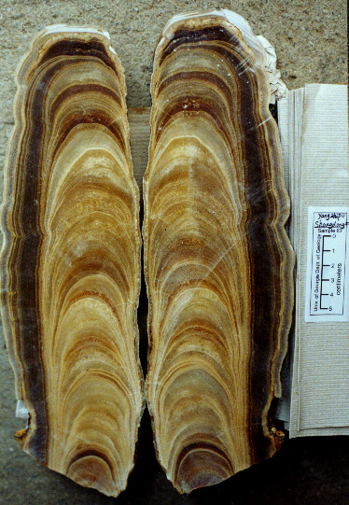
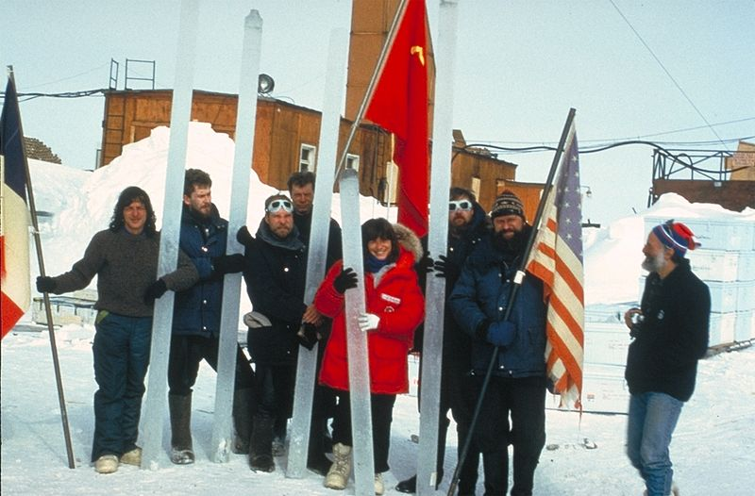
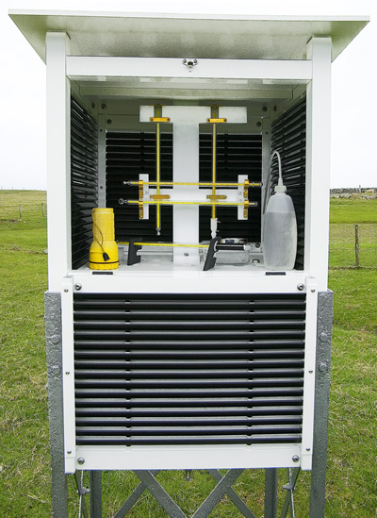
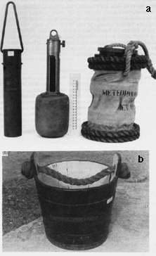
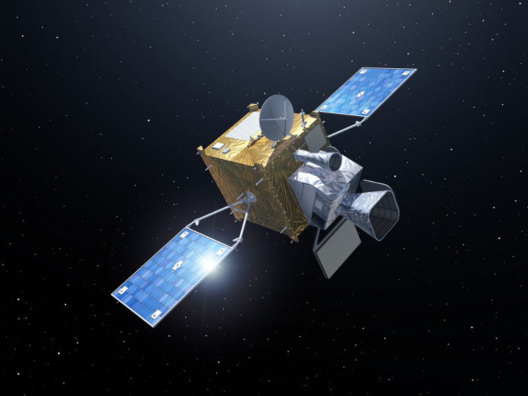
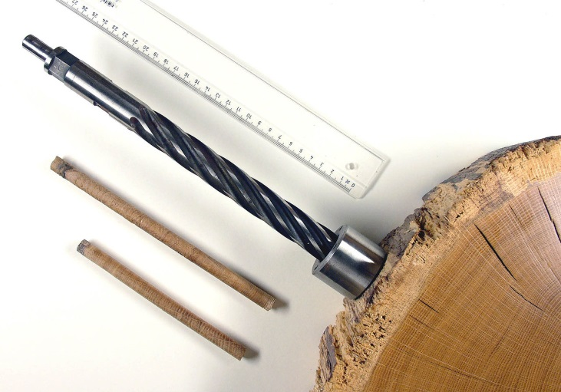
Instrumentation

Slide 11
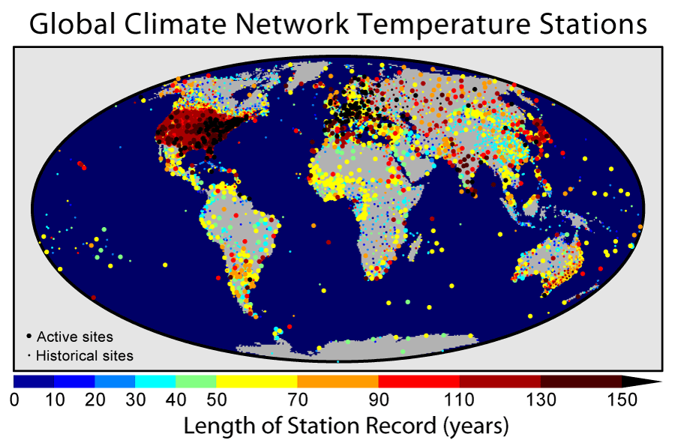
Coverage

Slide 12
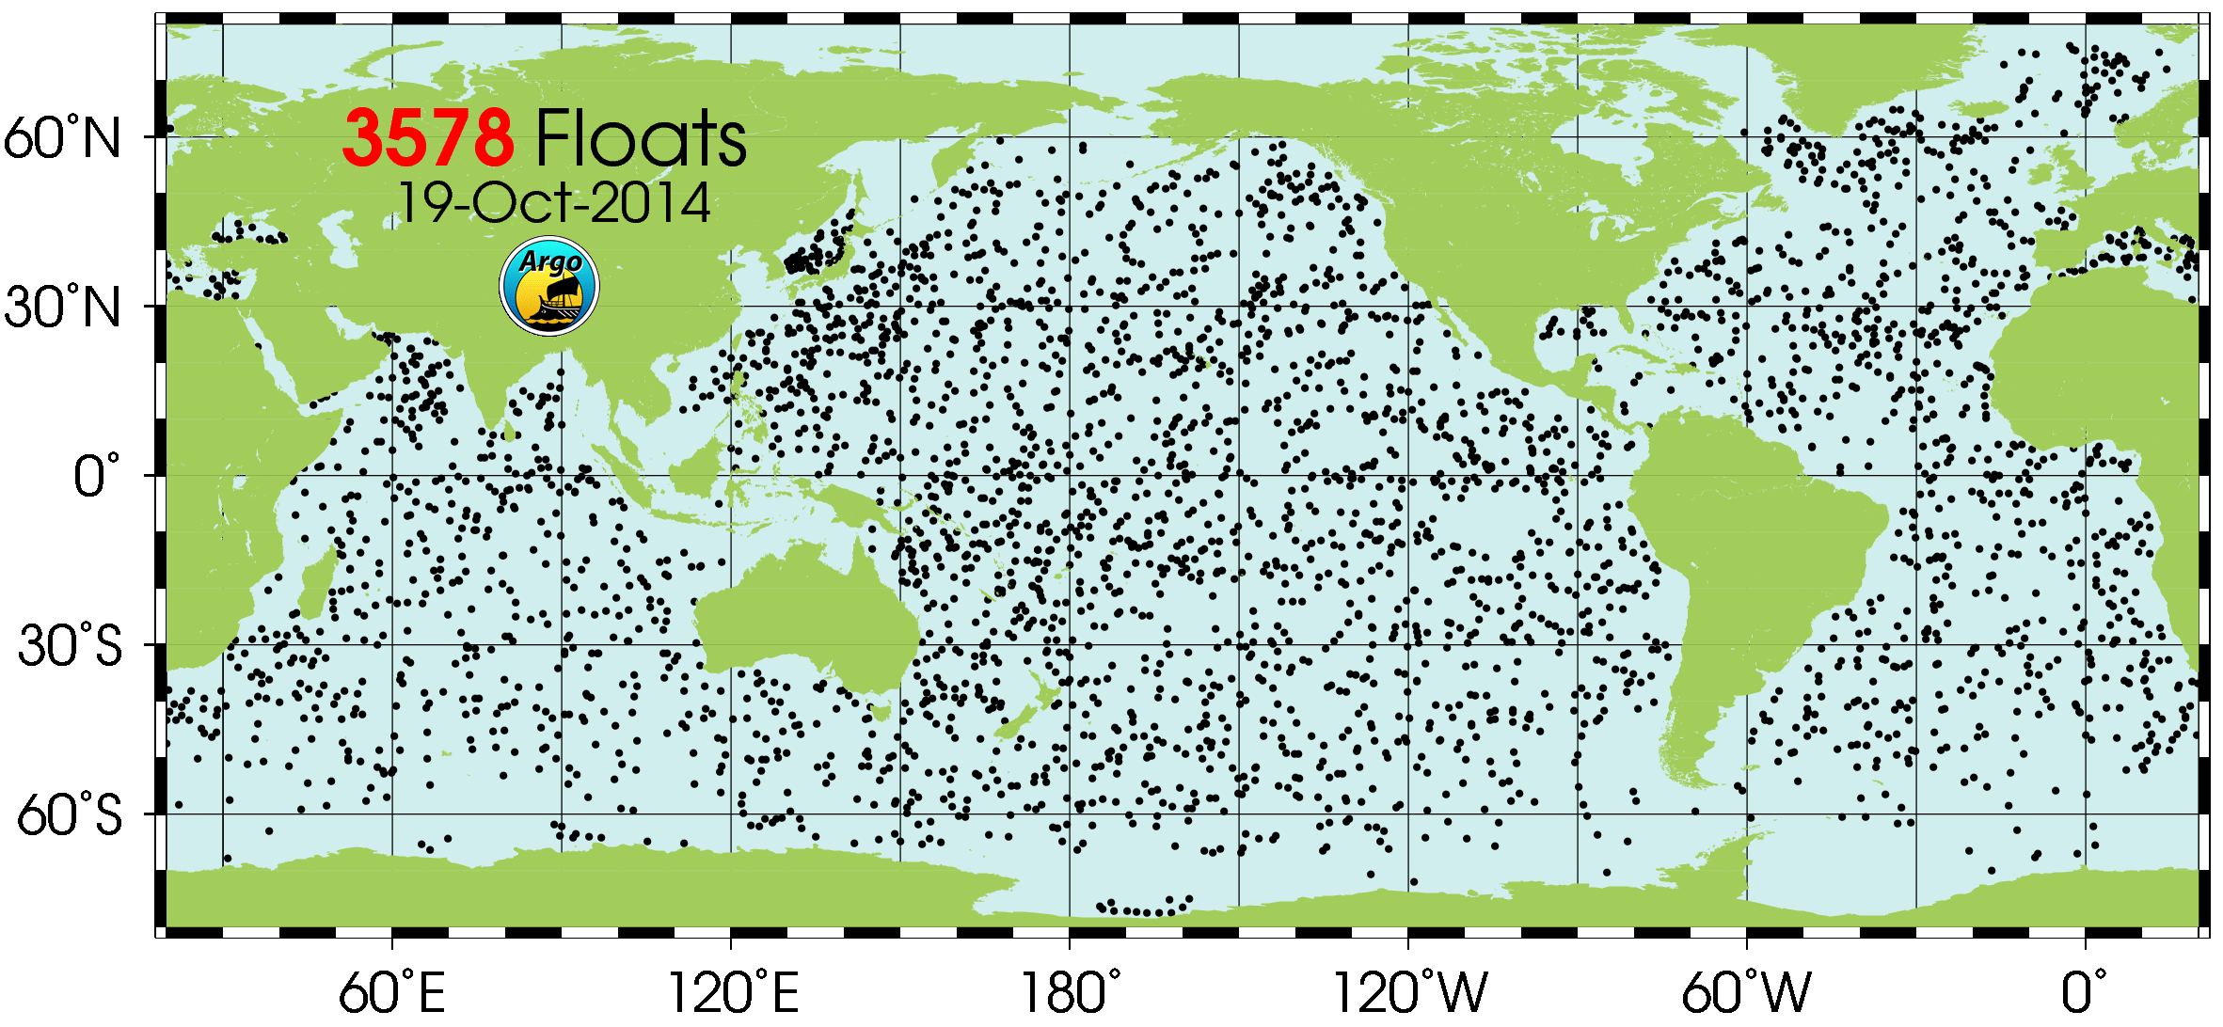
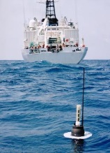
Coverage
Argo is a global array of free-drifting profiling floats providing continuous monitoring of the temperature, salinity, and velocity of the upper ocean, with all data being relayed and made publicly available within hours after collection. Most of the data only goes back 10 or 15 years.

Slide 13
A Song of Our Warming Planet
University of Minnesota https://www.youtube.com/watch?v=5t08CLczdK4

Slide 14
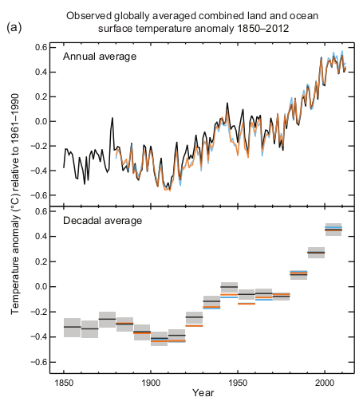
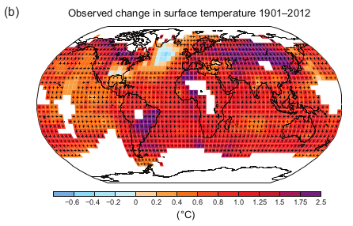
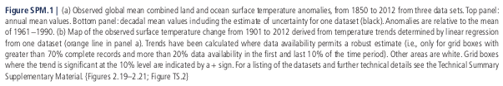
Temperature trends

Slide 15
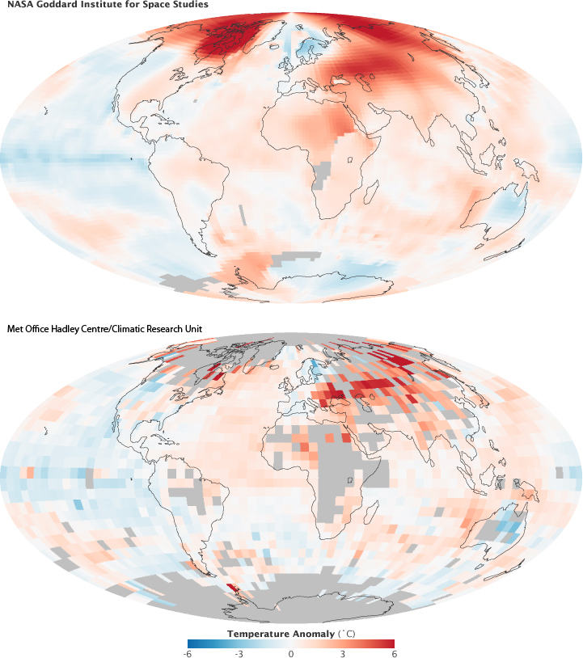
Temperature trends

Slide 16
NASA GISS
Animation
The temperature analysis produced at GISS is compiled from weather data from more than 1,000 meteorological stations around the world, satellite observations of sea-surface temperature, and Antarctic research station measurements, taking into account station history and urban heat island effects.
Software is used to calculate the difference between surface temperature in a given month and the average temperature for the same place from 1951 to 1980. This three-decade period functions as a baseline for the analysis.

Slide 17
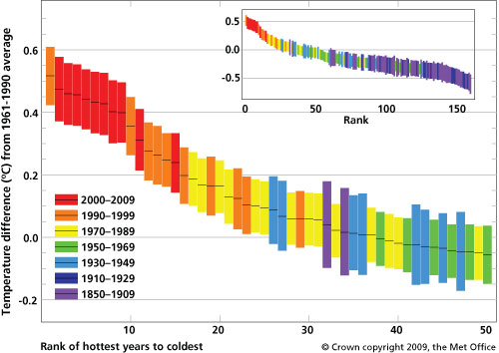
Temperature trends
"As a result of climate change, what would once have been an exceptionally unusual year has now become quite normal. Without human influence on climate change we would be more than 50 times less likely of seeing a year as warm as 2008." Peter Stott, Met Office

Slide 18
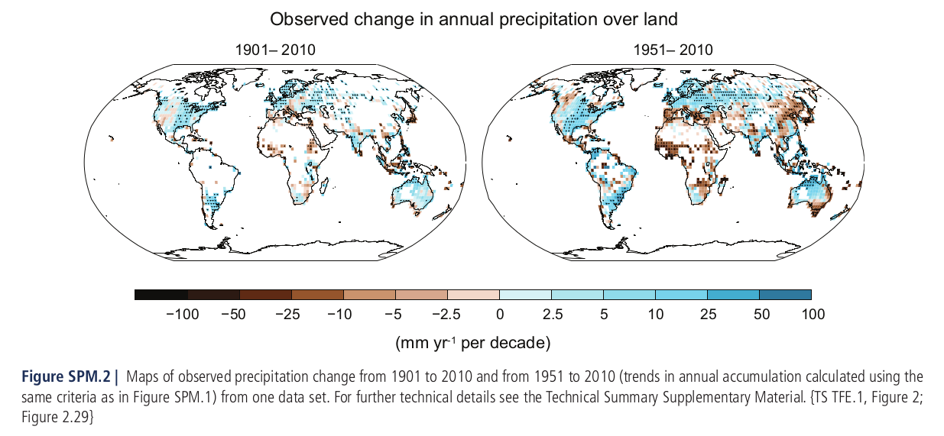
Precipitation trends

Slide 19
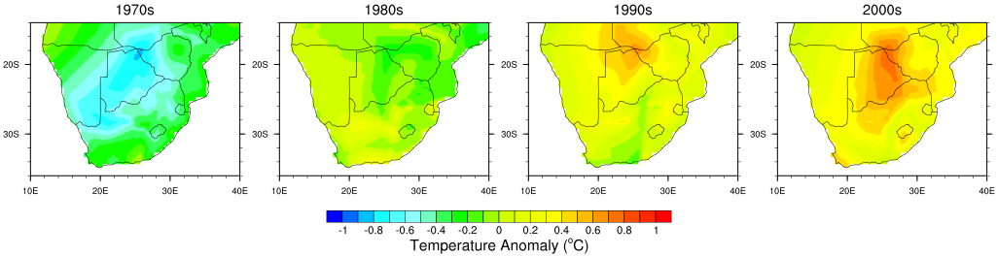
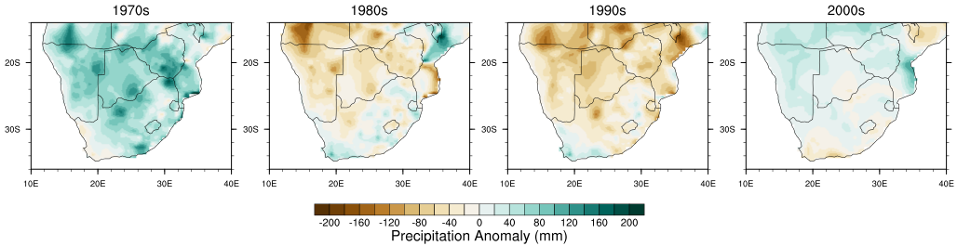
Regional scale changes
Difference between decadal mean and 1963 to 2012 mean annual a) rainfall totals, and b) temperatures, for each grid cell.
Data taken from the CRU TS3.1 dataset.

Slide 20
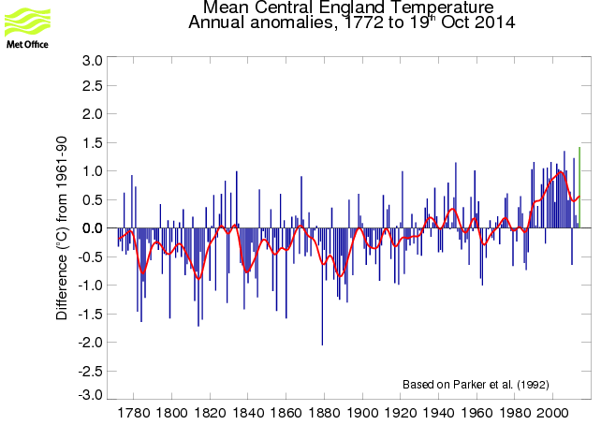
A little closer to home
These daily and monthly temperatures are representative of a roughly triangular area of the United Kingdom enclosed by Lancashire, London and Bristol. The monthly series, which begins in 1659, is the longest available instrumental record of temperature in the world. The daily series begins in 1772.
http://www.metoffice.gov.uk/hadobs/hadcet/

Slide 21
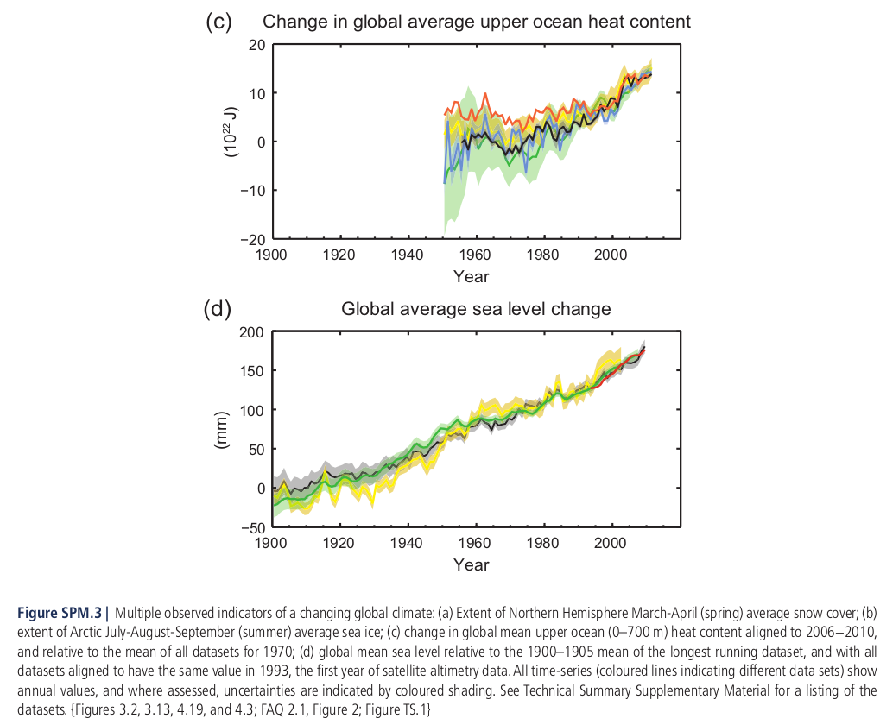
The Oceans

Slide 22
The Oceans
Ocean warming dominates the increase in energy stored in the climate system, accounting for more than 90% of the energy accumulated between 1971 and 2010 (high confidence). It is virtually certain that the upper ocean (0−700 m) warmed from 1971 to 2010 (see Figure SPM.3), and it likely warmed between the 1870s and 1971.
The rate of sea level rise since the mid-19th century has been larger than the mean rate during the previous two millennia (high confidence). Over the period 1901 to 2010, global mean sea level rose by 0.19 [0.17 to 0.21] m.
IPCC AR5

Slide 23
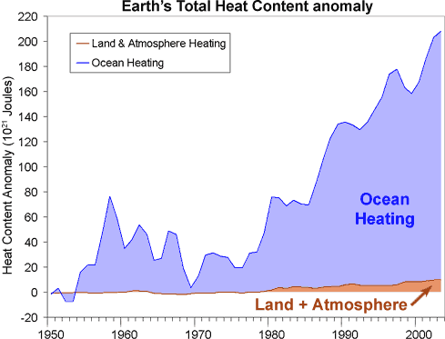
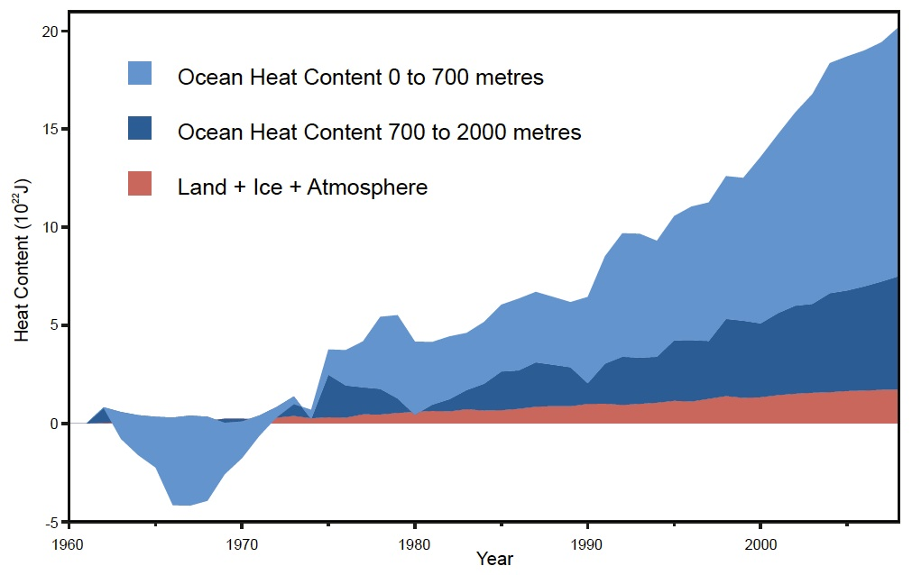
Total Earth Heat Content anomaly from 1950 (Murphy 2009). Ocean data taken from Domingues et al 2008. Land + Atmosphere includes the heat absorbed to melt ice.
Nuccitelli et al (2012)

Slide 24
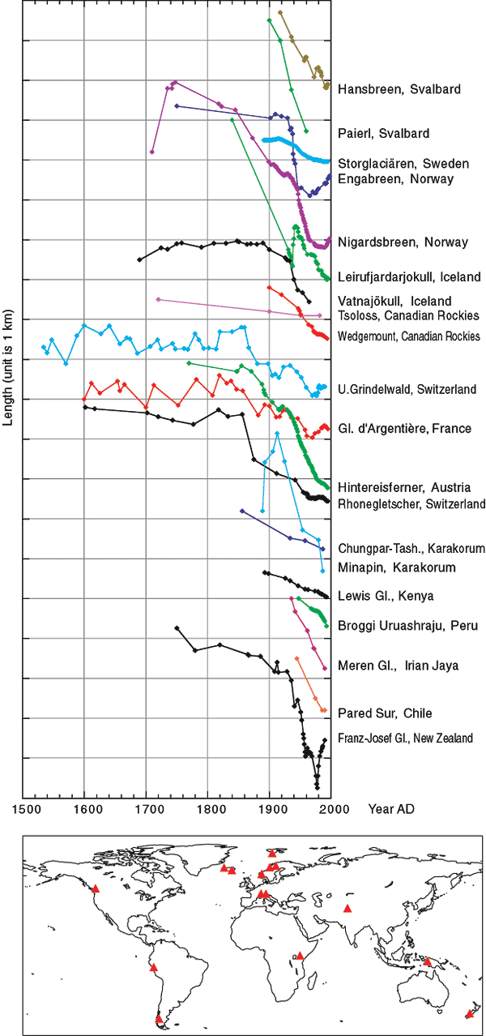
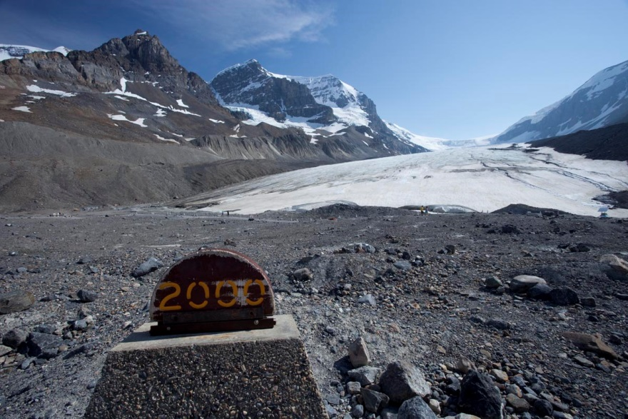
Glaciers
Athabasca Glacier, Canadian Rockies

Slide 25
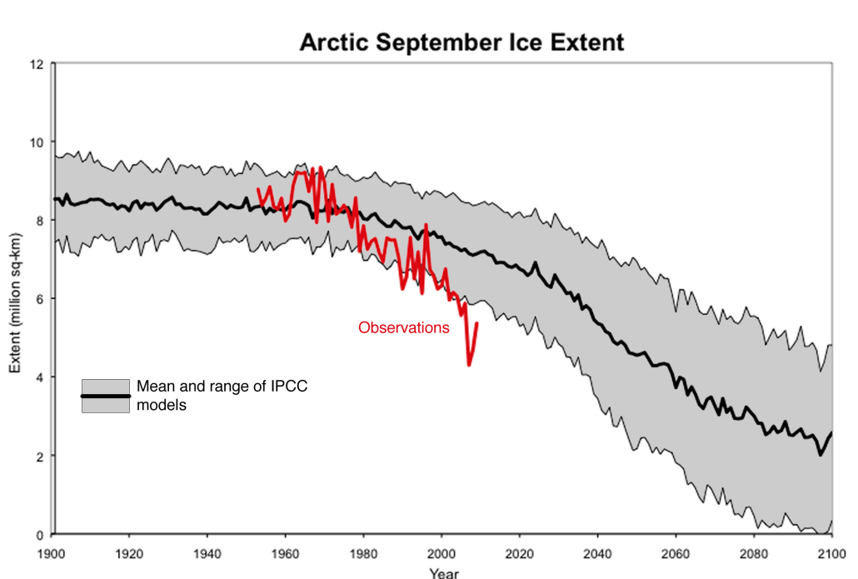
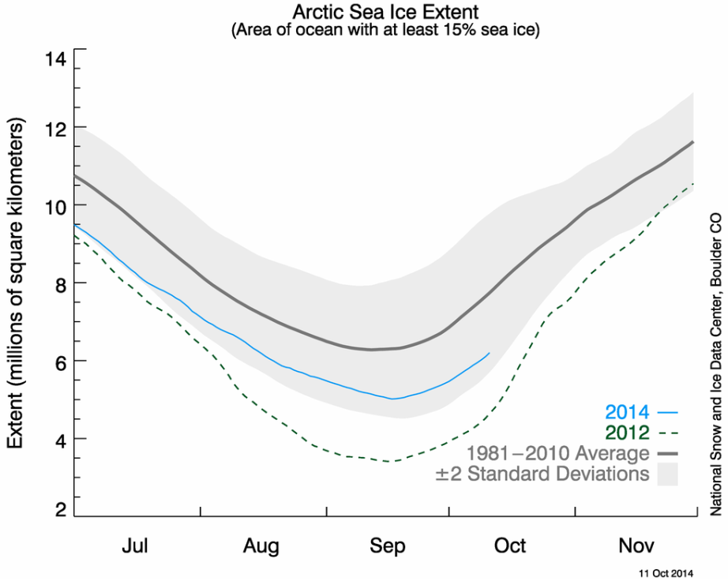
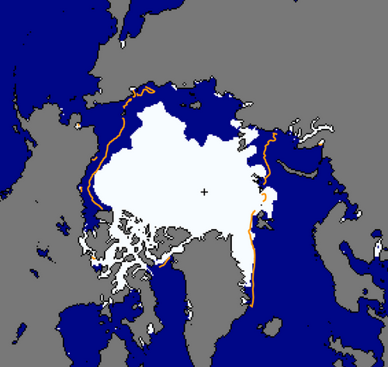

Arctic Sea Ice
Stroeve et al 2012, GRL
NSIDC

Slide 26
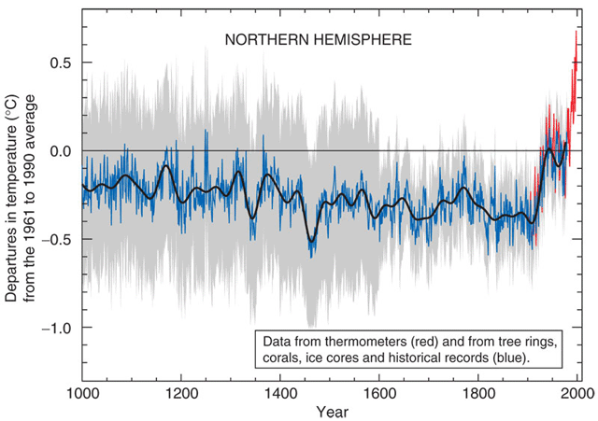

The "hockey stick" graph was the result of the first comprehensive attempt to reconstruct the average northern hemisphere temperature over the past 1000 years, based on numerous indicators of past temperatures. It was first Published in 1999 by Michael Mann and subsequently adapted for IPCC TAR.

Slide 27
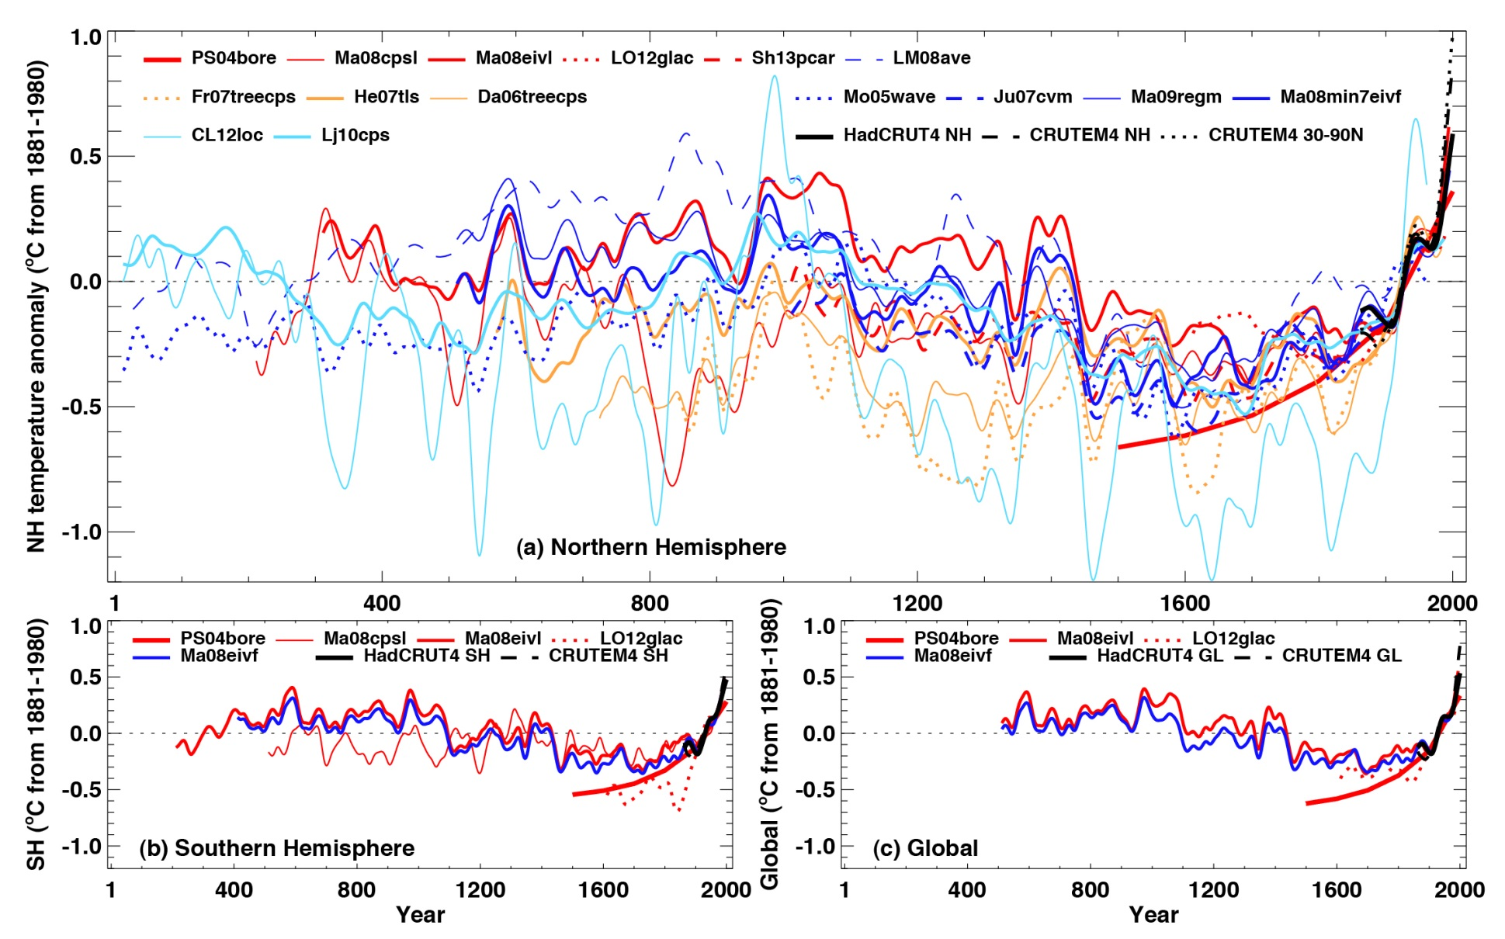
IPCC AR5 WG1, Chapter 5: Figs 5 to 7
Issues in tree ring data reliability at the end of the 20th century
D’Arrigo et al (2008) On the ‘divergence problem’ in northern forests: a review of the tree-ring evidence and possible causes. Glob. Planet. Change 60, 289–305

Slide 28
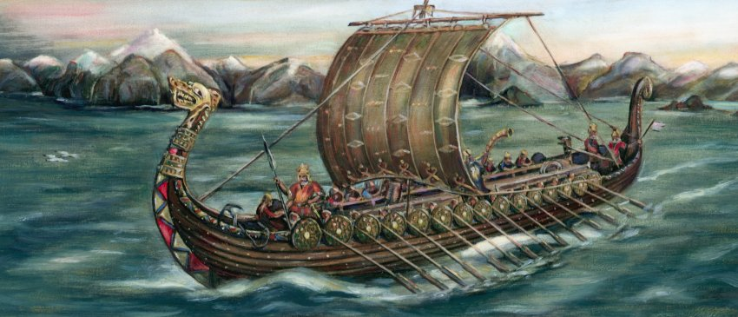
“Medieval Warm Period”
The Medieval Warm Period (MWP) is generally thought to have occurred from about AD 950–1250.
Studies suggest it was largely confined to Europe, the North Atlantic and Greenland and some regions of the Eurasian Arctic (Mann et al 2009, Science 302 5957).
Global temperature records taken from ice cores, tree rings, and lake deposits, have shown that, taken globally, the Earth may have been slightly cooler (by 0.03 degrees Celsius) during the 'Medieval Warm Period' than in the early and mid-20th century (Bradley et al 2003, Science 302, 5644).

Slide 29
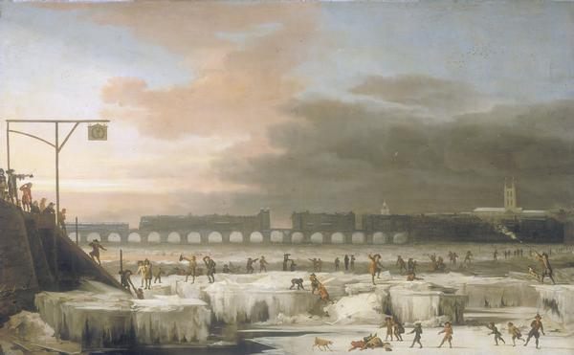
“Little Ice Age”
NASA defines the term as a cold period between AD 1550 and 1850 and notes three particularly cold intervals: one beginning about 1650, another about 1770, and the last in 1850, each separated by intervals of slight warming.
Several causes have been proposed: cyclical lows in solar radiation, heightened volcanic activity, changes in the ocean circulation, an inherent variability in global climate, or decreases in the human population.
The jury is still out on whether this event was global, with only anecdotal evidence supporting similar periods of cooling in the southern hemisphere.

Slide 30
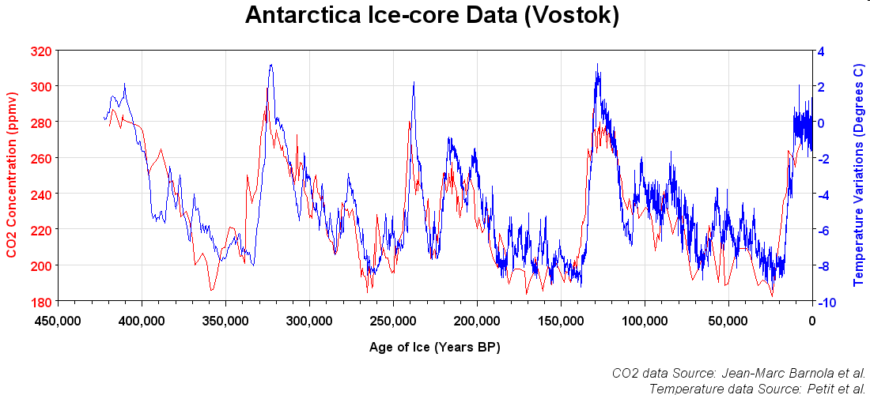
Paleoclimate perspective

Slide 31
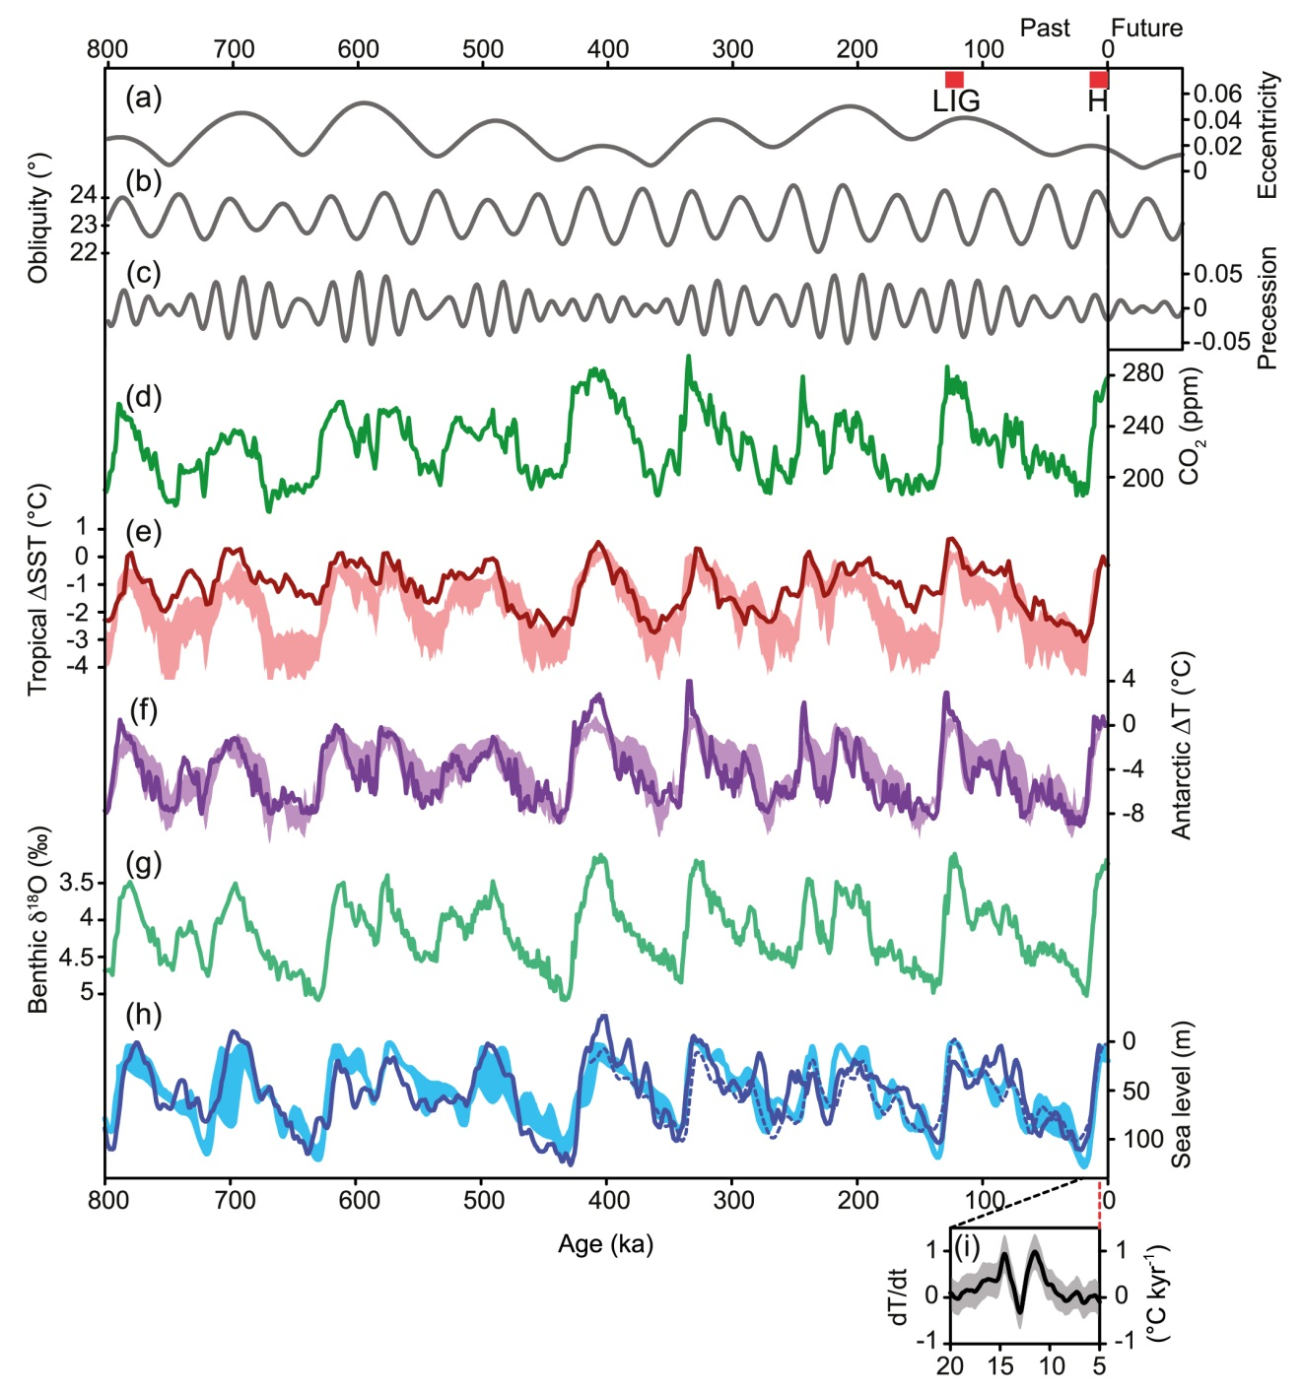
Paleoclimate perspective
IPCC AR5 WG1, Figure 5.3
Orbital parameters and proxy records over the past 800,000 years. (a) Eccentricity. (b) Obliquity. (c) Precessional parameter (Berger and Loutre, 1991). (d) Atmospheric concentration of CO2from Antarctic ice cores (e) Tropical sea surface temperature stack (f) Antarctic temperature stack based on up to seven different ice cores (g) Stack of benthic d18O, a proxy for global ice volume and deep-ocean temperature (h) Reconstructed sea level (dashed line). Lines represent orbital forcing and proxy records, shaded areas represent the range of simulations with climate models, climate–ice sheet models of intermediate complexity and an ice sheet model forced by variations of the orbital parameters and the atmospheric concentrations of the major greenhouse gases. (i) Rate of changes of global mean temperature during Termination I based on Shakun et al. (2012)

Slide 32
Climate change skepticism and denialism

Slide 33
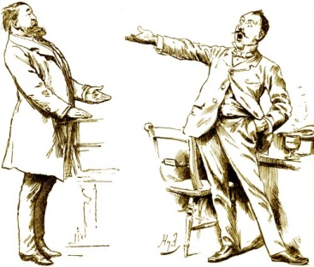
Cynics and believers

Slide 34
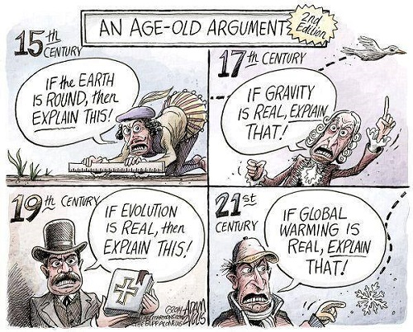
http://www.skepticalscience.com/

Slide 35
“Cli­mate change scep­ti­cism will not be over­come by a more forceful presentation of the sci­ence.”
“One of the reasons we disagree about climate change is that we receive multiple and conflicting messages about climate change and we interpret them in different ways.”
Mike Hulme (2009) Why we disagree about climate change
The Guardian: The H Word
http://www.theguardian.com/science/the-h-word/2013/mar/07/how-to-argue-with-sceptics-and-deniers

Slide 36
Useful resources that address climate change skepticism
“Genuine skepticism means considering the full body of evidence before coming
to a conclusion.”
The Scientific Guide to Global Warming Skepticism, John Cook, skepticalscience.com
PDF copy in course material
http://www.skepticalscience.com/argument.php
http://www.carbonneutral.com.au/climate-change/10-myths.html
http://talkingclimate.org/guides/beyond-climate-science-why-people-are-still-skeptical-of-climate-change/

Slide 37
Detection and Attribution
Detection of climate change is the process of demonstrating that climate has changed in some defined statistical sense, without providing a reason for that change.
Attribution of causes of climate change is the process of establishing the most likely causes for the detected change with some defined level of confidence.
IPCC AR4
In order to attribute global warming to anthropogenic emissions, 2 conditions must be met:
1) It must be demonstrated that the detected change is consistent with
computer model simulations of the climate change ‘signal’ that is
calculated to occur in response to anthropogenic forcing.
2) It must be demonstrated that the detected change is not consistent with
alternative, physically plausible explanations of recent climate change that
exclude important anthropogenic forcings.

Slide 38
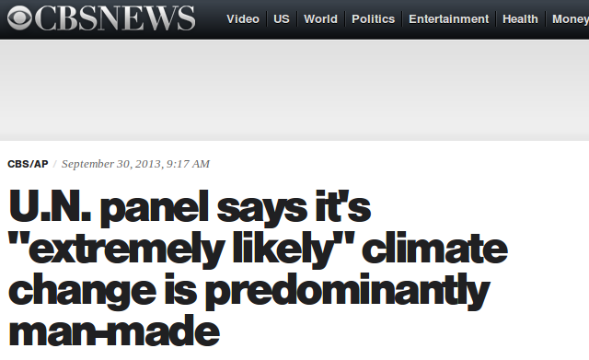
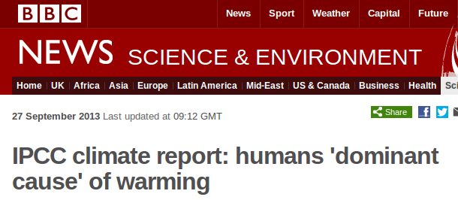
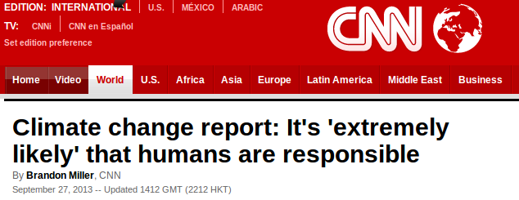
Key attribution messages – IPCC AR5
“It is extremely likely that human influence has been the dominant cause of the observed warming since the mid-20th century.”

Slide 39
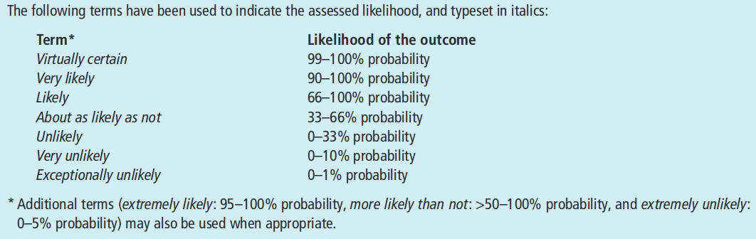
Key attribution messages – IPCC AR5
“It is extremely likely that human influence has been the dominant cause of the observed warming since the mid-20th century.”

Slide 40
Key attribution messages – IPCC AR5
“Greenhouse gases contributed a global mean surface warming likely to be in the range of 0.5°C to 1.3°C over the period 1951 to 2010, with the contributions from other anthropogenic forcings, including the cooling effect of aerosols, likely to be in the range of −0.6°C to 0.1°C. The contribution from natural forcings is likely to be in the range of −0.1°C to 0.1°C, and from natural internal variability is likely to be in the range of −0.1°C to 0.1°C. Together these assessed contributions are consistent with the observed warming of approximately 0.6°C to 0.7°C over this period.”
“Over every continental region except Antarctica, anthropogenic forcings have likely made a substantial contribution to surface temperature increases since the mid-20th century (see Figure SPM.6). For Antarctica, large observational uncertainties result in low confidence that anthropogenic forcings have contributed to the observed warming averaged over available stations.”

Slide 41
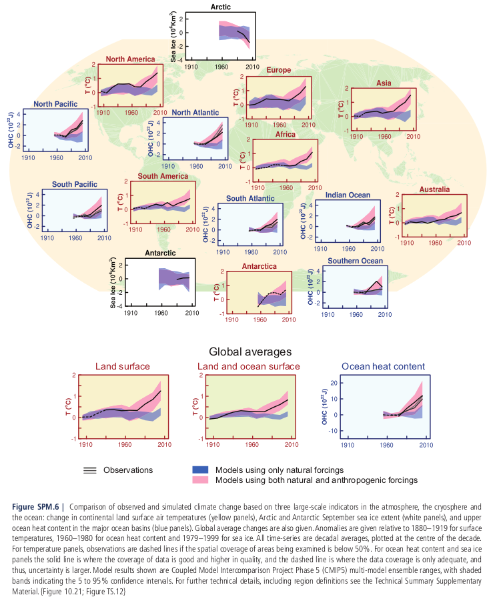

Slide 42
Summary
  Temperatures across the world have risen over the past 150 years to levels not seen for many centuries, if not thousands of years.
  The increase in temperature and energy in the climate system is also affecting other climate variables – e.g. sea level, precipitation.
  Scepticism is a natural, and often helpful, attitude towards interrogating scientific data.
  However, climate change scepticism is largely unfounded and routed in externally applied belief systems.
  Detection and attribution is a critical component of climate science and has significant implications for the design of policy interventions.

Slide 43
Course Material
https://www.ole.bris.ac.uk/bbcswebdav/courses/GEOGM1405_2014
FAQs
See you in two weeks - 4st November!
http://www.csag.uct.ac.za/~jdaron/GEOGM1405_FAQ.html
email: jdaron@csag.uct.ac.za

