Slide 1
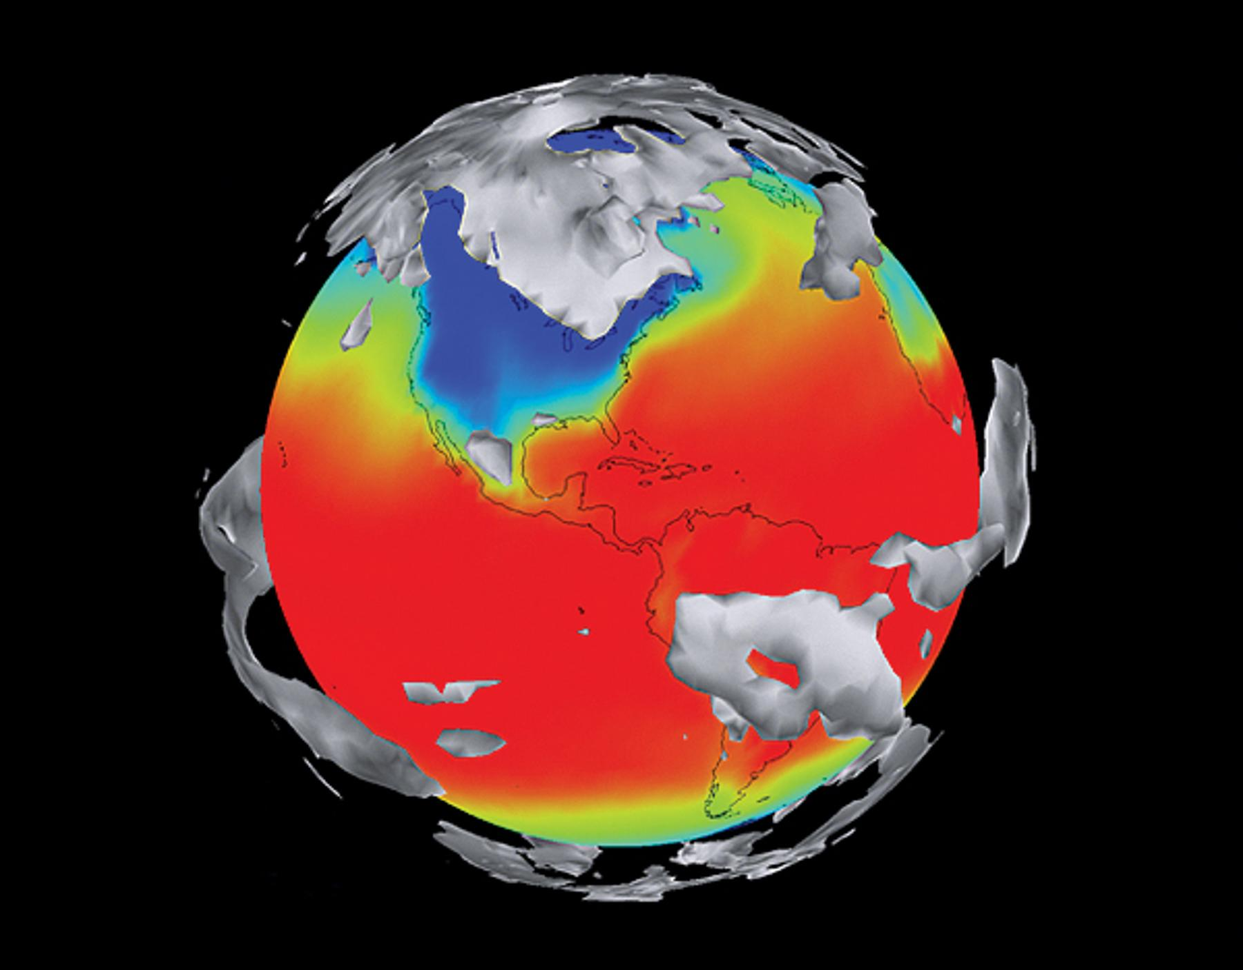
GEOGM1405
Climate Change: Science and Impacts
WEEK 4
Climate modeling
and uncertainties in climate prediction

Slide 2
Course Material
https://www.ole.bris.ac.uk/bbcswebdav/courses/GEOGM1405_2014
FAQs
http://www.csag.uct.ac.za/~jdaron/GEOGM1405_FAQ.html
email: jdaron@csag.uct.ac.za

Slide 3
9am to 11am in the Haggett Lab
Next week’s session:
Assignment 1 – Climate Modeling Practical

Slide 4
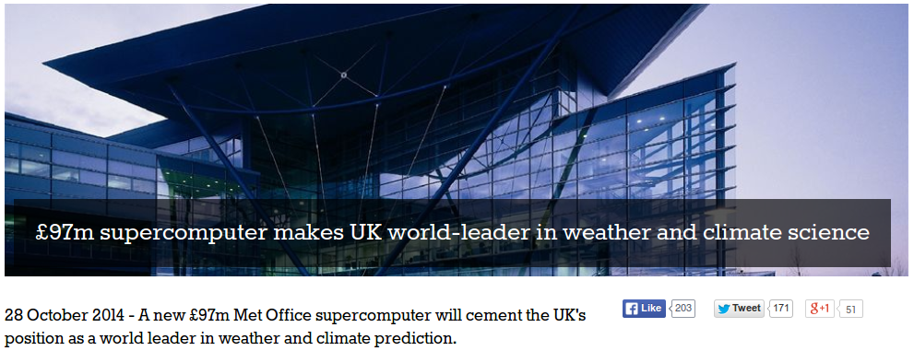
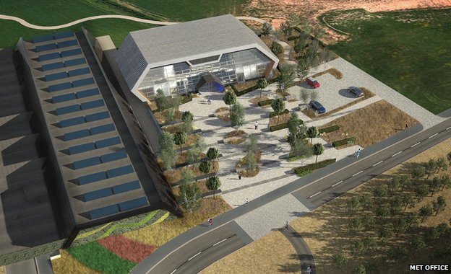

Slide 5
Aims of Today’s Lecture
Explain what we mean by a “climate model”
Describe the main components of a climate model
Understand key uncertainties in modeling the climate system
Consider the relevance of model projections for understanding climate change impacts and responses

Slide 6
What is a climate model?

Slide 7

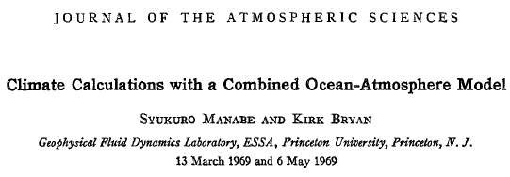
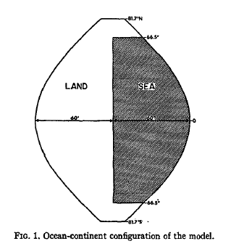
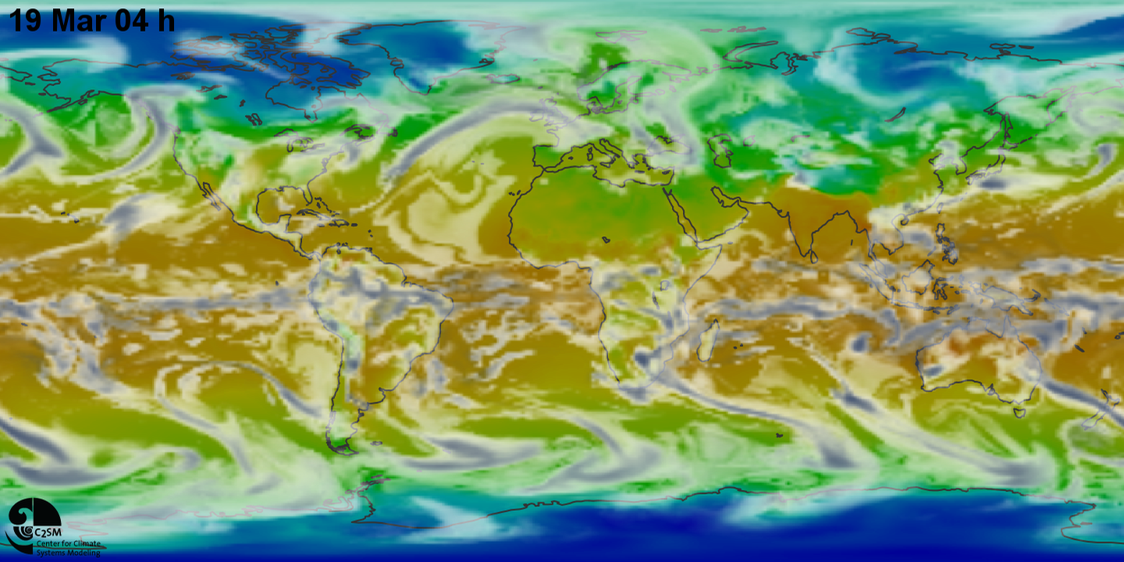
1960s - Syukuro Manabe: pioneered the use of computers to simulate global climate change and natural climate variations
Today’s state-of-the-art models – e.g. ETH, Zurich
https://www.youtube.com/watch?v=YlT6mJzNqEQ
Notes:
The development of computers has paralleled the development of NWP and climate science

Slide 8
Types of climate models
Simple climate models (Zero-dimensional or energy balance models)
Radiative-Convective Models
Earth-system Models of Intermediate Complexity (EMICs)
General Circulation Models / Global Climate Models (GCMs)
Coupled Atmosphere Ocean GCMs (AO-GCMs)
Earth System Models (ESMs)
Regional Climate Models (RCMs)
Notes:
Different degrees of complexity

Slide 9
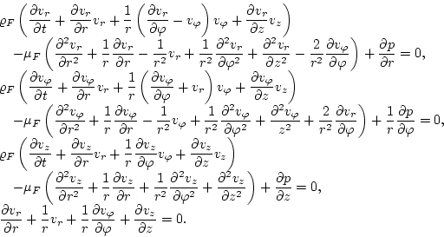
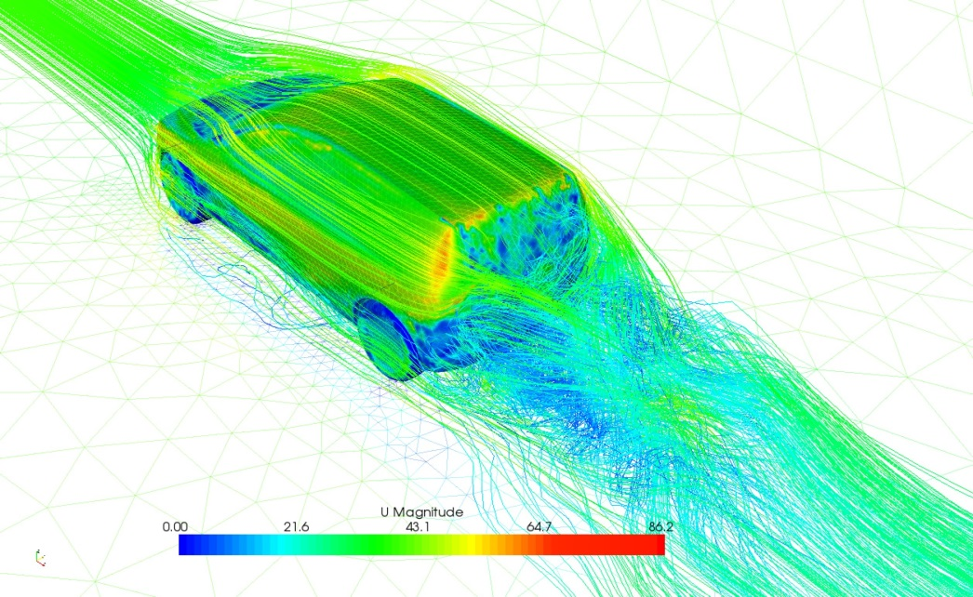
The Importance of Maths
The Navier-Stokes Equations
Notes:
Different degrees of complexity

Slide 10
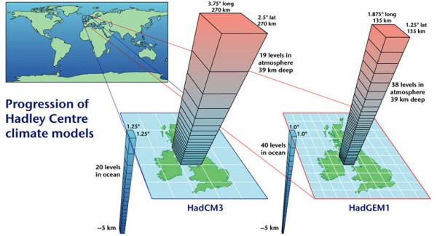
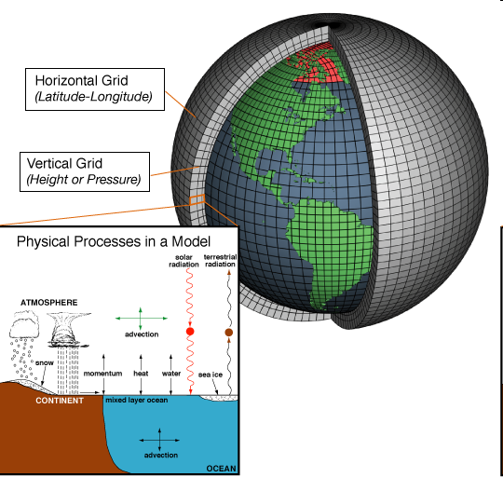
General circulation models (GCMs)
GCMs are mathematical models of the general circulation of a planetary atmosphere based on the Navier–Stokes equations on a rotating sphere

Slide 11
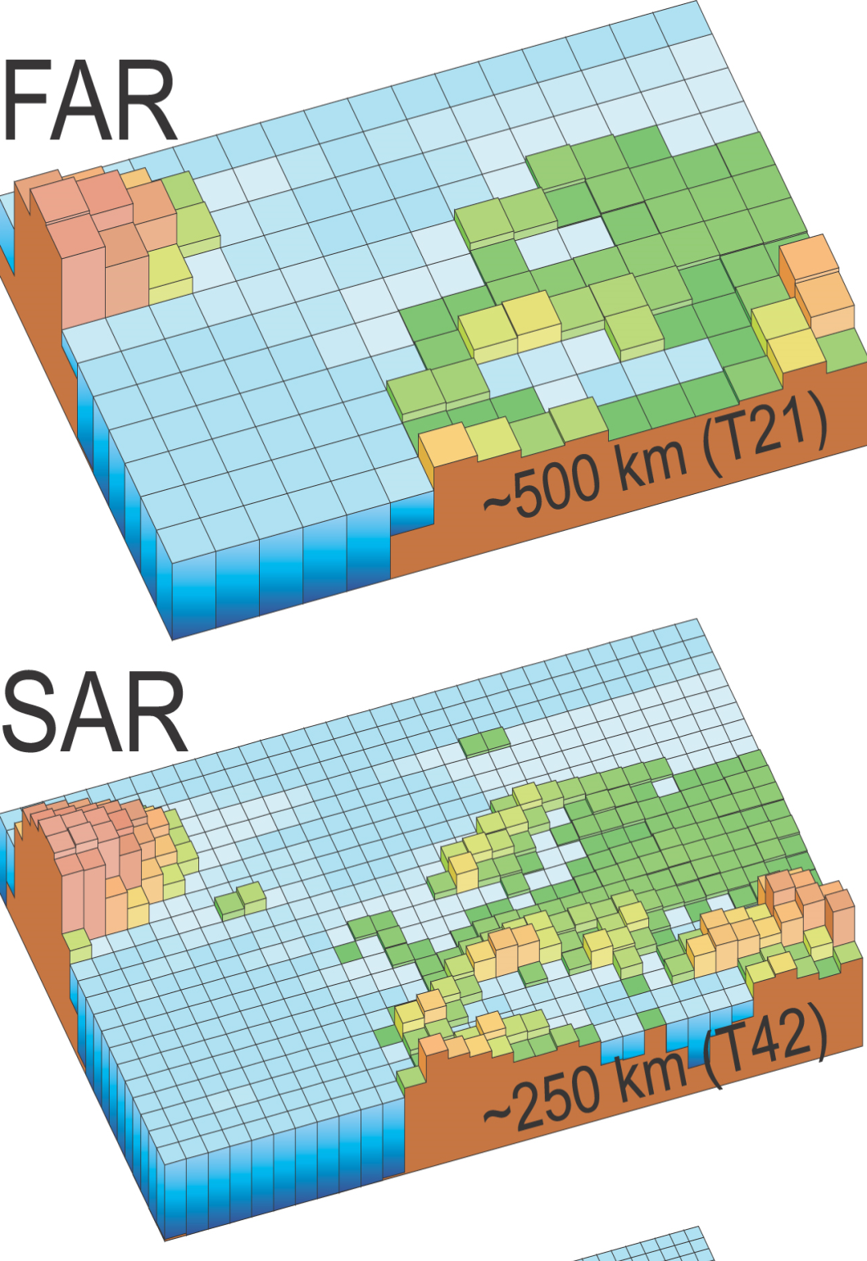


Slide 12
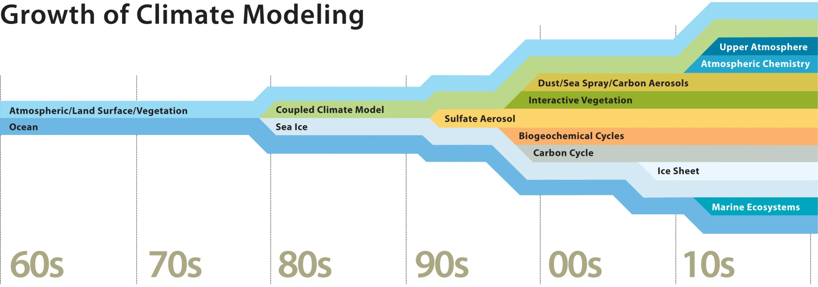
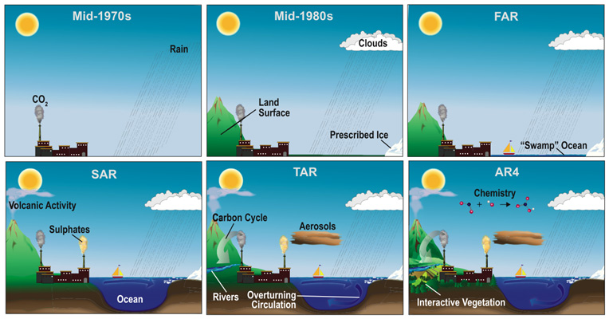
www2.ucar.edu/climate
Notes:
12

Slide 13
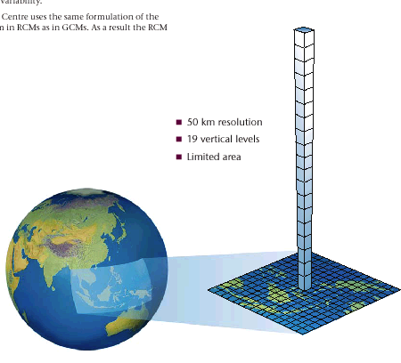
Regional Climate Models
Full climate model representing the physical processes (land and atmosphere) as in a GCM
Takes account of local characteristics e.g. mountains, coasts, inland waters
Better regional detail and extremes in weather
Driven at its boundaries by output from a GCM
Smaller domain (typically 5000 x 5000km)
Finer resolution (50-25km)

Slide 14
Model Experimental Design
CMIP5 – Coupled Model Intercomparison Project phase 5
CMIP5 promotes a standard set of model simulations in order to:
evaluate how realistic the models are in simulating the recent past,
provide projections of future climate change on two time scales, near term (out to about 2035) and long term (out to 2100 and beyond), and
understand some of the factors responsible for differences in model projections, including quantifying some key feedbacks such as those involving clouds and the carbon cycle
CMIP5 projections are a critical component of the IPCC AR5 report.

Slide 15
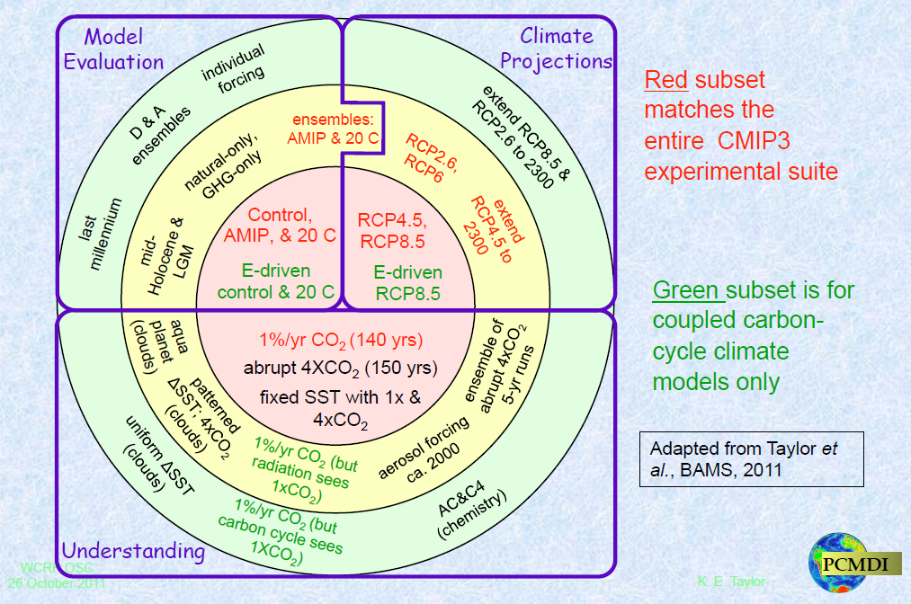
Model experiment Design
http://cmip-pcmdi.llnl.gov/cmip5/docs/Taylor_CMIP5_design.pdf

Slide 16
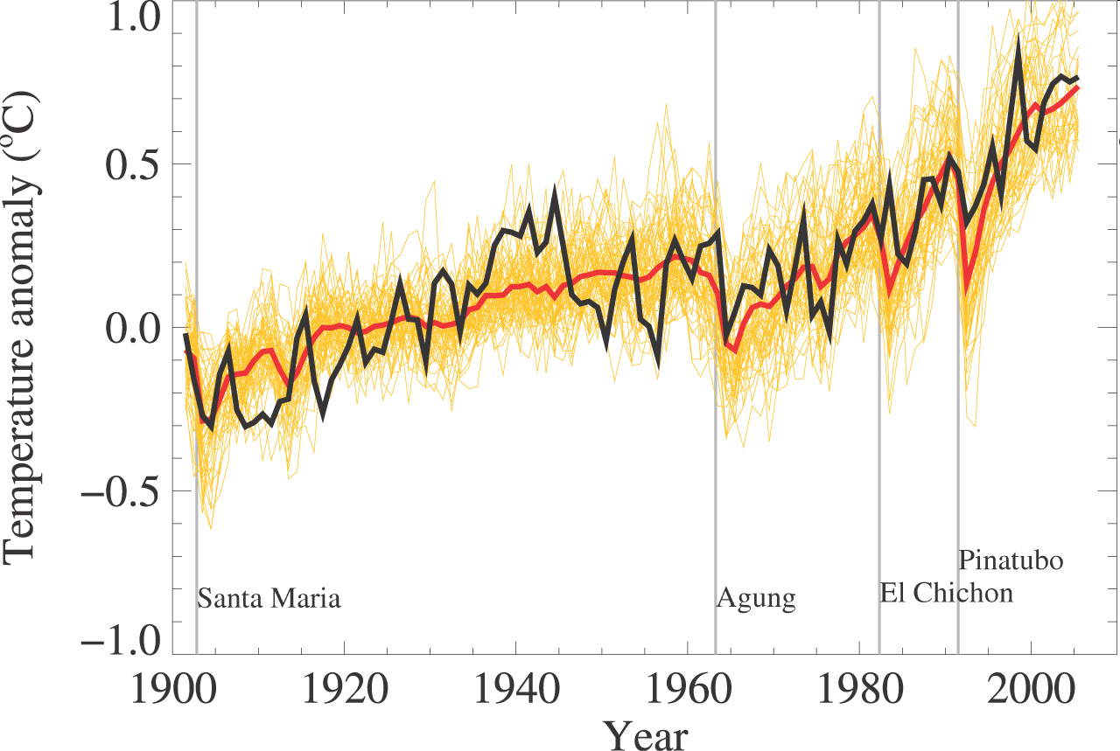
Strengths of climate models
Based on physical laws/equations (Navier Stokes Equations) and dynamical cores are subject to strict tests
Developed from weather forecast models which have proven skill in simulating atmospheric circulation
Capable of simulating important aspects of current and past climate
IPCC, AR4

Slide 17
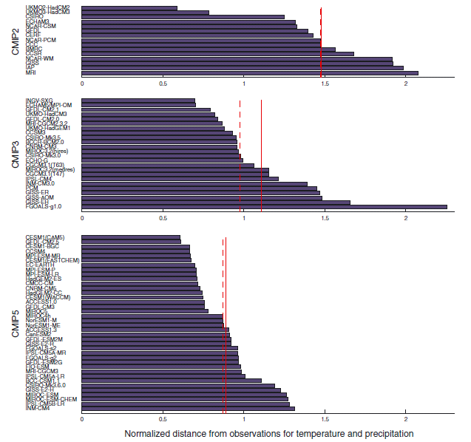
Model performance
Knutti et al 2013 GRL

Slide 18
Limitations of climate models
Significant systematic errors and deficiencies (tropical precipitation, ENSO, ice sheets)
Important small-scale processes, such as convection, cannot be explicitly resolved on coarse resolutions
Verification not possible: validation relies on using the observed record which is in sample
“Nevertheless, models have consistently provided a robust and unambiguous picture of significant climate warming in response to increasing greenhouse gases” (IPCC AR4, 2007)

Slide 19
Interpreting climate model output
What does each graph show?
What are the projected changes for Europe, and specifically the UK?
How confident are you in these changes?
What additional information might you need to aid the interpretation?
Construct a single sentence to communicate a “climate change message” for the UK based on the model projections. Aim the message at local government planning authorities.
http://www.ipcc-data.org/maps/

Slide 20
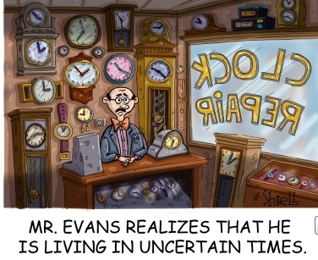
In climate prediction, we have to deal with: uncertainty

Slide 21

Certainty
If we have:
A perfect model AND
Perfect initial observations
…then, and only then, can we make statements of certainty.
e.g. Probability of getting a 1 = 0
Probability of getting a 2 = 0
Probability of getting a 3 = 1
Probability of getting a 4 = 0
Probability of getting a 5 = 0
Probability of getting a 6 = 0
Uncertainty
If we have:
A perfect model AND
Imperfect initial observations
…then the best we can do is make probabilistic statements.
e.g. Probability of getting a 1 = 1/6
Probability of getting a 2 = 1/6
Probability of getting a 3 = 1/6
Probability of getting a 4 = 1/6
Probability of getting a 5 = 1/6
Probability of getting a 6 = 1/6

Slide 22
Deeper uncertainty
If we have:
An imperfect model AND
Imperfect initial observations
…then we can say…nothing?
e.g. Probability of getting a 1 = ?
Probability of getting a 2 = ?
Probability of getting a 3 = ?
Probability of getting a 4 = ?
Probability of getting a 5 = ?
Probability of getting a 6 = ?
The best we can do is make conditional probability statements. Probabilities are conditional on the model used in the analysis. The crucial question is:
How good is our model at representing “reality”?

Slide 23

Deeper uncertainty
In weather prediction we can verify forecasts and update our models based on this information. In climate prediction, we don’t have this luxury.
We have to rely on other sources of confidence, such as:
model agreement
ability to represent driving (synoptic) processes
appropriate propagation and representation of teleconnections
ability to capture past climate behaviour

Slide 24
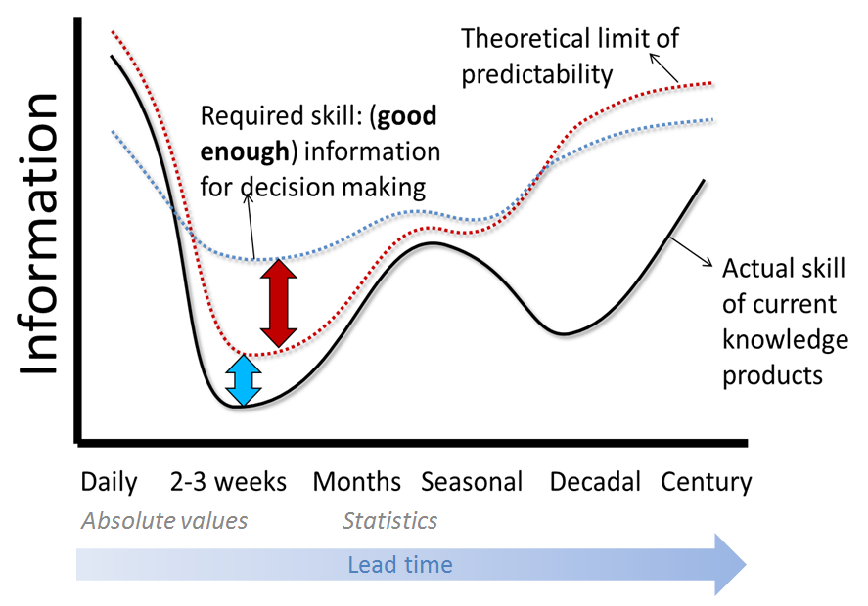
Predictability
Initial Condition
Predictability
Boundary Condition
Predictability
From Hewitson et al 2013

Slide 25

Uncertainty in predicting the weather
P(T=11) = 0.0
P(T=12) = 0.1
P(T=13) = 0.2
P(T=14) = 0.5
P(T=15) = 0.2
P(T=16) = 0.0
Imperfect initial observations
Perfect model scenario
We can make probabilistic statements.
“The probability of the temperature being at least 14 degrees is 0.7”
Probability
Temperature
In reality, we have imperfect models but we can verify our forecasts with observations of the system.
By identifying sources of model error, we can update our models and improve predictions.

Slide 26
Climate uncertainty...is different
We have inherent irreducible uncertainty, so even armed with a perfect model, we have to consider probabilities. In the imperfect model, the probability distribution is conditional on the model assumptions.
“Climate is what you expect”
“Given a perfect model, future climate is what you expect to expect”
μ future
weather
forecast
Probability
possible future climate
climate
μ
10th percentile
Temperature
90th percentile
Natural internal variability
+
probability
probability
Model uncertainty
μ change
90th percentile change

Slide 27
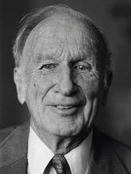
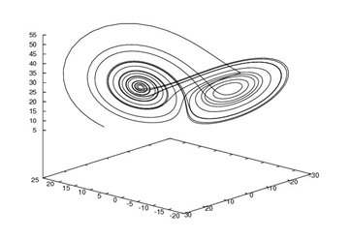

Climate uncertainty...is different
“Climate is a distribution.” Stainforth et al. (2007)
“Climate is what you expect, or better yet what you ought to expect, when you are not in the position to make a skillful weather forecast”
(Lorenz, 1995)
Z
Lorenz ‘63 attractor
X
Y

Slide 28
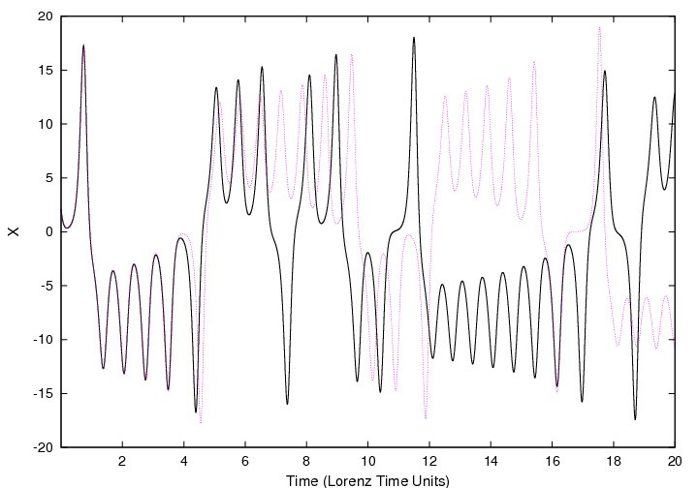
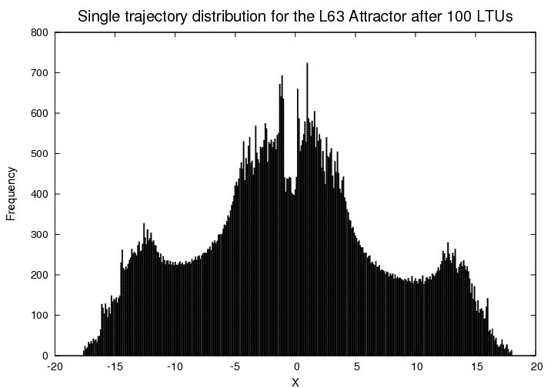

Climate uncertainty...is different
50%
50%

Slide 29
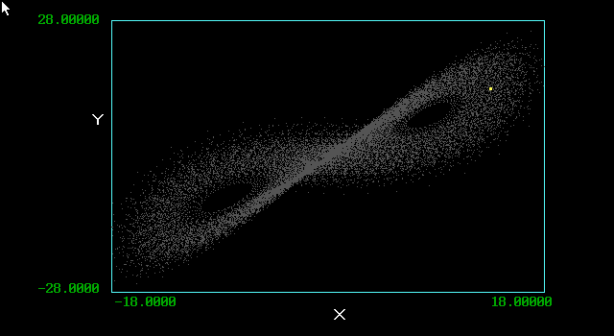
Ensemble weather prediction in a constant climate

Slide 30


Evolving Climate (Attractor)
increase system forcing

Slide 31
Sources of climate projection uncertainty
Initial Condition (IC) uncertainty partially reducible
  Sparse/incomplete observations in time and space
  Erroneous and uncertain observations
Model uncertainty largely reducible
  Model inadequacy
  Parameter uncertainty
Scenario uncertainty largely irreducible
  Human and natural emissions of greenhouse gases
  Translating emissions into concentrations of greenhouse gases and their effect on system radiative forcings

Slide 32
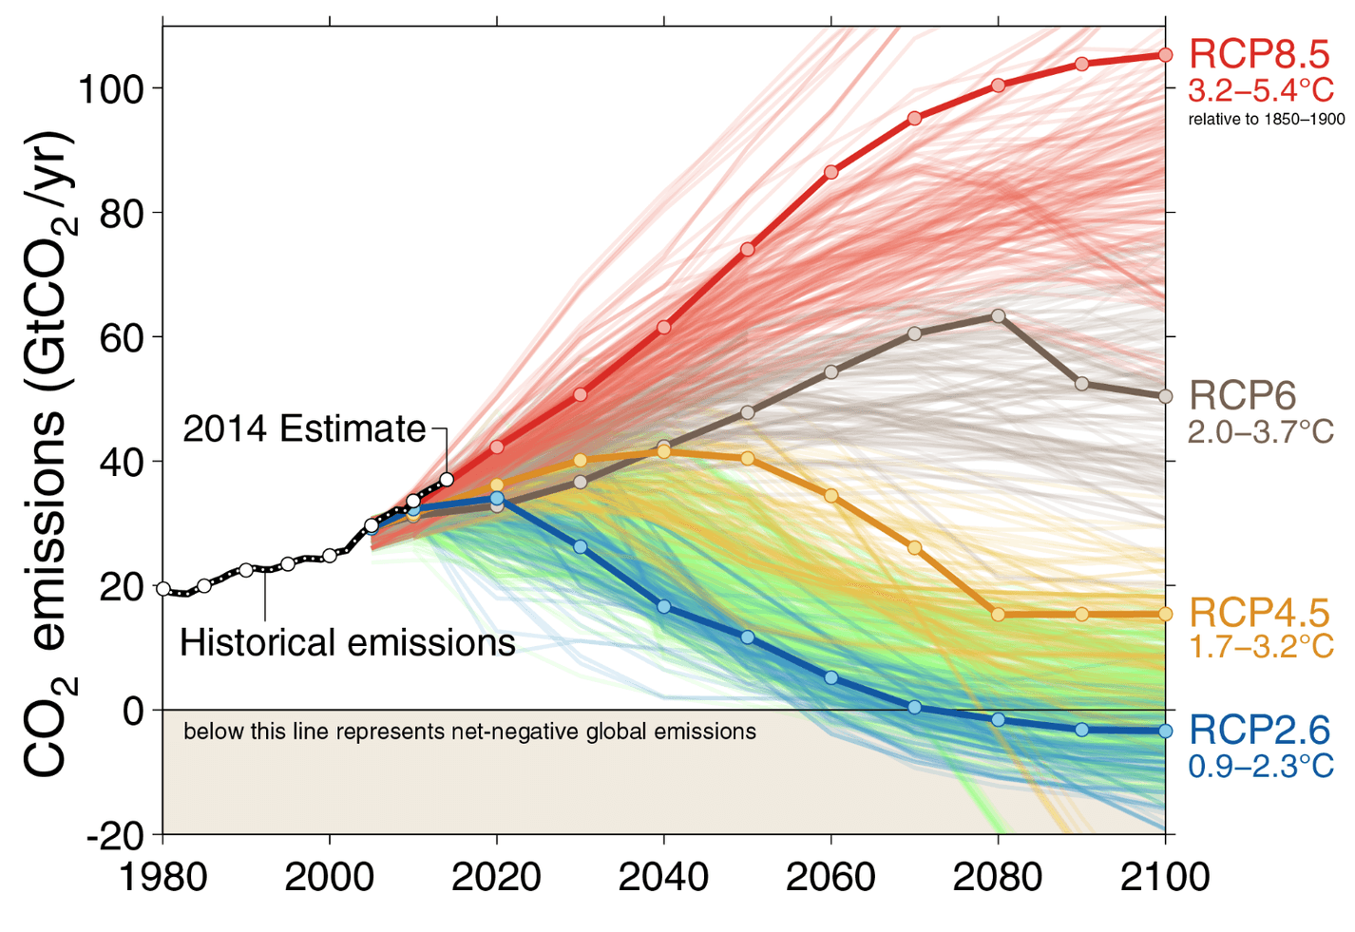
Scenario uncertainty
Fuss et al. 2014

Slide 33
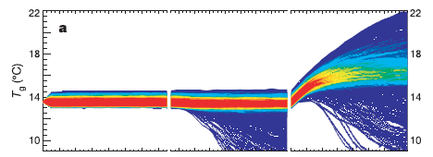
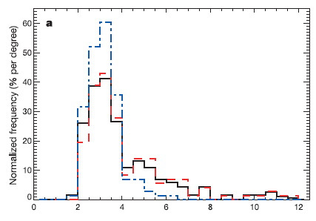

Climateprediction.net
Model uncertainty
Sampling parameter uncertainties and
sub-grid scale processes

Slide 34
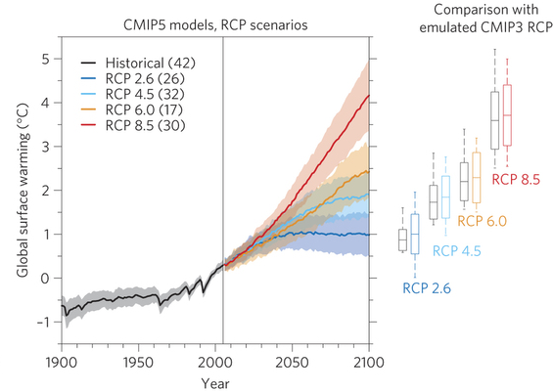
Scenario and model uncertainty
IPCC AR5

Slide 35
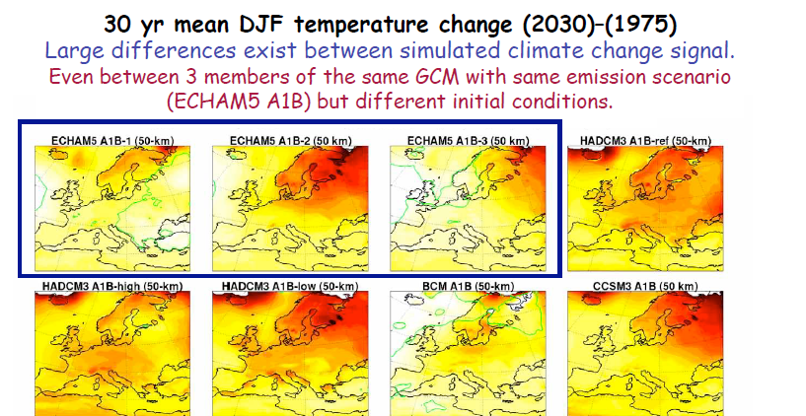
Initial condition uncertainty
Grigory Nikulin (Rossby Centre)

Slide 36
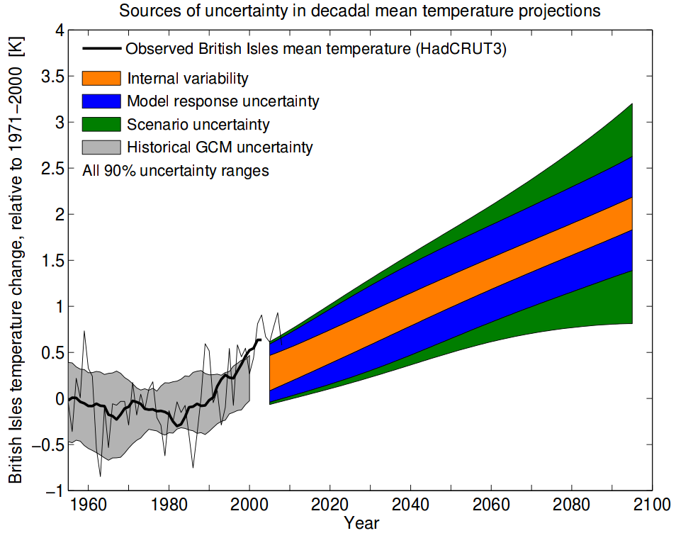
Contributions to overall uncertainty
Hawkins and
Sutton, 2009

Slide 37

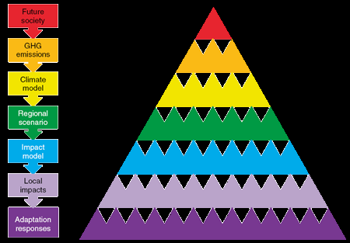
The Cascade of Uncertainty
The envelope of uncertainty
Wilby and Dessai, 2010 Robust Adaptation to Climate Change

Slide 38
Perspectives on uncertainty
Climate Scientist perspective
Can we quantify the full extent of climate-related uncertainties?
How far can we theoretically reduce uncertainties?
How far can we realistically reduce uncertainties?
“User” perspective
Do we need reduced uncertainty to determine meaningful output from impacts models?
Do we need reduced uncertainty to make informed decisions?
What level of uncertainty can we tolerate?

Slide 39
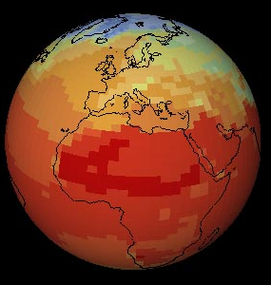
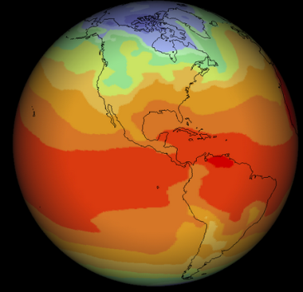
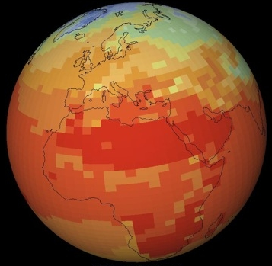
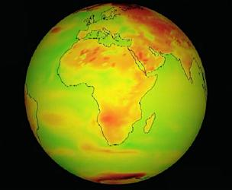
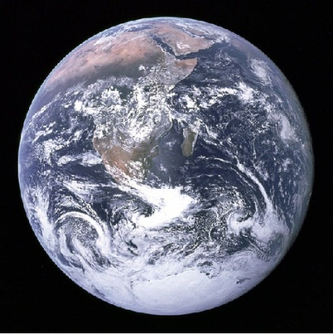
Dealing with multiple imperfect models
HadCM3, UK
ECHAM-5, Germany
GFDL-CM2, USA
CSIRO-Mk3, Australia
Planet Earth

Slide 40
Dangers of multi-model misuse
More information leads to a more robust decision…
…provided you don’t just average it!
The use of multi-model ensemble averages can be highly misleading.

Slide 41
Characterising future climate uncertainty
Probabilities
Scenarios
Schneider (2001), Pittock et al. (2001), UKCP09
Clark and Pulwarty (2003), Dessai and Hulme (2004)
Constructing probabilities enables decision makers to assess and manage risk. Adaptation needs threshold exceedance probabilities.
Under deep uncertainty, we need to consider a range of plausible scenarios. Probabilities may mislead decision makers creating false confidence.

Slide 42
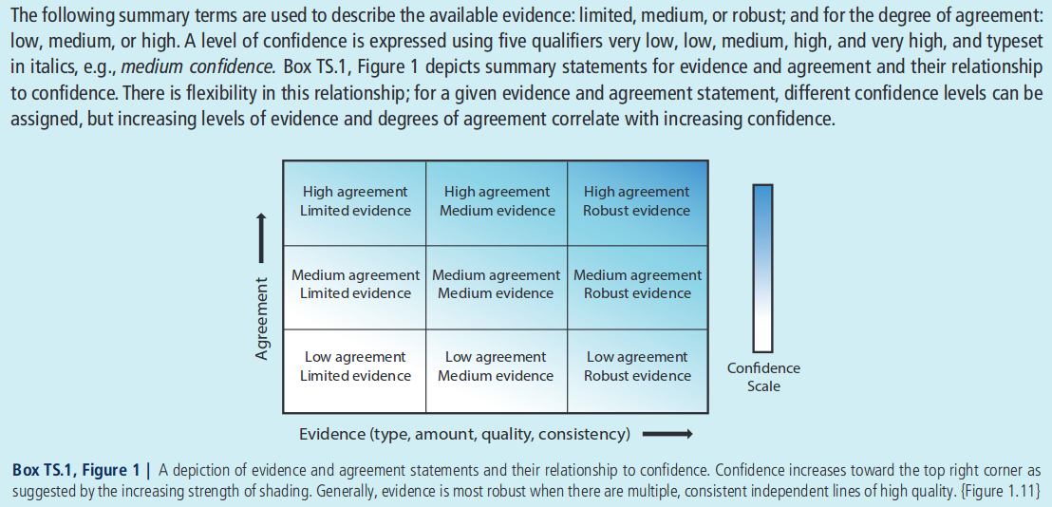
From uncertainty to confidence
Confidence in IPCC AR5

Slide 43
What are the most effective ways to communicate climate projections to convey the strengths and limitations in the information?

Slide 44
Summary
  Climate models are mathematical representations of the climate system
  Operational GCMs require very large computers to produce simulations
  Climate model projections are subject to large uncertainties
  Uncertainties can be divided into three types: initial condition, model, and scenario uncertainty
  It remains unclear how best to characterise model projections in the context of uncertainties but considerations include: spatial scale, prediction time horizon, variable and audience

Slide 45
Course Material
https://www.ole.bris.ac.uk/bbcswebdav/courses/GEOGM1405_2014
Reading for next week:
IPCC AR5 WG1, Chapter 9 Summary
Stainforth et al 2007, Confidence, uncertainty and decision-support relevance in climate predictions. Available here: http://rsta.royalsocietypublishing.org/content/365/1857/2145
See you next week at 9am!
email: jdaron@csag.uct.ac.za

