Slide 1
FAQs
Next week’s session
Mitigation – 2pm to 4pm
Office hours
Room B2S – Tuesday’s 10am to midday
http://www.csag.uct.ac.za/~jdaron/GEOGM1405_FAQ.html
email: jdaron@csag.uct.ac.za

Slide 2
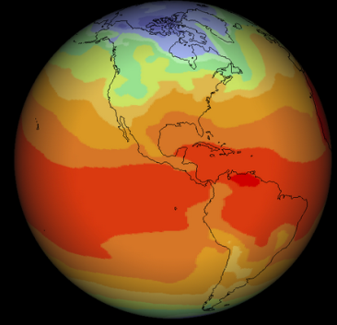
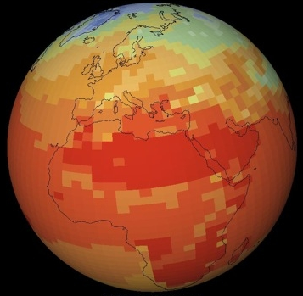
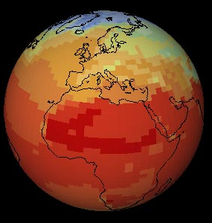
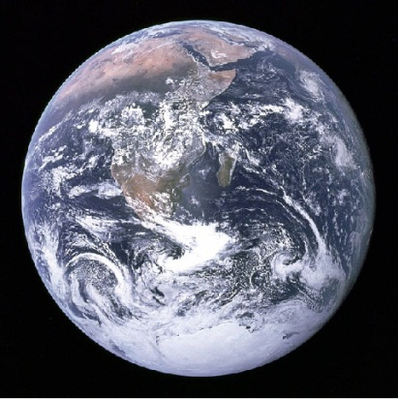
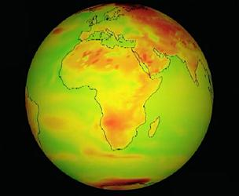
GEOGM1405
Climate Change: Science and Impacts
WEEK 5
…more climate modeling
and assignment 1

Slide 3
…leftovers from last week plus some additions…

Slide 4
Sources of climate projection uncertainty
Initial Condition (IC) uncertainty partially reducible
  Sparse/incomplete observations in time and space
  Erroneous and uncertain observations
Model uncertainty largely reducible
  Model inadequacy
  Parameter uncertainty
Scenario uncertainty largely irreducible
  Human and natural emissions of greenhouse gases
  Translating emissions into concentrations of greenhouse gases and their effect on system radiative forcings

Slide 5
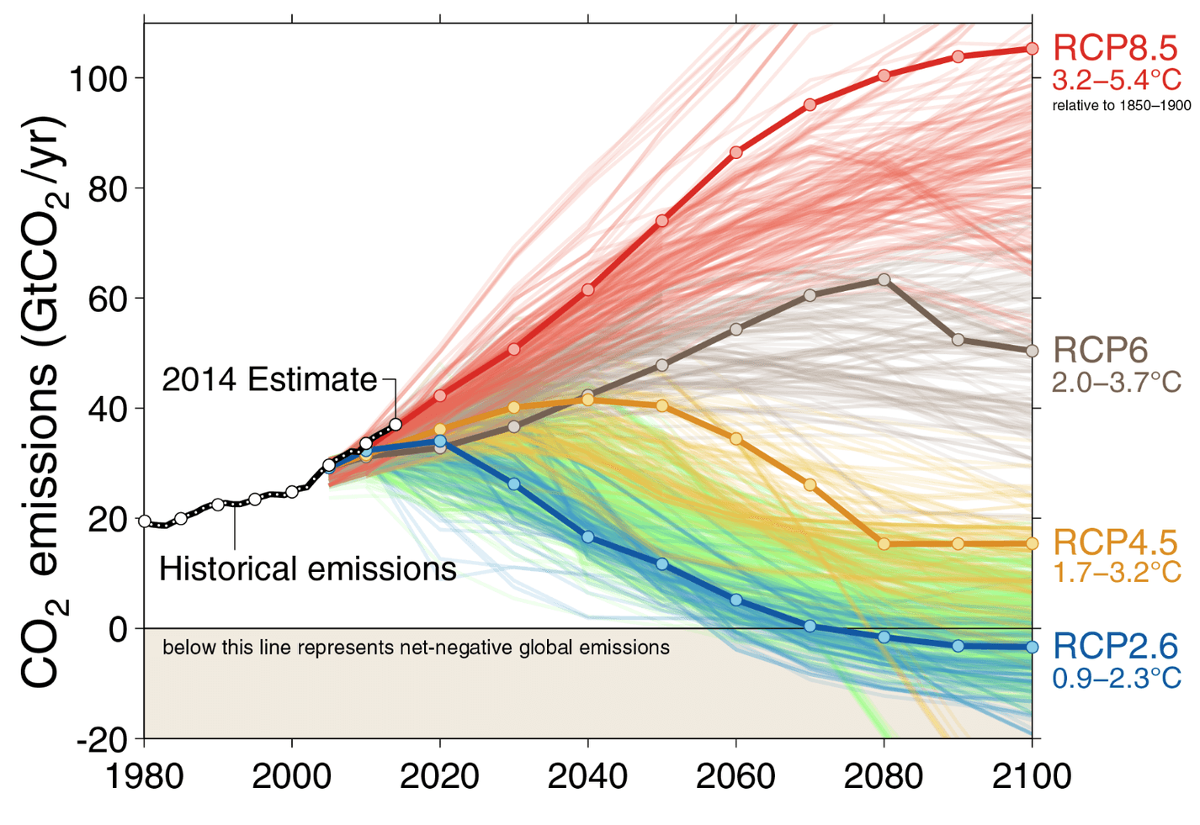
Scenario uncertainty
Fuss et al. 2014

Slide 6
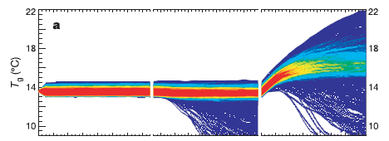
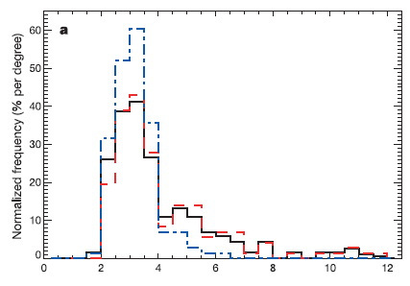

Climateprediction.net
Model uncertainty
Sampling parameter uncertainties and
sub-grid scale processes

Slide 7
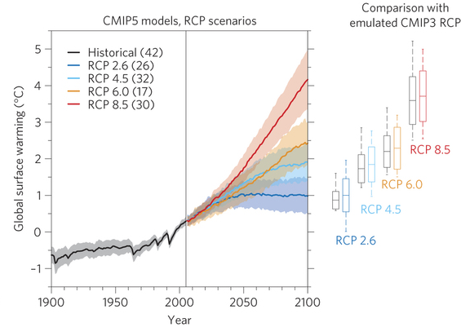
Scenario and model uncertainty

Slide 8
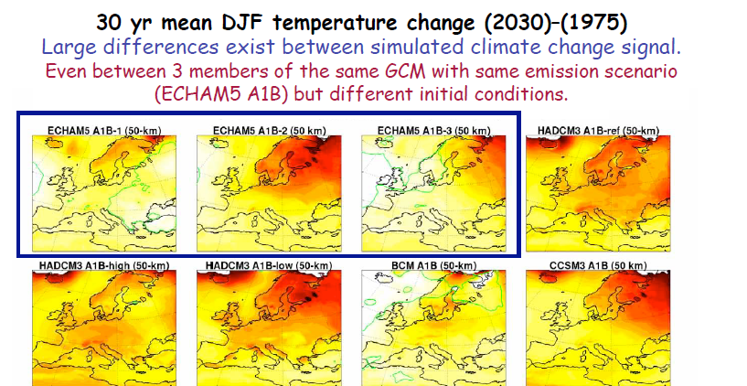
Initial condition uncertainty
Grigory Nikulin (Rossby Centre)

Slide 9
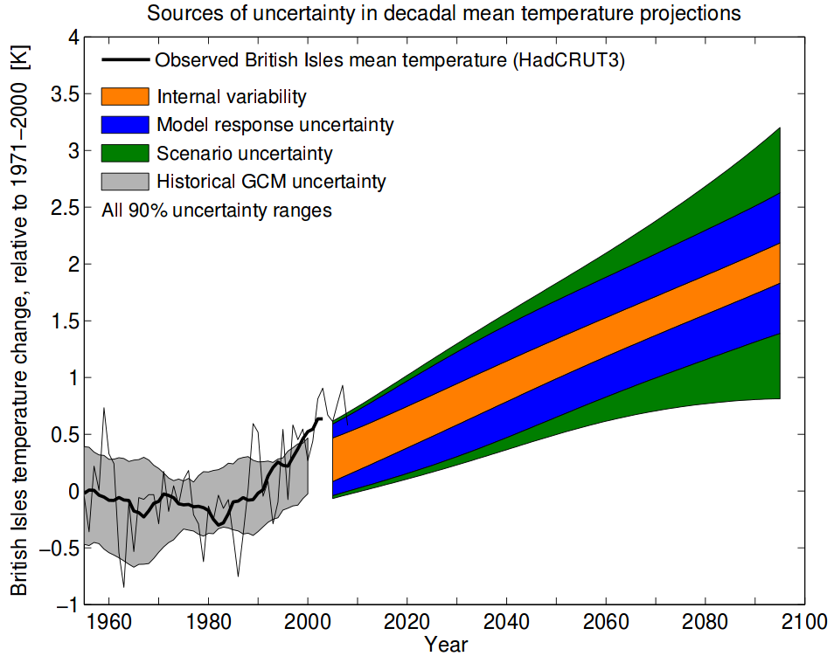
Contributions to overall uncertainty
Hawkins and
Sutton, 2009

Slide 10
Dealing with multiple imperfect models
HadCM3, UK
ECHAM-5, Germany
GFDL-CM2, USA
CSIRO-Mk3, Australia
Planet Earth

Slide 11
Characterising future climate uncertainty
Probabilities
Scenarios
Schneider (2001), Pittock et al. (2001), UKCP09
Clark and Pulwarty (2003), Dessai and Hulme (2004)
Constructing probabilities enables decision makers to assess and manage risk. Adaptation needs threshold exceedance probabilities.
Under deep uncertainty, we need to consider a range of plausible scenarios. Probabilities may mislead decision makers creating false confidence.

Slide 12
Dangers of multi-model misuse
More information leads to a more robust decision…
…provided you don’t just average it!
The use of multi-model ensemble averages is common but it can be highly misleading.

Slide 13
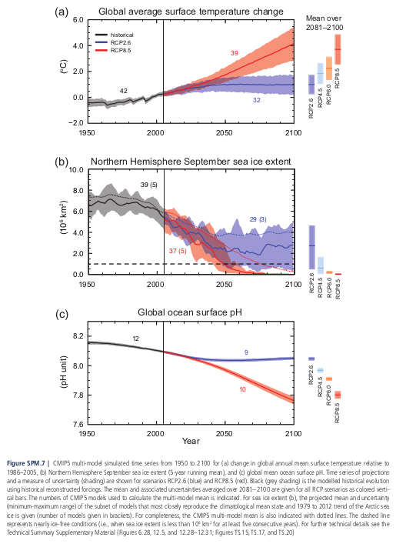
IPCC AR5 Projections
Fig SPM 7

Slide 14
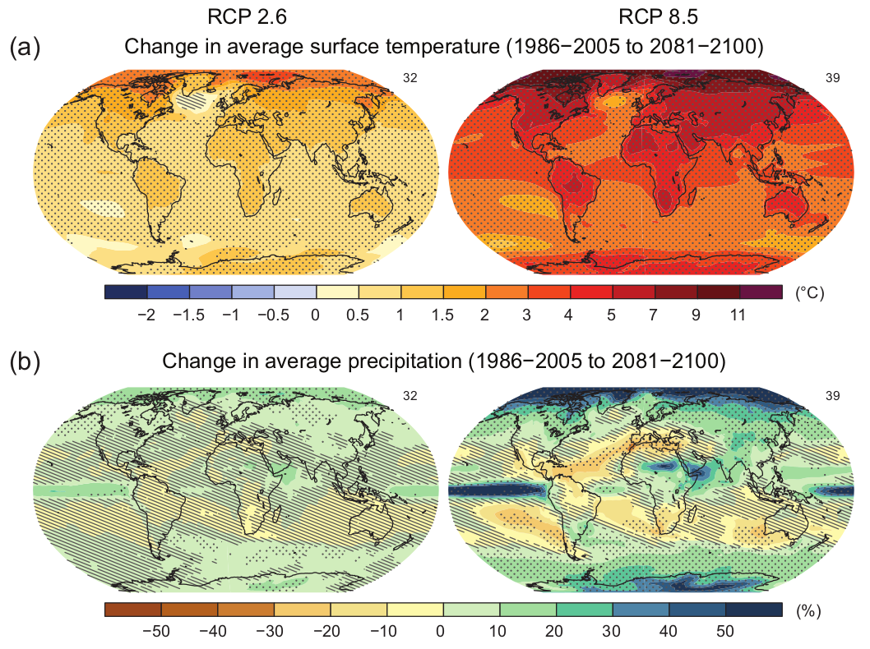
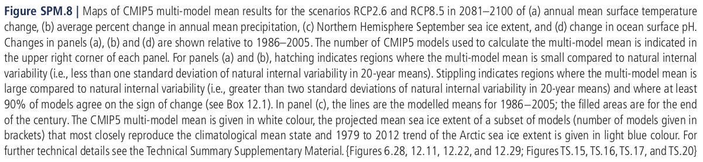
IPCC AR5 Projections

Slide 15
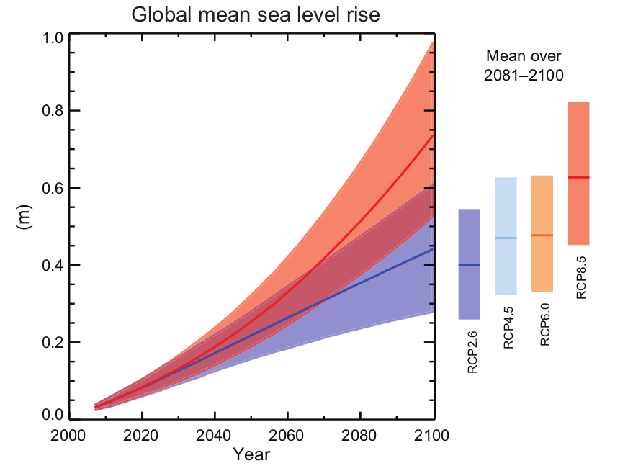
IPCC AR5 Projections
Sea level rise will not be uniform. By the end of the 21st century, it is very likely that sea level will rise in more than about 95% of the ocean area. About 70% of the coastlines worldwide are projected to experience sea level change within 20% of the global mean sea level change.
Fig SPM 9

Slide 16
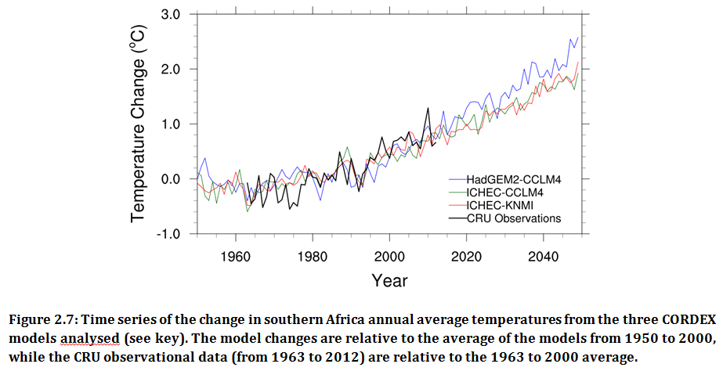
Regional Projections (CORDEX)

Slide 17
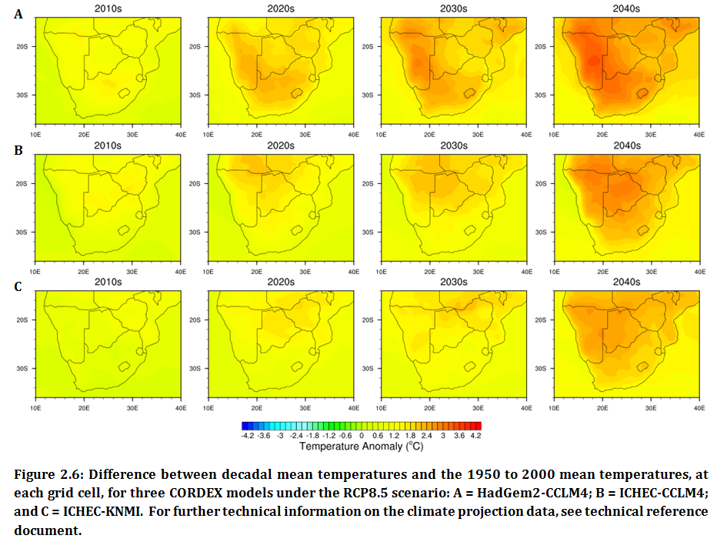
Regional Projections (CORDEX)

Slide 18
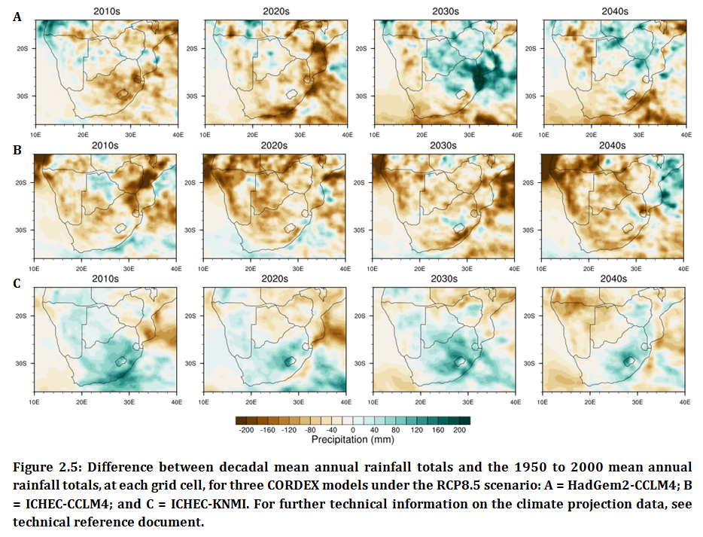
Regional Projections (CORDEX)

Slide 19
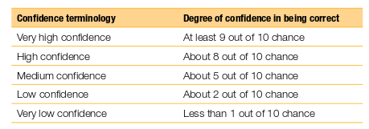
From uncertainty to confidence
Confidence in IPCC AR4

Slide 20
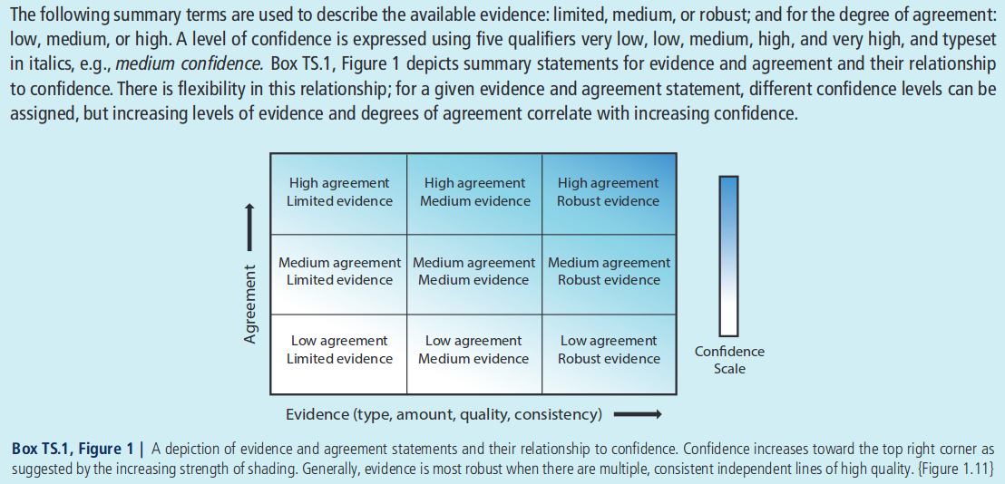
From uncertainty to confidence
Confidence in IPCC AR5

Slide 21
What do you think are the most effective ways to communicate climate projections to convey the strengths and limitations in the information?

Slide 22
…before we start the assignment, let’s unpack some of the jargon!
    Hindcast
    Forecast/prediction/projection
    Scenario
    Interpolation
    Coupled model
    Forcing
    Simulation
    Significance
    …

Slide 23
Assignment 1
…let’s begin

