Slide 1

GEOGM1405
Climate Change: Science and Impacts
WEEK 6
Mitigation

Slide 2
Aims of Today’s Lecture
Introduce the main global, regional and national efforts to reduce greenhouse gas (GHG) emissions and address global warming
Examine recent advances in mitigation policy
Understand the impact of implementing different mitigation options
Discuss the trade-offs and complexities in reducing GHG emissions in the context of other societal pressures

Slide 3
Two Key Definitions
Mitigation
  “An anthropogenic intervention to reduce the sources or enhance the sinks of GHGs” - IPCC
  e.g. shifting to renewable sources of energy, protecting forests
Adaptation
  “Adjustment of natural or human systems in response to actual or expected climate stimuli or their effects” - IPCC
  e.g. Building coastal defences, planting climate resilient crops

Slide 4
Is our current scientific understanding of the climate system and climate change sufficient to justify substantial reductions in GHG emissions?

Slide 5

Preventing “dangerous” climate change
Key principle of the Copenhagen Accord
To prevent dangerous anthropogenic interference with the climate system, recognizes the scientific view that the increase in global temperature should be below 2 degrees Celsius, in a context of sustainable development, to combat climate change.
"The power of the 2°C target is that it is pragmatic, simple and straightforward to understand and communicate, all important elements when science is brought to policymakers.“
Tom Stocker, co-chair of IPCC WG1

Slide 6
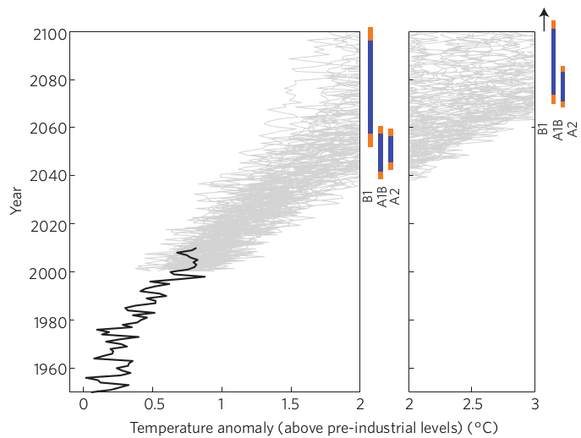
Will reducing GHG emissions prevent “dangerous” climate change?
Figure 1
Joshi et al. 2011
“In higher greenhouse-gas emission scenarios, a global average 2 °C warming threshold is likely to be crossed by 2060, whereas in a lower emissions scenario, the crossing of this threshold is delayed by up to several decades. On regional scales, however, the 2 °C threshold will probably be exceeded over large parts of Eurasia, North Africa and Canada by 2040 if emissions continue to increase — well within the lifetime of many people living now.”

Slide 7
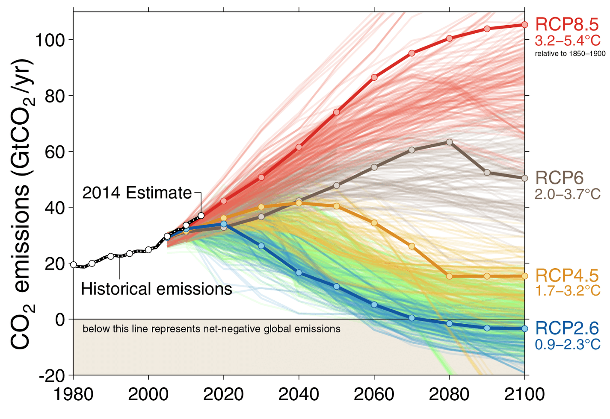
Will reducing GHG emissions prevent “dangerous” climate change?
Fuss et al. 2014

Slide 8
Why do we need international climate action?
Carbon dioxide, and some other key GHGs, are well-mixed gases. CO₂ has an atmospheric lifetime of 5 to 200 years.
GHG emissions are inextricably linked to trade and the increasingly globalised economy.
All nations will be impacted by climate change ...some more than others!

Slide 9

United Nations Framework Convention on Climate Change
An environmental treaty, established at the Earth Summit in Rio de Janeiro (1992) and entered into force on 21 March 1994.
154 nations signed the convention (including all major emitters), committing to a voluntary, legally non-binding aim. However, it included provisions for updates that would set mandatory emission limits.
Convention objective:
  “To achieve stabilization of greenhouse gas concentrations in the atmosphere at a level that would prevent dangerous anthropogenic interference with the climate system. Such a level should be achieved within a time-frame sufficient to allow ecosystems to adapt naturally to climate change, to ensure that food production is not threatened and to enable economic development to proceed in a sustainable manner.”

Slide 10
United Nations Framework Convention on Climate Change
The UNFCCC agreed to a set of common but differentiated responsibilities. The parties agreed that:
the largest share of historical and current global emissions of greenhouse gases has originated in developed countries.
per capita emissions in developing countries are still relatively low.
the share of global emissions originating in developing countries will grow to meet their social and development needs.
Annex I Countries - 40 developed nations
Non-Annex I Countries - 154 developing nations
Annex II countries - 23 developed nations
(pay for costs of developing countries and includes UK and USA but not Russia)

Slide 11
UNFCCC – Conference Of the Parties
COP-1 Berlin April 1995
COP-3 Kyoto December 1997
COP-15 Copenhagen December 2009
COP-19 Warsaw December 2013
COP-20 Lima December 2014
COP-21 Paris December 2015
Emerging messages from Warsaw
“Warsaw has set a pathway for governments to work on a draft text of a new universal climate agreement so it appears on the table at the next UN Climate change conference in Peru. This is an
essential step to reach a final agreement in Paris, in 2015”. (Marcin Korolec, COP19 president)
The conference also decided to establish an international mechanism to provide most vulnerable populations with better protection against loss and damage caused by extreme weather events and slow onset events such as rising sea levels. Detailed work on the so-called “Warsaw international mechanism for loss and damage” will begin next year. (COP-19 press release)

Slide 12
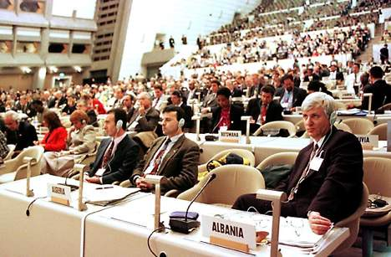
The Kyoto Protocol
Aim: To establish legally binding obligations for developed countries to reduce their greenhouse gas emissions
An agreement under which industrialized countries opted to reduce their collective emissions of greenhouse gases by 5.2% compared to the year 1990 (equivalent to 29% reduction relative to business as usual).
The reductions are measured relative to the average emissions over the commitment period 2008-2012.
Emissions reductions range from 8% for EU nations, 7% for the US, 0% for Russia and an increase in emissions of 8% for Australia and 10% for Iceland.

Slide 13
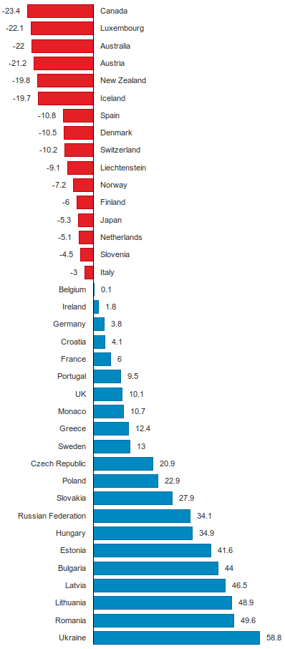
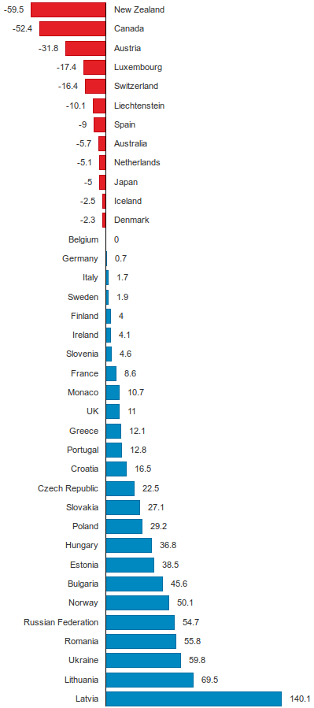
Was the Kyoto Protocol a success?
Results when land use emissions and sinks are excluded
Results when land use emissions and sinks are included
Red
Failed to meet
targets
Blue
Successfully made
targets

Slide 14
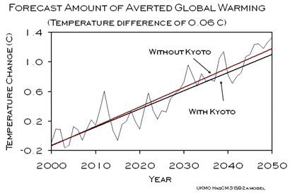
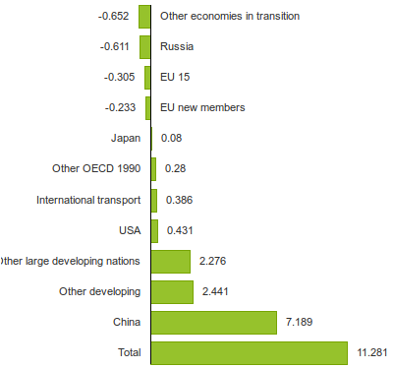
Was the Kyoto Protocol a success?
Change in CO2 emissions (GT)
1990 to 2011
data from Netherlands Environmental Assessment Agency

Slide 15
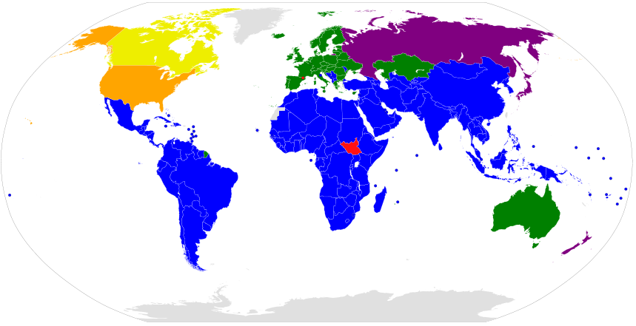
Participation in the Kyoto Protocol
Annex I parties with binding targets in the second period
Annex I parties with binding targets in the first period but not the second
Non-Annex I parties without binding targets
Annex I parties with binding targets in the first period but which withdrew from the Protocol
Signatories to the Protocol that have not ratified
Other UNFCCC member states that are not party to the Protocol

Slide 16
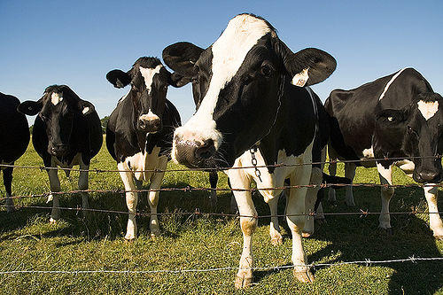
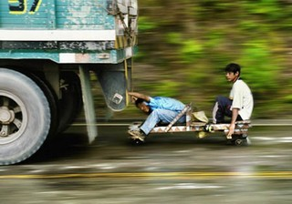
Reasons why establishing international consensus has been challenging?
1. The Tragedy of the Commons
A social and economic trap that occurs when there is conflict over finite resources between individual interests and the common good. In his 1968 Science essay Garrett Hardin popularized the theory using a hypothetical example of a pasture shared by local herders. The utility of each additional animal for the herder has both a positive and negative component:
Positive: the herder receives all of the proceeds from each additional animal.
Negative: the pasture is slightly degraded by each additional animal.
Overgrazing and degradation of the pasture is its long-term fate.
2. The Free Rider Problem
Just as increasing GHG emissions have globally negative effects, so too emissions reductions will have globally beneficial effects. There is no incentive for individual nations to contribute to emissions reductions as reductions in other nations yield the same benefits.

Slide 17
Where are we now?
http://carbonfootprintofnations.com/content/carbon_footprint_worldwide_1990_2010_/

Slide 18
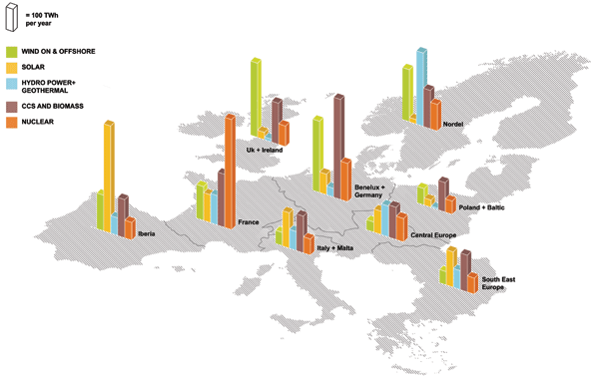
The European Union
80% reduction (from 1990 levels) in GHG emissions by 2050, 40% reductions by 2030 and 20% reductions by 2020
Building on 18% reduction between 1990 and 2011
Until 2020, at least 20% of the EU budget will be spent on transforming to a green economy
European Climate Foundation - “Roadmap 2050: A practical guide to a prosperous low-carbon Europe”
Figure 3. Energy resources in 2050 with an 80 per cent renewables mix

Slide 19
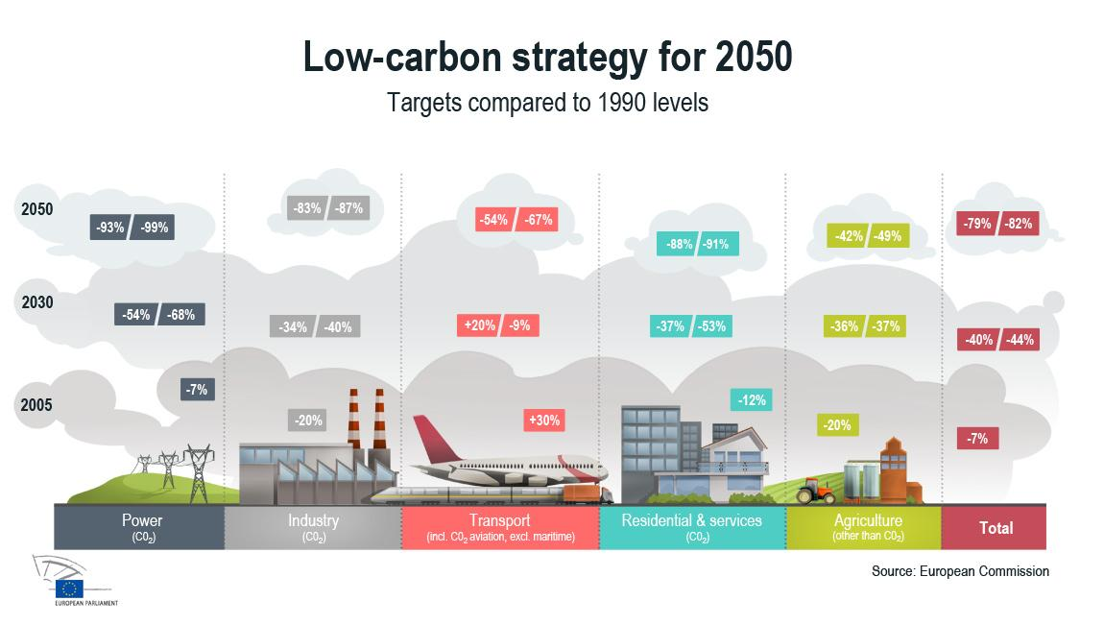
The European Union
“Roadmap for moving to a competitive low carbon economy in 2050”

Slide 20
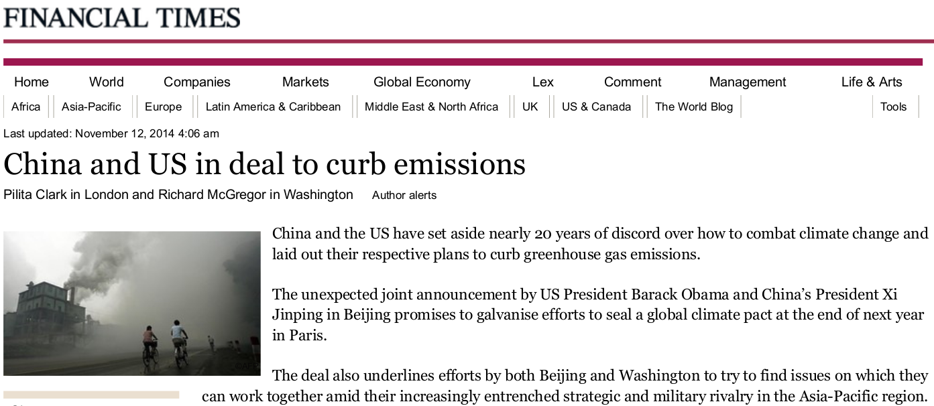
Agreement between China and the US?
“The landmark agreement, jointly announced by President Obama and President Xi Jinping, includes new targets for carbon emissions reductions by the United States and a first-ever commitment by China to stop its emissions from growing by 2030.
Mr. Obama announced that the United States would emit 26 percent to 28 percent less carbon in 2025 than it did in 2005.”
New York Times, 11-11-14

Slide 21
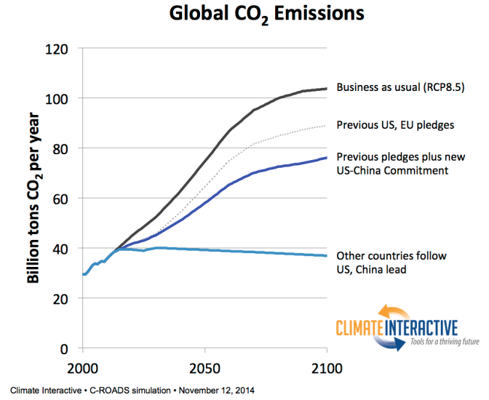
Agreement between China and the US?

Slide 22
Questions to think about before Paris 2015
Do we need a legally binding global climate treaty?
    Should such a treaty include all nations or just developed (Annex I) nations?
    What time-frame should such a treaty be operating on – 2020/2050?
What penalties should be imposed on nations who fail to meet emissions reductions targets?
What should the balance between mitigation and adaptation be?

Slide 23
Questions to think about before Paris 2015
Should climate mitigation targets be at the nation-scale or individual (per-capita) scale?
In a globalised economy, how should climate policies account for industry-based emissions and imported/exported emissions?
    Who is responsible for aviation and shipping?
How much money (GDP) should be spent on climate policies?
    How much should we discount future generations?

Slide 24

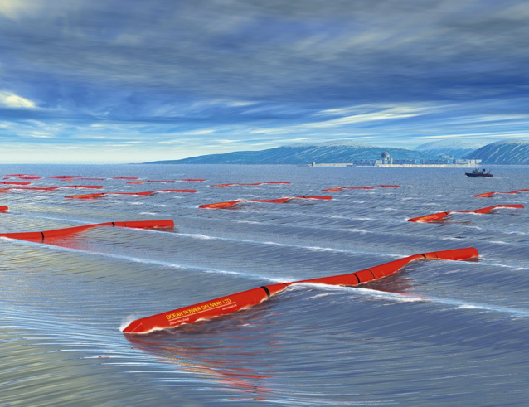
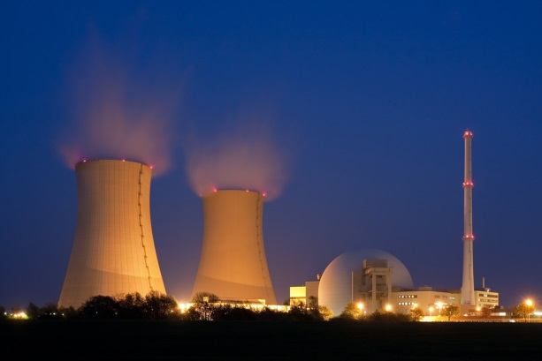

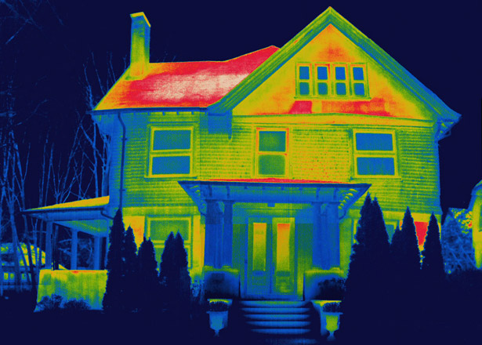
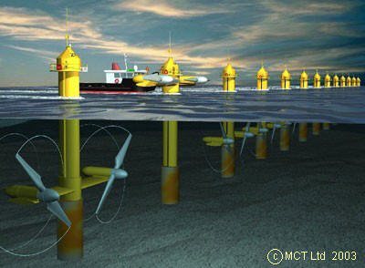
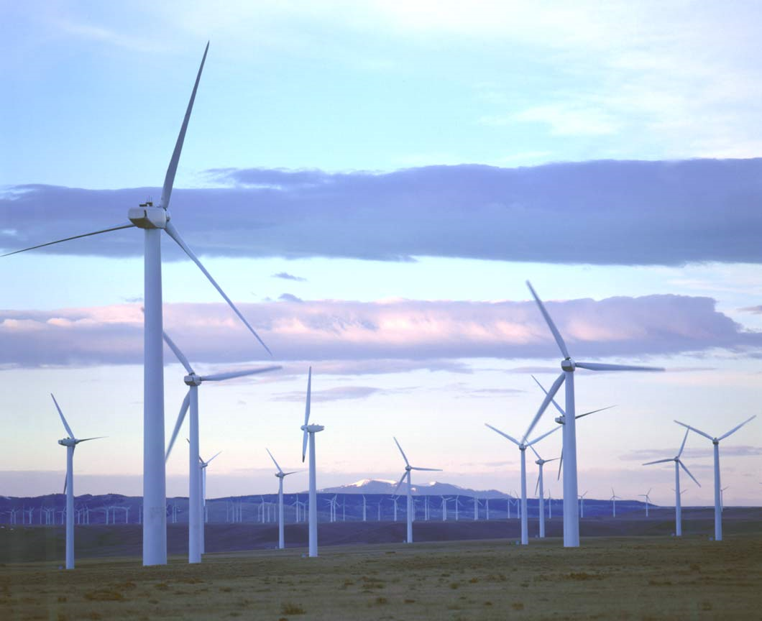

“Hard” mitigation options

Slide 25
“Soft” mitigation options
Encourage and incentivise people to consume less energy
Invest in energy efficiency measures
Protect and maintain carbon sinks (e.g. peatlands, forests)
Promote education and awareness to affect attitudes towards the use of resources
Encourage people to eat less meat
Incentivise smaller families
…

Slide 26
Making mitigation decisions

Slide 27
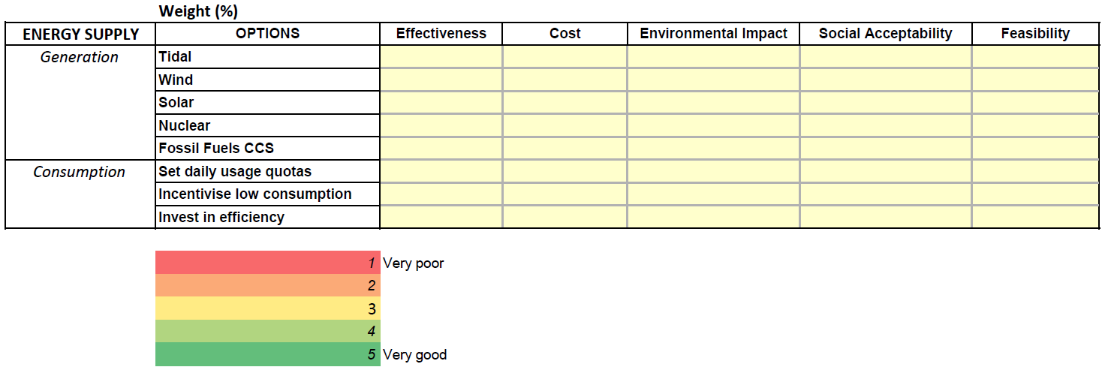
Multi-criteria decision analysis (MCDA)
Step 1: Decide on percentage weights for the five criteria - they must add up to 100%.
Step 2: Score each option against the each criterion from 1 (very poor) to 5 (very good).

Slide 28
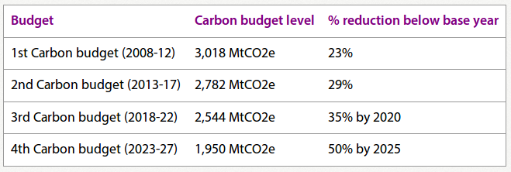
UK Climate Change Mitigation Policy
The 2008 Climate Change Act makes the UK the first country in the world to have a legally binding long-term framework to cut carbon emissions.
The Climate Change Bill finished its passage through parliament on 18th November 2008, and was enacted by Royal Assent on 26th November 2008.
Overall target: 80% reduction in GHG emissions by 2050 (consistent with EU target)
http://www.theccc.org.uk

Slide 29
UK Climate Change Act: Key Details
The Climate Change Act includes the following:
2050 Target. The act commits the UK to reducing emissions by at least 80% in 2050 from 1990 levels. This target was based on advice from the CCC report: Building a Low-carbon Economy.
Carbon Budgets. The Act requires the Government to set legally binding ‘carbon budgets’. The first four carbon budgets have been put into legislation and run up to 2027.
The Committee on Climate Change was set up to advise the Government on emissions targets, and report to Parliament on progress made in reducing greenhouse gas emissions. It includes the Adaptation Sub-Committee (ASC) which scrutinises and advises on the Government’s programme for adapting to climate change.
A National Adaptation Plan requires the Government to assess the UK’s risks from climate change, prepare a strategy to address them, and encourage critical organisations to do the same.

Slide 30
UK Low Carbon Transition Plan
The UK Low Carbon Transition Plan plots how the UK will meet the 35% cut in emissions on 1990 levels by 2020, set out in the budget. However, we have already reduced emissions by 21% – equivalent to cutting emissions entirely from four cities the size of London.
The plan states that by 2020:
More than 1.2 million people will be in green jobs.
7 million homes will have benefited from retrofits, and more than 1.5 million households will be supported to produce their own clean energy.
Around 40% of electricity will be from low-carbon sources, from renewables, nuclear and clean coal.
We will be importing half the amount of gas compared to business-as-usual.
The average new car will emit 40% less carbon than at present.

Slide 31
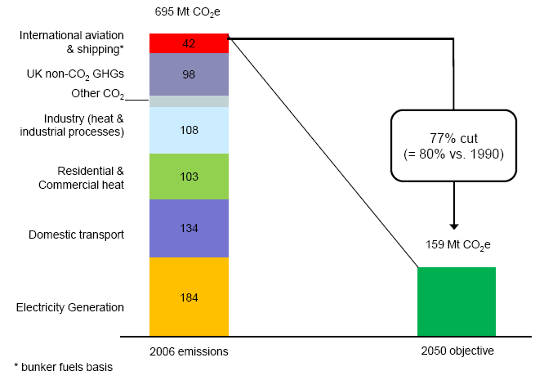
Scale of Challenge

Slide 32
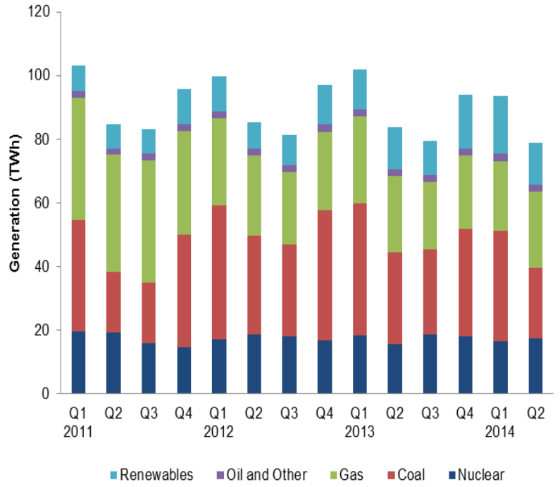
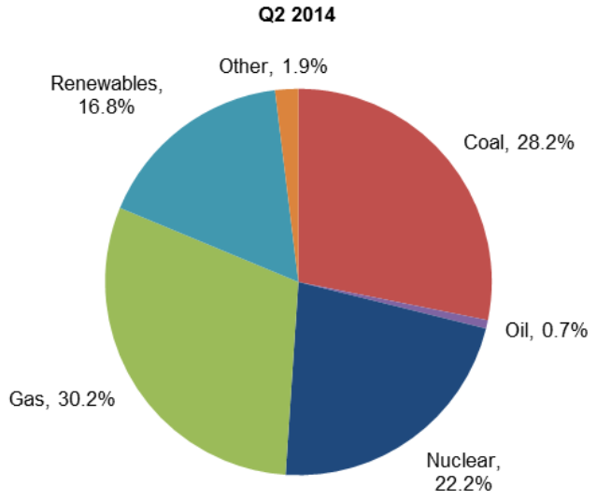
UK Energy Supply
Electricity generated by fuel type
Shares of Electricity Generation
Department of Energy & Climate Change (DECC)
Statistics: Energy trends section 5 – electricity
September 2014 report

Slide 33
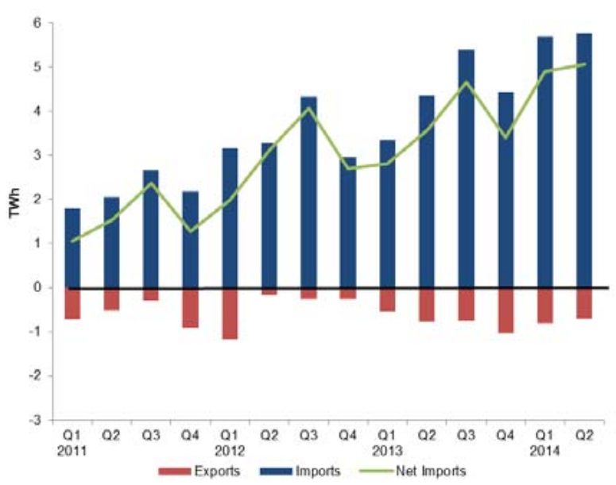
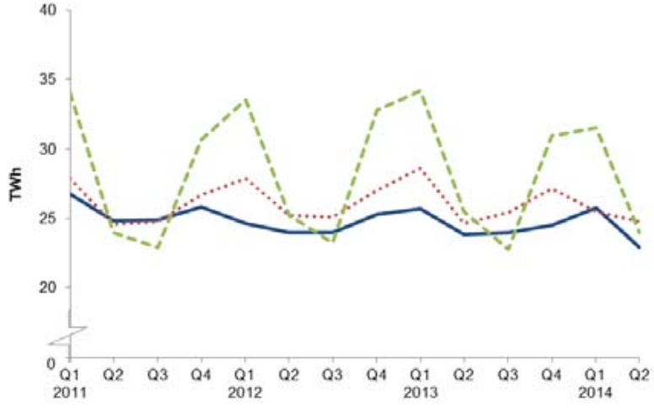
UK Energy Supply
UK Trade in Electricity
Electricity Final Consumption
Note: Total generation in Q2 2014 was 30 TWh
Department of Energy & Climate Change (DECC)
Statistics: Energy trends section 5 – electricity
September 2014 report

Slide 34
Has there ever been another global atmospheric problem requiring international cooperation?

Slide 35
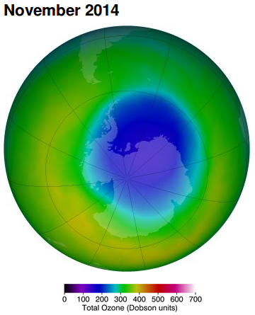
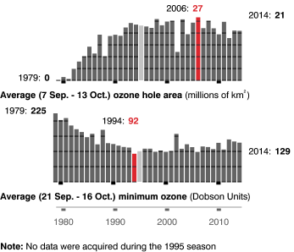
The Ozone Hole
The Antarctic Ozone Hole was discovered in 1985 by British scientists Joseph Farman, Brian Gardiner, and Jonathan Shanklin of the British Antarctic Survey.
The ozone helps to absorb the harmful UV-B radiation that leads to skin cancer and damage to crops.
Anthropogenic emissions of ozone depleting chemicals such as CFCs (Chlorofluorocarbons) in aerosols and refrigerants lead to the destruction of stratospheric ozone.
ozonewatch.gsfc.nasa.gov

Slide 36

The Montreal Protocol
The Montreal Protocol on Substances That Deplete the Ozone Layer - an international treaty designed to protect the ozone layer by phasing out the production of a number of substances believed to be responsible for ozone depletion.
Agreed upon on 16 September 1987 at the Headquarters of the International Civil Aviation Organization in Montreal. The treaty entered into force on January 1, 1989.
The 2006 World Meteorological Organization/United Nations Environment Programme Scientific Assessment of Ozone Depletion concluded the ozone hole recovery would be masked by annual variability for the near future and the ozone hole would fully recover in approximately 2065.
Due to its widespread adoption and implementation it has been hailed as an example of exceptional international co-operation with Kofi Annan quoted as saying it is "Perhaps the single most successful international agreement to date...".

Slide 37
Similarities
Montreal Kyoto
Global atmospheric issue
Problem driven by anthropogenic emissions of CFCs…
Emissions come primarily from developed nations
Impacts will be most severe for future generations
Poorer nations will be more vulnerable to increased risk of skin cancer and crop failure
Global atmospheric issue
Problem driven by anthropogenic emissions of GHGs…
Emissions come primarily from developed nations
Impacts will be most severe for future generations
Poorer nations will be more vulnerable to sea level rise and extreme weather

Slide 38
Differences
Montreal Kyoto
Protocol has led to near elimination of ozone depleting chemicals
To the United States, the apparent monetized benefits of the Montreal Protocol dwarfed the monetized costs
There was a direct replacement for CFCs in the form of HFCs (Hydroflourocarbons)
Industry advocated the change to alternative substances. (e.g. DuPont led research into HFCs)
Protocol has made only modest steps in reducing GHG emissions
To the United States, the apparent monetized costs of the Montreal Protocol dwarfed the monetized benefits (at least in the short- and medium-turn)
There are replacements to fossil fuels but they are perceived to be expensive and unreliable
Key industries have not (in general) supported the stringent emission reduction measures (e.g. Fossil fuel industries)

Slide 39
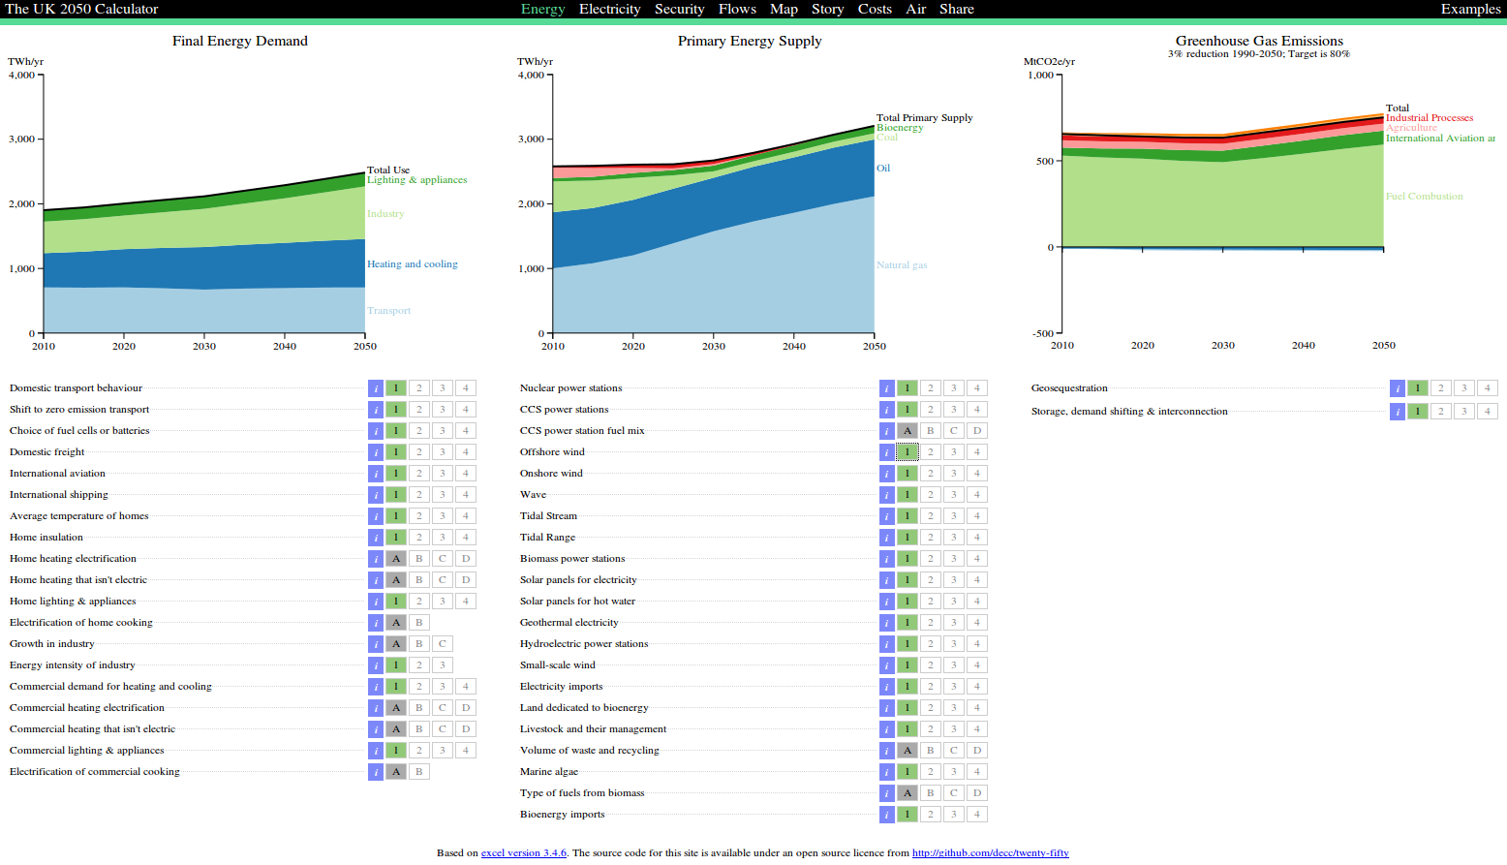
Try creating your own policies
http://2050-calculator-tool.decc.gov.uk/

Slide 40
Summary
  In order to prevent “dangerous” climate change, GHG emissions will have to be substantially reduced.
  GHG emissions reductions require coordinated global efforts, supported by ambitious regional and nation targets
  Despite historical gridlock, there are emerging signs that mitigation on a large scale is achievable
  There are many policy options and levers available but enacting different options requires trade-offs and compromises
  Anthropogenic global warming is not the first global atmospheric problem and we can learn lessons from the Montreal Protocol

Slide 41
…Homework

Slide 42
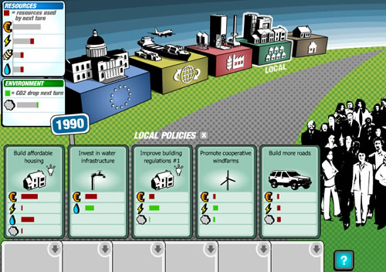
BBC Climate Challenge
http://www.bbc.co.uk/sn/hottopics/climatechange/climate_challenge/

Slide 43
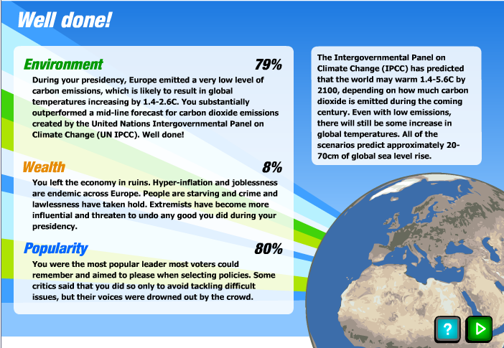
79 + 8 + 80 = 167 (from a possible 300)
Try this in your own time and send me (by email) a screenshot of your result. The person with the highest overall total will get a prize!

Slide 44
Further Reading
Mann, M (2009) Defining dangerous anthropogenic interference. Proceedings of the National Academy of Sciences, 106(11) 4065– 4066.
Joshi, M et al (2011) Projections of when temperature change will exceed 2 °C above pre-industrial levels, Nature Climate Change
Bowen, A and J Rydge (2011) Climate change policy in the United Kingdom
Policy Paper, Centre for Climate Change Economics and Policy, Grantham Research Institute on Climate Change and the Environment, LSE
David Mackay (2008) Sustainable Energy – without the hot air. www.withouthotair.com
Sunstein, C. R (2006) Montreal vs. Kyoto: A Tale of Two Protocols, Joint Centre for Regulatory Studies.

