Slide 1
A year of CO₂ emissions
https://www.youtube.com/watch?v=x1SgmFa0r04

Slide 2

GEOGM1405
Climate Change: Science and Impacts
WEEK 7
Climate Change Impacts

Slide 3
Aims of Today’s Lecture
Understand what we mean by climate impacts
Examine the latest findings from IPCC Working Group II for key climate change impacts
Discuss the complexities that are associated with predicting future impacts
Introduce some tools that climate scientists use to understand impacts on different sectors and systems

Slide 4
What do you understand by “climate impacts”?
How are you personally impacted by climate?
Climate Impacts
versus
Climate CHANGE Impacts

Slide 5
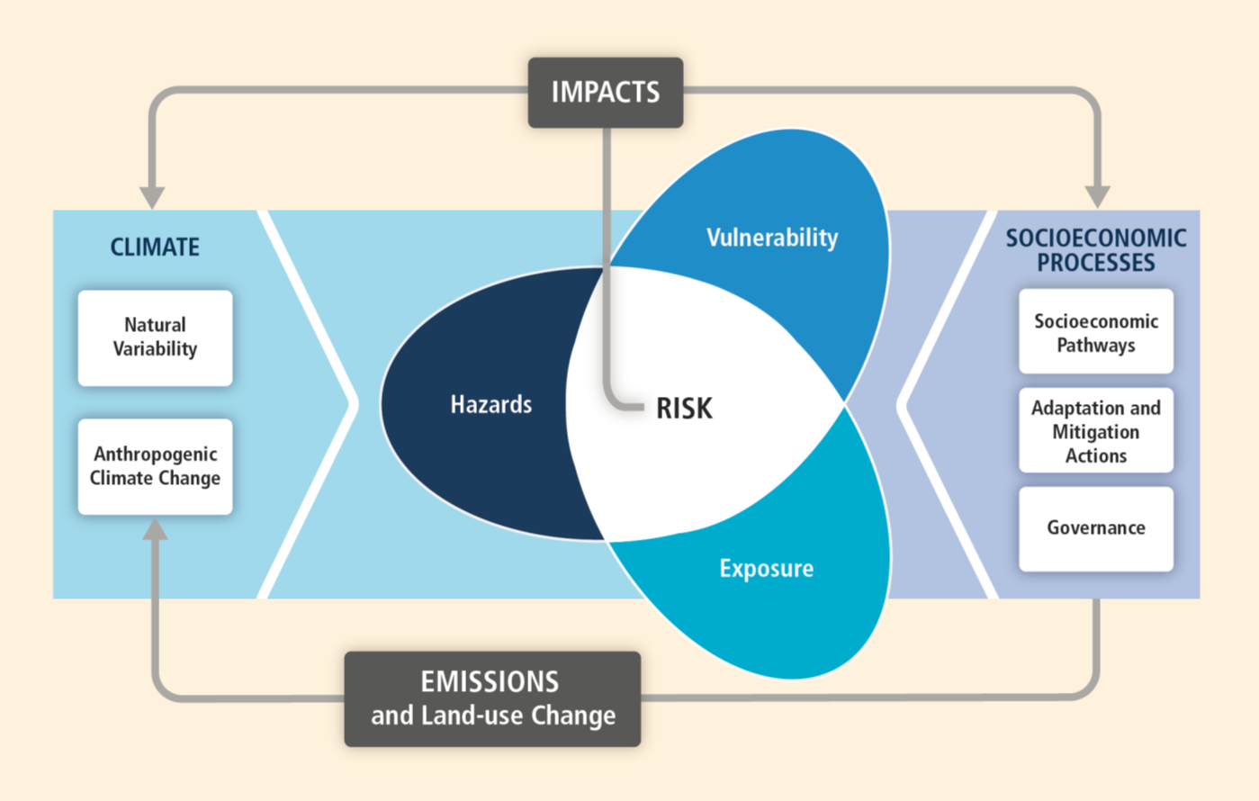
Impacts are intrinsically related to “risk”
IPCC Special Report on Extremes (SREX), 2011

Slide 6
Some important definitions (from IPCC AR5 WG2)
Risk
The potential for consequences where something of value is at stake and where the outcome is uncertain, recognizing the diversity of values. Risk is often represented as probability of occurrence of hazardous events or trends multiplied by the impacts if these events or trends occur. Risk results from the interaction of vulnerability, exposure, and hazard.
Impacts (Consequences, Outcomes)
Effects on natural and human systems. In this report, the term impacts is used primarily to refer to the effects on natural and human systems of extreme weather and climate events and of climate change. Impacts generally refer to effects on lives, livelihoods, health, ecosystems, economies, societies, cultures, services, and infrastructure due to the interaction of climate changes or hazardous climate events occurring within a specific time period and the vulnerability of an exposed society or system. Impacts are also referred to as consequences and outcomes. The impacts of climate change on geophysical systems, including floods, droughts, and sea level rise, are a subset of impacts called physical impacts.

Slide 7
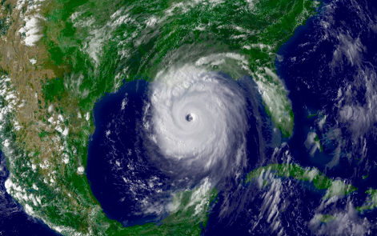
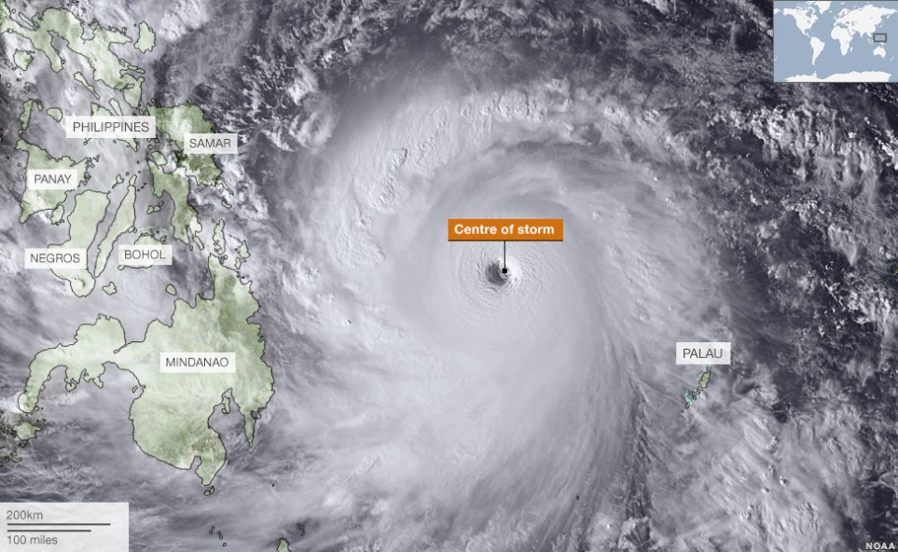
Some important definitions (from IPCC AR5 WG2)
Hazard
The potential occurrence of a natural or human-induced physical event or trend or physical impact that may cause loss of life, injury, or other health impacts, as well as damage and loss to property, infrastructure, livelihoods, service provision, ecosystems, and environmental resources. In this report, the term hazard usually refers to climate-related physical events or trends or their physical impacts.
Hurricane Katrina, September 2005
Typhoon Haiyan, November 2013

Slide 8
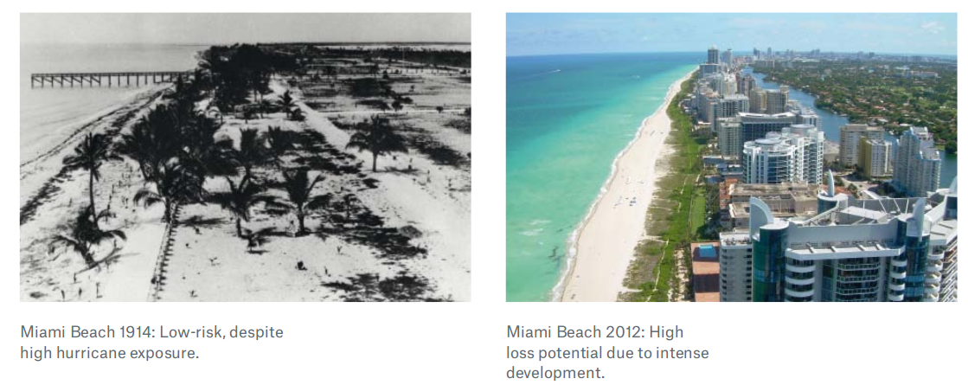
Some important definitions (from IPCC AR5 WG2)
Exposure
The presence of people, livelihoods, species or ecosystems, environmental functions, services, and resources, infrastructure, or economic, social, or cultural assets in places and settings that could be adversely affected.

Slide 9
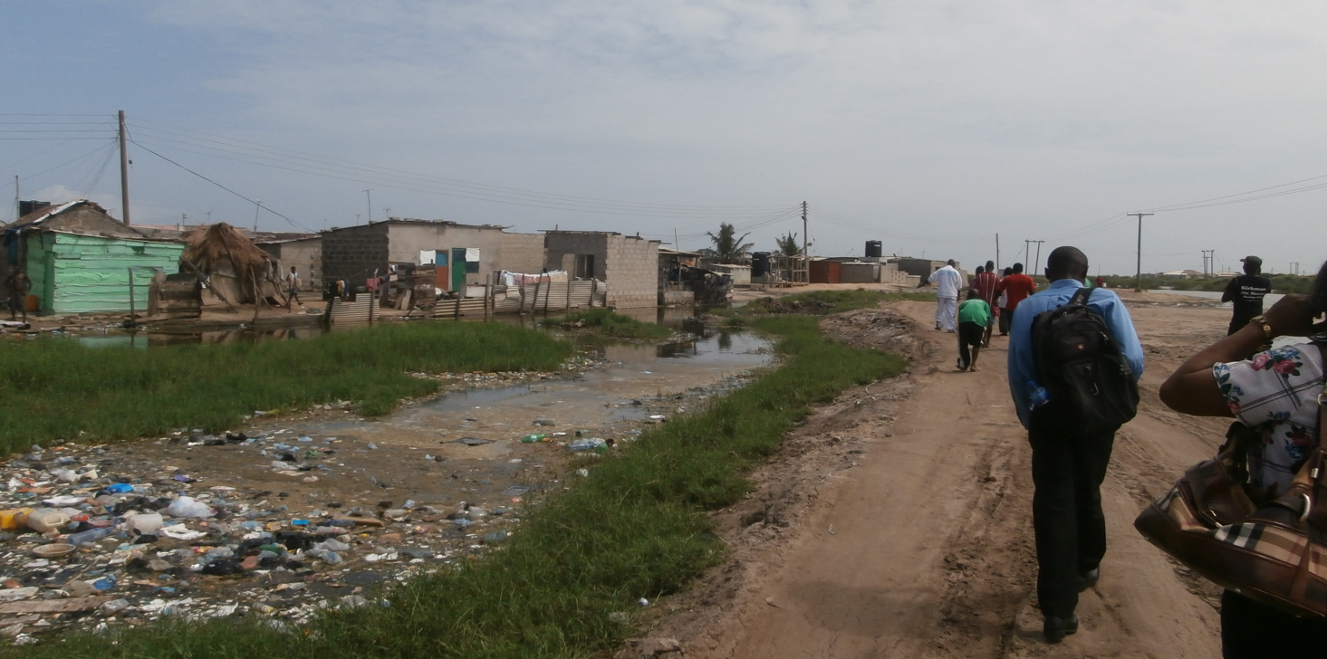
Some important definitions (from IPCC AR5 WG2)
Vulnerability
The propensity or predisposition to be adversely affected. Vulnerability encompasses a variety of concepts and elements including sensitivity or susceptibility to harm and lack of capacity to cope and adapt.
Dansoman, Accra, Ghana, June 2014

Slide 10
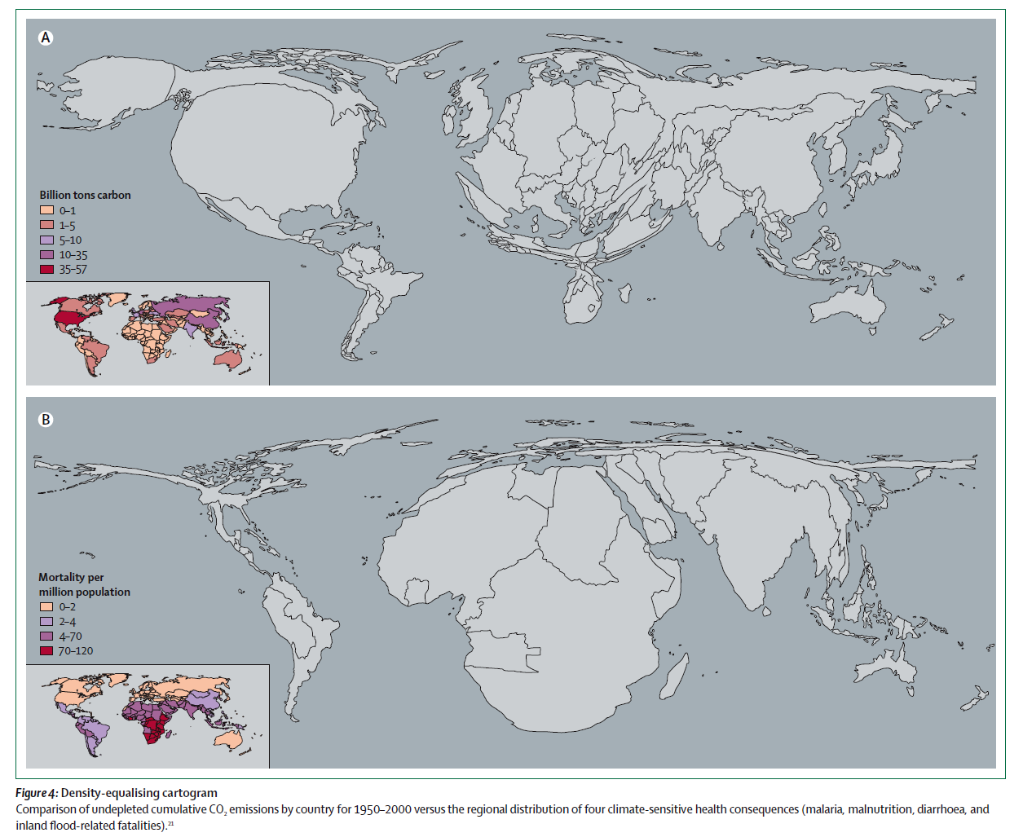
Emissions versus Impact
Costello et al, 2009 (Lancet)

Slide 11
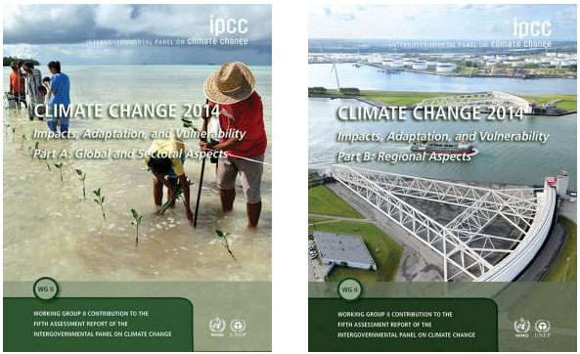
IPCC Working Group II: Impacts, Adaptation and Vulnerability
The Working Group II contribution to the Fifth Assessment Report considers the vulnerability and exposure of human and natural systems, the observed impacts and future risks of climate change, and the potential for and limits to adaptation.
The 242 Lead Authors and 66 Review Editors involved in the WGII AR5 are experts from around the world in disciplines including natural and physical sciences, engineering, social sciences, public policy, and development and management science

Slide 12
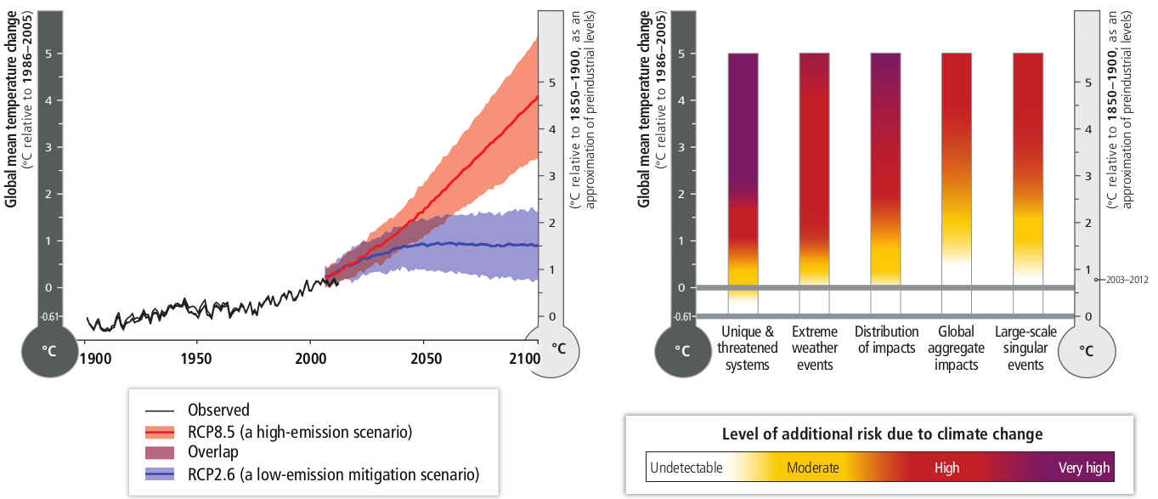
AR5 WGII SPM

Slide 13
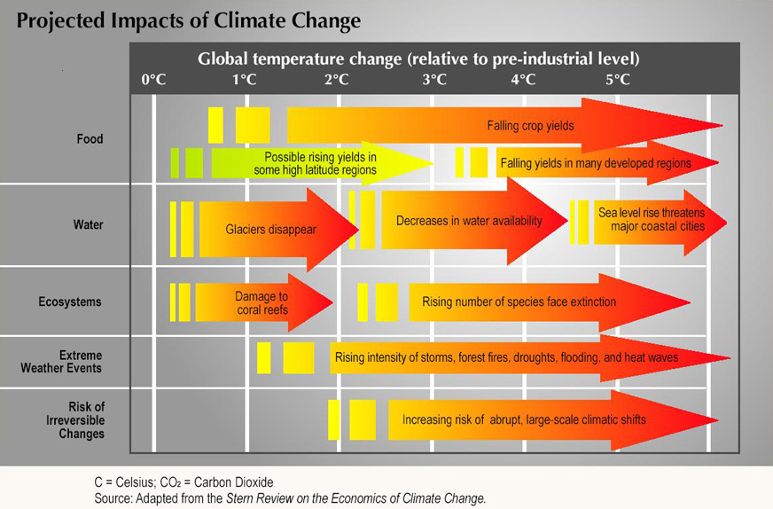

Slide 14
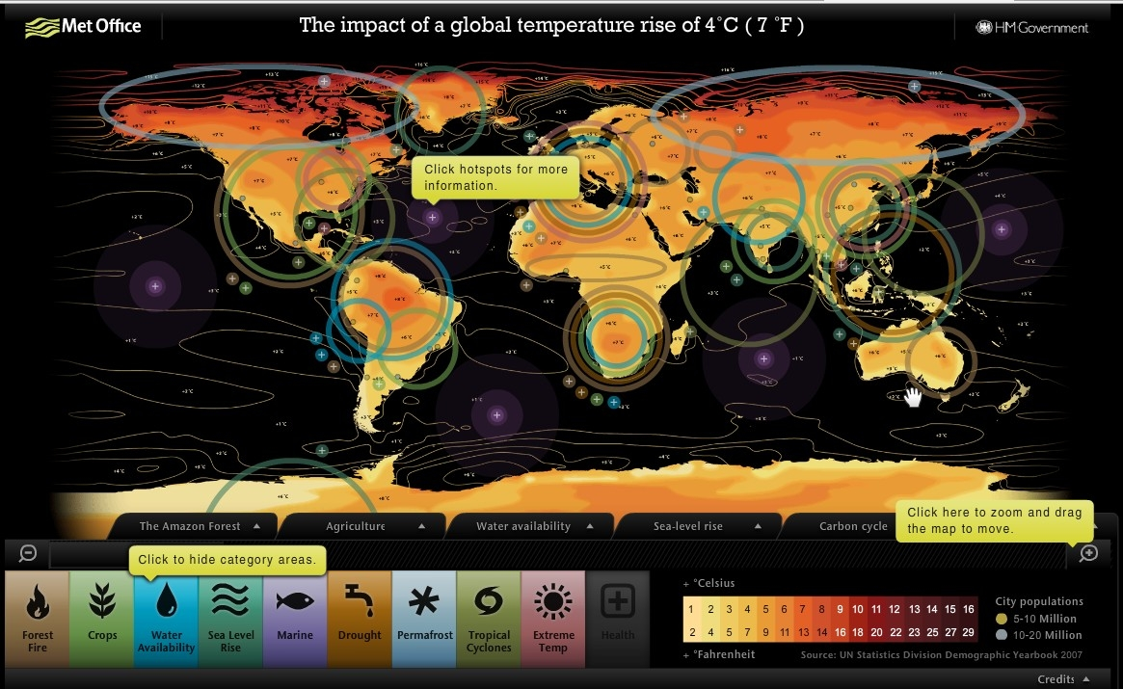
http://www.metoffice.gov.uk/climate-guide/climate-change/impacts/four-degree-rise/map

Slide 15
Four key sectors impacted by climate variability and climate change
Agriculture
Ecosystems
Human Health
Freshwater resources

Slide 16
Impacts on Agriculture
“The effects of climate change on crop and terrestrial food production are evident in several regions of the world (high confidence). Negative impacts of climate trends have been more common than positive ones. Positive trends are evident in some high-latitude regions (high confidence).”
“Evidence since AR4 confirms the stimulatory effects of carbon dioxide (CO2) in most cases and the damaging effects of elevated tropospheric ozone (O3) on crop yields (high confidence).”
“All aspects of food security are potentially affected by climate change, including food access, utilization, and price stability (high confidence).”
IPCC AR5 WG2: Chapter 7

Slide 17
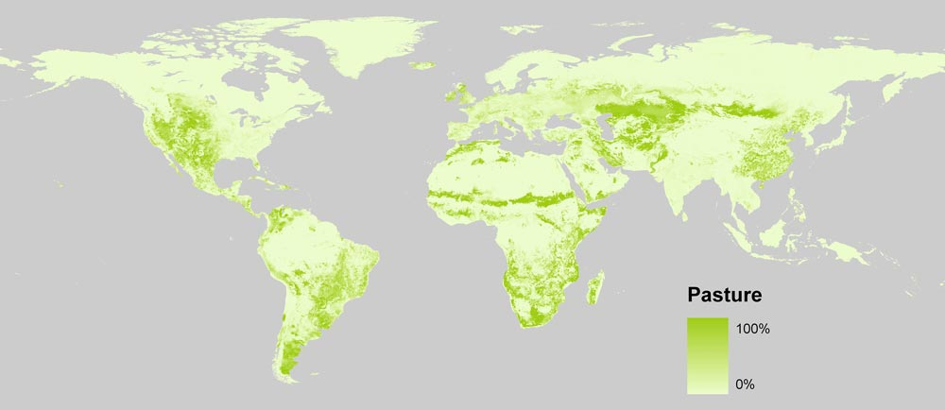
Impacts on Agriculture
Center for Sustainability and the Global Environment (SAGE) at UW-Madison (2005)

Slide 18
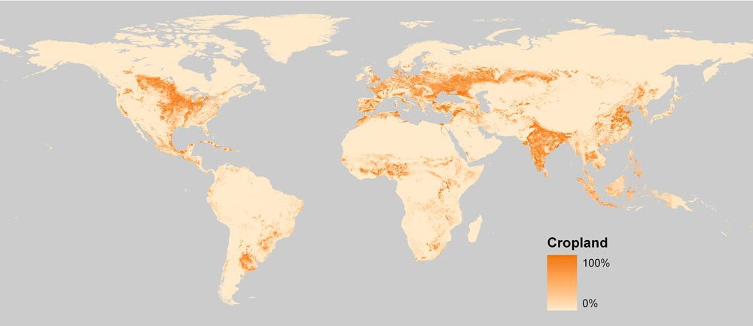
Impacts on Agriculture
Center for Sustainability and the Global Environment (SAGE) at UW-Madison (2005)

Slide 19
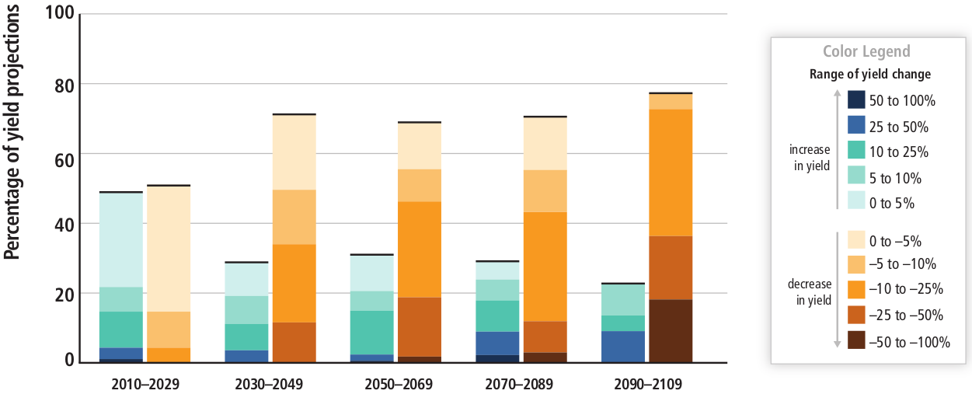
Impacts on Agriculture
IPCC AR5 WG2: Chapter 7

Slide 20
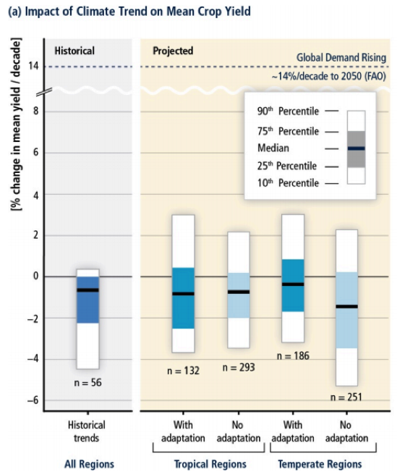
Impacts on Agriculture
For the world as a whole, climate change is anticipated to reduce crop yields for the remainder of the century, even with adaptation. This conclusion is a departure from the previous AR4 WG II report, in which crop production increases in mid-latitudes could offset losses in the early part of the 21st century.
IPCC AR5 WG2: Chapter 7

Slide 21
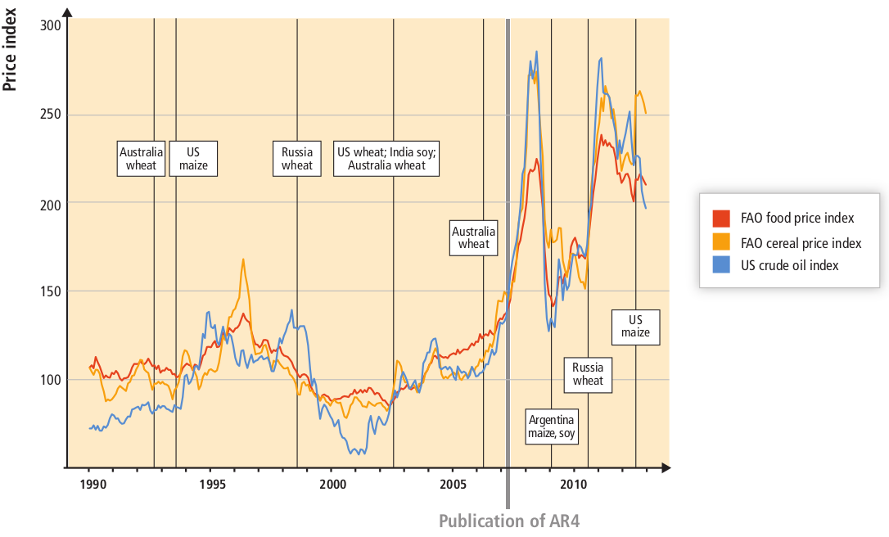
Impacts on Agriculture
Historical World Food Prices
Vertical lines indicating events when a top five producer of a crop had yields 25% below trend line (indicative of a seasonal climate extreme).
IPCC AR5 WG2: Chapter 7

Slide 22
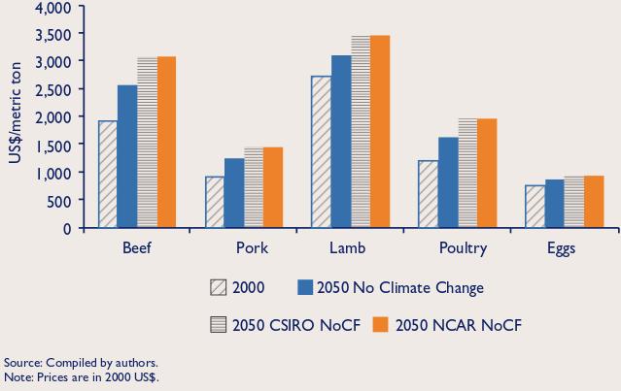
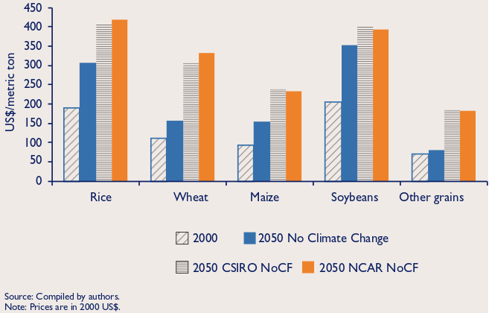
Impacts on Agriculture
Projected World Food Prices in 2050
Livestock
Crops
International Food Policy Research Institute (2009)
Climate Change Impact on Agriculture and Costs of Adaptation

Slide 23
Impacts on Ecosystems
“Climate change is projected to be a powerful stressor on terrestrial and freshwater ecosystems in the second half of the 21st century, especially under high-warming scenarios such as RCP6.0 and RCP8.5 (high confidence).”
“Many plant and animal species have moved their ranges, altered their abundance, and shifted their seasonal activities in response to observed climate change over recent decades (high confidence).”
“By the mid-21st century, the spatial shifts of marine species will cause species richness to increase at mid- and high latitudes (high confidence) and to decrease at tropical latitudes (medium confidence), resulting in global redistribution of catch potential for fishes and invertebrates, with implications for food security (medium confidence).”
IPCC AR5 WG2: Chapter 4 and Chapter 6

Slide 24
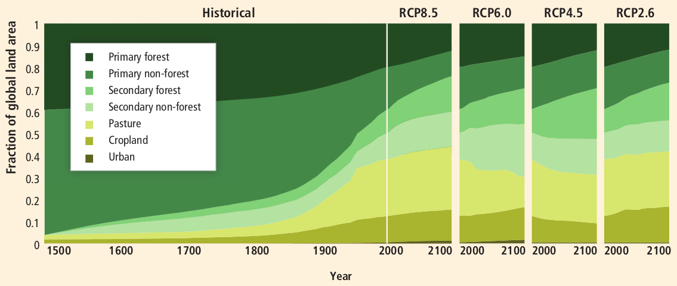
Impacts on Ecosystems
Historical and projected changes in land cover
IPCC AR5 WG2: Chapter 4

Slide 25
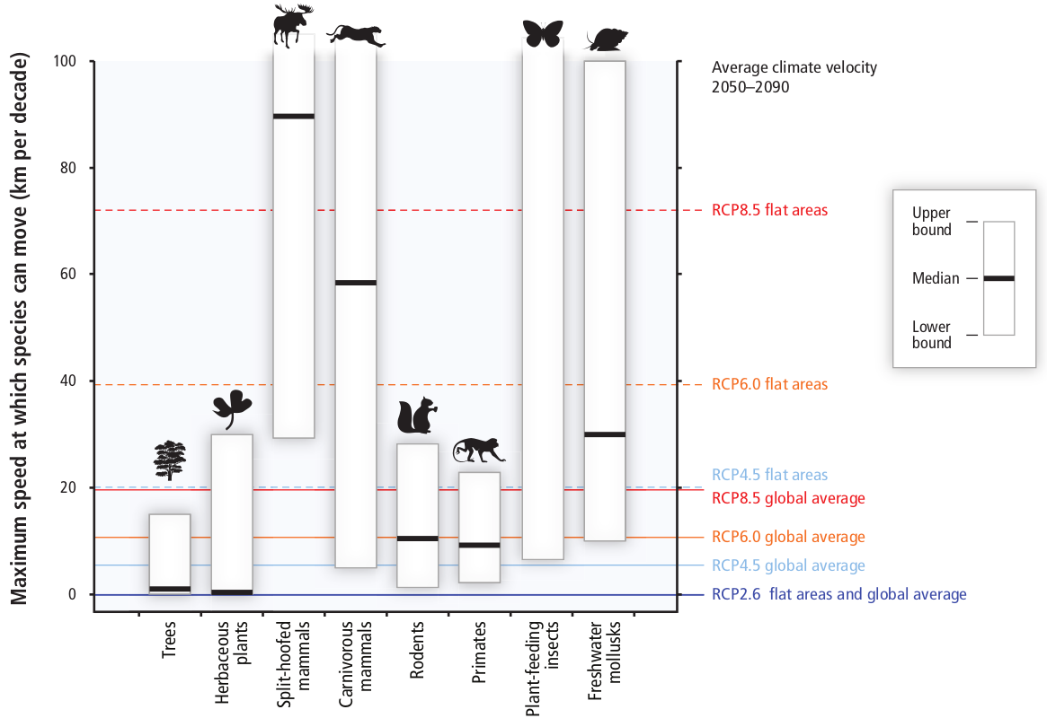
AR5 WGII SPM
Impacts on Ecosystems
“A large fraction of both terrestrial and freshwater species faces increased extinction risk under projected climate change during and beyond the 21st century, especially as climate change interacts with other stressors, such as habitat modification, over-exploitation, pollution, and invasive species (high confidence).”

Slide 26
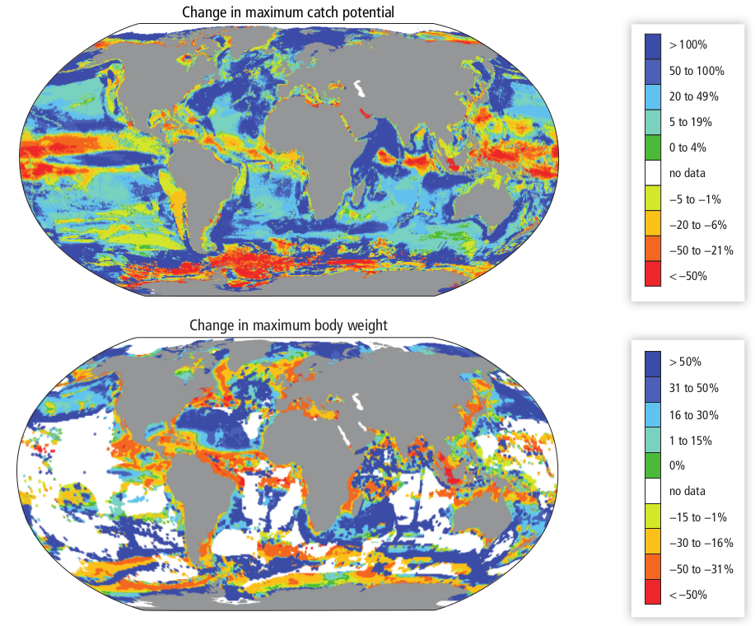
Impacts on Ecosystems
Projected changes to fish stocks
Climate change effects on the biogeography, body size, and fisheries’ catch potential of marine fishes and invertebrates.
Top: approximately 1000 species of exploited fishes and invertebrates, under warming by 2°C according to SRES A1B (≈RCP6.0), comparing the 10-year averages 2001–2010 and 2051–2060; redrawn from Cheung et al., 2010.
Bottom: 610 species of marine fishes, from 1991–2010 to 2041–2060 under SRES A2 (approximately RCP6.0 to 8.5; Cheung et al., 2013b).
IPCC AR5 WG2: Chapter 6

Slide 27
Impacts on Human Health
“Until mid-century climate change will act mainly by exacerbating health problems that already exist (very high confidence).”
“In recent decades, climate change has contributed to levels of ill health (likely) though the present worldwide burden of ill health from climate change is relatively small compared with other stressors on health and is not well quantified.”
“In addition to their implications for climate change, essentially all the important climate-altering pollutants (CAPs) other than carbon dioxide (CO2) have near-term health implications (very high confidence).”
IPCC AR5 WG2: Chapter 11

Slide 28
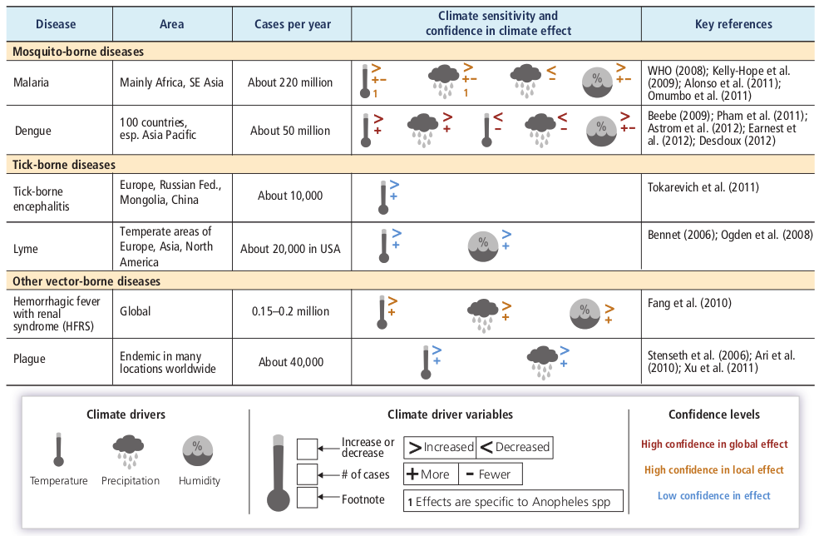
Impacts on Human Health
IPCC AR5 WG2: Chapter 11

Slide 29
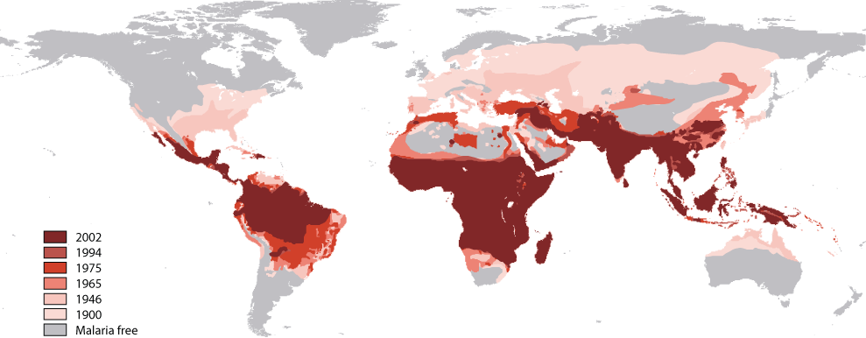
Historical changes in malaria prevalence
Hay et al (2004) Lancet Infectious Diseases, 4(6), 327-336.

Slide 30
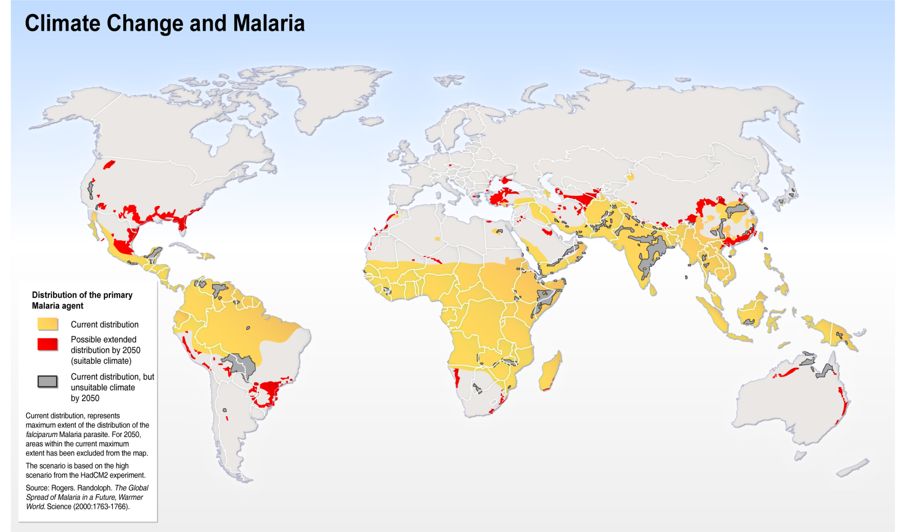
Future changes in malaria prevalence
Hugo Ahlenius (2005) Climate change and malaria, scenario for 2050,
Environment and Poverty Times #4, UNEP/GRID-Arendal

Slide 31
Impacts on Freshwater resources
“Freshwater-related risks of climate change increase significantly with increasing greenhouse gas (GHG) concentrations (robust evidence, high agreement).”
“Climate change is projected to reduce raw water quality, posing risks to drinking water quality even with conventional treatment (medium evidence, high agreement).”
“In regions with snowfall, climate change has altered observed streamflow seasonality, and increasing alterations due to climate change are projected (robust evidence, high agreement).”
“Because nearly all glaciers are too large for equilibrium with the present climate, there is a committed water resources change during much of the 21st century, and changes beyond the committed change are expected due to continued warming.”
IPCC AR5 WG2: Chapter 4

Slide 32
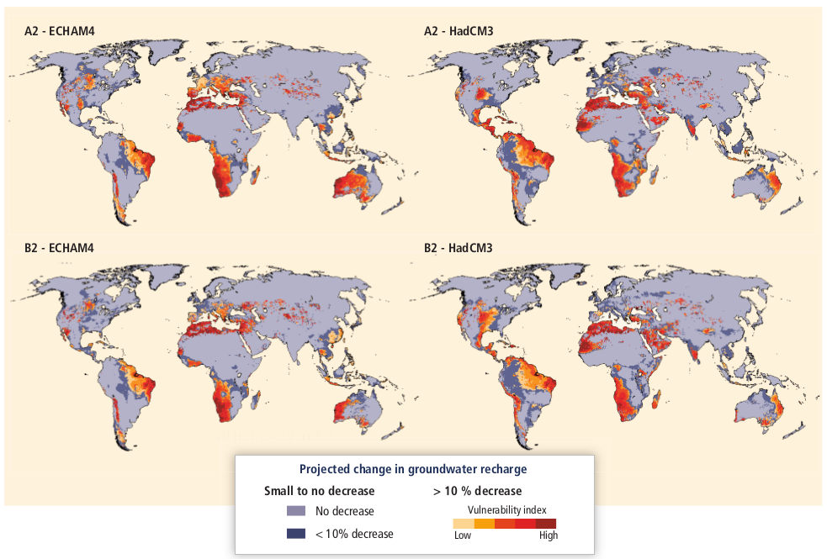
Impacts on Freshwater resources
Projected Renewable groundwater resources by the 2050s.
IPCC AR5 WG2: Chapter 4

Slide 33
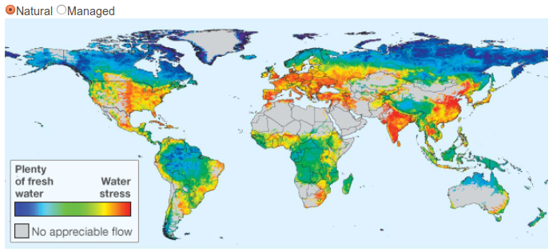
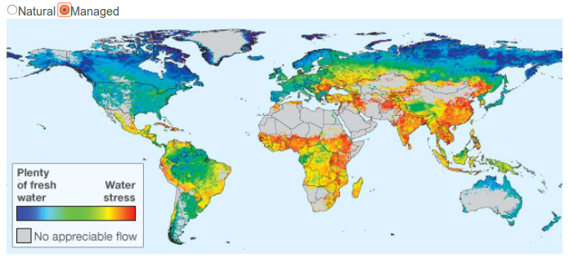
Impacts on Freshwater resources
Vörösmarty et al (2010) Nature

Slide 34
Exploring climate change impacts

Slide 35
Exploring climate change impacts
  Imagine you work in a specific sector and region (e.g. tourism in north Africa, mining in eastern USA, finance in London…)
  Is your sector currently sensitive to climate? If so, how?
  What might the impacts of climate change be on your sector?
  Think about:
    Positive and negative impacts
    Direct and indirect impacts
    What climate variables are important?
    What non-climatic drivers of future risk are particularly relevant?
  3. Write two or three sentences to summarise the impact of current climate and projected future climate change on your sector.

Slide 36
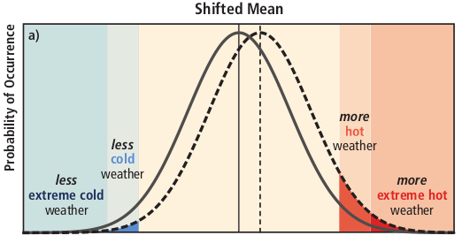
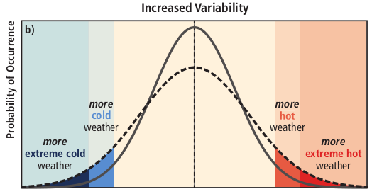
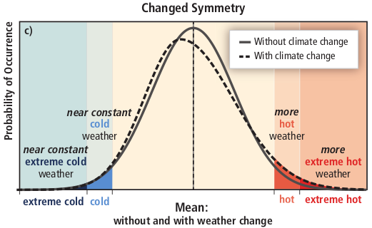
Extremes

Slide 37
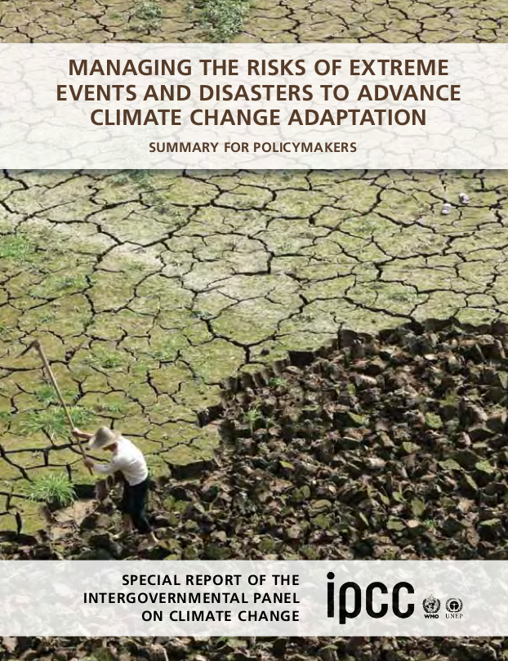
Extremes
“There is evidence from observations gathered since 1950 of change in some extremes. Confidence in observed changes in extremes depends on the quality and quantity of data and the availability of studies analyzing these data, which vary across regions and for different extremes.”
e.g. “There is medium confidence that some regions of the world have experienced more intense and longer droughts, in particular in southern Europe and West Africa, but in some regions droughts have become less frequent, less intense, or shorter, for example, in central North America and northwestern Australia.”

Slide 38
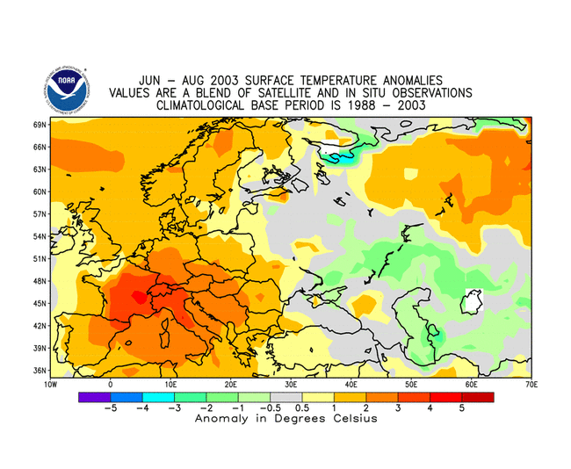
August 2003 heat wave
Maximum daily temperatures 36ºC for around 9 days.
An estimated 30,000 to 70,000 related deaths in Europe with France worst affected, experiencing approximately 15,000 excess deaths.

Slide 39
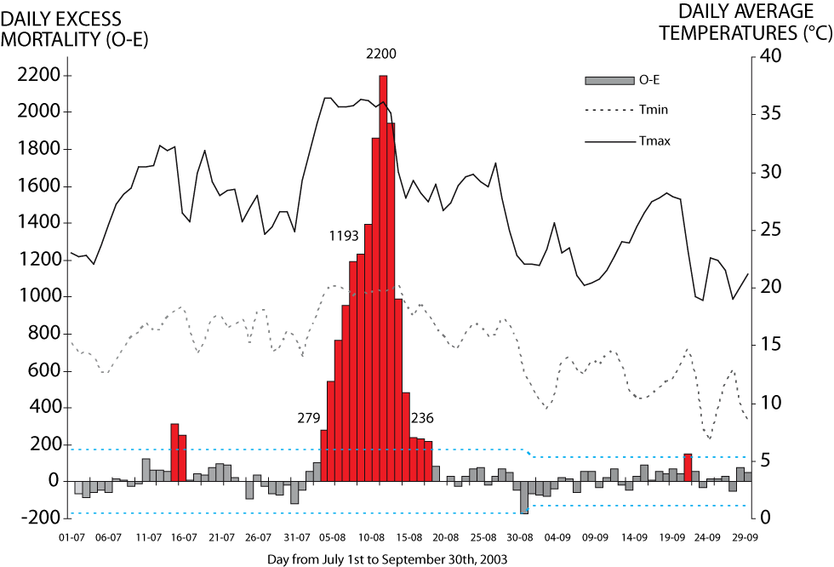
August 2003 heat wave
Fouillet et al (2006) Int Arch Occup Environ Health, 80, 16-24.
Notes:
This figure shows the variation of the difference between observed mortality (O) and the expected mortality (i.e. background mortality; E) during the period of the 2003 heat wave. Values of O-E significant to the 95% confidence interval are plotted with a blue dashed line. Values of O-E that are statistically significant are plotted in red. Overlain are the observed daily maximum and minimum temperatures (solid and dashed grey lines). The important features of this figure are that the large O-E anomaly corresponds to the highest maximum and minimum temperatures and that the maximum excess mortality (O-E) lags behind the onset of the heat wave. Note this is total mortality and includes a range of different causes of death.
The peak rate is an additional 2200 deaths per day.
Fouillet A. et al., (2006) “Excess mortality related to the August 2003 heat wave in France. Int Arch Occup Environ Health, 80, 16-24.

Slide 40
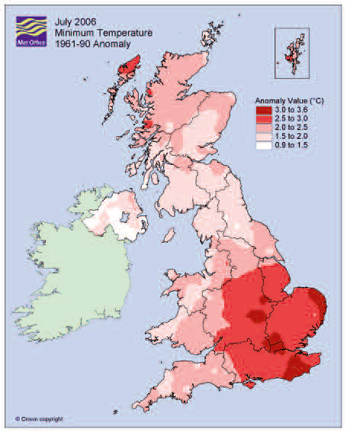
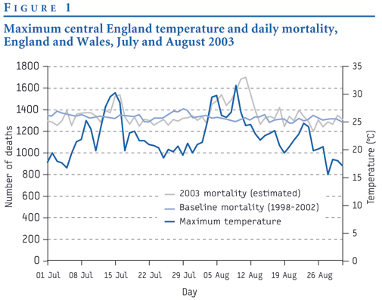
August 2003 heat wave
In one hot spell in London in August 2003, deaths among people aged over 75 rose by 60 per cent. Overall 16% excess deaths.

Slide 41
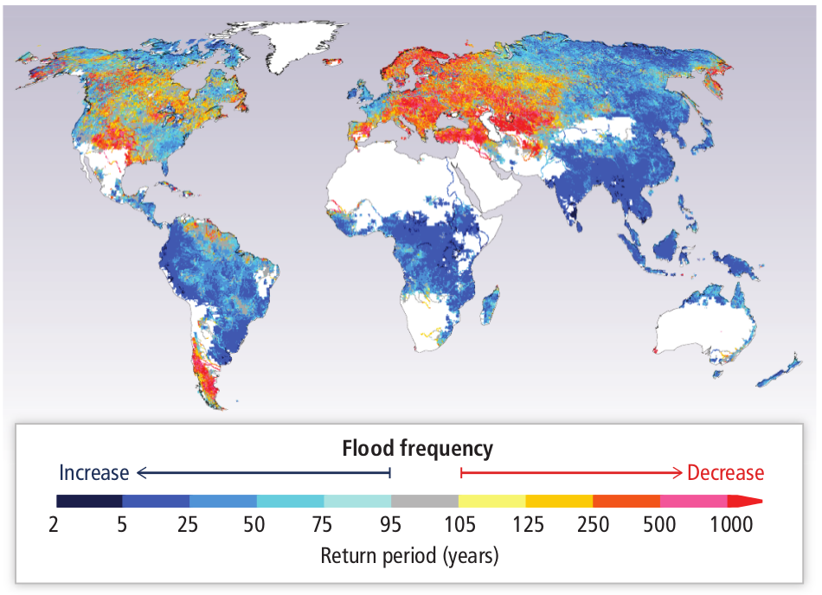
…but extremes can be complicated
IPCC AR5 WG2: Chapter 3
“So far there are no widespread observations of changes in flood magnitude and frequency due to anthropogenic climate change, but projections imply variations in the frequency of floods (limited evidence, medium agreement).”
Multi-model median return period (years) in the 2080s for the 20th century 100-year flood (Hirabayashi et al., 2013), based on one hydrological model driven by 11 Coupled Model Intercomparison Project Phase 5 (CMIP5) General Circulation Models (GCMs) under Representative Concentration Pathway 8.5 (RCP8.5).

Slide 42
IPCC Working Group 2 Video https://www.youtube.com/watch?v=jMIFBJYpSgM
(1:44 to 4:44)

Slide 43
Key non-climatic drivers of vulnerability
Neil Leary (2008) Climate Change and Vulnerability
e.g. resources non-climates drivers relevant for water resources
Growing water demand
Failure of water and land-use policy, planning and management
High dependence on single water source
High dependence on rain-fed agriculture
Land degradation
High poverty rate
Pollution to water from industry and agriculture
Undefined or insecure water usage rights
Ineffective disaster preparedness, prevention and warning systems

Slide 44
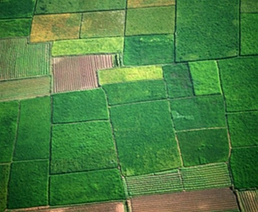
Impact Modelling
  Met Office JULES (Joint UK Land Environment Simulator)
  Aims
  Increase our understanding of the interactions between the land and the atmosphere
  Investigate the impact of the land surface on the predictability of weather and climate on all timescales
  Develop our understanding of the land processes that contribute towards the changing climate, for example through changes in surface hydrology and the terrestrial carbon cycle
  Investigate the interactions between different impacts of climate change on the land surface

Slide 45
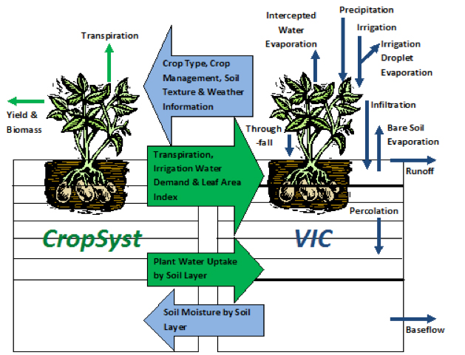
Impact Modelling
  Crop Models
e.g. CropSyst is a multi-year, multi-crop, daily/hourly time step cropping systems simulation model developed to serve as an analytical tool to study the effects of climate, soils, and management on cropping systems (Stöckle et al., 1994, 2003, 2010).

Slide 46
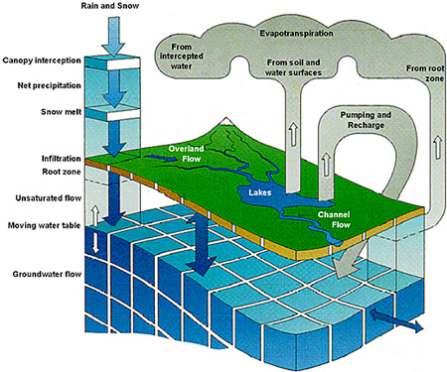
Impact Modelling
  Hydrological models
  Hydrologic models are simplified, conceptual representations of a part of the hydrologic cycle. Two major types of hydrologic models can be distinguished:
  Stochastic Models. These models are based on data and using mathematical and statistical concepts to link a certain input (for instance rainfall) to the model output (for instance runoff).
  Process-Based Models. These models try to represent the physical processes observed in the real world.

Slide 47
Impact Modelling
  Other types of impacts models include:
    Economic models (e.g. DICE)
    Land-use models
    Ecosystem-specific models
    Energy generation and demand models
    Forestry models

Slide 48
Summary
  It is critical to distinguish between impacts associated with the current and past climate with those anticipated under future climate change
  The impacts of climate change in the future are expected to be largely negative but this varies with regions and sectors.
  Climate is only one driver of risk and impacts need to be understood in the context of other non-climatic driving factors.
  Impacts are often associated with climate extremes.
  Scientists use impacts models to translate the climate model output into sector and system specific relevant data.

