Slide 1
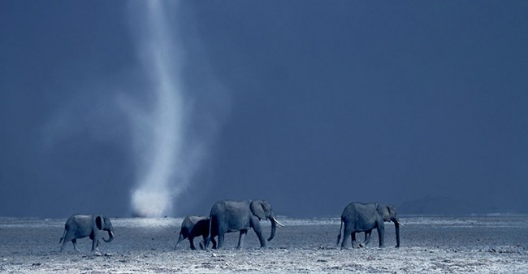
GEOGM1405
Climate Change: Science and Impacts
WEEK 8
Climate Change Impacts – Part 2

Slide 2
Assignment 2
Impacts Essay
Write a 2,000 to 2,500 word essay on any aspect related to the impacts of climate variability and climate change.
Deadline for submission: 14:00 Thursday 22nd January 2015

Slide 3
Aims of Today’s Lecture
Outline the tools that climate scientists use to understand potential impacts
Explore the impact of climate change on extreme weather and climate events
Consider the economic impacts of climate change
Discuss the use of insurance to reduce climate risks
Outline key climate impacts for the UK

Slide 4
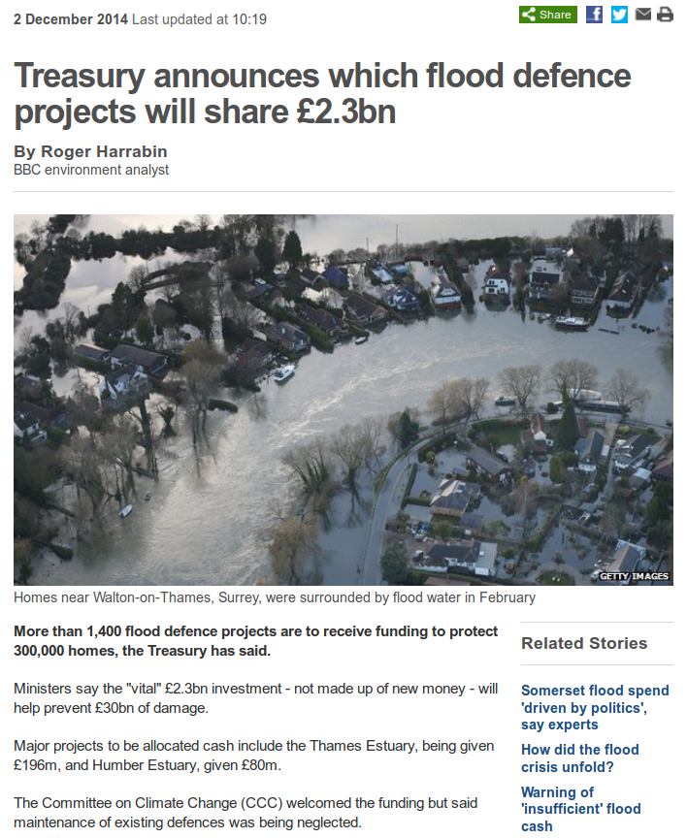
“The CCC - an independent body that advises the UK government - told BBC News that only a quarter of flood defences were being maintained fully. This means the remainder will degrade and need replacing at extra expense.
The condition of assets was in decline before the storms of last winter, mirroring the reduction in maintenance spending over the period, it said.
The committee also said the Environment Agency now had 800 fewer flood risk management staff than in 2010/11, including in asset management and incident control.”

Slide 5
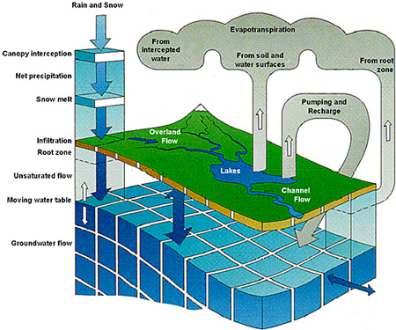
Impact Modelling
  Hydrological models
  Hydrologic models are simplified, conceptual representations of a part of the hydrologic cycle. Two major types of hydrologic models can be distinguished:
  Stochastic Models. These models are based on data and using mathematical and statistical concepts to link a certain input (for instance rainfall) to the model output (for instance runoff).
  Process-Based Models. These models try to represent the physical processes observed in the real world.

Slide 6
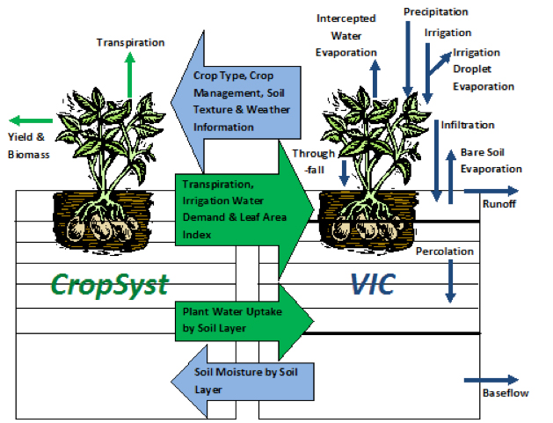
Impact Modelling
  Crop Models
  Crop models estimate crop yield as a function of weather conditions, soil conditions, and choice of crop management practices. Two major types of crops models can be distinguished:
1. Statistical models. These typically rely on yield information for large areas (such as counties), and identify broad trends.
2. Mechanistic models. These attempt to use fundamental mechanisms of plant and soil processes to simulate specific outcomes. These involve fairly detailed and computation-intensive simulations.
e.g. CropSyst is a multi-year, multi-crop, daily/hourly time step cropping systems simulation model developed to serve as an analytical tool to study the effects of climate, soils, and management on cropping systems (Stöckle et al. 2010).

Slide 7
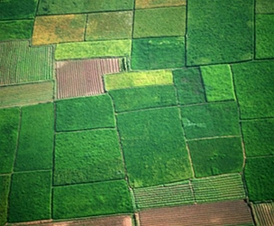
Impact Modelling
  Met Office JULES (Joint UK Land Environment Simulator)
  Aims:
  Increase our understanding of the interactions between the land and the atmosphere
  Investigate the impact of the land surface on the predictability of weather and climate on all timescales
  Develop our understanding of the land processes that contribute towards the changing climate, for example through changes in surface hydrology and the terrestrial carbon cycle
  Investigate the interactions between different impacts of climate change on the land surface

Slide 8
Impact Modelling
  Other types of impacts models include:
    Economic models (e.g. DICE)
    Land-use models
    Ecosystem-specific models
    Energy generation and demand models
    Forestry models

Slide 9
IPCC Working Group 2 Video https://www.youtube.com/watch?v=jMIFBJYpSgM
(1:44 to 4:44)

Slide 10
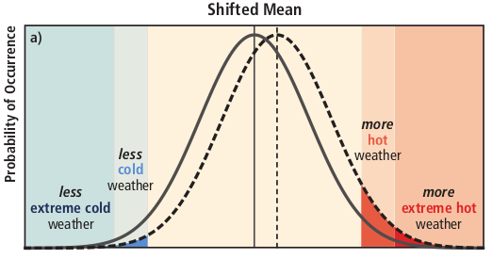
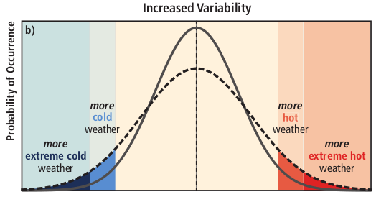
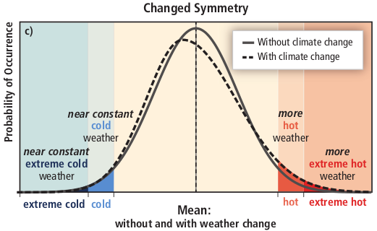
Extremes

Slide 11
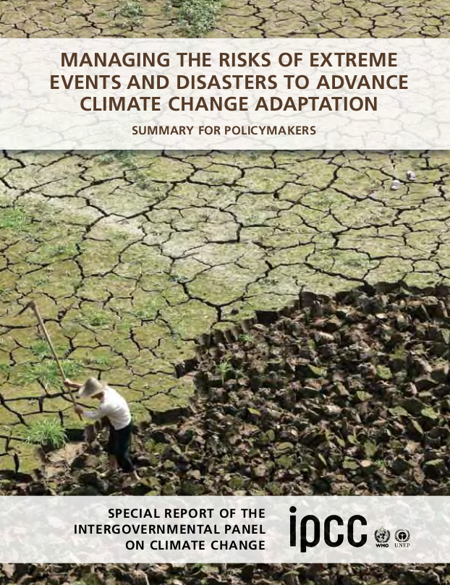
Extremes
“There is evidence from observations gathered since 1950 of change in some extremes. Confidence in observed changes in extremes depends on the quality and quantity of data and the availability of studies analyzing these data, which vary across regions and for different extremes.”
e.g. “There is medium confidence that some regions of the world have experienced more intense and longer droughts, in particular in southern Europe and West Africa, but in some regions droughts have become less frequent, less intense, or shorter, for example, in central North America and northwestern Australia.”

Slide 12
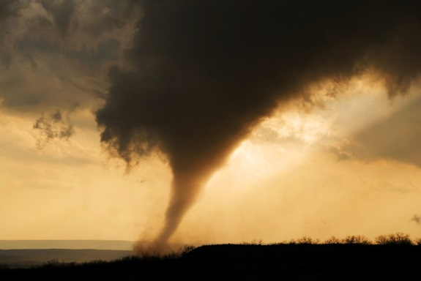
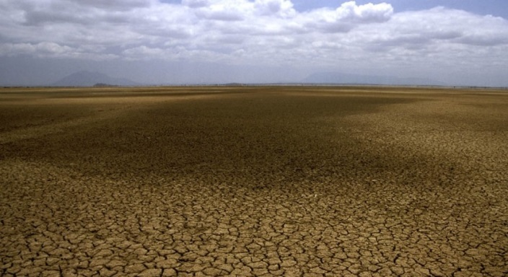
Extremes
Rapid versus slow onset events
A rapid onset event may be a single, discrete event that occurs in a matter of days or even hours, whereas slow onset events evolve gradually from incremental changes occurring over many years or from an increased frequency or intensity of recurring events.
There are some important relationships between rapid onset and slow onset events.
Drought, for example, is an extreme weather event, but it is also closely linked to slow
onset, incremental climatic change.

Slide 13
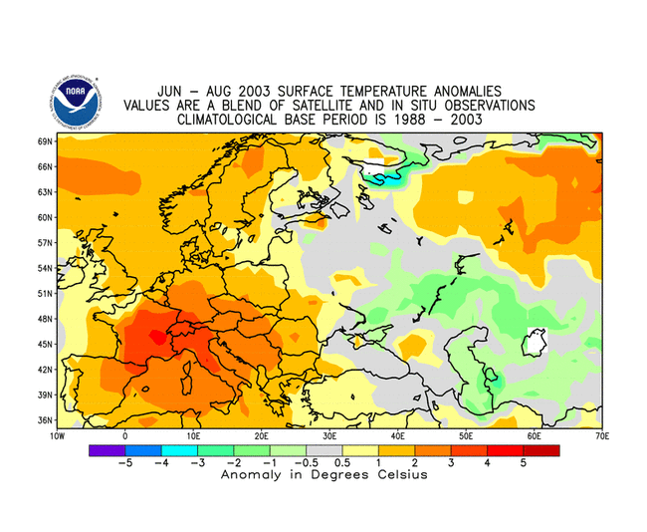
August 2003 heat wave
Maximum daily temperatures 36ºC for around 9 days.
An estimated 30,000 to 70,000 related deaths in Europe with France worst affected, experiencing approximately 15,000 excess deaths.

Slide 14
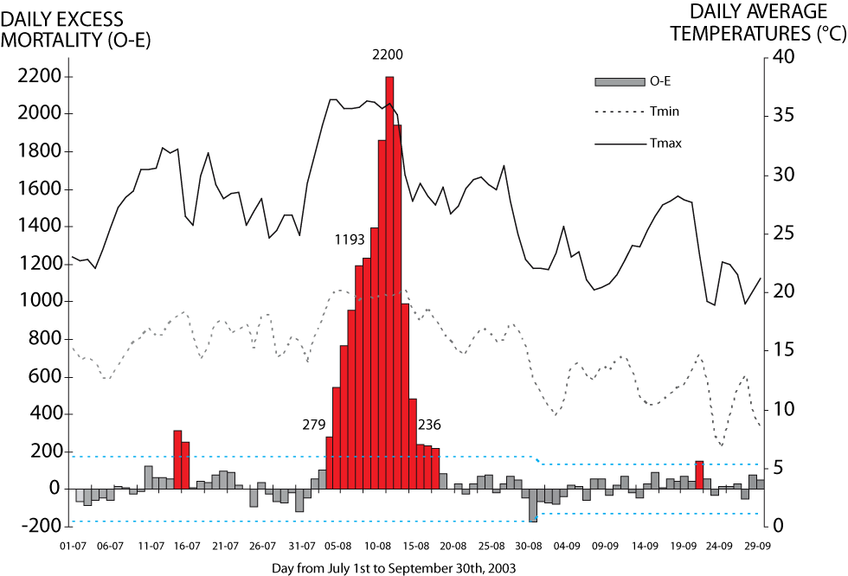
August 2003 heat wave
Fouillet et al (2006) Int Arch Occup Environ Health, 80, 16-24.
Notes:
This figure shows the variation of the difference between observed mortality (O) and the expected mortality (i.e. background mortality; E) during the period of the 2003 heat wave. Values of O-E significant to the 95% confidence interval are plotted with a blue dashed line. Values of O-E that are statistically significant are plotted in red. Overlain are the observed daily maximum and minimum temperatures (solid and dashed grey lines). The important features of this figure are that the large O-E anomaly corresponds to the highest maximum and minimum temperatures and that the maximum excess mortality (O-E) lags behind the onset of the heat wave. Note this is total mortality and includes a range of different causes of death.
The peak rate is an additional 2200 deaths per day.
Fouillet A. et al., (2006) “Excess mortality related to the August 2003 heat wave in France. Int Arch Occup Environ Health, 80, 16-24.

Slide 15
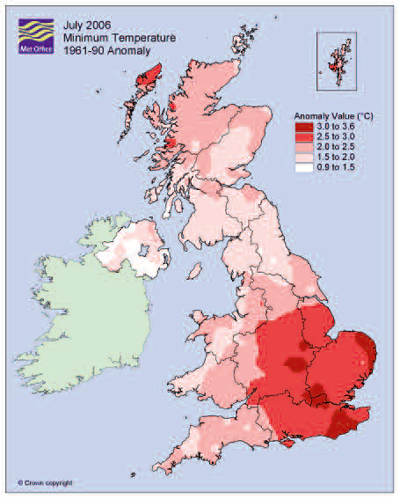
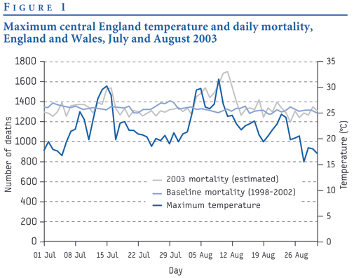
August 2003 heat wave
In one hot spell in London in August 2003, deaths among people aged over 75 rose by 60 per cent. Overall 16% excess deaths.

Slide 16
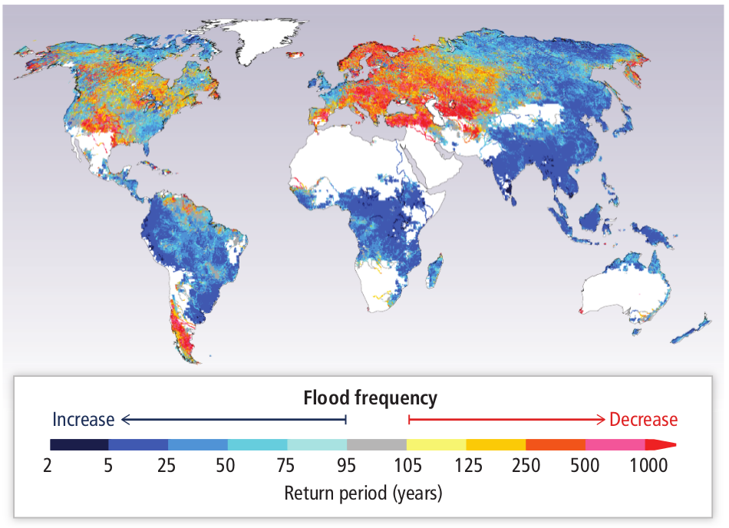
…but extremes can be complicated
IPCC AR5 WG2: Chapter 3
“So far there are no widespread observations of changes in flood magnitude and frequency due to anthropogenic climate change, but projections imply variations in the frequency of floods (limited evidence, medium agreement).”
Multi-model median return period (years) in the 2080s for the 20th century 100-year flood (Hirabayashi et al., 2013), based on one hydrological model driven by 11 Coupled Model Intercomparison Project Phase 5 (CMIP5) General Circulation Models (GCMs) under Representative Concentration Pathway 8.5 (RCP8.5).

Slide 17
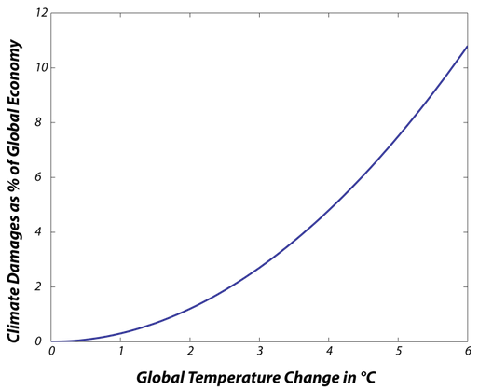
Economics of climate change
William Nordhaus
https://www.e-education.psu.edu/earth103/node/764

Slide 18
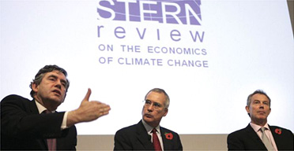
Economics of climate change
The Stern Review (2007)
The independent review was commissioned by the Chancellor of the Exchequer,
reporting to both the Chancellor and to the Prime Minister, to help assess the evidence and building under standing of the economics of climate change.
“The benefits of strong, early action on climate change outweigh the costs. The effects of our actions now on future changes in the climate have long lead times. What we do now can have only a limited effect on the climate over the next 40 or 50 years. On the other hand what we do in the next 10 or 20 years can have a profound effect on the climate in the second half of this century and in the next.”
“The Review estimates the annual costs of stabilisation at 500-550ppm CO₂e to be around 1% of GDP by 2050 - a level that is significant but manageable.”
Uses economic models, including integrated assessment models that estimate the economic impacts of climate change, and transition to low-carbon energy systems for the economy as a whole.

Slide 19
Economics of climate change
“I find that the difference stems almost entirely from its technique for calculating discount rates and only marginally on new science or economics. The reasoning has questionable foundation in terms of its ethical assumptions and also leads to economic results that are inconsistent with market data.”
“[The discount rate] measures the relative importance in societal decisions of the welfare of future generations relative to that of the current generation. A zero discount rate means that all generations into the indefinite future are treated the same; a positive discount rate means that that the welfare of future generations is reduced or “discounted” compared with nearer generations.”
“The Stern Review’s unambiguous conclusions about the need for urgent and immediate action will not survive the substitution of assumptions that are consistent with today’s
marketplace real interest rates and savings rates. So the central questions about global-
"warming policy—how much, how fast, and how costly—remain open.”
Nordhaus (2007) Critical Assumptions in the Stern Review on Climate Change, Science 317, 201-202

Slide 20
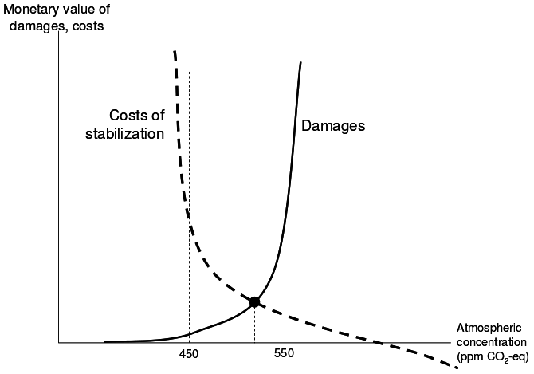
Economics of climate change
“As Weitzman and others have noted, this alone could be sufficient to flip the outcome of cost-benefit analysis: the high discount rates favored by many economists seem to justify doing very little for now; Stern’s low discount rate, applied to the same data, endorses dong much more, much sooner”
Ackerman (2007) Debating Climate Economics: The Stern Review vs. Its Critics
“Unfortunately, the Review did not develop a persuasive argument for why climate change threatens to inflict upon future generations irreversible and non-substitutable damage to
and loss of natural capital. This represents a missed opportunity as it would have provided a much more compelling case for drastic action than the Review’s arguments for a low discount rate.”
Neumeyer (2007) A missed opportunity: The Stern Review on climate change fails to tackle the issue of non-substitutable loss of natural capital. Global Environmental Change, 17, 297–301.

Slide 21
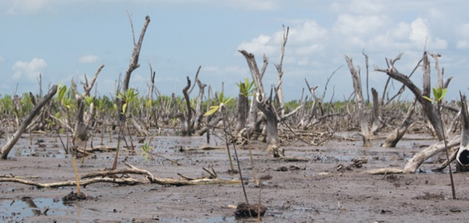
Loss and damage
At the 2012 UNFCCC COP meeting in Doha, Qatar, nations agreed that rich nations should compensate poor countries for loss and damage inflicted by climate change.
“(Non-economic) Loss and damage describes the impact associated with the adverse effects of climate change. These adverse effects include those related to extreme events and slow onset events such as sea level rise, increasing temperatures, ocean acidification, glacial retreat and related impacts, salinization, land and forest degradation, loss of biodiversity and desertification.”
UNFCC Background Paper 2012
Loss and damage has been categorized as avoided (through mitigation and adaptation), unavoided (through inadequate mitigation and adaptation efforts) or unavoidable loss and damage from climate change impacts that cannot be adapted to such as sea level rise or ocean acidification.
Verheyen, R. (2012) Bonn: Germanwatch. Tackling Loss and Damage: A new role for the climate regime?

Slide 22
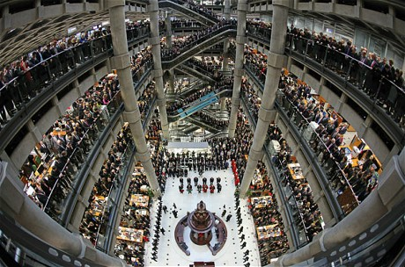
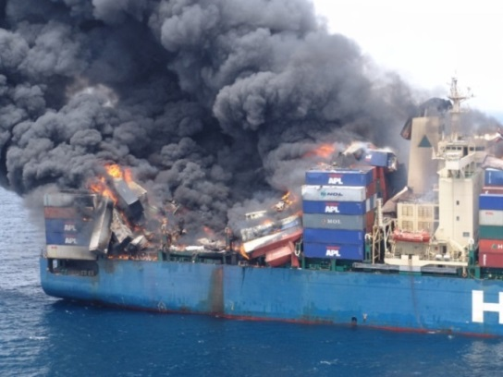
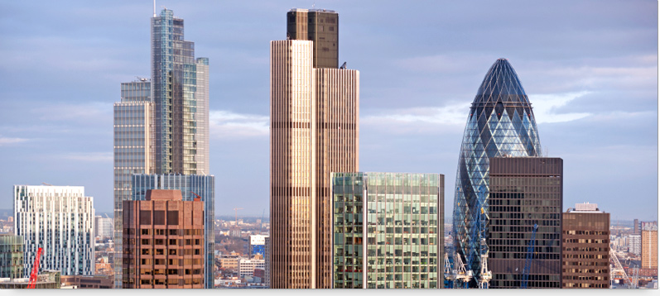
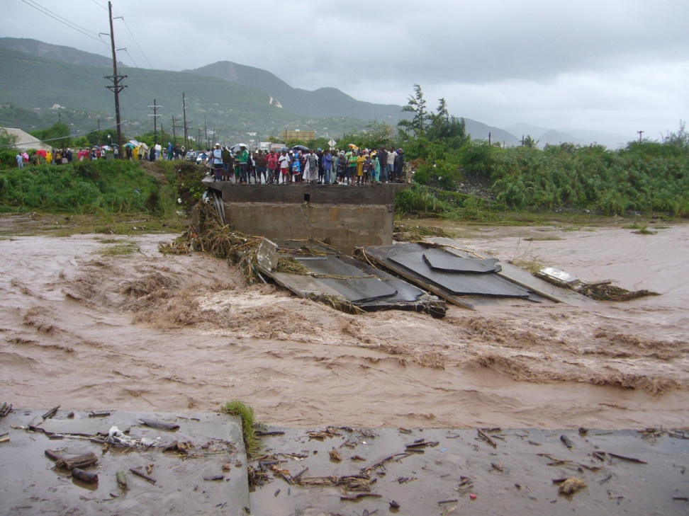
Insurance
Insurance is the equitable transfer of the risk of a loss, from one entity to another in exchange for payment. It is a form of risk management primarily used to hedge against the risk of a contingent, uncertain loss.
Wikipedia (2014) …who else!?

Slide 23
Two primary insurance issues related to climate change
The impacts of climate change on insurance business activities
    Managing losses
    Exploiting opportunities
2. The role of insurers in acting as an enabler, or barrier, to adaptation and mitigation

Slide 24


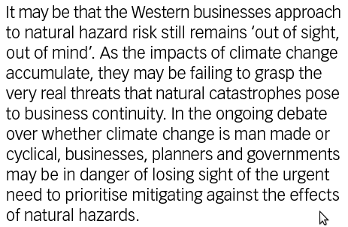
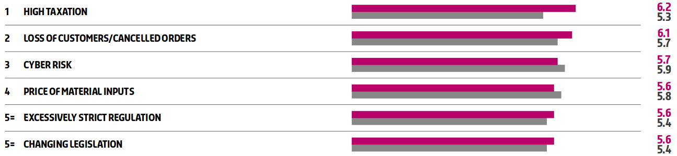
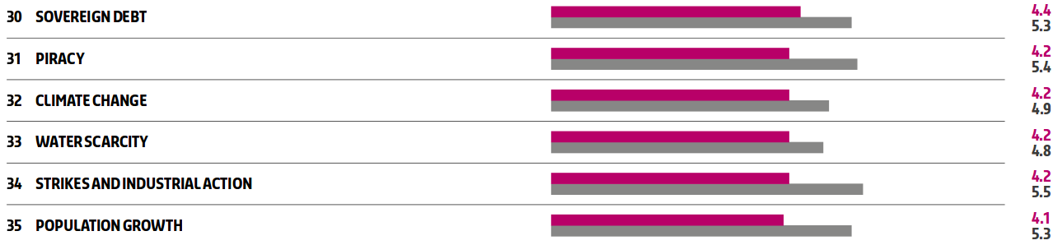
Insurers’ attitudes to climate change risk

Slide 25
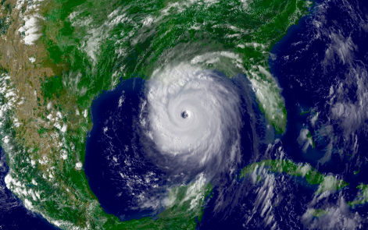
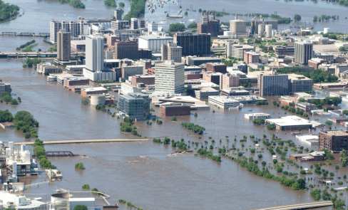
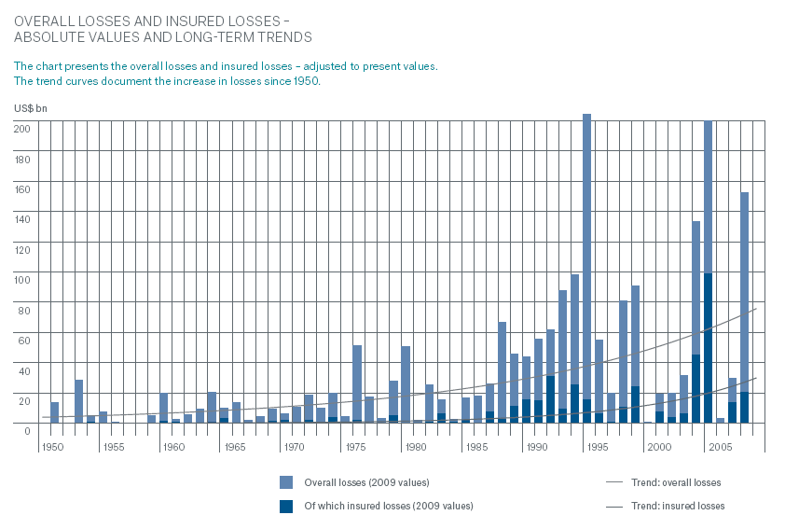
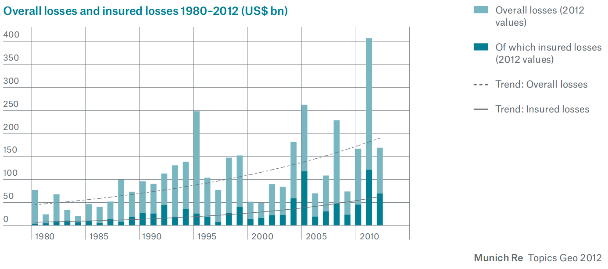
Catastrophe Losses
Munich Re, 2010

Slide 26
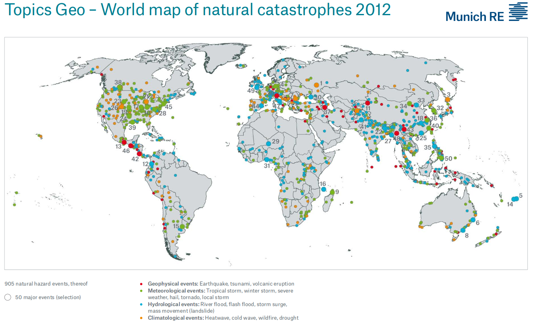
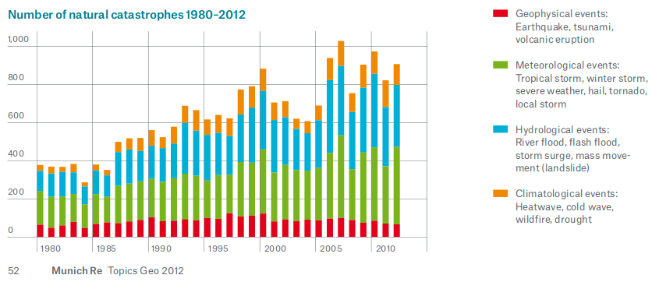
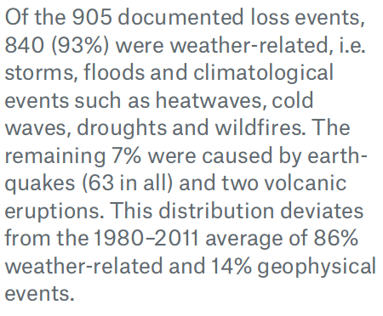

Slide 27
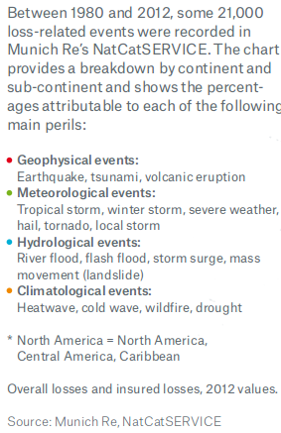
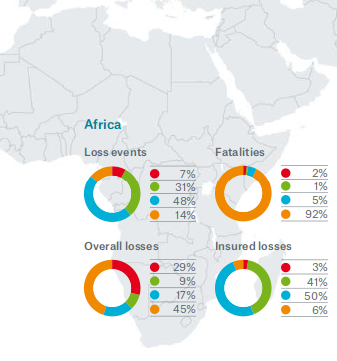

Slide 28
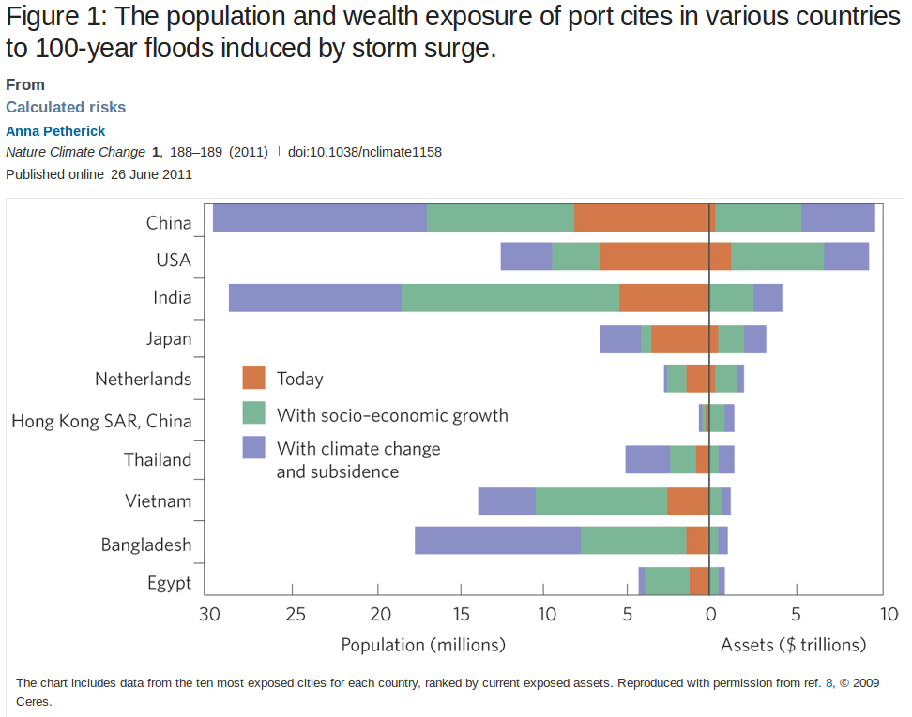

Slide 29
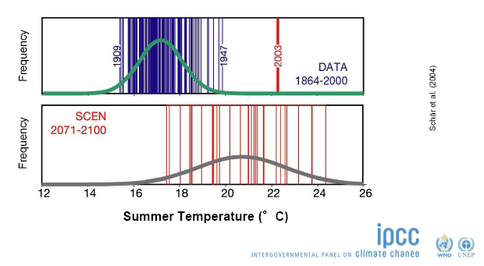
Pricing climate risk in a changing climate
In order to enable risk-based pricing, insurers typically refer to historical loss data, hazard data and use empirical relationships linking hazards with insured losses.
Establishing current climate risk:
Today’s climate ≠ average statistics of past weather
“From a < 1 in 1000 year event to a 1 in 4 year event”

Slide 30
Exploiting opportunities
Climate change heralds a huge opportunity for insurers. In theory, if climate-related risks are set to grow then so should demand for many classic insurance products, and markets for new products may appear. (Petherick, 2011)
Opportunties include:
Insurance for growing renewables market (especially BRICS countries)
Liability insurance for companies
Insurance of adaptation measures
Increased demand for novel insurance products in vulnerable sectors and regions (e.g. microinsurance)

Slide 31
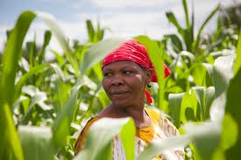
Microinsurance
Insurance directed towards low-income people. Such insurance is increasingly being made available to people in developing countries who do not have access, or cannot afford the high premiums associated with traditional forms of insurance.
Weather index insurance
Policyholders purchase insurance to cover losses in the event of damages related to a specific hazard (or peril to use insurance language).
Unlike traditional claims based insurance, payouts depend on the triggering of some index/proxy.
  e.g. for crop insurance, measured rainfall below a drought threshold
All policyholders within a defined radius of a measuring station receive the same payout if the index is triggered.
  e.g. If rainfall is below 50mm, all policyholders receive a payout.

Slide 32
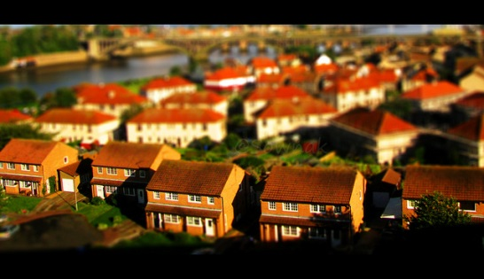
Maintaining Insurance Viability in a
Changing Climate
Premium = Expected loss + loading for ambiguity + profit
Where the expected loss is the value of a possible loss times the probability of that loss occurring.

Slide 33
What role for insurers in adaptation?

Slide 34
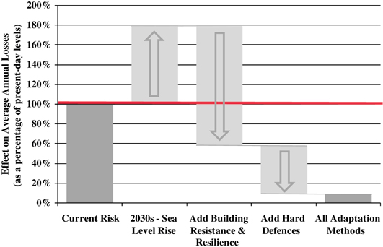
Incentivising adaptation
“The insurance industry can benefit from adaptation and therefore, has an incentive to promote action.”
Ranger (2009)
“The fundamental requirement to maintain insurability in the long term makes successful and timely adaptation a necessity.”
Herweijer et al. (2009)
Lloyds, 2008

Slide 35
Enabling adaptation
Promote risk awareness and risk-reducing behaviour through risk-based pricing
Develop insurance products and/or terms and conditions that incentivise risk reduction
Finance risk reduction/adaptation measures
Offer climate change risk management/advisory services
Risk education
Fostering disaster resilience practices and technologies
Stengthen relationships with policy-makers, regulators, government and other parts of the private sector
Corporate Social Responsibility – reputation rewards and sustainable business practice
Herweijer et al. (2009)

Slide 36
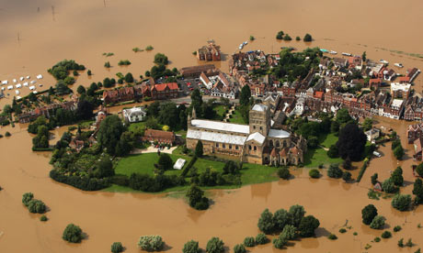
Climate Change Impacts in the UK

Slide 37
The UK 2012 Climate Change Risk Assessment (CCRA) Evidence Report
The Climate Change Act 2008 makes the UK the first country in the world to have a legally-binding
long-term framework to cut greenhouse gas emissions and a framework for building the UK’s ability to
adapt to a changing climate. The Act requires:
A UK-wide climate change risk assessment (CCRA) that must take place every five years;
A national adaptation programme (NAP) which must be put in place and reviewed every five years, setting out the Government’s objectives, proposals and policies for responding to the risks identified in the CCRA;
Adaptation Reporting Powers (not applicable in Northern Ireland) which enable the Secretary of State to direct “reporting authorities” to prepare climate change adaptation reports.
In addition, the Adaptation Sub-Committee of the Committee on Climate Change, an independent expert
body, was set up as required under the Climate Change Act 2008. Its role is to advise on the preparation
of the UK CCRA, to report to Parliament on the UK Government’s progress in the implementation of the
NAP and to provide advice to the Devolved Governments, as required.

Slide 38
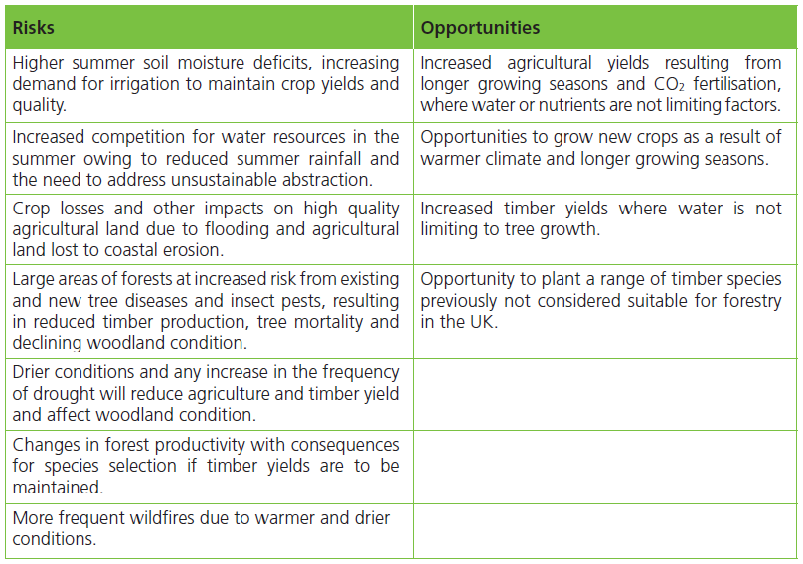
CCRA Report Key Findings
Agriculture and Forestry

Slide 39
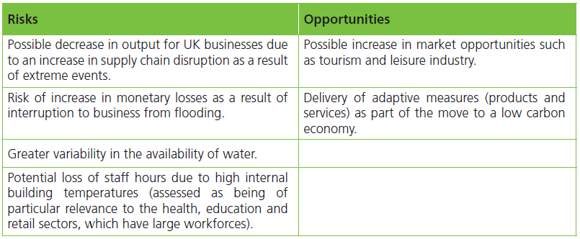
CCRA Report Key Findings
Business

Slide 40
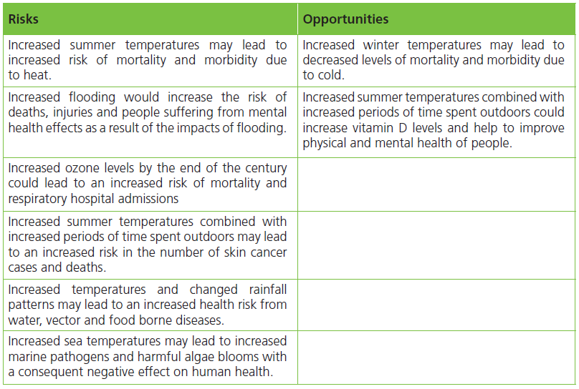
CCRA Report Key Findings
Health and Wellbeing

Slide 41
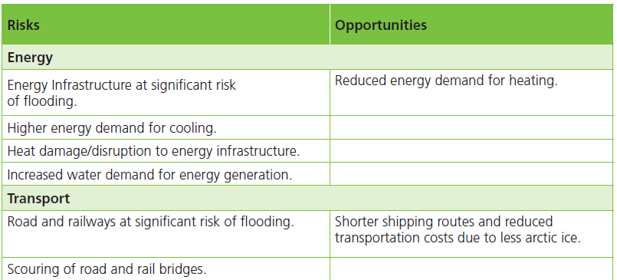
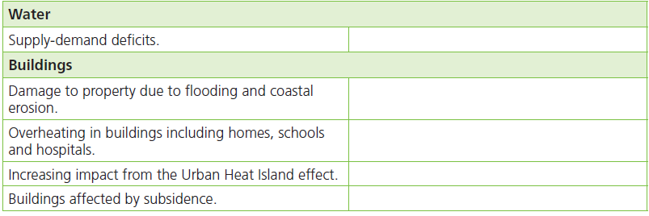
CCRA Report Key Findings
Buildings and Infrastructure

Slide 42
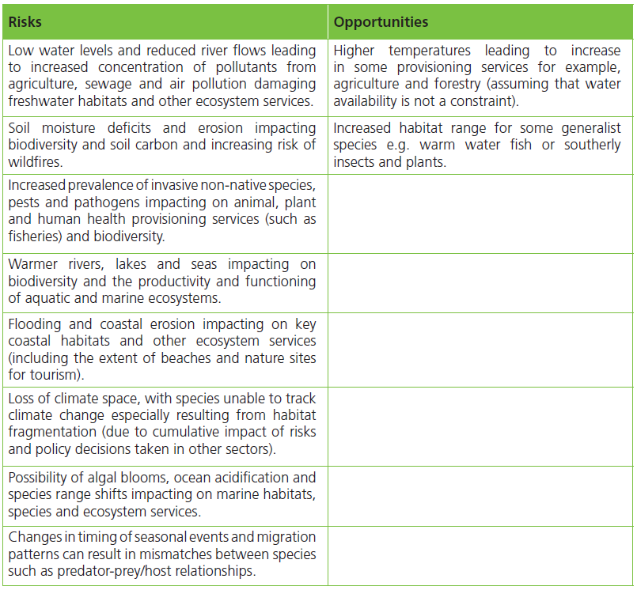
CCRA Report Key Findings
Natural Environment

Slide 43
Summary
  Climate impacts scientists use a range of dynamic and statistical models to understand what climate change means for different systems
  Extremes in climate are often the greatest source of climate risk but their impact is not simply a function of the frequency or severity of the climate hazard
  The debate over the past decade on the economic impacts of climate change centre on the issue of how much to discount the future
  Insurance and financial risk transfer is one of the key mechanisms used to reduce climate risk but insurers themselves are not entirely resilient to climate change
  The UK is exposed to a number of risks and some opportunities in a changing climate; addressing these risks and taking advantage of the opportunities requires action at different scales of government and across sectors of society

