Slide 1
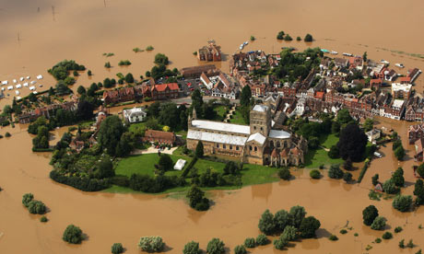
GEOGM1405
Climate Change: Science and Impacts
WEEK 9
Climate Change Adaptation

Slide 2
Aims of Today’s Lecture
Understand what we mean by climate risk management and climate change adaptation
Discuss different approaches to adaptation
Consider a hypothetical adaptation example and explore the complexities of making decisions under uncertainty
Cover some remaining topics: geoengineering, classifying climate

Slide 3
Climate Risk Management
“Climate risk management is the use of climate information in a multidisciplinary scientific context to cope with climate's impacts on development and resource-management problems. Climate risk management covers a broad range of potential actions, including: early-response systems, strategic diversification, dynamic resource-allocation rules, financial instruments, infrastructure design and capacity building.
In addition to avoiding adverse outcomes, climate risk management seeks to maximize opportunities in climate-sensitive economic sectors through improved resource management. It confronts the question of climate change adaptation by focusing on actions that can be taken today, to improve outcomes today and to understand and anticipate the interactions of economic, environmental and social systems with the climate into the future.”
IRI, Columbia University, NYC

Slide 4
Climate Risk Management
In climate change discourse, the two primary responses to manage climate risk are categorised as:
Mitigation and Adaptation
Enacting mitigation/adaptation policies and decisions requires consideration of a number of risk management steps:
  Determine stakeholder objectives and values
  Scope risk factors/variables
  Establish baseline climate risk
  Understand future climate risk
  Identify policy response options
  Identify tools and methodologies to consider outcomes of policy interventions

Slide 5
Defining (climate (change)) adaptation

Slide 6
Adaptation is…
“Reacting to changes in the climate”
(Dessler and Parson, 2006)
"adjustments in natural or human systems in response to actual or expected climatic stimuli or their effects, which moderate harm or exploit beneficial opportunities“
(IPCC, 2001)
“A process by which strategies to moderate, cope with and take advantage of the
consequences of climatic events are enhanced, developed and implemented”
(UNDP, 2005)
“Adaptation involves adjustments to enhance the viability of social and economic
activities and to reduce their vulnerability to climate, including its current variability and extreme events as well as longer term climate change”
(Smit, 1993)

Slide 7
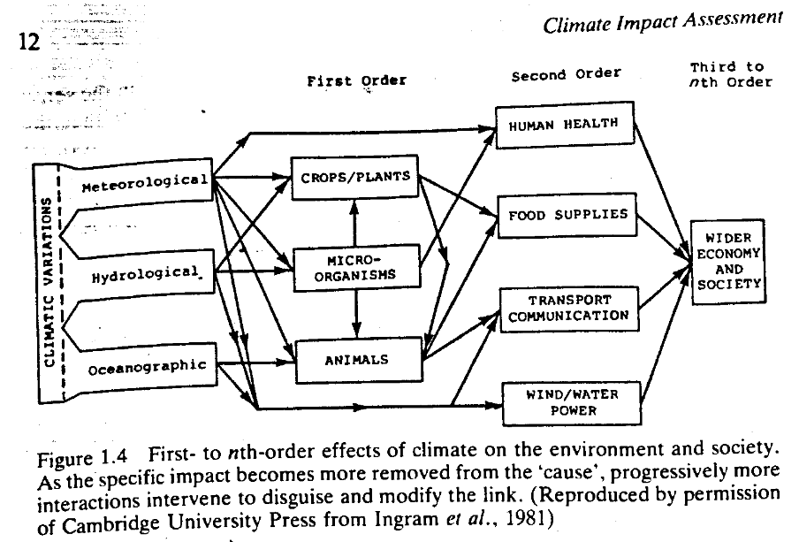
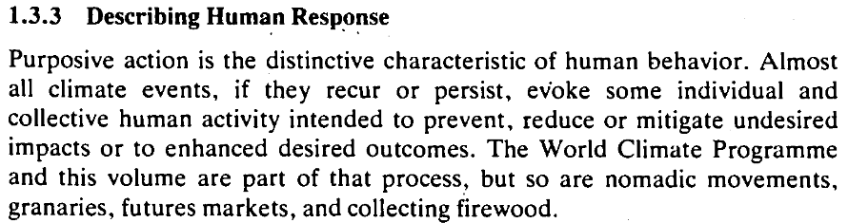
Adaptation is not new
Kates, R W (1985) Chapter 1: The Interaction of Climate and Society, In: Climate Impact Assessment

Slide 8
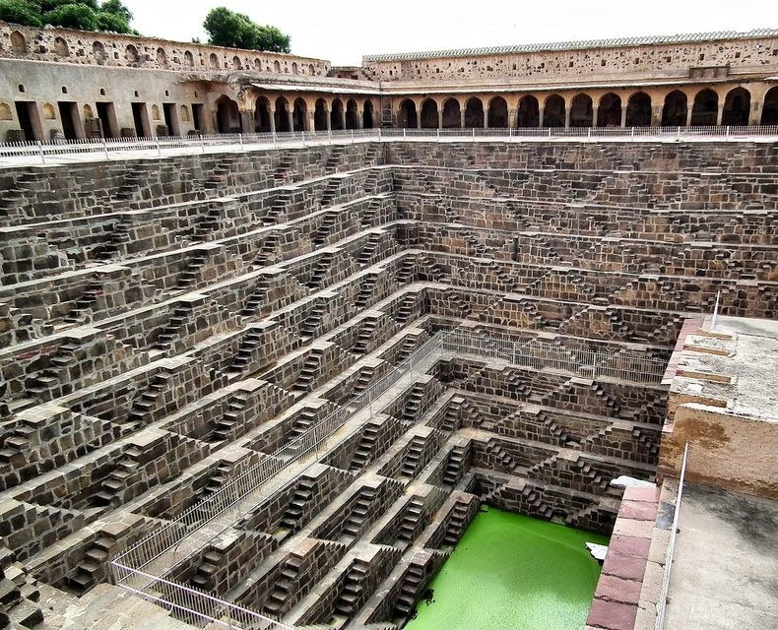
Adaptation is not new
“Adaptation to climate variability and change has been necessary for the continued existence of human and other species ever since life began. Climate varies on interannual, interdecadal and longer timescales, so that even within a supposedly “constant” climate, spatial and temporal variations in the weather create conditions to which we must adapt or perish.”
Pittock, A. B. and R. N. Jones 2000 Adaptation to what and why? Environmental Monitoring and Assessment 61, 9-35
Chand Baori
Built in 800AD in Rajasthan, northwest India

Slide 9
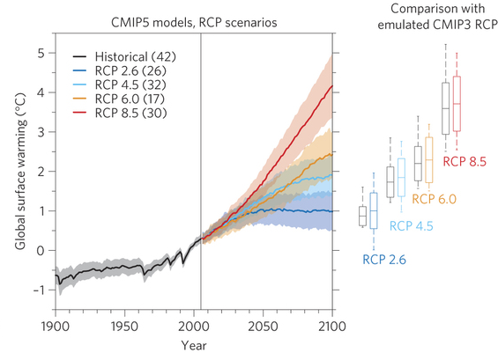
Adaptation is not optional

Slide 10
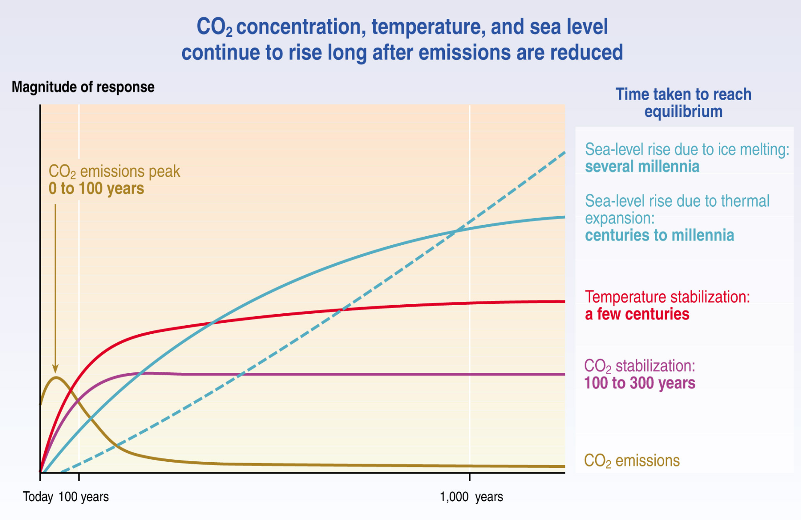
Adaptation is not optional

Slide 11
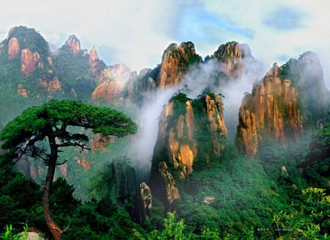
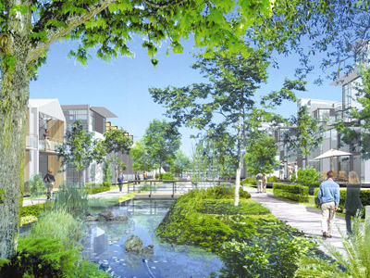
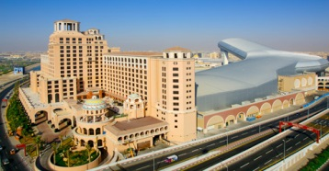
Adaptation is not straightforward

Slide 12
The adaptation deficit
Definition
  “the degree of separation between a desired level of acceptable climate risk (e.g. living in a place which floods once every 100 years) and the real level of climate risk (e.g. living in a place which actually floods once every 10 years).”
  (Me)
The deficit may exist for a number of reasons including, but not limited to:
  Lack of financial resources
  Lack of implementing capacity
  Lack of solutions (interventions)
  Insufficient information or knowledge
  Historical legacy
  Political inertia
  Social unacceptability
  A need to address other more immediate pressures
Barriers to adaptation | Limits to adaptation
A barrier represents a stressor or an impediment to adaptation that can in principle be overcome. | An adaptation limit implies a level of adaptive capacity, broadly defined, that cannot be surpassed.

Slide 13
Adaptation Deficit
(current climate)
…Money
…Knowledge
…Institutional Capacity
Intervention 1
Intervention 2
Intervention 3
Barriers
Deficit
Intervention 4
Limits
Increasing…

Slide 14
Adaptation Deficit
(future climate)
…Money
…Knowledge
…Institutional Capacity
Intervention 1
Intervention 2
Intervention 3
Barriers
Deficit
Intervention 4
Limits
Climate
Change
Further reading: Fankhauser and McDermott (2014) Understanding the adaptation deficit: Why are poor countries more vulnerable to climate events than rich countries? Global Environmental Change, 27, 9–18

Slide 15
Approaches to adaptation

Slide 16
Planned Adaptation vs Autonomous Adaptation
Autonomous adaptation (coping)
“Adaptation that does not constitute a conscious response to climatic stimuli, but is triggered by ecological changes in natural systems and by market or welfare changes in human systems. It is also referred to as spontaneous adaptation.” (IPCC, 2001)
Source: Tiempo 77, adapted from CARE Climate Vulnerability and Capacity Handbook, 2009

Slide 17
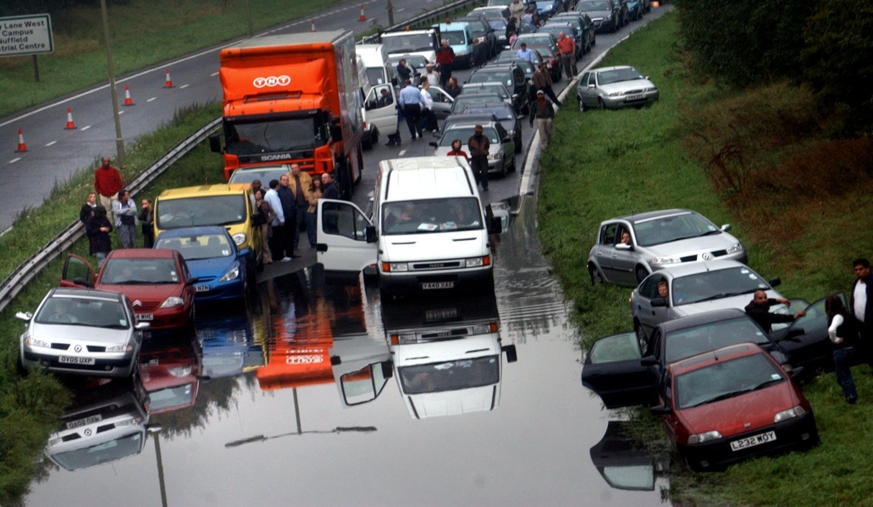
Planned adaptation
To make an adaptation strategy you need to know:
Exposure to risk
What are your vulnerabilities?
What are the threats and opportunities?
When are they likely to occur?
How serious will they be?
Adaptation Opportunities
What adaptation options are available?
How robust are the options to uncertainty?
How costly is the installation/maintenance?
How socially and politically acceptable are the interventions?

Slide 18
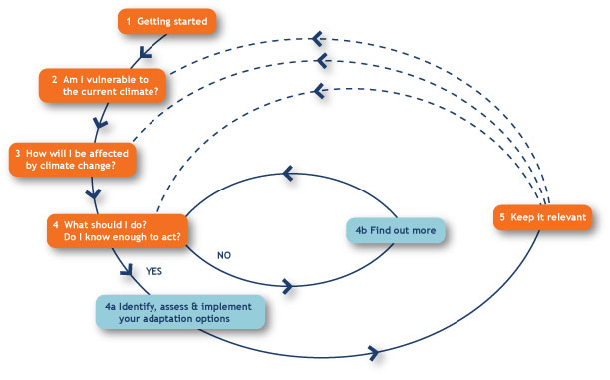
Adaptation Planning Cycle
Example from UKCIP’s: Adaptation Wizard (http://www.ukcip.org.uk/wizard/)

Slide 19
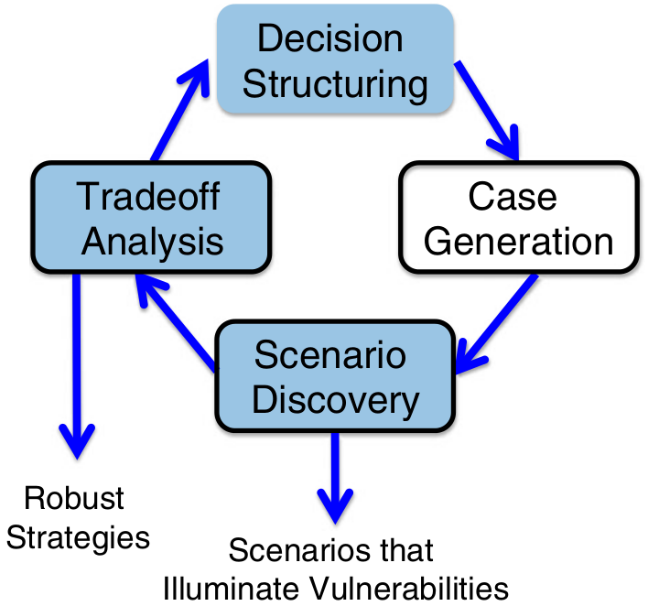
Robust Decision Making (RDM)
Moving away from a science-prescriptive approach:
Projections Impacts Policy Responses
Policy Responses Sensitivities/vulnerabilities Uncertainties
Fig. 1 Iterative steps in Robust Decision Making (RDM) analysis.
Lempert R. 2013 Scenarios that illuminate vulnerabilities and robust responses, Climatic Change, 117, 627–646

Slide 20
Community based adaptation
Local community-led process, emphasis on participation
Factors climate risk into current activities: considers climate change amongst a range of natural, social and economic problems experienced locally
Based on communities’ priorities, needs, knowledge and capacities
Strong empowerment and social justice focus, linked to poverty reduction
Attempts to link between scientific and indigenous knowledge
(Reid et al, PLA 60, 2009)
Ecosystem based adaptation
“Ecosystem-based adaptation is the use of biodiversity and ecosystem services as part of an overall adaptation strategy to help people to adapt to the adverse effects of climate change.”
e.g. restoration of coastal mangroves to prevent storm surges, intrusion of salt water and coastal erosion
(Source: Convention on Biological Diversity’s Second Ad-hoc Technical Expert Group on Biodiversity and Climate Change)

Slide 21

What’s your risk appetite?
You have the option of playing one of three games. You must play one so which game do you play?
Each game is free and involves rolling a die. Depending on which side it lands, you win the given sum of money.
Game 1
Game 2
Game 3
1 = £0
2 = £0
3 = £0
4 = £0
5 = £0
6 = £60
1 = £0
2 = £0
3 = £0
4 = £0
5 = £30
6 = £30
1 = £0
2 = £0
3 = £0
4 = £20
5 = £20
6 = £20
Number of players:

Slide 22
What’s your risk appetite?
You have the option of playing one of three games. You must play one so which game do you play?
You now have £60. Depending on which side it lands, you lose the given sum of money.
Game 1
Game 2
Game 3
1 = £0
2 = £0
3 = £0
4 = £0
5 = £0
6 = £60
1 = £0
2 = £0
3 = £0
4 = £0
5 = £30
6 = £30
1 = £0
2 = £0
3 = £0
4 = £20
5 = £20
6 = £20
Number of players:

Slide 23
What’s your risk appetite?
You have the option of playing one of three games. You must play one so which game do you play?
You now have £60. Depending on which side it lands, you lose the given sum of money …but the die is not fair.
Game 1
Game 2
Game 3
1 = £0
2 = £0
3 = £0
4 = £0
5 = £0
6 = £60
1 = £0
2 = £0
3 = £0
4 = £0
5 = £30
6 = £30
1 = £0
2 = £0
3 = £0
4 = £20
5 = £20
6 = £20
Number of players:

Slide 24


Decisions under uncertainty
How can we make decisions when faced with uncertainty?
When we know the probabilities:
Risk is often considered as the consequences of a hazard multiplied by the probability of the hazard’s occurrence. This can be formalised using the expected value.
In the dice game:
Game 1
E = (5/6 * 0) + (1/6 * 60) = £10
Game 2
E = (4/6 * 0) + (2/6 * 30) = £10
Game 3
E = (3/6 * 0) + (3/6 * 20) = £10
In this case the game we eventually decide to play depends entirely on our risk preference.
Game 1
Game 2
Game 3
1 = £0
2 = £0
3 = £0
4 = £0
5 = £0
6 = £60
1 = £0
2 = £0
3 = £0
4 = £0
5 = £30
6 = £30
1 = £0
2 = £0
3 = £0
4 = £20
5 = £20
6 = £20
But what if we don’t know the probabilities?

Slide 25
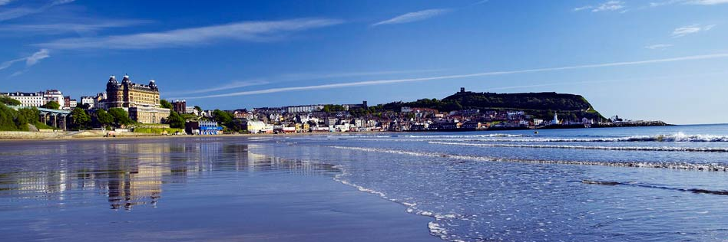
Making adaptation decisions

Slide 26
Making adaptation decisions
Imagine you are part of a decision making team deciding how to adapt the coastline of a small coastal town in the UK to climate change. Much of the town lies within a few metres of sea level and the town is largely dependent on tourism in the summer, boasting a vibrant sea front and sandy beach. The team must consider how to address climate and environmental risks with a 50 year decision time horizon.
“The sea level is projected to rise between 5 and 65 cm by 2065 and, although the models have questionable reliability, there is projected to be an increase in the number of damaging storm surge events by 20 to 50%.”
UK Met Office (2014)

Slide 27
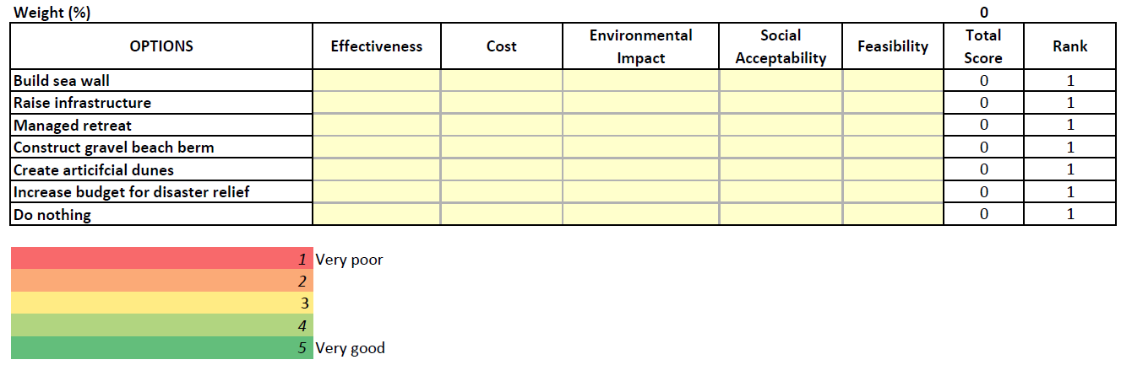
Making adaptation decisions
Roles include:
Coastal engineer, city councillor, local resident, local shop owner, environmental campaigner, climate scientist
Step 1: Choose a role
Step 2: Decide on percentage weights for the five criteria.
Step 3: Score each option against the each criterion.

Slide 28
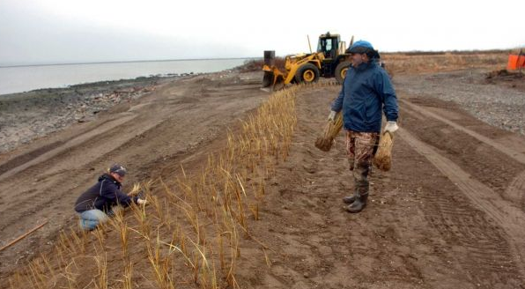
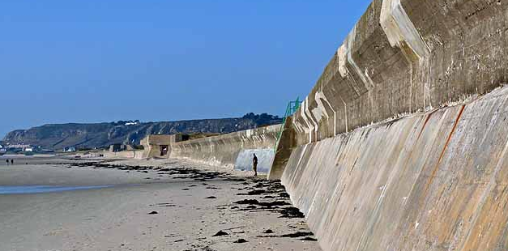
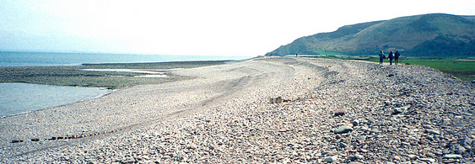
Making adaptation decisions
Artificial dunes
Sea wall
Gravel Beach Berm

Slide 29
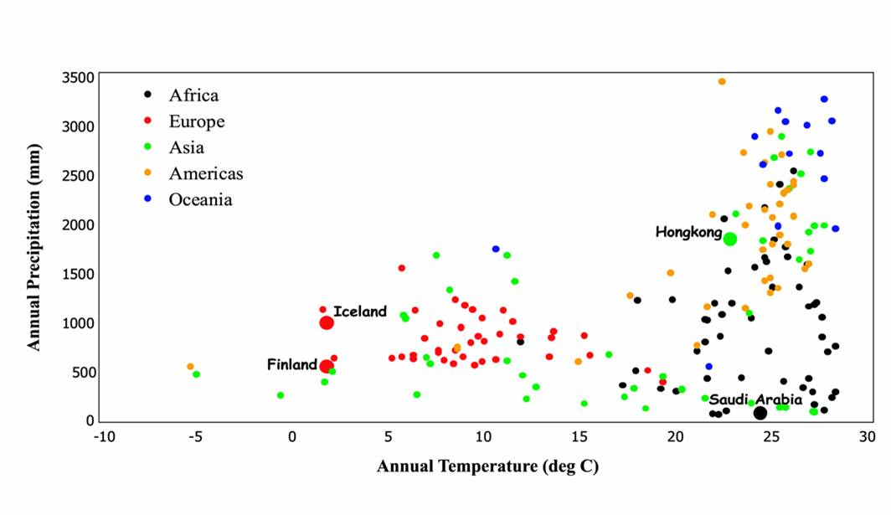
Classifying climate
Mitchell, T.D., Hulme, M. and New, M., 2002: Climate data for political areas. Area 34, 109-112. http://www.cru.uea.ac.uk/~timm/grid/papers/mitchell2002a.pdf

Slide 30
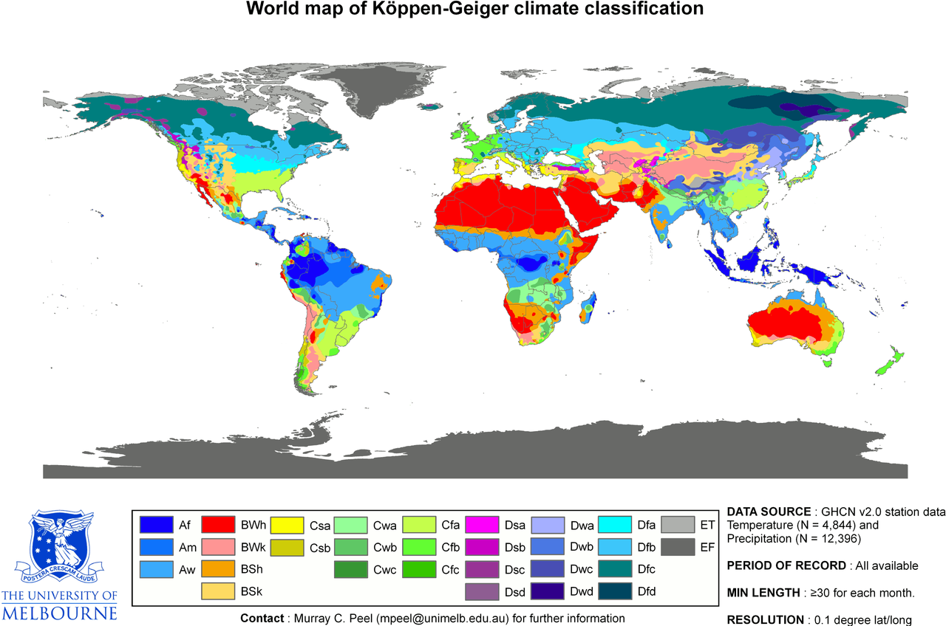
Classifying climate: Köppen-Geiger
Tropical
Dry (arid and semi-arid)
Temperate
Continental
Polar and alpine
Peel et al (2007) Updated world map of the Köppen–Geiger climate classification. Hydrol. Earth Syst. Sci. 11 1633–1644

Slide 31
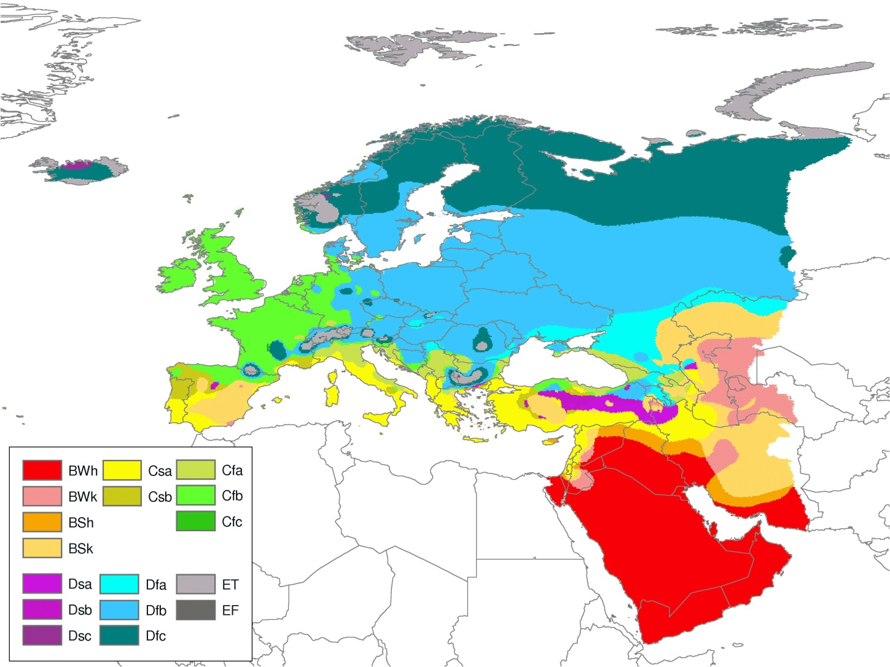
Classifying climate: Köppen-Geiger
Cfb: Maritime temperate climate - dominated all year round by the polar front, leading to changeable, often overcast weather
Peel et al (2007) Updated world map of the Köppen–Geiger climate classification. Hydrol. Earth Syst. Sci. 11 1633–1644

Slide 32

(Bio)Geoengineering
“the deliberate large-scale intervention in the Earth’s climate system, in order to moderate global warming” (Royal Society, 2009)
Requirements of any geoengineering solution:
The idea has to work (i.e. reduce global warming)
The side effects need to be minimal.
It has to keep up with an increasing forcing from ever higher greenhouse gas levels.
It has to be cheaper than simply reducing emissions at the source.

Slide 33
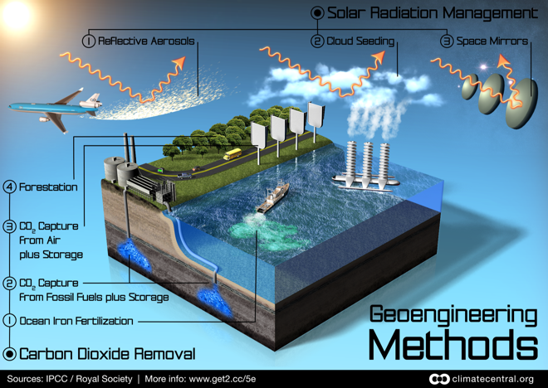
Two classes of geoengineering solutions
Carbon Dioxide Removal (CDR)
Solar Radiation Management (SRM)

Slide 34
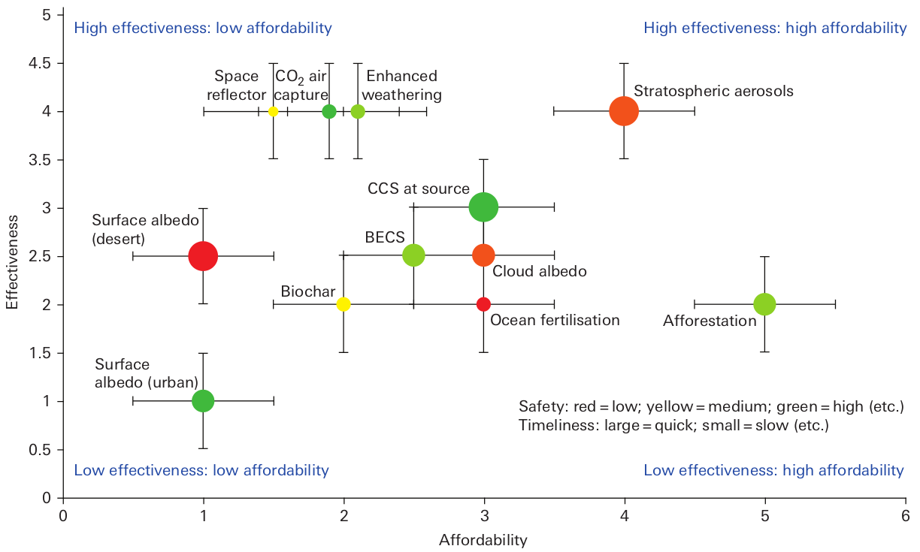
Relative effectiveness
Figure 5.1. Preliminary overall evaluation of the geoengineering techniques considered in Chapters 2 and 3 (Royal Society 2009)

Slide 35
Social, political and legal issues
Who controls the thermostat? There are a number of issues regarding to conflicts of interests. For example, if one country is experiencing a colder winter, who gets to adjust the mirrors?
Such schemes may weaken the resolve to reduce CO₂ emissions and therefore increase the atmospheric concentration further and do nothing to address the acidification of the oceans.
Lessens the motivation to abandon fossil fuels which are a non-renewable and finite energy resource.
There is also a potential legal impediment. The 1978 UN “Convention on the Prohibition of Military or any Other Hostile Use of Environmental Modification Techniques.” would need to be amended before implementation.

Slide 36
Latest Science
Although all the simulations showed that blocking the Sun's rays - or solar radiation management, as it is called - did reduce the global temperature, the models revealed profound changes to precipitation including disrupting the Indian Monsoon.
Prof Piers Forster of Leeds University said: "We have found that between 1.2 and 4.1 billion people could be adversely affected by changes in rainfall patterns.
"The most striking example of a downside would be the complete drying-out of the Sahel region of Africa - that would be very difficult to adapt to for those substantial populations - and that happens across all the scenarios.“
BBC News, “Geo-engineering: Climate fixes 'could harm billions’ ” 26 Nov 2014

Slide 37
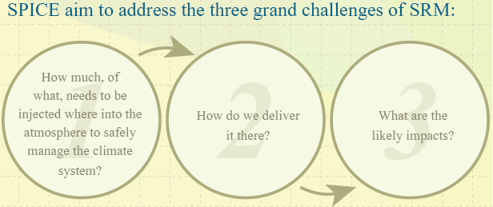
Latest Science
SPICE (Stratospheric Particle Injection for Climate Engineering) is a project investigating the feasibility of putting particles into the stratosphere in order to affect global temperatures.
The inspiration for solar radiation management using stratospheric aerosols is the observed natural behaviour of volcanoes which can inject significant quantities of particles into the stratosphere, having an overall cooling effect on global temperatures.
The Principal Investigator of the SPICE project is Dr Matthew Watson (Bristol University).

Slide 38
Summary
  Adaptation to climate and environmental variability is nothing new climate change brings a new set of challenges that humans need to address
  Planned adaptation responses can be framed in different ways: from science prescriptive (top down) to policy prescriptive (bottom up)
  Making adaptation decisions requires tradeoffs and acknowledgement of different attitudes to risk
  And…
  Climate can be classified using the Köppen-Geiger classification
  Geoengineering is emerging as a serious area of research (especially at Bristol) but the implementation of geoengineering solutions could have widespread unintended consequences

Slide 39
Readings and additional resources
Successful adaptation climate change across scales (Adger et al, 2005)
Participatory Learning and Action 60: Community-based adaptation (2009)
OECD Policy Guidance on Integration Climate Change Adaptation into Development Cooperation (2009)
Adaptation to Global Warming: Do Climate Models Tell Us What We Need to Know? (Orskes et al, 2010)
Designing Climate Change Adaptation Initiatives: A UNDP Toolkit for Practitioners (2010)
UK Climate Impacts Programme Adaptation Wizard http://www.ukcip.org.uk/wizard/
SEI weAdapt platform http://weadapt.org/

