Slide 1
CSAG Postgrad student meeting
6 November 2012

Slide 2
Hussen

Slide 3
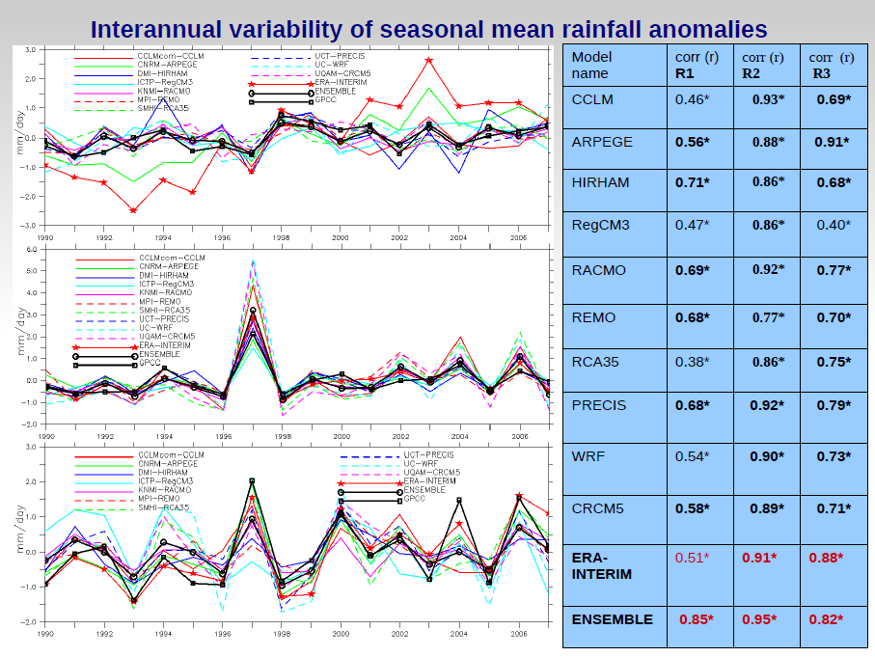

Slide 4
Julio

Slide 5
Phenological Stages | Parameters | PPT |  |  |  | TMP |  |  |  | TMN |  |  |  | TMX |  |  |  | DTR |  |  |  | VAP |  |  |  | CLD |  |  |  | FRS |  |  |  | WET |  |  |  | PET
 |  | R | O | S |  | R | O | S |  | R | O | S |  | R | O | S |  | R | O | S |  | R | O | S |  | R | O | S |  | R | O | S |  | R | O | S |  | R | O | S
Dormancy | May |  |  |  |  |  |  | + |  | + |  | + |  |  |  |  |  |  |  |  |  |  | - |  |  | + |  | + |  | - |  | - |  | +
 | Jun |  |  |  |  | - |  | - |  | - |  | - |  | - |  |  |  | - | + |  |  |  | + | - |  | + |  | + |  |  | -
 | Jul | + | - |  |  | - |  | - |  |  |  | - |  | - | + |  |  | - |  | + |  |  | + |  |  |  |  |  |  |  | -
 | Aug |  |  | + |  | - | - | - |  |  |  | - |  | - |  |  |  |  |  | + |  |  |  | - |  | + |  |  |  |  | - |  |  |  |  | - |  |  | -
Budding | Sep |  | - | - |  |  |  |  |  | + |  |  |  |  |  |  |  |  |  | + |  |  |  | + |  |  | - |  |  |  |  |  |  | + | -
 | Oct |  |  | + |  |  |  | + |  |  |  | + |  |  | + |  |  |  | + | + |  |  | + |  |  |  | - | - |  |  | - |  |  |  |  |  |  |  | + | +
Blooming | Nov | + | + | + |  | - |  | - |  |  | - | - |  | - | + |  |  |  |  | + |  |  |  | - |  |  | - |  |  |  |  |  |  |  |  | -
 | Dec |  |  | - |  |  |  | + |  |  |  | + |  |  | + |  |  |  | + | + |  | + |  |  |  | - | - | - |  |  |  | - |  | - | + |  |  |  | + | +
Ripening & Harvest | Jan |  | + |  |  |  |  |  |  |  |  | + |  |  | + |  |  | - |  | + |  |  | - |  |  |  |  | - |  |  |  | - |  | - |  |  |  | - | + | +
 | Feb |  |  | + |  |  |  | + |  | + | + | + |  |  | + |  |  | - | + |  |  |  |  |  |  | + |  | + |  | - |  | - |  |  |  | +
 | mar | - |  |  |  |  |  | + |  |  |  | + |  |  | + |  |  | - | + |  |  | + |  |  |  | - | - | - |  | - |  | - |  | - | + |  |  |  | + | +
 | Apr |  |  | + |  |  |  | + |  | + |  | + |  |  |  |  |  |  |  | - |  |  |  |  |  |  |  |  |  | - |  | - |  |  |  |  |  |  | + | +
Table#. A comparison of the impacts of monthly climatic condition on grape yield groups at Robertson (R), Olifants River (O) and Stellenbosch (S). The climatic condition is characterised with precipitation (PPT), mean temperature (TMP), minimum temperature (TMN), maximum temperature (TMX), daily temperature range (DTR), water vapour (VAP), cloud cover (CLD), frost (FRS), and number of wet days (WET). The blue shading implies that 1 grape yield group shows a significant positive significant (+) or a negative (-) coupling with the climate variable. The green shading implies that 2 grape yield groups show significant coupling with the climate variable; the positive sign (+) means that both groups agree on positive coupling while the negative sign (-) means that both groups agree on negative coupling.

Slide 6
Lawal

Slide 7
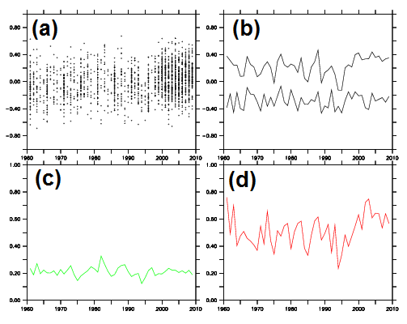
Figure 4. Annual variations of surface air temperature variables over LMP from a small sample of the simulations for the month of July. Panel a: annual mean anomalies of ensemble members (the black dots); panel b: the percentile plots of panel a, of which the upper and lower curves are the 90th and 10th percentiles respectively, the space between them is referred to as domain of possibility (DoP); panel c: time series plot of ensemble spreads as measured by standard deviations (StdDev) of panel a; panel d: time series plot of ensemble spreads as measured by the difference between the 90th and 10th percentiles on panel b, this is known as range of possibility (RoP).

Slide 8
 | Dec | Jan | Feb | Mar | Apr | May | Jun | Jul | Aug | Sep | Oct | Nov
FSP | - - | - - | + + | + + | + + | - + | + - | + + | + - | + + | + + | - -
GGP | - - | - - | + + | + + | + + | - + | + + | + + | + + | + + | + + | - -
LMP | - - | - - | - - | - - | + - | - - | + + | + + | + + | + + | + + | - -
MLP | - - | - - | - - | + - | + + | - - | + + | + + | + - | + - | + + | - -
NWP | - - | - - | + + | + + | + + | + - | - - | + + | - - | + + | + + | - -
**ECP | + + | + + | + + | + + | + + | + + | + + | + + | + + | + + | + + | + +
**KZP | - - | - - | - - | + - | + + | - - | + + | + + | + + | - + | + + | - -
**NCP | - - | - - | + - | + + | + + | + - | + - | - - | + + | + - | + + | - -
**WCP | + + | + + | + + | - - | - - | + + | + + | + + | + + | + + | + + | + +
Figure 11. Provincial monthly mathematical signs of trends of ensemble spreads as produced by RoP and StdDev respectively for precipitation. Coastal provinces are prefixed with asterisk signs (**). Negative signs indicate narrowing of the range of possible monthly values from the forecasts (i.e. the width of the ensemble spread), lesser uncertainty from the forecasts and a reduction in the internal noise of the model that produces the forecasts. Positive signs indicate the opposite. Simultaneous presence of positive and negative signs indicates lack of unison by metrics of scale.

Slide 9
 | Dec | Jan | Feb | Mar | Apr | May | Jun | Jul | Aug | Sep | Oct | Nov
FSP | + + | + + | + + | + + | + + | + + | - - | + + | - - | + + | + + | + +
GGP | + - | + + | + + | + - | + - | + - | - - | - + | + + | + - | + - | + -
LMP | - - | + + | + + | + + | + + | + - | - - | - + | + + | + + | + + | + +
MLP | + + | + + | + + | + + | + + | + + | + + | + - | + + | + + | + + | + +
NWP | + + | + + | + + | + + | + + | + + | + - | - - | - - | + + | + + | + +
**ECP | - - | + + | + + | - - | + - | + - | - - | + + | + + | - - | - - | - -
**KZP | - - | + + | + - | - - | + - | - - | - - | + + | + + | - - | - - | - -
**NCP | - - | + + | + + | + + | + + | + + | + + | + + | - - | + - | - - | - -
**WCP | - - | + + | + + | + - | + + | - - | - + | + + | + + | - - | - - | - -
Figure 14: Same as in figure 11, but for surface air temperature.

Slide 10
Dave M

Slide 11
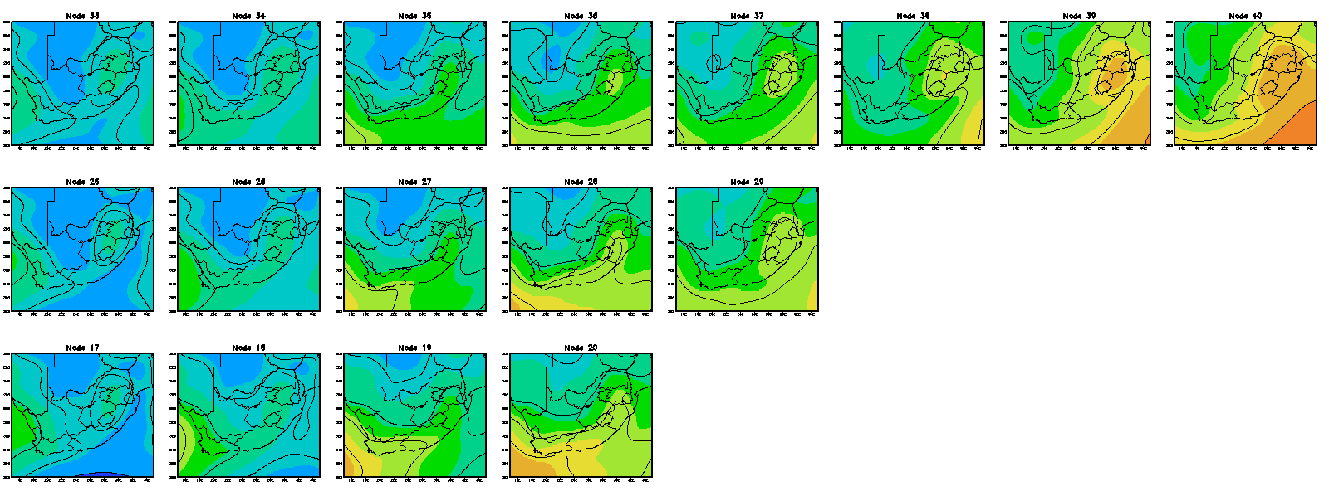
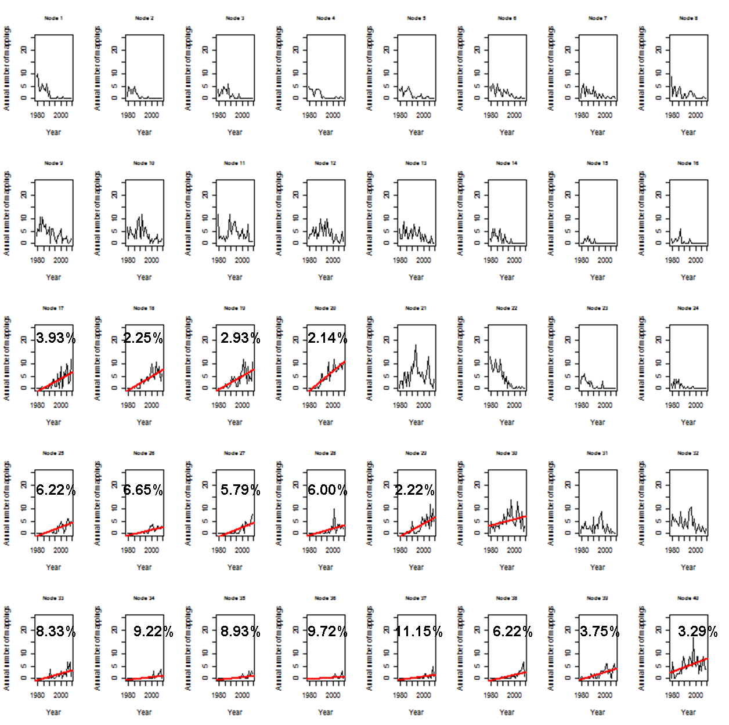
Synoptics circulations that characterize a particular season show significantly increasing trends in their frequency of occurrence in the preceding season
Relationship exists between:
SON – DJF (including extreme rainfall synoptics, nodes 36 and 37)
JJA – SON
MAM – JJA
Apart from the SON-DJF relationship, most cases cannot be linked to extreme rainfall

Slide 12
Arlindo

Slide 13
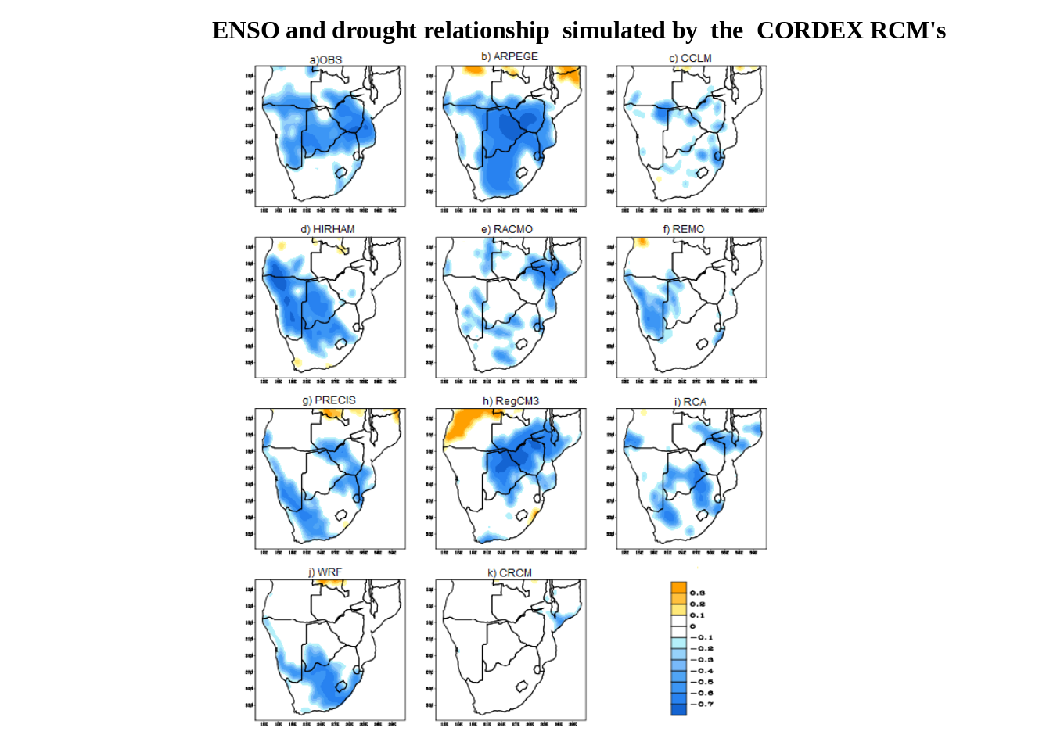

Slide 14
Zoe

Slide 15


Slide 16


Slide 17


Slide 18


Slide 19
Teboho

Slide 20
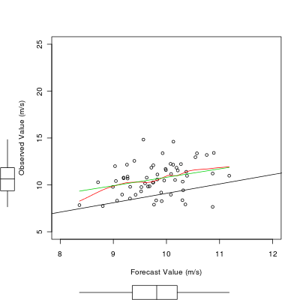
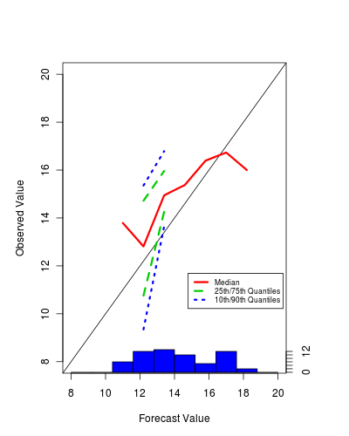
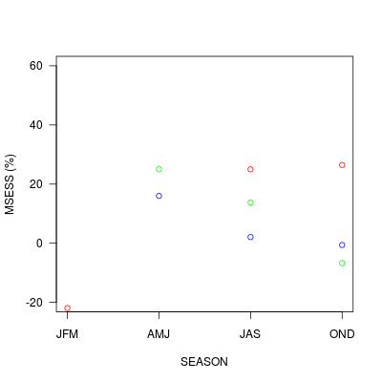
Teboho Nchaba
JFM
Cor = 0.3
MAE = 1.47
OND 500 hPa
Limpopo

